Slide 2
#WeAreCruise (The world`s largest cruise industry trade association)
50+ Cruise Lines – From ocean to speciality cruise ships, CLIA lines represent more than 95 % of global cruise capacity and 350+ Executive Partner,13,000 Global Travel Agency and 50,000 Travel Agent Members
CLIA Cruise Lines serve nearly 30 million passengers annually.
The economic impact of Cruise Tourism Globally: over $US150 billion in total economic impact to the global economy, supporting nearly 1.2 million jobs and US$50 billion in wages. Cruise lines and cruise passengers spend over NZ$550 million each year in New Zealand.
With the launch of 14 ships from CLIA-member cruise lines during 2023, the CLIA fleet by year-end will include 293 ships, and €38 billion invested in 62 ships for delivery between now and 2028
The world`s largest cruise industry trade association

Slide 3
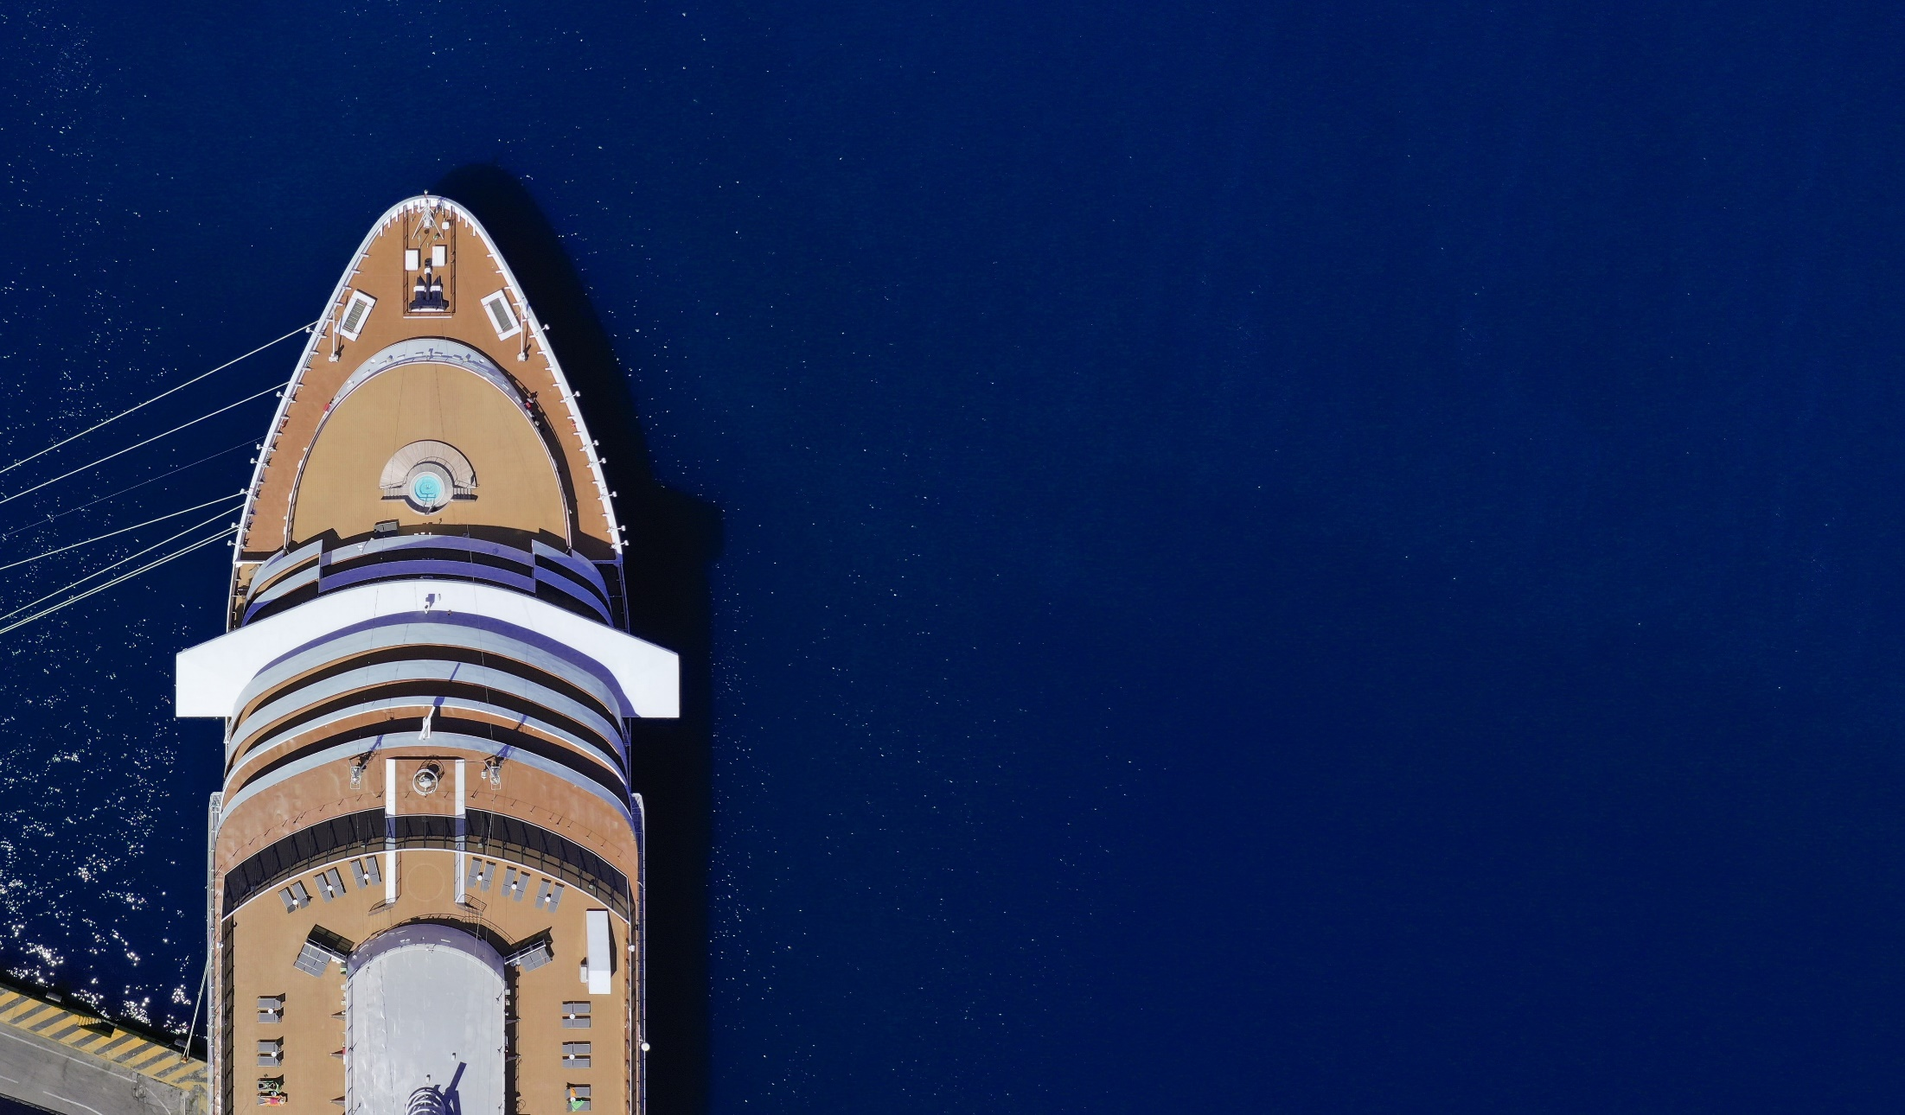
Strategy

Slide 4
Sailing to a Better Future (Two Core Strategies)
PURSUING NET–ZERO CARBON CRUISING
RESPONSIBLE SUSTAINABLECRUISE TOURISM

Slide 5
Ship

Slide 6
Sailing to a Better Future (Two Core Strategies)
PURSUING NET–ZERO CARBON CRUISING
RESPONSIBLE SUSTAINABLECRUISE TOURISM

Slide 7
Clear commitments, aligned with global targets
IMO 2023 GHG Strategy on Reduction of GHG Emissions from Ships
Levels of ambition
carbon intensity of the ship to decline through further improvement of the energy efficiency for new ships
carbon intensity of international shipping to decline to reduce CO2 emissions per transport work, as an average across international shipping, by at least 40% by 2030, compared to 2008;
uptake of zero or near-zero GHG emission technologies, fuels and/or energy sources to increase - uptake of zero or near-zero GHG emission technologies, fuels and/or energy sources to represent at least 5%, striving for 10%, of the energy used by international shipping by 2030; and
GHG emissions from international shipping to reach net zero by or around 2050
Key CLIA cruise line member commitments
Pursue net zero carbon cruising by 2050
Reduce the rate of carbon emissions by 40% by 2030 compared to 2008
All CLIA member ships will be equipped to connect to Shoreside Electricity facilities wherever available at ports as soon as possible, and no later than 2035

Slide 8
The most technologically advanced fleet (now and development until 2028)
PURSUING NET–ZERO CARBON CRUISING
STARTS NOW
The latest CLIA Environment Technology Report tracks progress in CLIA members investment in technologies aimed at reducing their environmental impact.
A comprehensive approach beyond CO2 , also looking at SOX using Exhaust Gas Cleaning Systems, alternative fuel options and water treatment systems.
Progress is happening now with the youngest fleet ever and a set of technologies that accelerates.
We now have reached shoreside electricity capability at 40% and continue to invest in new fuels, fuel cells and advanced propulsion solutions.

Slide 9
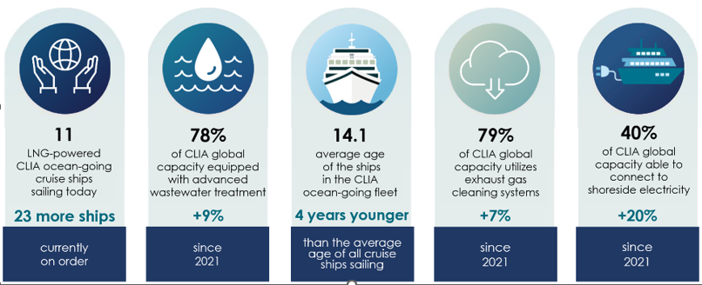
The most technologically advanced fleet (today’s impact)
TODAY
Source: CLIA Environmental Technologies and Practices Report, October 2022
Notes:
This year’s ETP report shows continued and notable advancements as the industry continues to pursue net-zero carbon cruising globally through reductions in emissions:
Shoreside Power Capability – Cruise lines continue to make significant investments for cruise ships to connect to shoreside electricity, allowing engines to be switched off in port for significant emissions reduction. This year’s ETP report shows:
40% of global capacity (up 20% year over year) are fitted to operate on shore-side electricity in the 29 ports worldwide (less than 2% of the world’s ports) where that capability is provided in at least one berth in the port.
85% of CLIA-member ships coming online between now and 2028 will be able to plug in to shoreside electricity.
98% of new build capacity on order book between now and 2028 is either committed to be fitted with shore-side electricity systems or will be configured to add shore-side power in the future.
Liquefied Natural Gas (LNG) Fuel – In addition to having virtually zero sulfur emissions, LNG as a transitional fuel provides a 95% to 100% reduction in particulate emissions, an 85% reduction in NOx emissions, and up to a 20% reduction in greenhouse gas emissions. The 2022 report found:
61% of new-build capacity will rely on LNG fuel for primary propulsion.
LNG provides real benefits now, and also allows LNG-ready ships to adapt to a future generation of sustainable marine fuels.*
*Sustainable marine fuels can include biofuels and other advanced approaches such as bio and synthetic fuels, methanol, ammonia, and hydrogen.
-continued-
Exhaust Gas Cleaning Systems - Exhaust Gas Cleaning Systems (EGCS) reduce sulfur oxide levels by as much as 98%, typical total particulate matter of 50% or more (including elemental and organic carbon and black carbon), and nitrogen oxides by up to 12%. According to the 2022 report:
More than 79% of global capacity utilizes EGCS to meet or exceed air emissions requirements, representing an increase in capacity of 7% compared to 2021.
Additionally, 88% of capacity of non-LNG new builds will have EGCS installed, in line with already high historical level of investments.
Advanced Wastewater Treatment Systems – Advanced wastewater treatment systems onboard cruise ships treat wastewater to a higher level of treatment than in many coastal cities.
100% of new ships on order are specified to have advanced wastewater treatment systems.
78% of the CLIA ocean-going cruise line fleet capacity is currently served by advanced wastewater treatment systems (a 9% increase compared to 2021).

Slide 10
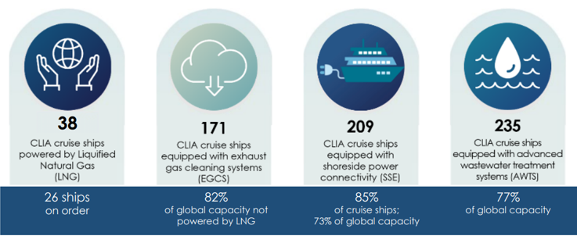
The most technologically advanced fleet (future impact)
by 2028
Source: CLIA Environmental Technologies and Practices Report, October 2022
Note: Projections do not account for retirement of vessels between now and 2028; vessels more likely to be retired first are those without these technologies and/or unable to be retrofitted with these technologies, are .
Notes:
This year’s ETP report shows continued and notable advancements as the industry continues to pursue net-zero carbon cruising globally through reductions in emissions:
Shoreside Power Capability – Cruise lines continue to make significant investments for cruise ships to connect to shoreside electricity, allowing engines to be switched off in port for significant emissions reduction. This year’s ETP report shows:
40% of global capacity (up 20% year over year) are fitted to operate on shore-side electricity in the 29 ports worldwide (less than 2% of the world’s ports) where that capability is provided in at least one berth in the port.
85% of CLIA-member ships coming online between now and 2028 will be able to plug in to shoreside electricity.
98% of new build capacity on order book between now and 2028 is either committed to be fitted with shore-side electricity systems or will be configured to add shore-side power in the future.
Liquefied Natural Gas (LNG) Fuel – In addition to having virtually zero sulfur emissions, LNG as a transitional fuel provides a 95% to 100% reduction in particulate emissions, an 85% reduction in NOx emissions, and up to a 20% reduction in greenhouse gas emissions. The 2022 report found:
61% of new-build capacity will rely on LNG fuel for primary propulsion.
LNG provides real benefits now, and also allows LNG-ready ships to adapt to a future generation of sustainable marine fuels.*
*Sustainable marine fuels can include biofuels and other advanced approaches such as bio and synthetic fuels, methanol, ammonia, and hydrogen.
-continued-
Exhaust Gas Cleaning Systems - Exhaust Gas Cleaning Systems (EGCS) reduce sulfur oxide levels by as much as 98%, typical total particulate matter of 50% or more (including elemental and organic carbon and black carbon), and nitrogen oxides by up to 12%. According to the 2022 report:
More than 79% of global capacity utilizes EGCS to meet or exceed air emissions requirements, representing an increase in capacity of 7% compared to 2021.
Additionally, 88% of capacity of non-LNG new builds will have EGCS installed, in line with already high historical level of investments.
Advanced Wastewater Treatment Systems – Advanced wastewater treatment systems onboard cruise ships treat wastewater to a higher level of treatment than in many coastal cities.
100% of new ships on order are specified to have advanced wastewater treatment systems.
78% of the CLIA ocean-going cruise line fleet capacity is currently served by advanced wastewater treatment systems (a 9% increase compared to 2021).

Slide 11
Immediate solutions:
Shore Side Electricity

Slide 12
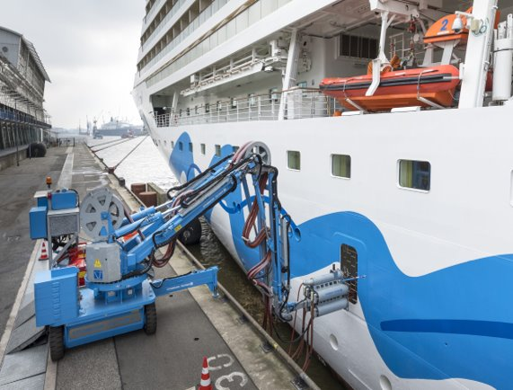
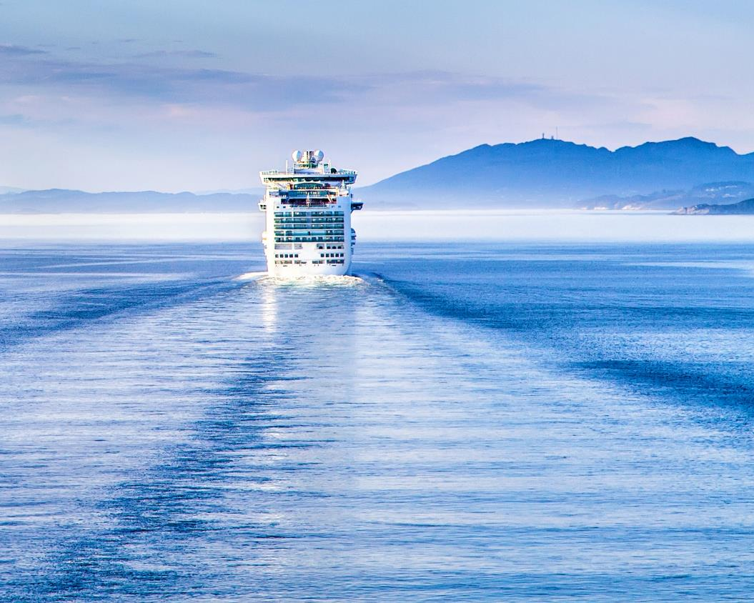
EU goal is to have full SSE coverage or ‘zero-emission’ solutions by 2035
SSE will be a viable solution when at Dock
Alternative fuel options will focus on Sailing
“The time a vessel is on SSE is crucial to stockpile other low emission fuels for sailing times”

Slide 13
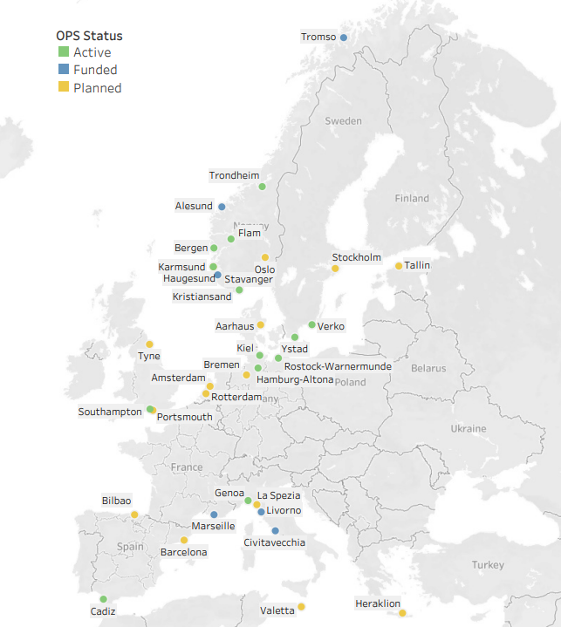
European SSE
Feb 2023
“40% of the fleet operated by CLIA members can connect to SSE today. By 2028, this number will be 75% globally”
“Our members have invested and are ready; what we lack is the shoreside infrastructure at scale”

Slide 14
Shore

Slide 15
Sailing to a Better Future (Two Core Strategies)
PURSUING NET–ZERO CARBON CRUISING
RESPONSIBLE SUSTAINABLECRUISE TOURISM

Slide 16
Cruise Tourism is Managed Tourism
Cruise tourism is managed tourism; by collaborating with ports and destinations.
Ocean and marine life protection, and coral reef restoration; with advanced wastewater treatment, noise reduction, and self-produced water.
Waste reduction through repurposing and recycling; by eliminating single-use plastic; repurposing waste generated onboard.
Responsible sourcing for food and supplies.
Sustainable tour excursions; with a rigorous certification program.
1
RESPONSIBLE SUSTAINABLECRUISE TOURISM
2
3
4
5

Slide 17
Keeping the Timeline Realistic

Slide 18
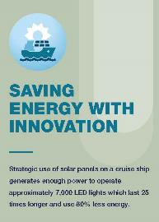
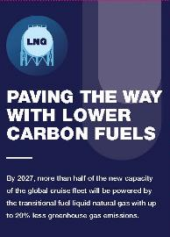
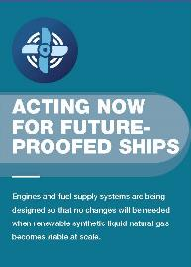
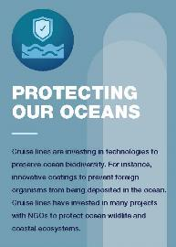
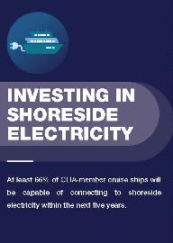
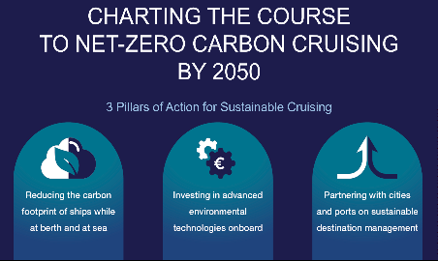
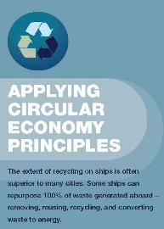
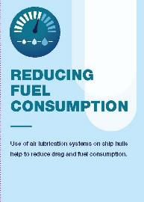
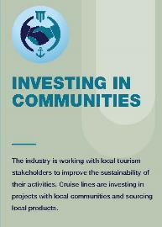
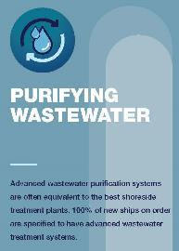
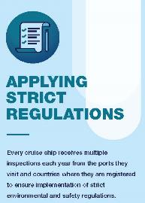

Slide 19
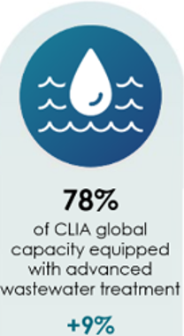
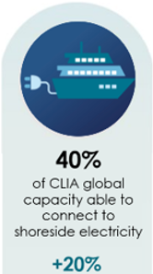
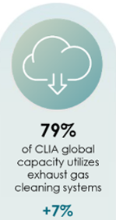
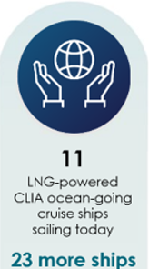
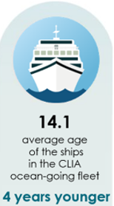
A Realistic Timeline – managing short-term perception
Biodiversity
(Society of Maritime Industries)
UK Government Border Strategy
(Border Security –EES)
Millennium Goals
(2000)
Education and Engagement with stakeholders
(Travel Agent Education)
Cruise Skills
(Home Grown Talent – Ship Crew / Infrastructure / Green Skills )
Sustainable Development Goals
(2015)
growth
2050
(net zero )
Taxation
(pay your fair share)
reduction
The European Green Deal
(2020)
Zero Emissions Vessel and Infrastructure Plan
(UK Shore)
2023
UK Green Taxonomy
(Treasury and BEIS)
Cruise Industry Government Forum
(Policy 2050)
1
EU – Fit for 55
(2021)
Ports and Port Infrastructure
(Alternative Fuel Infrastructure)
Shore Side Electricity
(Maritime UK, Chamber of Shipping and CLIA)
[0 to 100[
2001
(Juneau Alaska – first shore power program negotiations )
2013
(designing the first LNG-powered vessel )
[100 to 200[
Blue Flag
(2015
[200 to 300[
Clean Maritime Plan (Maritime 2050)
[300 to 400[
400+
Clean Air Strategy
(UK Shore)
1992
(Save the Waves – focus on sustainability )
400+
2020
(pledge: pursuing net zero cruising)
2007
(pioneering the first Exhaust Gas Cleaning System)
400+
400+
1
400+
400+
2023/01 SG – Conceptual – Zero Landscape

Slide 20
Port of Tauranga cruise visits
2022/23 season
91 actual ship berths, a total of 77 actual ship days.
153,177 cruise passengers and 68,366 crew visited the region.
2023/24 season
115 scheduled cruise ship arrivals resulting in 93 ship arrival days.
These visits will bring 291,000 passengers and crew into the Bay of Plenty region.
Cruise as a percentage of all port calls
In the year to 30 June 2023, there were approximately 90 cruise ship departures from Tauranga out of an overall total of around 1432 departures.
Cruise = 6.3% of all departures

Slide 21
Communication and Information

Slide 22
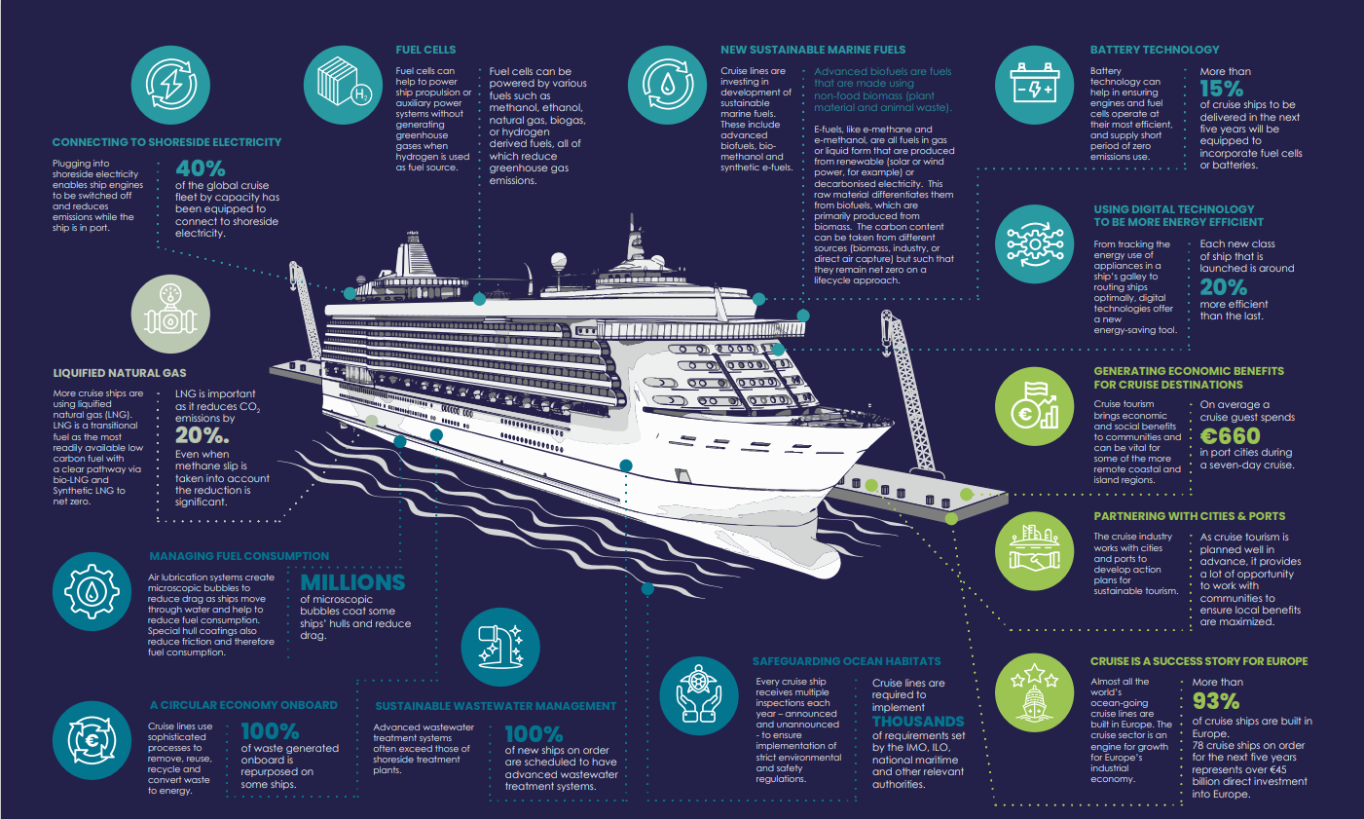
visit www.cruiseinfohub.com
A new, online, multilingual resource
containing reports, statistics, infographics,
videos, case studies and more…

