Slide 1
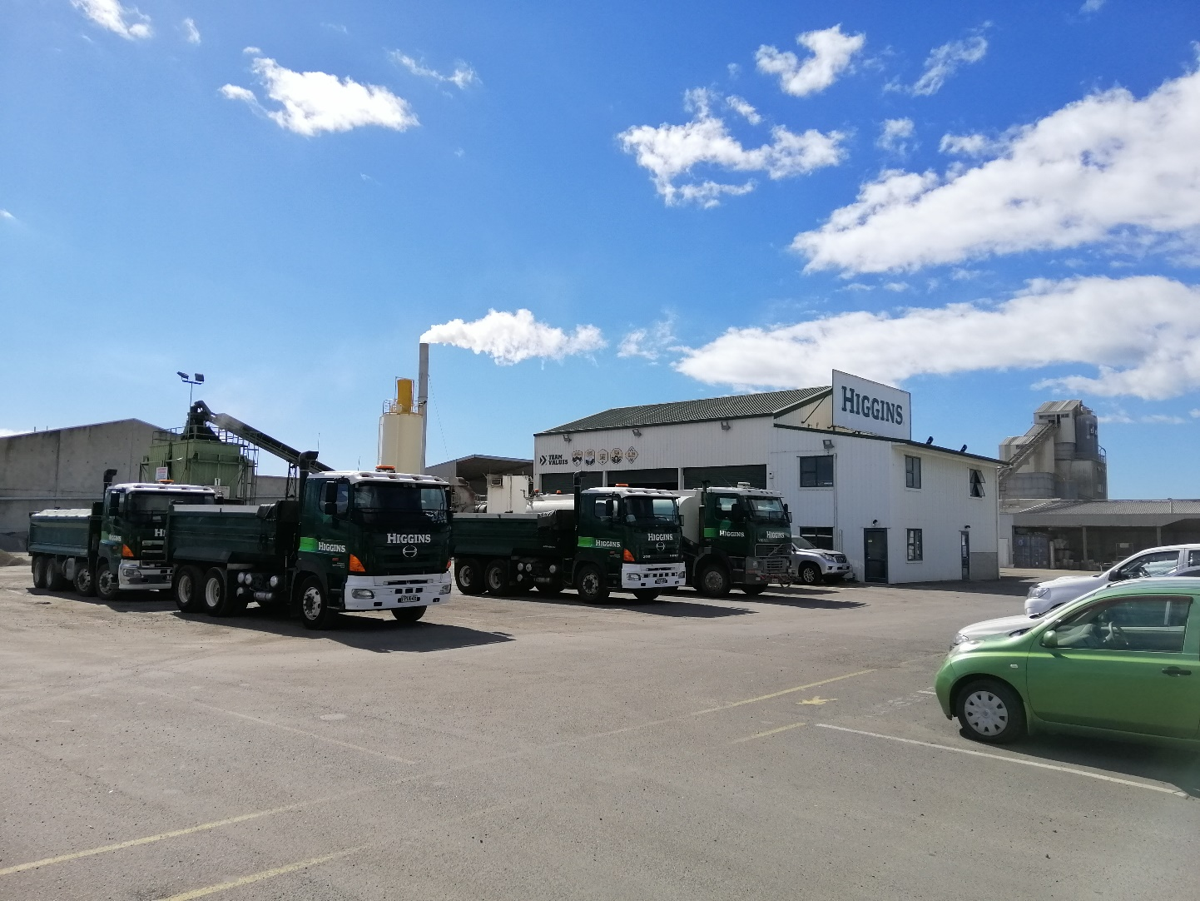
Higgins Tauranga Asphalt Plant Air Quality Assessment
Chris Bender| Pattle Delamore Partners Limited

Slide 2
Description of Proposal
Renewal of application for discharges to air from an asphalt manufacturing plant
Mitigation used: Discharges pass through a venturi wet scrubber before discharge through a 13m stack
Proposed reduction in consented emission rates for TSP from 2.5 kg/hr to 1.5 kg/hr.
Production rate capped at historic rates (i.e. no increase) of 50,000 tonnes per year
Proposed changes ensure Higgins don’t make air quality worse in the Mount
Short term of consent proposed to allow time for Higgins to upgrade to a new plant
2

Slide 3
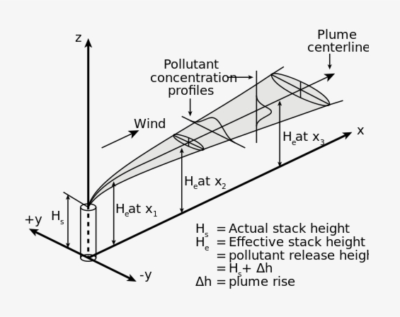
Assessment Methodology (Dispersion Modelling)
Table 1: Highest Predicted offsite MGLCs of Contaminants from the HCL Asphalt Plant (
Contaminant | Highest Predicted MGLCs (µg/m³) |  | Averaging Period | Assessment Criteria (µg/m³)
 | Excluding Background | Including Background
PM₁₀ | 9.1 | 39.4 | 24-hour | 50
 | 1.3 | 15.9 | Annual | 20
PM_{2.5} | 2.4 | 16.4 | 24-hour | 25
 | 0.4 | 7.9 | Annual | 10
NO₂ | 35.8 | 100.8 | 1-hour | 200
 | 12.6 | 55.6 | 24-hour | 100
 | 1.7 | 17.7 | Annual | 30
CO | 82 | 5082 | 1-hour | 30,000
 | 70 | 2070 | 8-hour | 10,000
SO₂ | 0.07 | 24.1 | 1-hour | 350
 | 0.02 | 16.0 | Annual | 120
Assumptions of operation:
Maximum contaminant emission rates
Continuous emissions 12 hours per day over two year period (around 7 x more than actual operations annually)
Dispersion Modelling Results
Maximum predicted concentrations are within the health-based assessment criteria for all contaminants
Modelled concentrations at the nearest sensitive receptors significantly lower
Trace contaminants, including heavy metals, VOCs, dioxins/furans, and PAHs) were predicted to be at concentrations that are considered to have negligible health effects
3

Slide 4
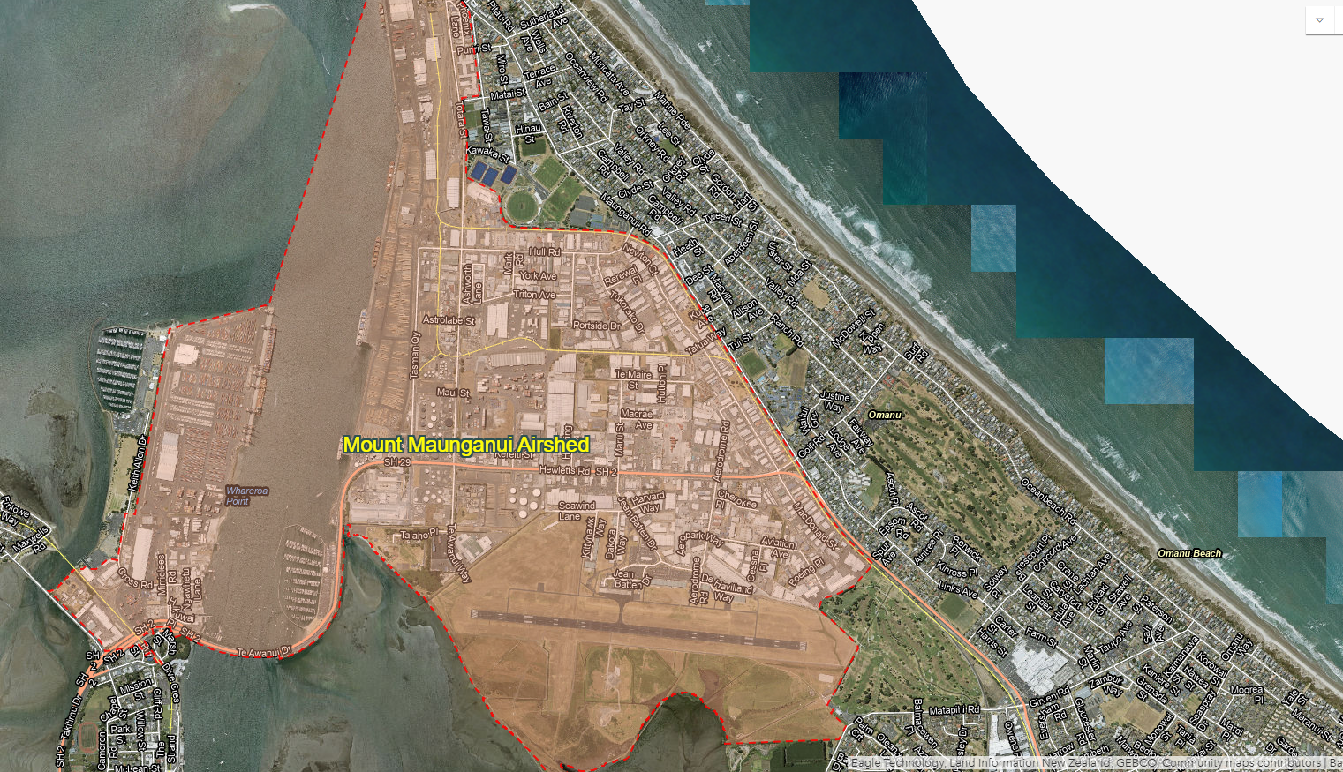
Assessment Methodology (Airshed Analysis)
Mount Maunganui Airshed:
Gazetted as of 31 October 2019
Considered ‘polluted’ under the NESAQ with respect to PM10
Regulation 17 of the NESAQ restricts new sources of PM10, but can permit existing sources to continue
2018 Emissions inventory shows Higgins asphalt plant a minor contributor to PM10 in Tauranga:
<1.8% of total industrial emissions
<0.3% of total PM10 emissions
Higgins
4

Slide 5
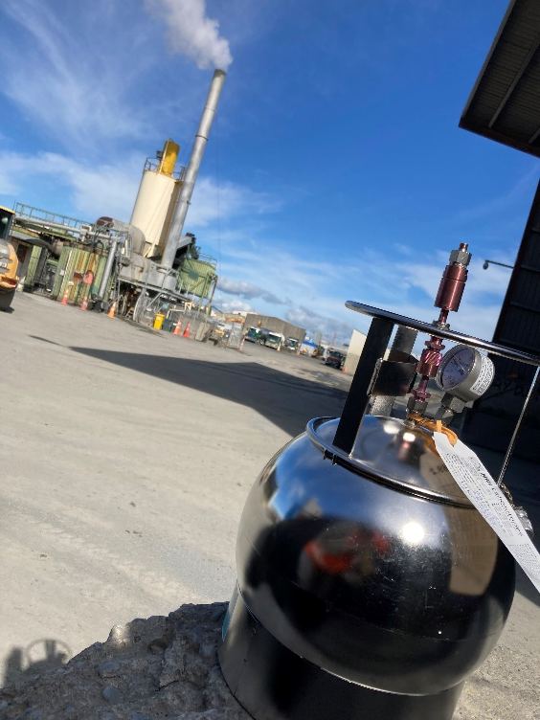
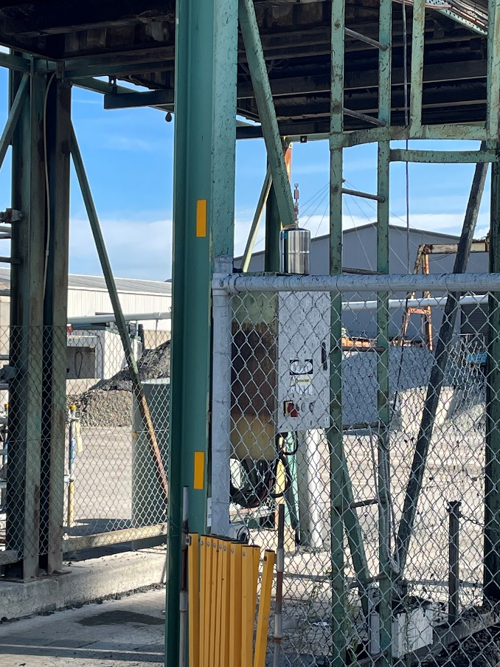
Additional Assessments: VOC Monitoring
VOC Monitoring:
Ambient Air sampling and analysis for VOCs collected near load-out area and downwind of the stack (worst case conditions)
Stack Emissions VOC Measurement collected during peak operating conditions, and VOCs assessed using dispersion modelling
VOCs assessed against the relevant health-based criteria for all compounds detected.
Ambient VOC Monitoring Results:
Ambient monitoring detected a number of VOCs, however concentrations were all well below the assessment criteria (<5%)
Stack Emission VOC Monitoring Results:
Highest concentrations of VOCs discharged from the stack occur near the site boundary, and are <2% of all assessment criteria
Overall assessment:
VOCs generated from the Higgins site will result in a very low risk for adverse health effects
5

Slide 6
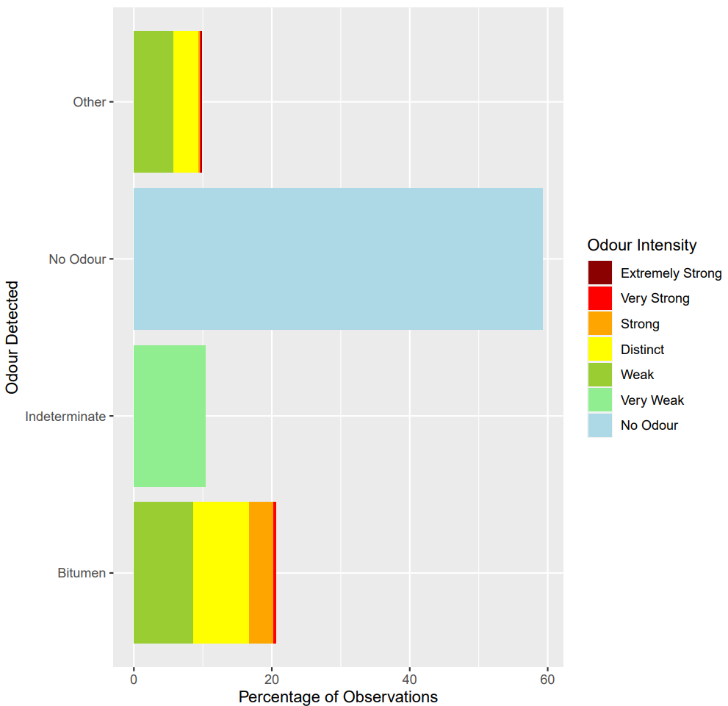
Additional Assessments: Odour Monitoring
Odour Observations
Higgins commissioned PDP to undertake an independent odour monitoring study
Ten separate odour monitoring events were undertaken to measure nature and intensity of odour downwind of the Higgins site
Bitumen odour detected around 20% of the time
Odours were generally weak to distinct, but occasionally strong
Would generally be expected to be ‘acceptable’ in an industrial area, but would depend on overall frequency
6

Slide 7
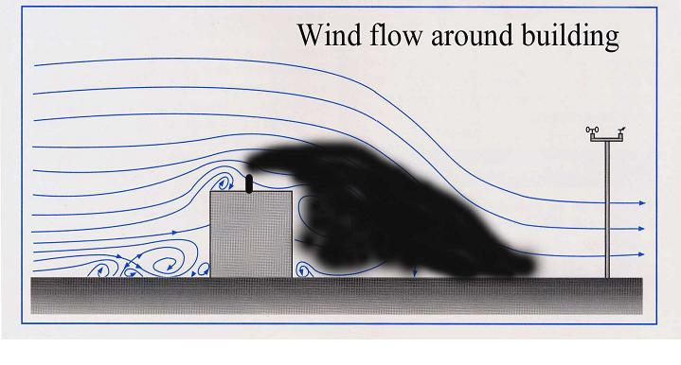
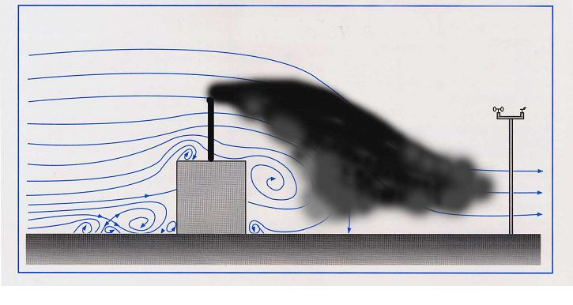
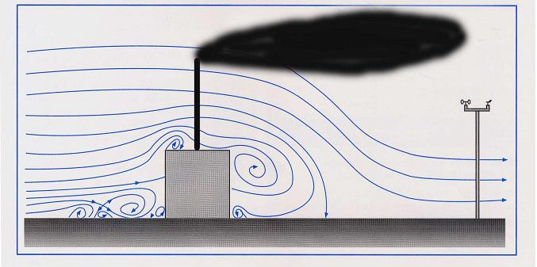
Proposed additional mitigation:
Stack Height Sensitivity
Building downwash effect results in high concentrations near the source
Increasing stack heights can mitigate building downwash effect on stack emissions
Higgins is investigating options for increasing the stack height from 13m to the permitted activity height of 16m
Dispersion modelling indicates that increasing the stack height to 16m will decrease odour concentrations by around 20%
7

