Slide 1
Air quality monitoring trends and developments

Slide 2
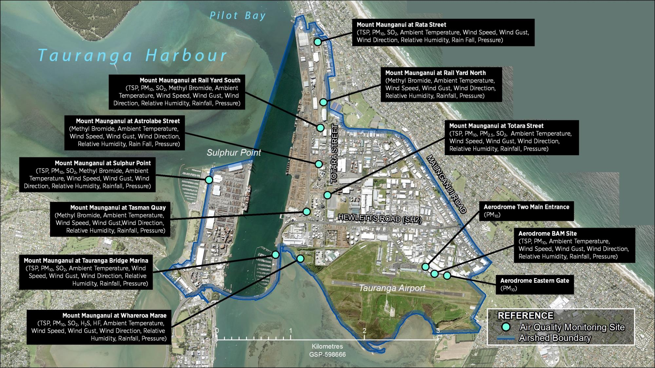
Existing monitoring locations

Slide 3
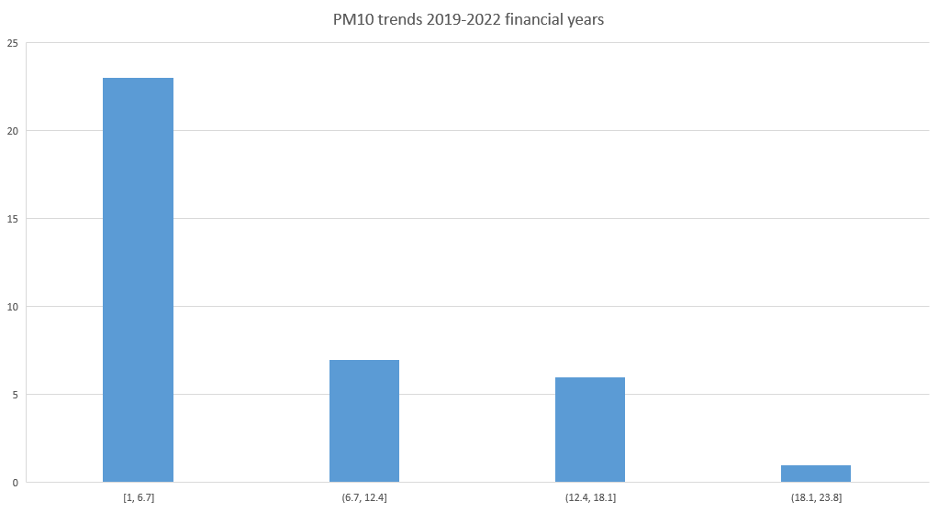
PM10 trends – NES breaches - 50µ/m3 - 24 hour mean
2019/20
2020/21
2021/22
2022/23

Slide 4
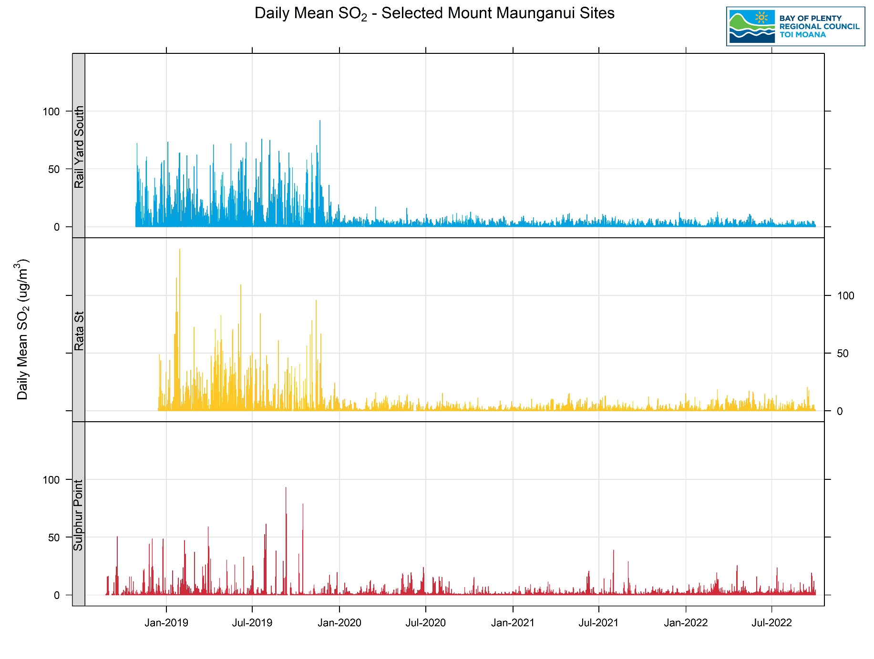
Sulphur dioxide trends - 350µ/m3 one hour mean

Slide 5
Industrial auditing programme
Region wide
Undertaken in conjunction with TLA
600+ businesses in Mount Industrial Area
Every business visited every two to three years
Full audit undertaken on 250 Mount premises in past 12 months
Focus on all discharges – air, land and water
Set time-frames to address issues before enforcement considered

Slide 6
What’s on and what’s planned
Continue to work with business, community, iwi/hapū, residents. New residential monitoring being installed
1
Continue industrial audit programme to ensure each business is visited every 2-3 years
2
Undertake dust and odour survey – planned over the next few months with resource allocated
3
Implement PC13 and progress PC18 – plan changes with specific rules for the Mount air-shed
4
Work with TCC to ensure new residential density zoning is fit for purpose
5
Continue to promote technology upgrades and best business practice
6

