Slide 1
Rivers and Drainage Further Submission no. FS02
Plan Change 5
(Kaituna River)

Slide 2
Rivers and Drainage at a glance
Council
Chief Executive Officer
General Manager Integrated Catchments
Coastal Catchments Manager
Rotorua Catchments Manager
Biosecurity Manager
Integrated Catchments ProgrammeManager
Rivers & Drainage Assets Manager
Rivers & Drainage Operations Manager
Engineering Manager

Slide 3
Kaituna Catchment Control Scheme

Slide 4
Kaituna Catchment Control Scheme - Lower Kaituna area

Slide 5
Lower Kaituna scheme info
Assets
79km’s of stopbank
81km of drains in the lower Kaituna area
9 pump stations
Levels of Service agreed with the community
Focus on conveyance to avoid flooding.
No flooding if the rainfall event is of a certain magnitude (= or < 37mm rain/day for 3 days).
Typical maintenance works: drain desilting, spraying, pump station servicing

Slide 6
Integrated Catchment Group’s Focus Catchment Work in the lower Kaituna area

Slide 7
Ford Rd/ Waitepuia & Kopuaroa Focus Catchment
2019 - 30 June 2023
$1.4million expenditure BOPRC
$320k expenditure landowners
29km of new stock exclusion fencing
44 ha of retired land
205k native trees planted
3 treatment wetlands constructed

Slide 8
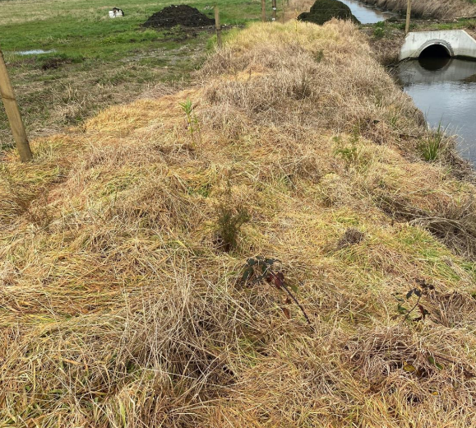
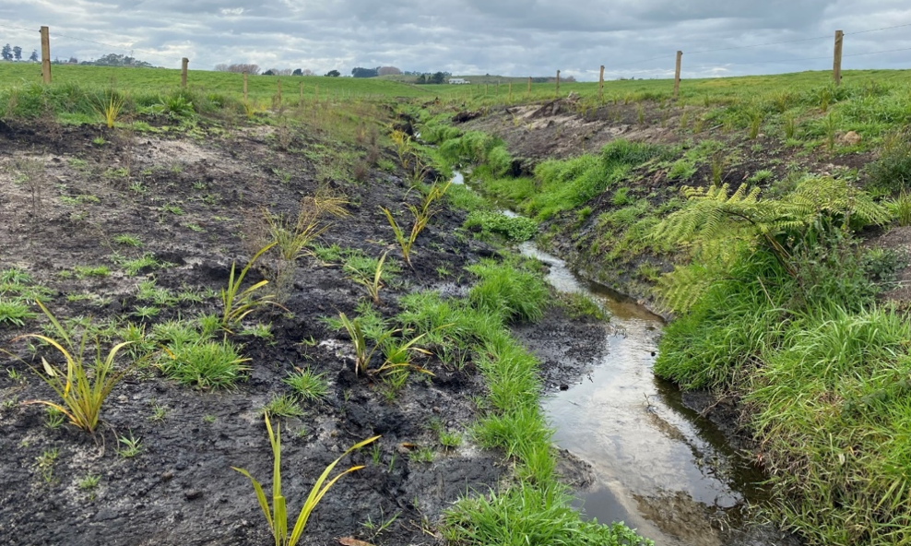
Drain enhancement work – Lower Kaituna

Slide 9
Rivers and Drainage Further Submission no. FS02
Retain the wording of Issue 2.12.4(4) as “Waterbody Modifications”
As explained by the Reporting Officer, referring to ‘drainage schemes’ unnecessarily narrows the scope of the issue

Slide 10
Rivers and Drainage Further Submission no. FS02
Retain the current definition of “Riparian Areas or Margins”
“A strip of land of varying width adjacent to a waterway which contributes or may contribute to the maintenance and enhancement of the natural functioning, quality and character of the waterway and its margins”.

