Slide 1
Mount Air Quality Working Group Consents
17 May 2022

Slide 2
Consent related topics
Overview : Air Discharge consents – existing and applications in progress
S124 Rights of continuance
Consent applications - Information requirements

Slide 3
Regional Council responsibilities
Under the RMA consents are required under sections 9 (land), 12, (CMA), 13 (beds of rivers and lakes), 14 (water) and 15 (discharges).
Environmental effects.
Rules are contained in the Regional Natural Resources Plan (RNRP) and Regional Coastal Environment Plan (RCEP).
There are no existing use rights for activities governed by the Regional Council, however, some previously consented activities received the maximum term (35years) when the RMA came into effect.
Except for reclamations, consents granted under the RNRP and the RCEP have a finite term/ expiry date, unlike land use consents from the City Council which have no expiry.

Slide 4
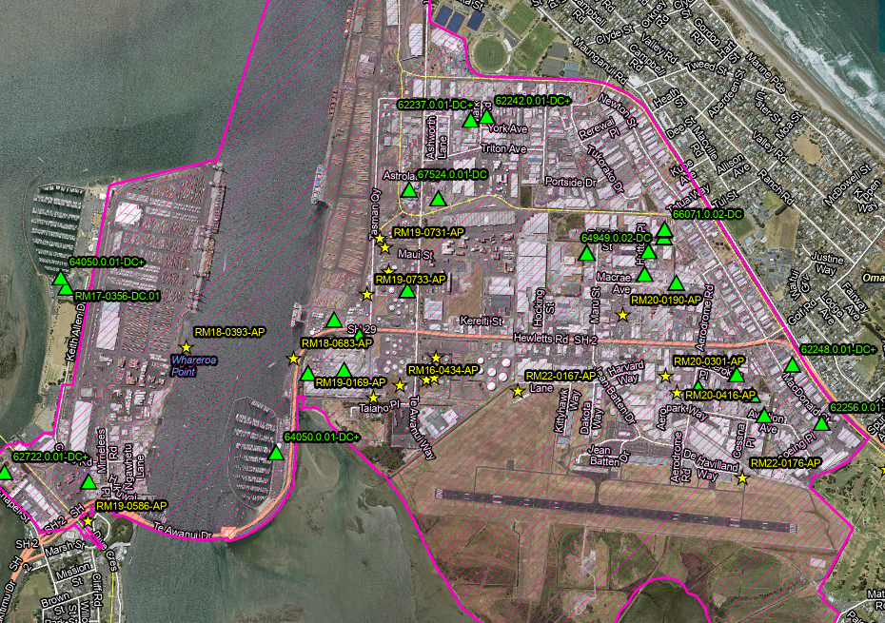
Overview: Air discharge consents
31 existing air discharge consents in the Mount Airshed (12 spray painters)
Currently processing 9 applications:
4 ‘renewals’
Waste Management
Lawter
Allied Asphalt
Higgins
5 ‘new’ applications
HR Cement
TPT Forests Ltd
Matariki Forests
Timberlands Ltd
Ziwi Petfood - granted
on 14 April
1 existing consent Reviewed under s128

Slide 5
Applications in progress
Increased level of complexity – [growth, NES, monitoring, airshed]
‘Renewals’ –s124 rights of continuance
RM16-0434 - Waste Management - Particulates, odour, gas - SO₂ Modelling, cultural effects
RM19-0753 - Lawter – Particulates, odour, gas Technical review, cultural effects
RM20-0301 – Allied Asphalt - Particulates, odour, gas
Propose a new plant Cumulative effects and cultural effects
RM20-0190 – Higgins - Particulates, odour, gas
‘New’ applications : Pre- PC13, these were operating as permitted activities
RM19-0733 – TPT Forests Ltd – Particulates Further information requested
RM19-0731 – Matariki Forest - Particulates On hold pending the outcome of the PC13
RM19-0732 – Timberlands Ltd – Particulates appeal to the Environment Court
RM20-0416 – HR Cement – Particulates Cultural effects
Includes Upgrade & New Mill

Slide 6
New discharges – PM₁₀
Reg 17(NES):
New activities that generate particulate matter cannot establish in the airshed, unless their discharge is:
< 2.5ug/m³ ; or
is offset by removing another existing emission
Existing activities (renewals):
no increase in emissions, unless the increase is offset

Slide 7
S124 RMA
Exercise of resource consent while applying for a new consent
Applies if:
Application is for a new consent for the same activity
Application is made 6 months prior to expiry
Application is made 3 months prior to expiry – at the Consent Authority’s discretion
The consent holder may continue to operate under the existing consent until the new consent is either granted or declined and all appeals are determined.

Slide 8
S124 Timeframes
Non-notified applications: 20 working days
Limited notified applications: 100 working days
Publicly notified applications: 130 working days
Excludes: Time required to provide further information

Slide 9
Consent Applications
Environmental effects - Technical Review
Stack emission monitoring
Fugitive emission monitoring (site perimeter)
Modelling of the emissions generated on site
Cumulative effects assessment
Management Plans
Cultural effects assessment
Time consuming work – start early
Best practice (including technology) will be sought [PC13: AIR P3]
Cumulative effects - Similar industries in close proximity may benefit from working together

