Slide 1
Methyl bromide
Modified reassessment of methyl bromide: APP203660
November 2021

Slide 2
1
Any person or the CE of the EPA may request a reassessment
s63 Reassessment
s63A Modified Reassessment
a procedure for amendments to approvals of hazardous substances

Slide 3
Significant Milestones
18 Apr 2018 - Grounds
25 Mar 2019 – Application Lodged
9 Apr 2019 – Application formally recieved
12 Apr 2019 – Pathway (modified) and public notification decided
15 Apr 2019 – Further information requested
18 Jul 2019 – Public notification
2 Sep 2019 – Submissions close
Sep 2019 – Jun 2020 – DMC recieves more technical information
11 Aug 2020 – Hearing
Aug 2020 – Jul 2021 – DMC receives more technical information
7 Jul 2021 - Hearing closed
18 Aug 2021 – Decision made
2

Slide 4
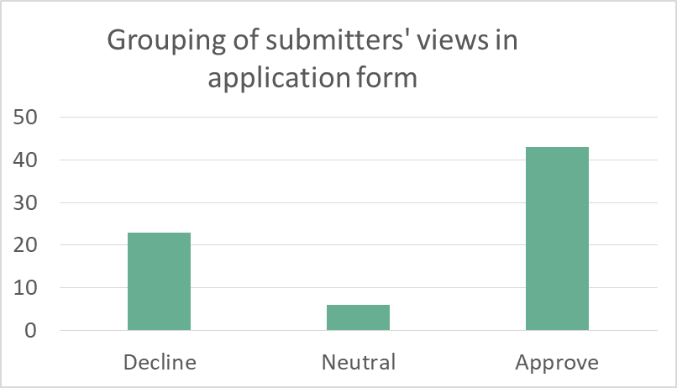
Submissions
4
72 submitters
37 wished to be heard (originally)
FIGURE 1a: Summary of submitters views
Notes:
during the submissions period for the reassessment we received 72 submissions. of these 37 submitters originally requested to be heard at a hearing. we would note here that our submissions analysis reflects the submissions we received at the time, and the number of submitters wishing to be hear has now changed with a reduced number of submitters now wishing to be heard at the updated hearing
we received a balance of different views in submissions as you can see on the graphs here.
the majority of those submitters in opposition, outright opposed the reassessment proposals, with a small group wanting changes to what was proposed but otherwise in opposition, while there were more split opinions in those who supported a change to the controls but may have had different views on what the change should be, between what was proposed and something more or less restrictive.

Slide 5
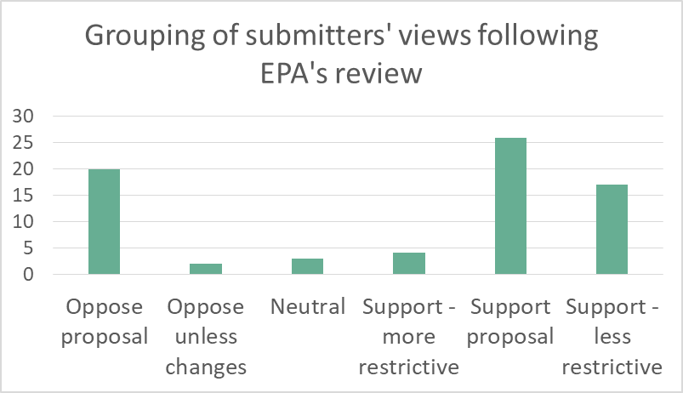
Submissions
5
Following EPA’s review of submissions, revised bandings
FIGURE 1b: Grouping of submitters’ views after review
Notes:
during the submissions period for the reassessment we received 72 submissions. of these 37 submitters originally requested to be heard at a hearing. we would note here that our submissions analysis reflects the submissions we received at the time, and the number of submitters wishing to be hear has now changed with a reduced number of submitters now wishing to be heard at the updated hearing
we received a balance of different views in submissions as you can see on the graphs here.
the majority of those submitters in opposition, outright opposed the reassessment proposals, with a small group wanting changes to what was proposed but otherwise in opposition, while there were more split opinions in those who supported a change to the controls but may have had different views on what the change should be, between what was proposed and something more or less restrictive.

Slide 6
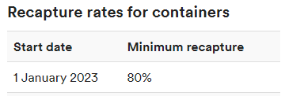
Methyl bromide reassessment timeline
3
Today
grounds
h
g
Public consultation
hearing
decision
From 1 January 2022: New rules in place (extract):
From 1 January 2023:
New rules in place (extract):
Use in ship’s hold banned
Full details in the approval document and EPA website

Slide 7
Summary of reassessment and all documents considered by DMC
6
https://www.epa.govt.nz/public-consultations/decided/reassessment-of-methyl-bromide/

Slide 8
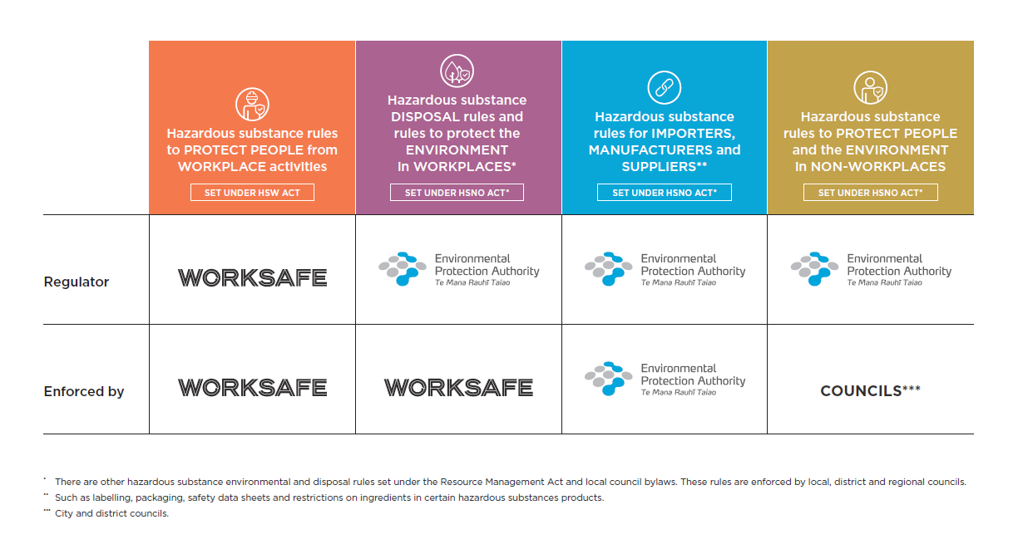
Responsibilities for regulation and enforcement
7

Slide 9
For more information contact:
General enquiries Phone +64 4 916 2426 info@epa.govt.nz

