Slide 1
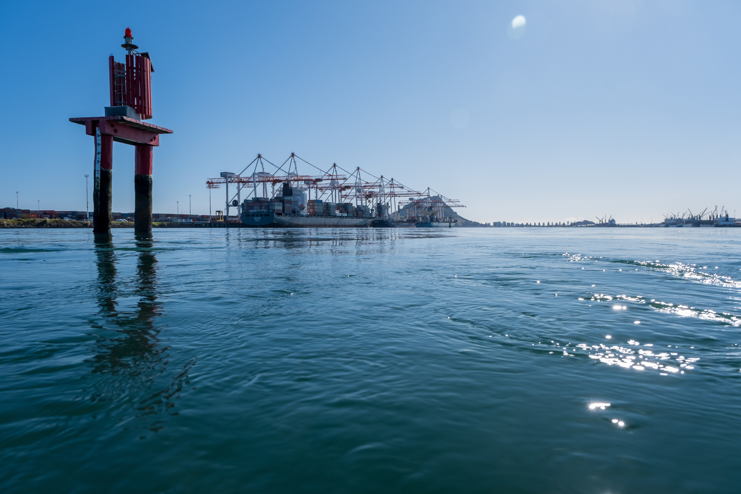
Methyl Bromide - Port of Tauranga
November 2021

Slide 2
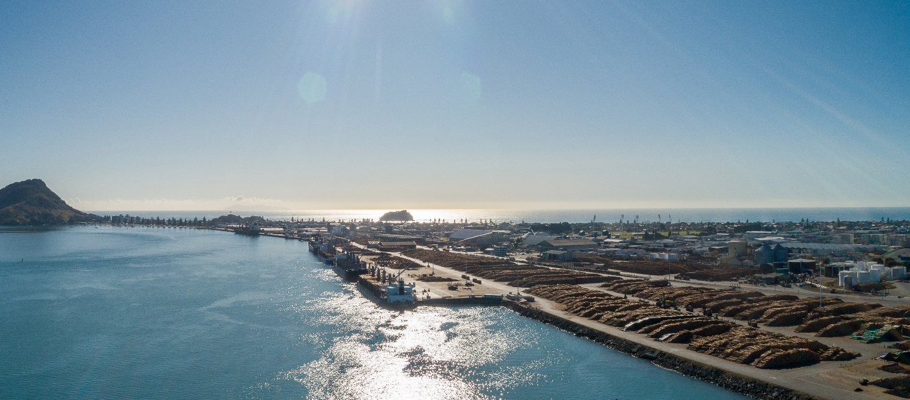
Methyl Bromide
Fumigation is undertaken at the Port by Genera
MBr is used for fumigating some containerised cargo and deck stow logs
Genera hold resource consent for fumigation activities
POTL and regulators require Genera to demonstrate compliance with regulations

Slide 3
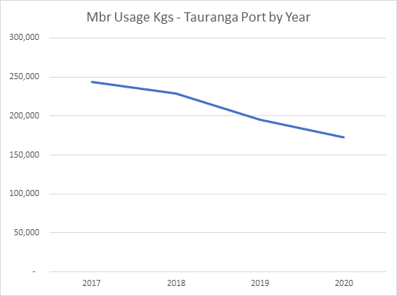
Methyl Bromide use

Slide 4
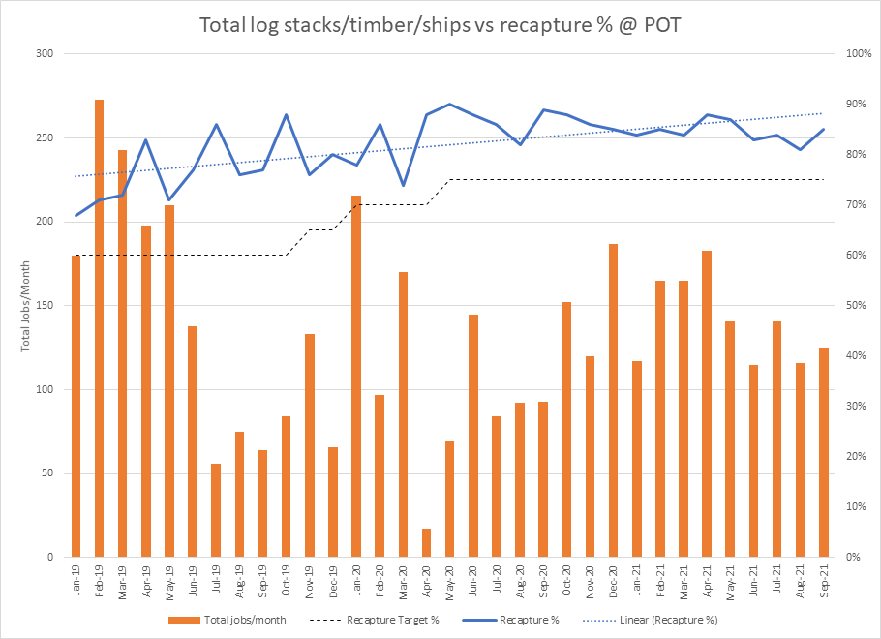
Methyl Bromide recapture
Current consent requires Genera to apply MBr recapture to
75% of all log stack operations
100% of container operations
Genera have been complying with this requirement
POTL requires recapture technology to be applied to 100% of all log stack fumigations from 1 January 2022.

Slide 5
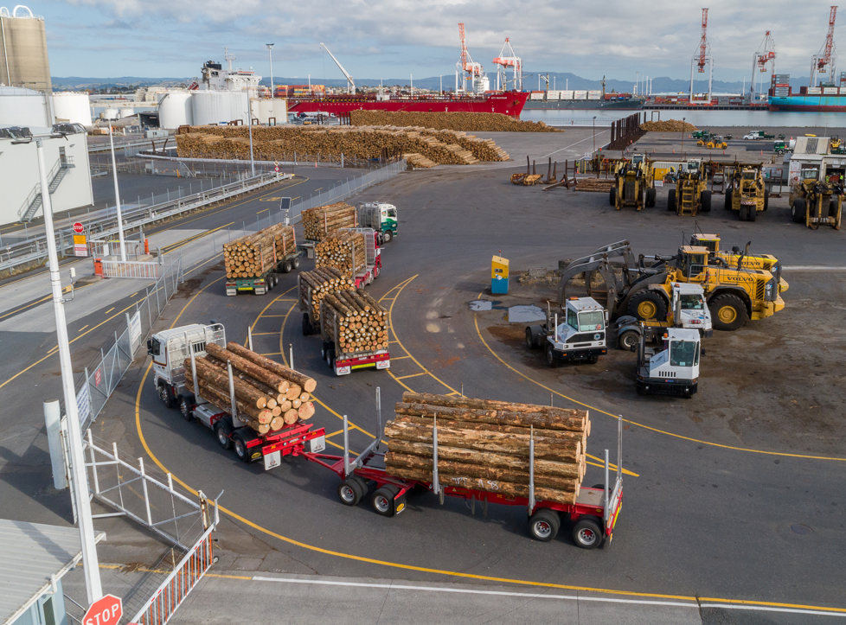
Methyl Bromide
POTL encourages debarking of logs
POTL incentives debarked logs through reduced environmental levies
Debarking contributes to MBr reductions
Any remaining MBr usage will need to be appropriately and compliantly managed

Slide 6
THANK YOU
THANK YOU

