Slide 1
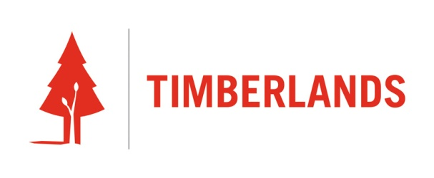
Debarker

Slide 2
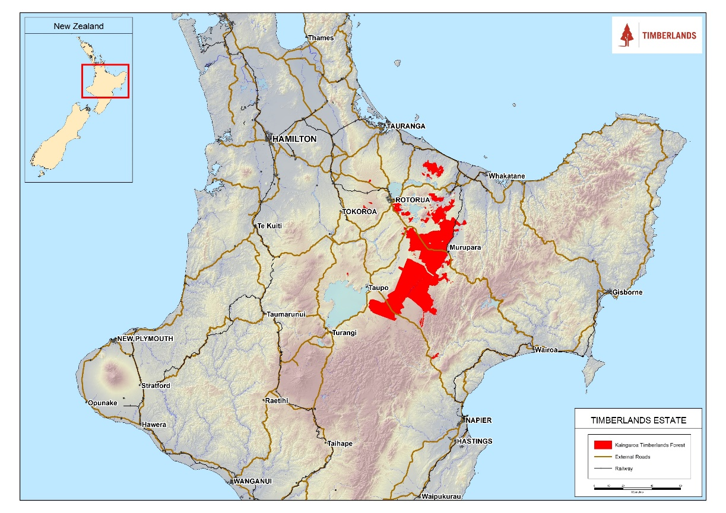
Timberlands
Manages Kaingaroa Forest
Harvest 4.7M tonnes per annum
1.7 M tonnes to export 33%

Slide 3
Background
Importance of export
  Small/low grade logs
  Overflow
Phytosanitary
  MBr review
  Underdeck vs. on-deck
  Country by country
  Currently accepted alternatives
Requirements driven by the receiving country

Slide 4
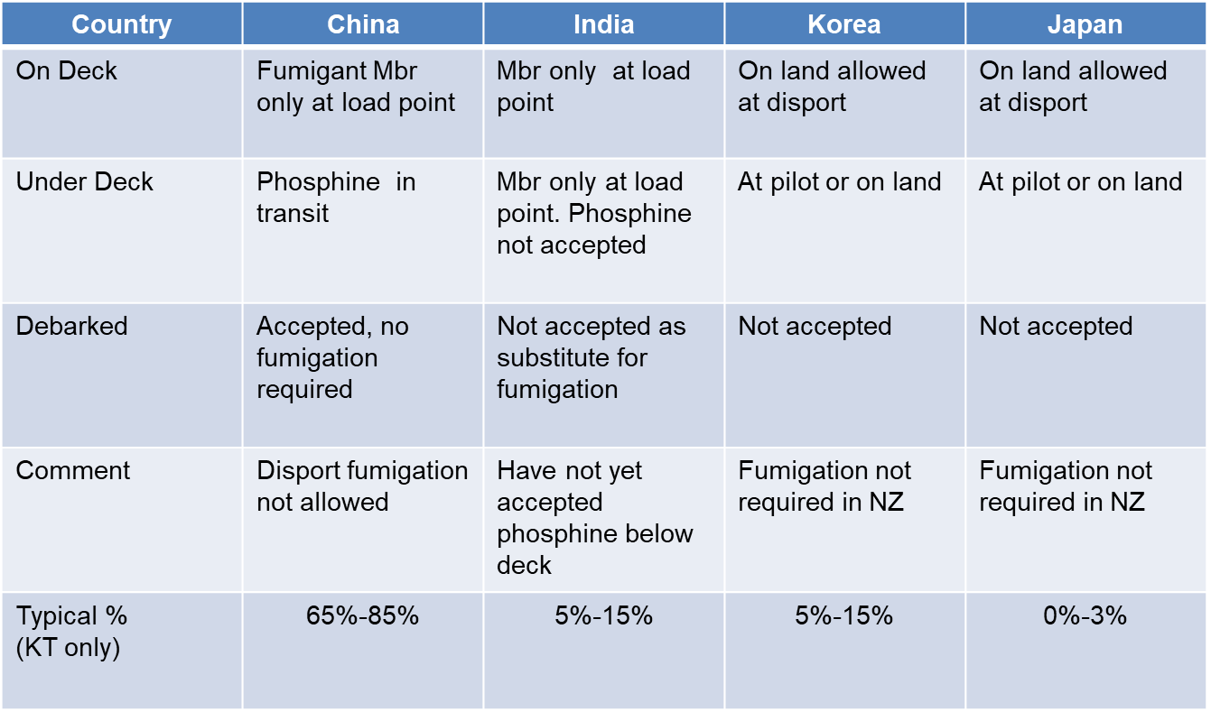
By Country

Slide 5
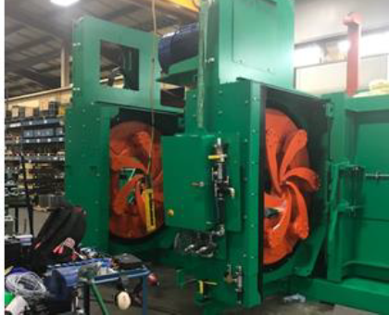
Objective
Strategic vision: “To being the best and safest production forest in the world”
Meet EPA & consent conditions
Continue export operations
Minimise/eliminate methyl bromide use
Safe operations
$14m investment approved in Nov 2017
Opened in May 2019
Debarking volume over 660,000 m3/yr
Potential 1.8m

Slide 6
Why it works for Timberlands
Large scale contiguous forest
Offhighway network to rail head
90% of export goes through one point
Significant China volume
Cash, strategic intent, owners

Slide 7
Why Timberlands
Not so for:
  Farmers woodlots
  Scattered forests
  Some countries (India)
MBr
  NZ 8% to almost 0

Slide 8
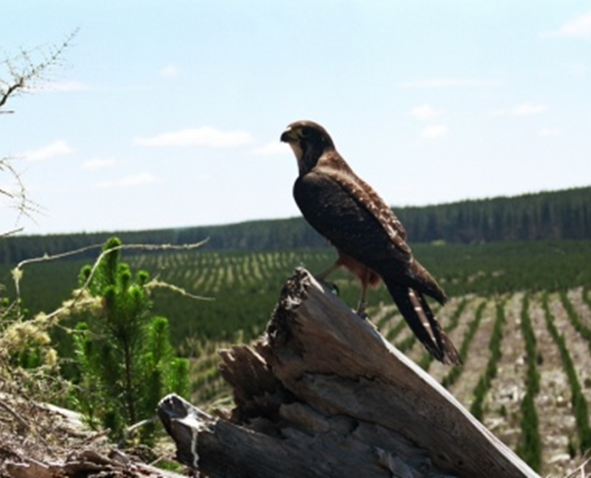
Other Benefits
Reduced bark on port:
  Reduced sediment
  Reduced dust
Leadership
Reputation
Quality = high
Was it worth it?

