Slide 1
Further mussel research proposal

Slide 2
Recommendations from Kura Paul-Burke September 2016
Continue monitoring whole harbour
Develop technical designs to restore mussel populations and include matauranga Māori alongside western science
Develop best practice seastar management plan
Include hapū / iwi into future field based research and/or monitoring programs
Report findings of catchment wide sedimentation and silt deposits into the harbour
Consider establishing a harbour wide shellfish monitoring program

Slide 3
2016 Findings
94 % of original western mussel bed area no longer present
99.6% of original western mussel population no longer present (down from 112 million in 2007 to 485,000)
99.6% of sea-star population no longer present (either run out of prey or moved on to pipi)
2 of 3 traditional eastern mussel beds no longer present (only 59,000 left in one bed)

Slide 4
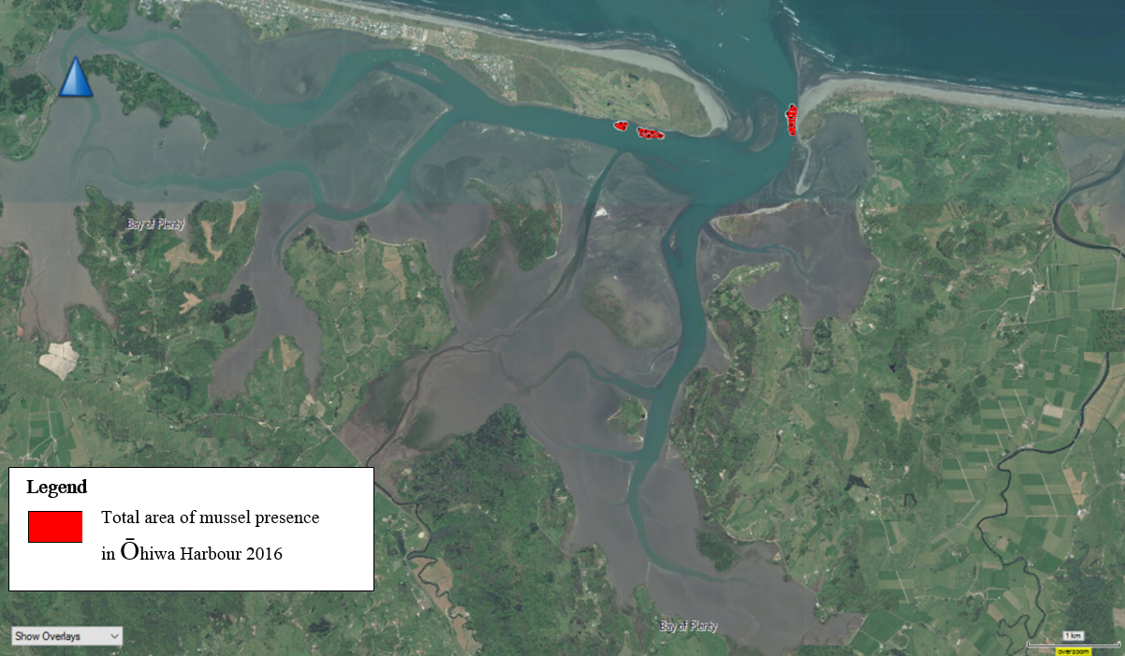

Slide 5
Proposed actions
Deploy spat collection lines to recruit juvenile spat
West side – place 6 cages in existing mussel bed to enclose mussels
Est side – place cages containing deal shells debris in historic beds and relocate mussels from spat lines into cages
Monitor equipment mussel populations, seastars, control sites and historic bed boundaries.
Continue to investigate causes of seastar population explosions and possible methods of control.

Slide 6
Consultation since last September
Kura has undertaken considerable consultation and discussion with:
Upokorehe and Ngāti Awa
Mai i ngā Kuri a Wharei ki Tihirau
Auckland University marine scientists
NIWA marine scientists
Mussel aquaculture experts

Slide 7
Possible funding
Kura has submitted a collaborative science funding proposal to MBIE.
This will bring together marine scientists from NIWA, Auckland Uni and MUSA dive.
It involves 5 estuary sites across the northern North Island.
Ōhiwa would receive $50,000 for 5 years.
Outcome of funding round will be known in late 2017.
In the meantime, work can begin with funding from BOPRC and possibly Mai i ngā Kuri a Wharei ki Tihirau.

