Slide 1
North Island Tuna Review
Duncan Petrie

Slide 2
Purpose
The Purpose of this presentation is to:
Summarise stock assessment;
Obtain input and participation from Tangata Whenua prior to the development of proposed options for the North Island Tuna review.
This presentation based on MPI’s fisheries science stock assessment. It is acknowledged that the information presented may differ from the believes and understanding of Tangata Whenua. MPI welcome discussion around these differences.

Slide 3
Taxonomy
Longfins prefer faster flowing water and rocky river beds, and their distribution generally extends further inland
Shortfins prefer slower moving water and often inhabit lakes and swamps and the lower reaches of rivers.
Not all individuals follow the rules and the two species often co-occur.
Longfinned tuna (Anguilla dieffenbachii)
Maximum size: 2.0 m, 25 kg
Shortfinned tuna (A. australis)
Maximum size: 1.1 m, 3 kg
Australian longfin tuna (A. reinhardtii)
Maximum size: 2.0 m, 21 kg
Drawings courtesy of R. M. McDowall

Slide 4
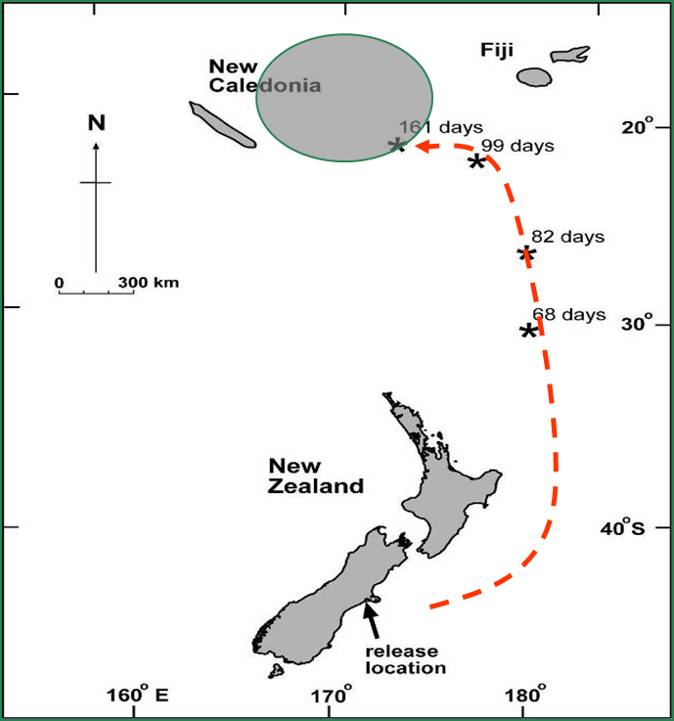
Life-cycle

Slide 5
Sub-Adults
Sub-adults are tuna >15cm long that are not yet mature
The commercial fishery targets sub-adult tuna of around 300g - 4kg (<2kg in the Waikato). Although the MLS is 220g, legislated 31mm escape tubes exclude fish < 300g . Tuna >Max legal size are returned alive.
Commercial fishers voluntarily avoid migrating silver tuna (i.e. Adults) in 1995-96.

Slide 6
Eel QMAs

Slide 7
Catch Limits and Allowances (tonnes)
Shortfin Tuna
Longfin Tuna
 | SFE 20 | SFE 21 | SFE 22 | SFE23
TAC | 148 | 181 | 121 | 36
TACC | 86 | 134 | 94 | 23
CUS | 30 | 24 | 14 | 6
REC | 28 | 19 | 11 | 5
Other | 4 | 4 | 2 | 2
 | LFE 20 | LFE 21 | LFE 22 | LFE23
TAC | 39 | 60 | 34 | 34
TACC | 19 | 32 | 21 | 9
CUS | 10 | 16 | 6 | 14
REC | 8 | 10 | 5 | 9
Other | 2 | 2 | 2 | 2

Slide 8
MPI Tuna Monitoring
Research contracted by the Ministry for Primary Industries (MPI) is largely focused on monitoring trends in:
the recruitment of elvers and
the relative abundance of larger exploited tuna (300g to 4kg) .
Elver recruitment is monitored by counting the number of elvers arriving at several dams, throughout the country, during the elver migration season in late summer.
Abundance of commercially caught tuna is monitored using standardised catch rates of commercial fishers (based on statutory catch and effort data).

Slide 9
Commercial CPUE
Catch per day is modelled as a function of the following key variables: year, permit holder, number of nets, target species, month and river flow.
Standardised catch per unit effort (CPUE) trends are produced for each Eel Statistical Area (ESA), and the series for each species is updated on a three-year cycle.

Slide 10
North Island ESAs

Slide 11
% Longfin Habitat Fished Commercially
Standardised commercial CPUE monitors the abundance of tuna of legal size in the part of each ESA that is fished commercially.
In 2014 MPI commissioned a research project to determine the proportion of habitat in each ESA that was fished commercially and also impacted by hydro dams.
The area fished in each ESA was determined from face to face interviews with fishermen, using maps.
The area not fished included:
DoC Estate;
areas closed by MPI to commercial fishing, e.g. Whanganui, Motu, and Mohaka Rivers
Inaccessible areas and streams too small to be commercially viable.
The proportion of longfin habitat was determined using models based on presence absence data on the NZFWFDB and environmental predictors on the REC2 Data Base.

Slide 12
% Longfin Habitat Fished Commercially
 |  |  | Percent (%)
QMA | Eel Statistical Area | Current habitat fished | Max. impacted area
LFE 20 | AA | 36.1 | 40.2
LFE 20 | AB | 34.9 | 38.2
LFE 21 | AC | 50.0 | 55.0
LFE 21 | AD | 43.2 | 55.7
LFE 21 | AE | 17.4 | 23.9
LFE 21 | AF | 8.6 | 13.6
LFE 22 | AG | 17.3 | 24.7
LFE 23 | AH | 24.8 | 29.9
LFE 23 | AJ | 17.0 | 23.6
LFE 22 | AK | 36.0 | 40.6
LFE 22 | AL | 4.2 | 5.0
LFE 22 | AM | 2.4 | 7.4
All NI | All NI | 22.5 | 29.0

Slide 13
North Island CPUE Trends

Slide 14
North Island ESAs

Slide 15
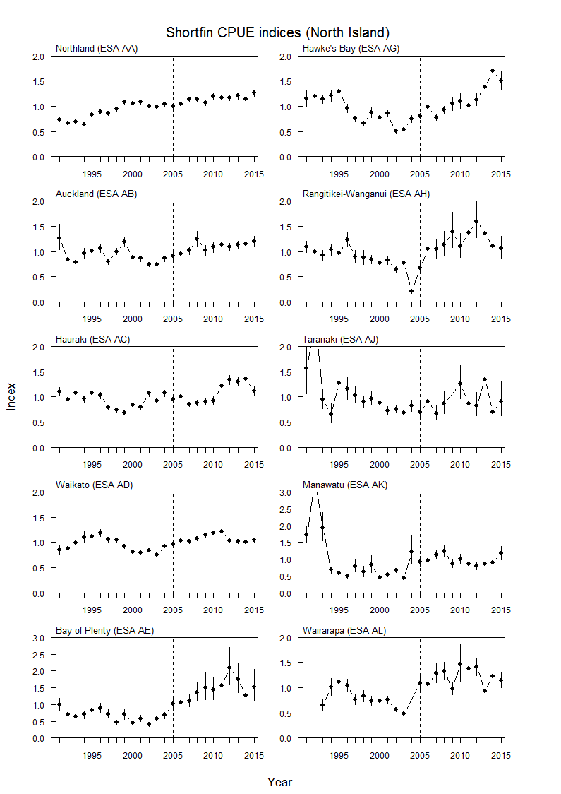

Slide 16
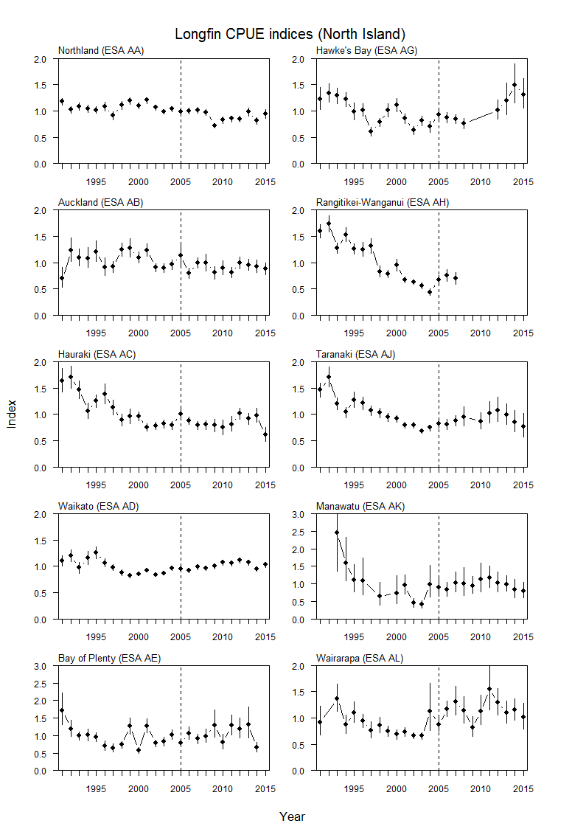

Slide 17
Limitations of Long Fin CPUE Series
They apply only to the areas commercially fished in each ESA (3-50% of habitat).
CPUE biased low for the following reasons:
An increase in escape tube dia. from 25 mm to 31 mm in 2012–13. Some eels previously retained are no longer caught – also applies to shortfins
Failure of some fishers to record on ECE returns all legal sized tuna caught, not just those retained. Due to limitations in ACE for longfins, a substantial portion of the catch is often returned to the water. Not recording this results in underestimated CPUE/abundance. ACE became limiting after longfin TACCs were severely cut in 2007, and even more so during the last few years when many Iwi, concerned with LFE sustainability, shelved their quota.
Unrecorded release of > 4kg tuna ( >2kg in Waikato co-management area). The 4kg maximum legal size was introduced in 2007-08, with no statutory requirement to record the weight of returned eels. CPUE before 2007-08 includes eels >4kg, but after this date does not. A voluntary logbook programme on the SI showed that large numbers of large eels are returned. The new electronic monitoring system planned to begin in 1 October 2017 does include recording of eels over the maximum legal size

Slide 18
Elver monitoring at dam sites
The purpose of this programme is to monitor recruitment of longfin and shortfin eels - to ensure there are enough adults escaping to spawn.
It is not the intention to measure recruitment to as many rivers as possible, but rather to monitor those rivers deemed to be representative of recruitment to North and South Islands

Slide 19
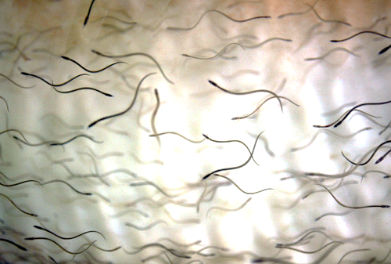
Trap and Transfer sites - North Island
Wairua Falls (WRU)
Watercare Reservoirs
Karāpiro Dam (KAR)
17
Wairere Falls & Mokauiti
18
Matahina Dam (MAT)
19
Upper Whanganui
1
Motukawa
4
3
5
Mangorei
11
12
22
6
Patea Dam (PAT)
20
Piripaua (PIR)
(Waikaremoana)
Turitea Dam

Slide 20
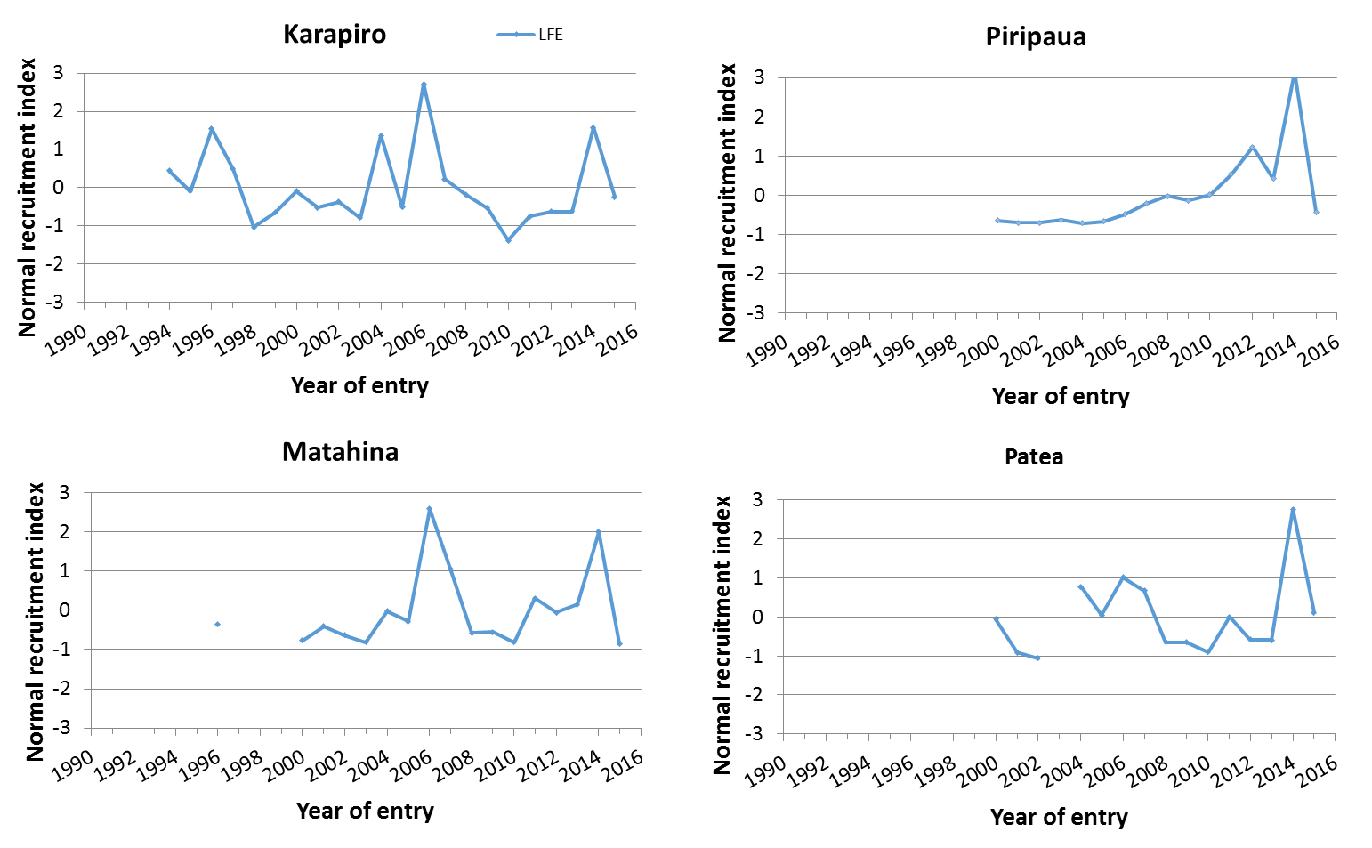
Longfin Tuna Recruitment

Slide 21
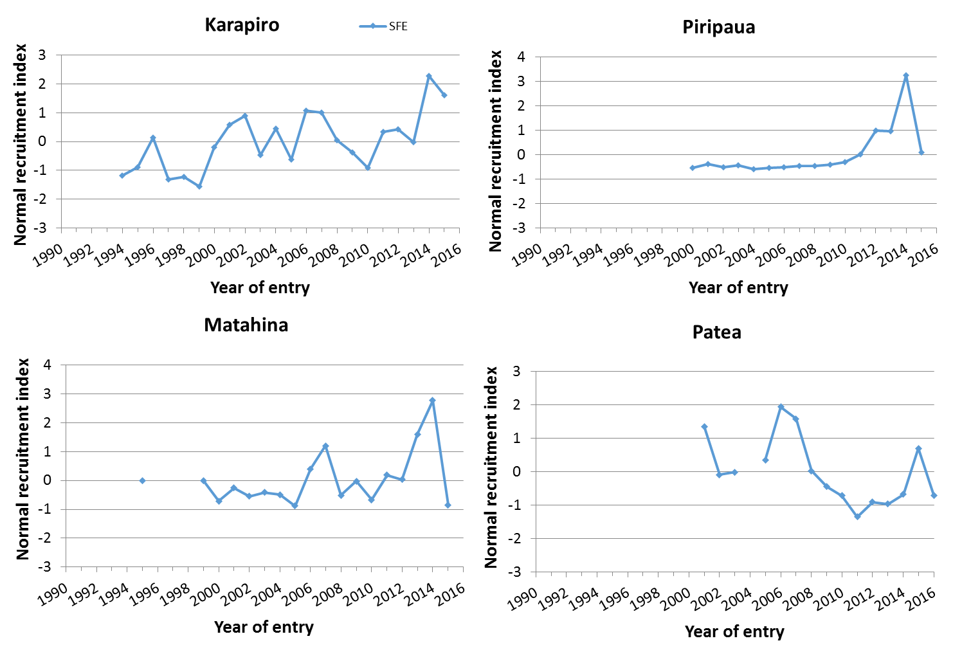
Shortfin Tuna Recruitment

Slide 22
STOCK ASSESSMENT OF North Island tUNA

Slide 23
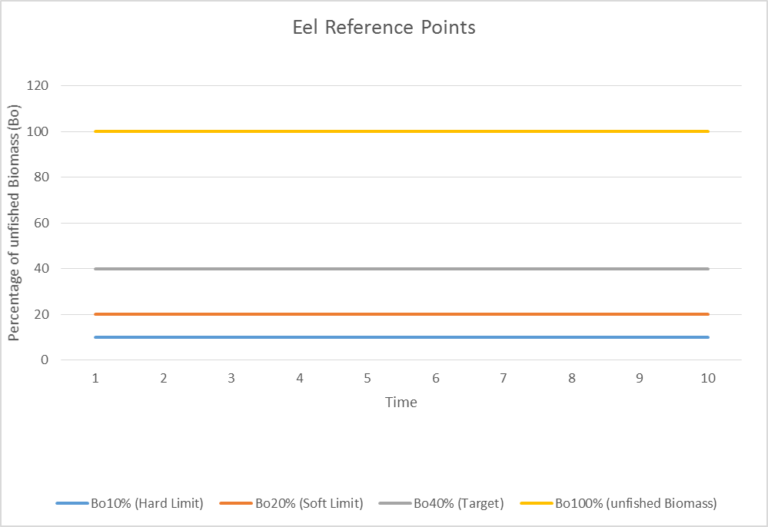
Reference Points for each ESA
Target: 40%B0
Soft Limit: 20%B0
Hard Limit: 10%B0
Overfishing threshold: Fmsy = F40%B0

Slide 24
Longfin Assessment Method
The LFE population in each ESA was assessed by taking into account:
Proportion of habitat impacted by hydro dams and commercial fishing
The CPUE trend in the fished area
Relative exploitation rate in the fished area
Trends in elver recruitment at dams

Slide 25
ESA | % Imp. (F+D) | Status in relation to Target | Status in relation to limits | Over-fishing
AA | 40.2 | Likely (> 60%) at or above | Soft Limit: Very Unlikely (< 10%) below Hard Limit: Very Unlikely (<10%) below | Unlikely (< 40%)
AB | 38.2 | Likely (> 60%) at or above | Soft Limit: Very Unlikely (< 10%) below Hard Limit: Very Unlikely (<10%) below | Unlikely (< 40%)
AC | 55.0 | Likely (> 60%) at or above | Soft Limit: Very Unlikely (< 10%) below Hard Limit: Very Unlikely (<10%) below | Unlikely (< 40%)
AD | 55.7 | Likely (> 60%) at or above | Soft Limit: Very Unlikely (< 10%) below Hard Limit: Very Unlikely (<10%) below | Unlikely (< 40%)
AE | 23.9 | Likely (> 60%) at or above | Soft Limit: Very Unlikely (< 10%) below Hard Limit: Very Unlikely (<10%) below | Unlikely (< 40%)
AF | 13.6 | Likely (> 60%) at or above | Soft Limit: Very Unlikely (< 10%) below Hard Limit: Very Unlikely (<10%) below | Unlikely (< 40%)
AG | 24.7 | Likely (> 60%) at or above | Soft Limit: Very Unlikely (< 10%) below Hard Limit: Very Unlikely (<10%) below | Unlikely (< 40%)
AH | 29.9 | Likely (> 60%) at or above | Soft Limit: Very Unlikely (< 10%) below Hard Limit: Very Unlikely (<10%) below | Unlikely (< 40%)
AJ | 23.6 | Likely (> 60%) at or above | Soft Limit: Very Unlikely (< 10%) below Hard Limit: Very Unlikely (<10%) below | Unlikely (< 40%)
AK | 40.6 | Likely (> 60%) at or above | Soft Limit: Very Unlikely (< 10%) below Hard Limit: Very Unlikely (<10%) below | Unlikely (< 40%)
AL | 5.0 | Likely (> 60%) at or above | Soft Limit: Very Unlikely (< 10%) below Hard Limit: Very Unlikely (<10%) below | Unlikely (< 40%)
AM | 7.4 | Likely (> 60%) at or above | Soft Limit: Very Unlikely (< 10%) below Hard Limit: Very Unlikely (<10%) below | Unlikely (< 40%)

Slide 26
Stock Status of NI Shortfin Tuna
No negative trends in recruitment
Shortfin CPUE is increasing in most ESAs
But no information on the proportion of habitat fished or impacted by dams.
Therefore not possible assess status of populations in each ESA against reference points.

Slide 27
North Island TACC Review
Step | Timing
Eel stock assessment reviewed by Working Group and Plenary | Completed
Pre-consultation with industry and Tangata Whenua on North Island Tuna TACs | June - November 2017
Public consultation | February/March 2018
Implementation of decisions on North Island Tuna stocks | Late 2018
Contact for Review:
Duncan Petrie – Senior Analyst Inshore Fisheries
04 894 2466
021821054
Duncan.petrie@mpi.govt.nz

Slide 28
Discussion
Are you happy with your Tuna fishery?
Where do you want your to Tuna Fishery to be in the future?

Slide 29
Acknowledgments
Marc Griffiths, MPI, Presentation, 2017.
Shannan Crow, Mike Martin, Mike Beentjes (NIWA) for figures used in this presentation.
The Eel Working Group members for their contribution to the work and to the assessment.
Iwi involved with elver trap and transfer programmes at dams.

Slide 30
Bay of Plenty subarea catch data (tonnes)
Sub Area | 2012 - 13 |  | 2013 – 14 |  | 2014 - 15
 | SFE | LFE | SFE | LFE | SFE | LFE
Tauranga (AE1) | 0.5 | 0 | 0.75 | 0.25 | 0.5 | 0
Rotorua Lakes (AE2) | 0 | 0 | 1.5 | 1 | 2 | 0.5
Rangitaiki River (AE3) | 5 | 2 | 7 | 0.5 | 4.5 | 0.5
Whakatane River (AF1) | 0 | 0 | 0 | 0 | 0.25 | 0.25
Catch data approximate values only.

