Slide 1
Eastern Bay – Beyond Today and Strategic Issues Meeting 21 March 2017

Slide 2
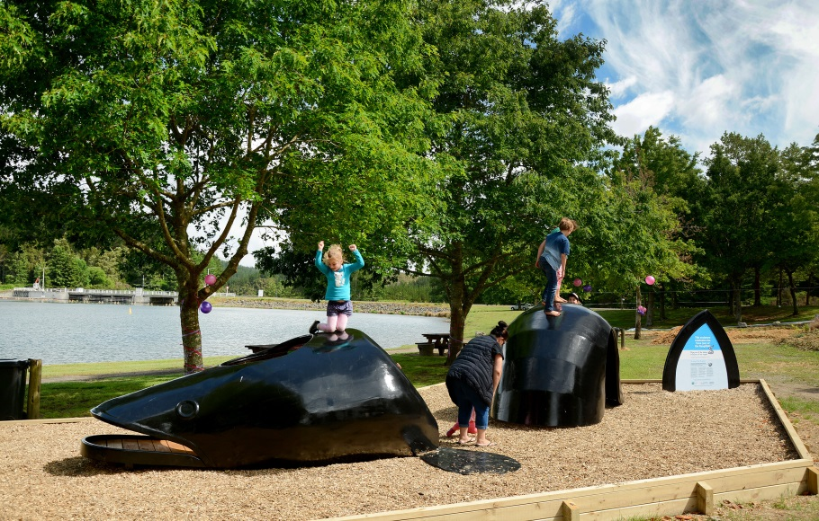
Te Ara Whanui o Rangataiki
Eastern Bay – Beyond Today
Te Ara Whanui o Rangitaiki:
He taonga tuku iho – desired outcomes
Actions
Eastern Bay – Beyond Today:
Outcomes
Key Opportunities
Notes:
Te Ara Whanui o Rangitāiki and Eastern Bay – Beyond Today are complementary documents.
Part of group of strategic documents and programmes working in Eastern Bay and Rangitāiki River catchment.
Note:
Section 3 of report
Te Ara Whanui o Rangitāiki outcomes – He Taiao, He Tangata, He Awa
Actions – Appendix 1
Eastern Bay – Beyond Today outcomes under Economy, People and Culture, Environment themes
Key Opportunity - Caring for our communities and environment

Slide 3
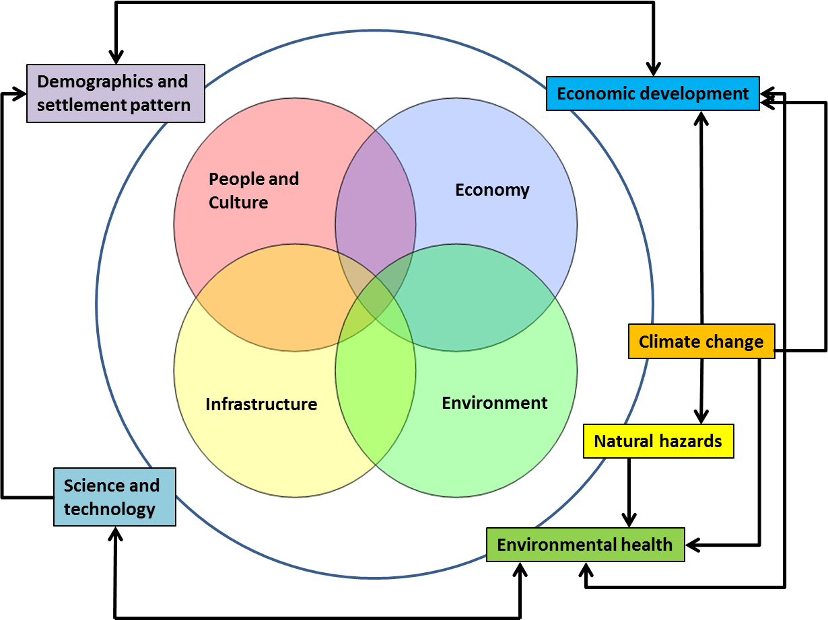
Notes:
Eastern Bay – Beyond Today aims to take a strategic view to our challenges and responding to future changes.
We know there will be significant changes to technology, science, population demographics, society, the economy and the environment. And that there are:
Relationships and overlap between 4 themes (e.g. the environment can affect the economy and vice-versa).
The major influencing factors (outside ring) affect each other (e.g. climate change increases extreme weather events – flooding) and the 4 themes in the middle.
Over time a clear ‘spatial’ understanding of the interactions between the economy, communities, environment and infrastructure will be developed. This will lead to better decisions and responses to our challenges and opportunities.

Slide 4
Strategic issues
Limits and drivers of change
Water quality and quantity
Conflicts between limits and economic drivers?
Adapting to climate change
Weather events, rainfall patterns, water flow, sea level rise
Understanding implications of ongoing change
Demographics, communities, economy, environment, science and technology
Notes:
Strategic issues for Rangitāiki River Forum - from Section 4 and Appendix 2 of the report.
Note:
The strategic issues are around the relationships and feedback loops between influences, limits and drivers of change.
These include positive (win-win) relationships, potential conflicts, and things where we know will change – but not the details.

