Slide 1
Mount Air Quality Working Party meeting
Wednesday 3rd March 2021

Slide 2
Section 31 of the RMA – our functions
31 Functions of territorial authorities under this Act
(1) Every territorial authority shall have the following functions for the purpose of giving effect to this Act in its district:
  (a) the establishment, implementation, and review of objectives, policies, and methods to achieve integrated management of the effects of the use, development, or protection of land and associated natural and physical resources of the district:
  (aa) the establishment, implementation, and review of objectives, policies, and methods to ensure that there is sufficient development capacity in respect of housing and business land to meet the expected demands of the district:
  (b) the control of any actual or potential effects of the use, development, or protection of land, including for the purpose of—
    (i) the avoidance or mitigation of natural hazards; and
    (ii) [Repealed]
    (iia) the prevention or mitigation of any adverse effects of the development, subdivision, or use of contaminated land:
    (iii) the maintenance of indigenous biological diversity:
  (c) [Repealed]
  (d) the control of the emission of noise and the mitigation of the effects of noise:
  (e) the control of any actual or potential effects of activities in relation to the surface of water in rivers and lakes:

Slide 3
HOW DO WE DELIVER ON OUR RESPONSIBILITIES
Develop, consult and adopt a City Plan
Amend as required (selected plan changes)
Undertake a full review of the Plan every ten Year (working on 2024 review)
Consider and grant Resource Consents in accordance with the City Plan and other planning documents

Slide 4
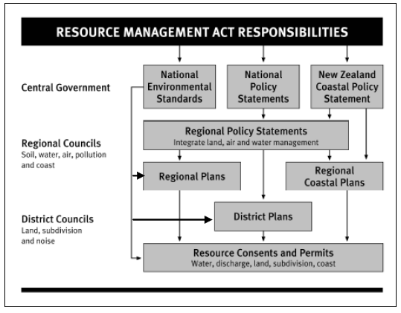
Hierocracy of Planning Documents

Slide 5
Air Quality issues/ City and District Plans
With regards to managing discharges to air, this sits with the Regional Council under s30(1)(f) of the RMA.
When considering truck movements, it is in terms of the design standards for road classification and strategic function. Impact of air emissions is out of scope.
Our existing Industrial zone rules are relatively permissive for heavy industry. Our consideration of the effects of heavy industry is constrained to whether the landuse is suitable within the relevant zoning. Our plan does acknowledge potential offsite impacts as a result of a significant event (e.g. chemical fire).

Slide 6
TCC Environmental Monitoring
TCC Environmental Monitoring Team is responsible for monitoring the City Plan and conditions of landuse and subdivision resource consents issued by TCC.

Slide 7
Health Act
Tauranga City Council’s Environmental Health Team have some responsibilities under the Health Act Section 29 (h),
In relation to the Health Act EHO would only be required to respond to nuisance complaints, example would be nuisances from residential fires creating smoke issues.
The Environmental Health team would refer any larger scale complaints to the relevant authority such as:
  Regional Council
  Ministry of Health

