Slide 1
Kaituna Rediversion Update Tangata Whenua Hui 21 July 2020

Slide 2
Meeting Agenda
Kaituna River re-diversion update
Estuary monitoring results
Reclamation
Te Pourepo o Kaituna – Wetland Extn update

Slide 3
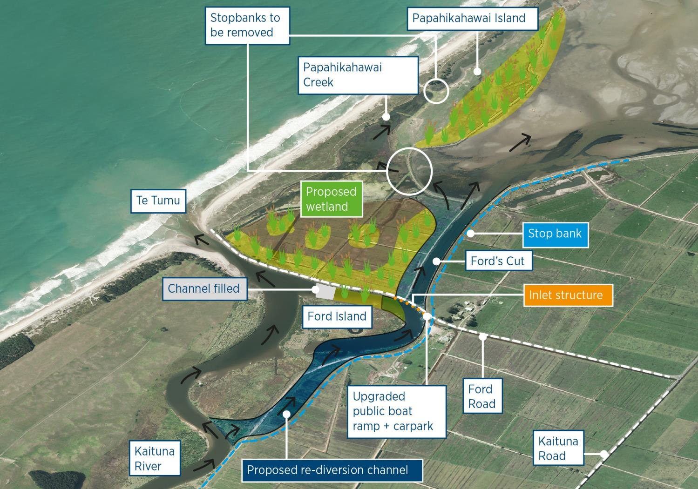
Notes:
To significantly increase the volume of water (particularly fresh water) flowing from the Kaituna River into Ongatoro/Maketu Estuary by 2018 in a way that maximises the ecological and cultural benefits (particularly wetlands and kaimoana) while limiting the economic cost and adverse environmental effects to acceptable levels
20% of river flow + 20 ha new wetlands

Slide 4
Progress since February
Salinity block completed
Construction of Coastguard pontoon
Gate testing
Regular inspections of project works commenced
Additional planting at Te Pa Ika
Covid-19 works stopped

Slide 5
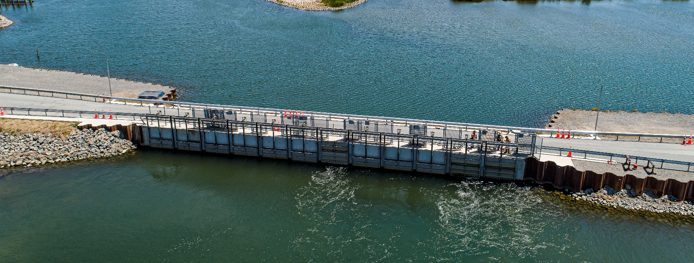
Gate operation
Until Feb 2021 – 9 out of 12 gates operating
Gates used get rotated

Slide 6
What work is remaining?
Move the commercial fisherman & remove current wharfs
‘Tidy up’ along the river edge
Relocate Hoe Waka club
Papahikahawai Island bridge protection works
Notes:
1 open gate is approx. equivalent in flow to the four old round culverts

Slide 7
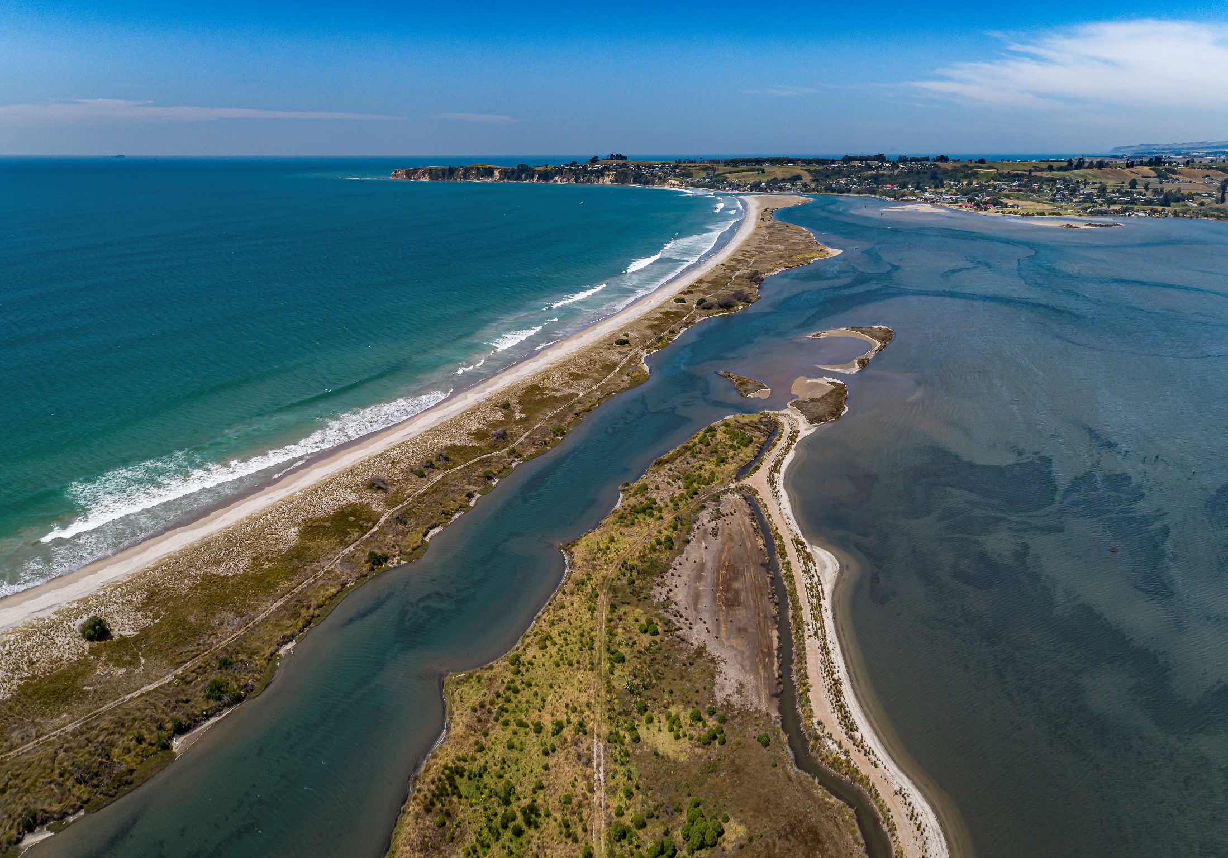
Estuary monitoring

Slide 8
Cross sections
Notes:
1 open gate is approx. equivalent in flow to the four old round culverts

Slide 9
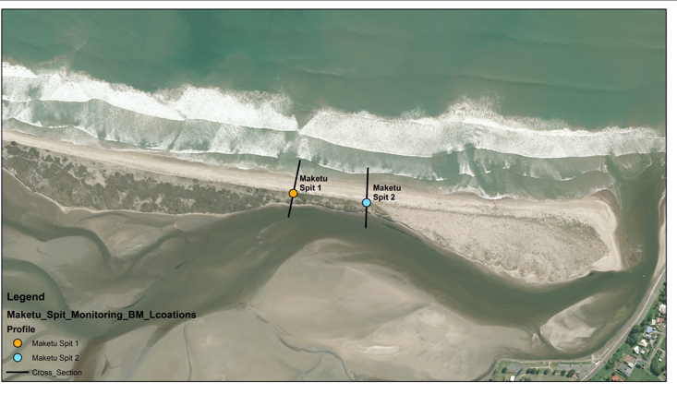
Cross sections
Spit 1 & 2
consistent on the estuary side
ocean side both aggradation and erosion
Notes:
1 open gate is approx. equivalent in flow to the four old round culverts

Slide 10
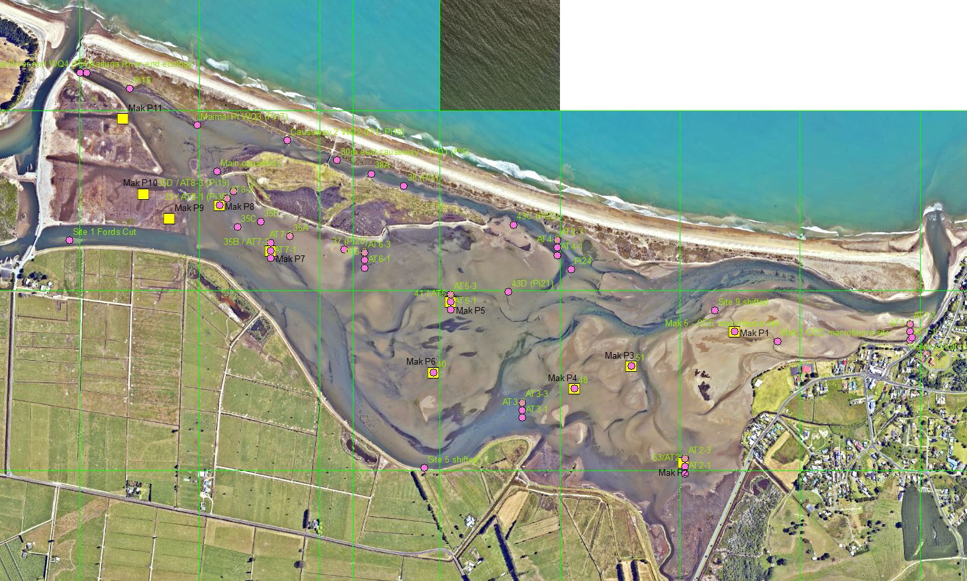
Where are we monitoring?
Pink dots = ecology
Yellow squares = sediment rates

Slide 11
Papahikahawai Creek-Causeway area
Flows restored June 2017

Slide 12
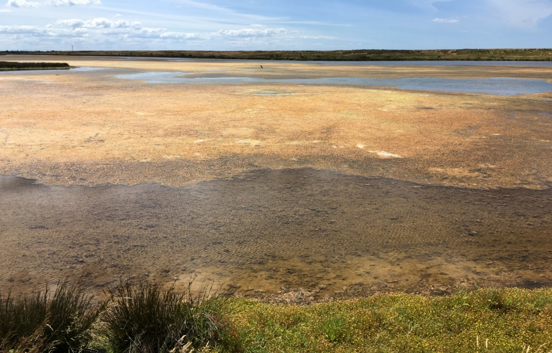
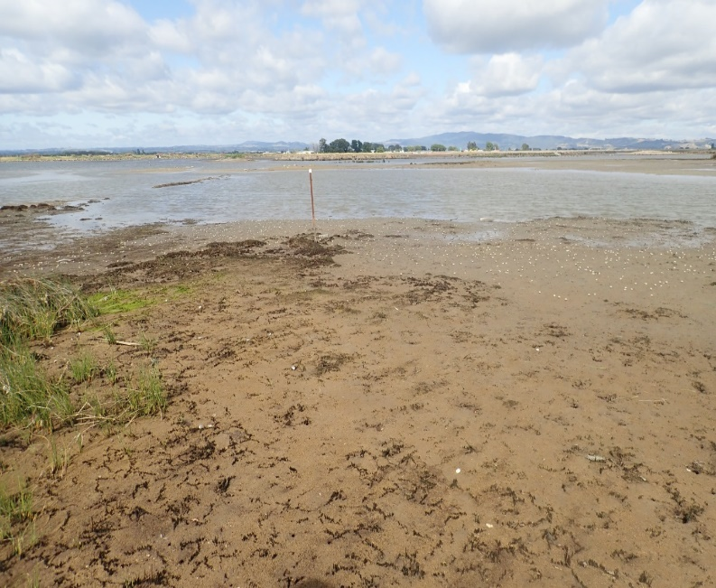
Macroalgae & sediment
Macroalgae cover reduced from 100% to near 0%
December 2016 Jan 2020
Amount of mud in sediments reducing but recovery will be very slow

Slide 13
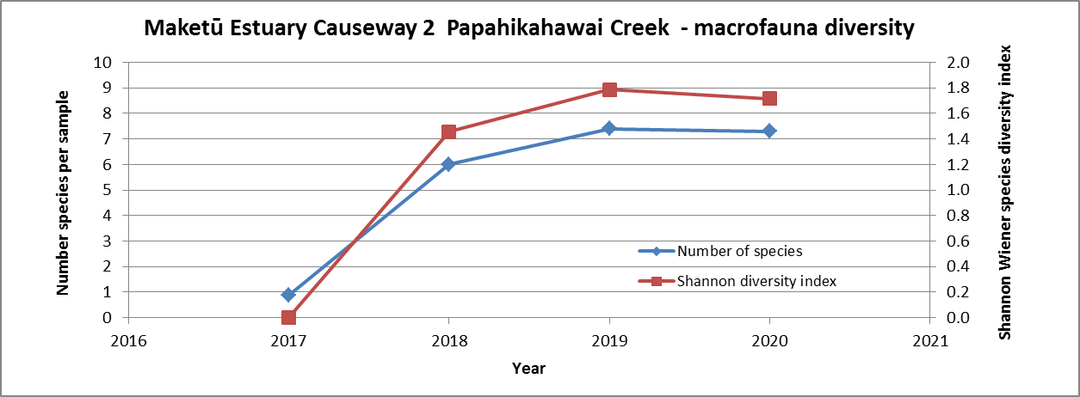
Benthic macrofauna
Increase in species diversity as habitat has improved
Measured by looking at the number of species per sample

Slide 14
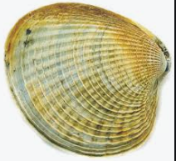
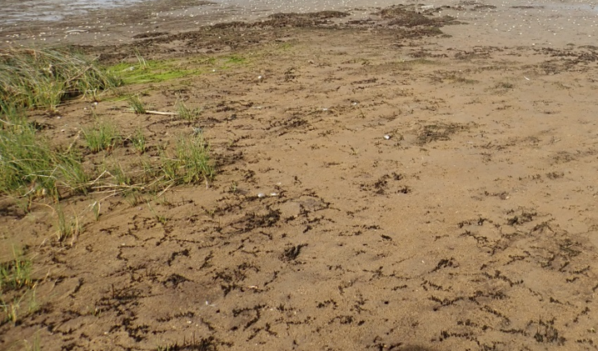
Tuangi and crabs
Tuangi
Causeway 2: some have reached sizes of 25-30mm, average 18mm
Upper areas of Papahikahawai Creek have also recorded some recruitment of tuangi but not to the same extent as the habitat is not as suitable
Increase in number of crabs

Slide 15
Fish, birds & vegetation
Productivity of area has improved
Reflected in increased fish and bird numbers
Only adverse effect has been die back in rush around the margins – will expand in time

Slide 16
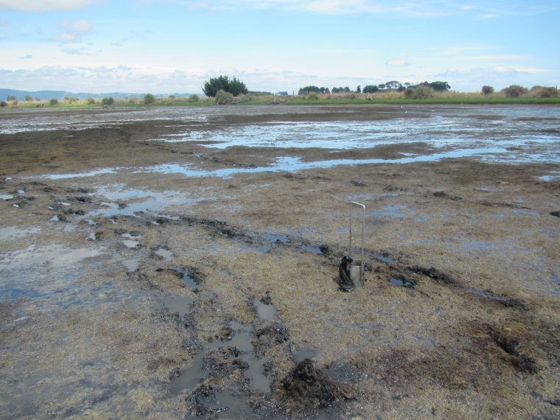
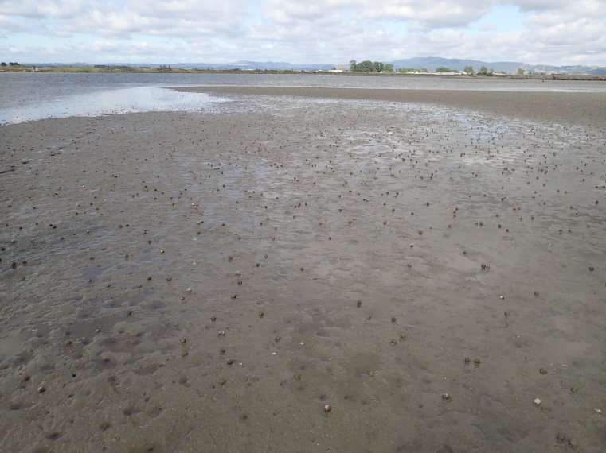
Wider Estuary area
Significant reduction in macroalgal and cyanobacteria cover
January 2018 2020
Titiko present

Slide 17
Wider Estuary area
Increase in tuangi numbers
Some improvement in oxygen levels but still low
Drop in salinity levels, will see more change with all 12 gates open
Too early to see any changes in sediment accumulation of lower estuary

Slide 18
Te Pa Ika wetland
Plantings from 2019 have established well, further planting occurred in June
Estuarine macrofauna have established
Sediments are still quite muddy and have moderate nutrient and organic content

Slide 19
Summary
A range of physical parameters are being monitored
No notable adverse consequences for the ecology
Very obvious improvement to the previously cut-off section of Papahikahawai Creek
Mid & lower estuary: some changes in ecology have been observed but these are more likely the result of natural cycles of change

Slide 20
Reclamation
BoPRC in the process of applying for freehold interest over the salinity block.
Process:
Resource consents
Certificate of reclamation from the Regional Council
Apply to the Minister for Land Information
Application considered including cultural values

Slide 21
Te Pourepo o Kaituna wetland

Slide 22
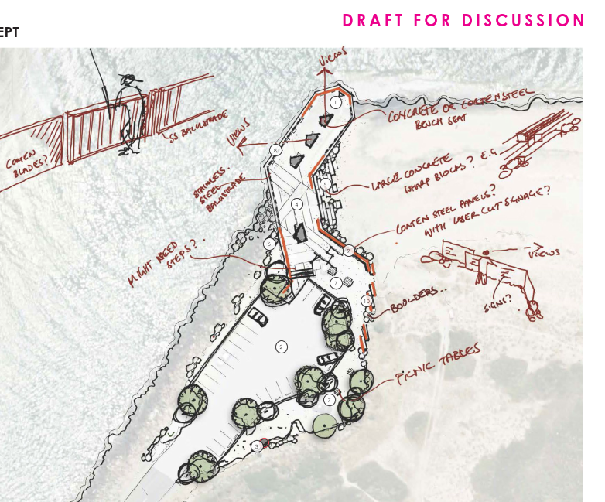
Kaituna Mole Renewal

Slide 23
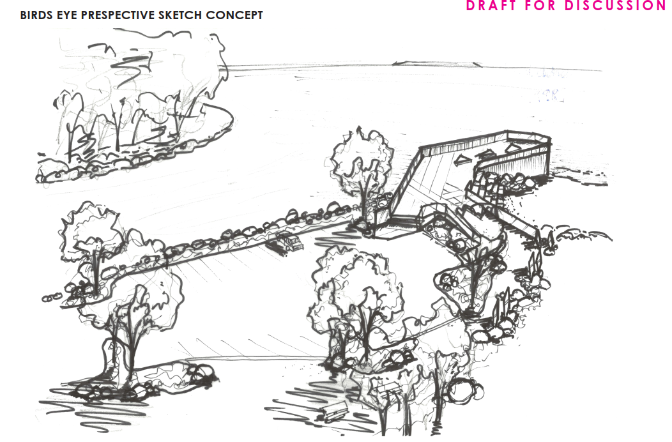
Kaituna Mole Renewal

Slide 24
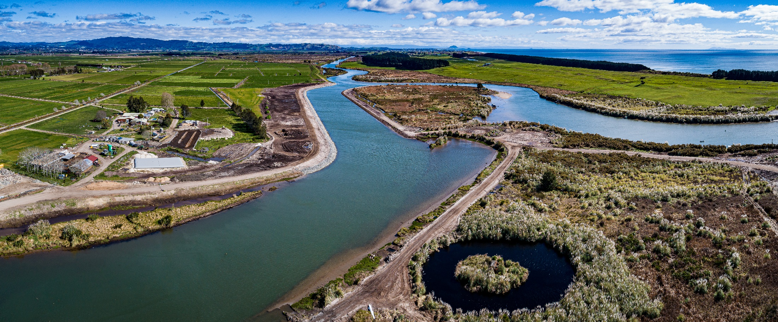
He patai, any questions?

