Slide 1
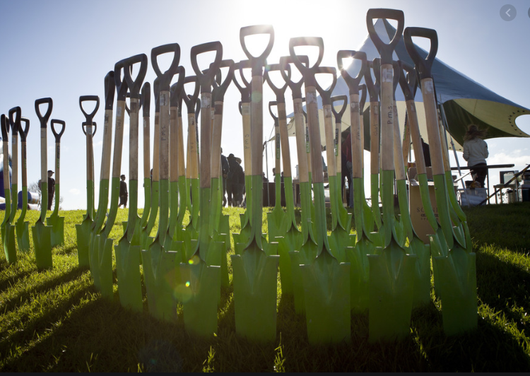
Post-COVID projects opportunities for winning Central government co-funding for stimulating local employment in the Bay of Plenty

Slide 2
Regional Recovery

Slide 3
Various funding categories
Provincial Development Unit Funding
Crown Infrastructure Partners bids
Green Projects, bids coordinated by MfE
One Billion Trees programme funding
PDU “riparian enhancement” fund
Department of Conservation programme

Slide 4
Provincial Development Unit Funding
Council CEOs were asked for ideas in March on what work might be offered to local forestry crews, who were affected earlier than most sectors
WDC invited BOPRC to co-submit ideas
BOPRC projects are regional - not just in Whakatāne District
BOPRC projects include track clearance and pest plant work mainly, including coast-care, wilding trees etc.
Any funds approved must be spent in the following six months: pre-qualified panel contractors would engage COVID-impacted workers where possible.
Social Procurement requirements to be applied

Slide 5
Crown Infrastructure Partners
A Summary of the three BOPRC bids
Project 1 | Total cost | Employment benefit | Location
Rangitāiki River Community Resilience and Flood Protection | $13.7M | 54 FTEs | Whakatāne District
Project 2 | Total cost | Employment benefit | Location
Implementing Ngongotahā Stream Independent Review | Civil works $1-2M Detainment bunds $0.7M At risk tree removal $1M | ~ 80 FTEs across all five projects | Ngongotahā Stream in Rotorua District.
Kaituna Mole Upgrade | $2.5M |  | Western Bay of Plenty District
Whakatāne River stopbank raising | Tbc |  | Whakatāne District
Waioeka Estuary Concept | Tbc |  | Ōpōtiki District
Rangitāiki Floodwalls resilience | ~ $3M |  | Whakatāne District
Project 3 | Total cost | Employment benefit | Location
Modernising our scheme drains to best practice standards | ~ $20M | ~30-40 (est) FTEs | Kaituna plains, Rangitaki-Whakatāne plains and Opotiki

Slide 6
Green Projects (Regionwide)
Modernising scheme drains to best practice
Fish Care BOP (improving fish passage in streams)
Upgrading Bay of Plenty Marae On-Site Wastewater Systems
Bay Conservation Cadets programme
Coastal Bay of Plenty Pest Plant Service Delivery
Priority Ecosystem Management (Priority Biodiversity Sites on private land)
Japanese walnut control and other weeds - region wide to improve floodplain areas alongside rivers.

Slide 7
Green Projects (Mauao)
Clean Up Tauranga Moana: removing dumped materials and derelict structures;
Toitu Te Awanui;
Te Maru O Kaituna River Authority Action Plan Implementation;
Tauranga Moana Coastal Wetlands Restoration;
Maketū estuary and lowland biodiversity initiatives;
Waihī Estuary enhancement initiatives;
Habitat Enhancement & Landcare Partnership (Katikati);
Kauri Dieback surveillance: Soil sampling;
Kaimai Mamaku Ranges Integrated Animal Pest Control Plan.

Slide 8
Green Projects (Okurei)
Tarawera Catchments Pest and Weed Control and Ka whakamōtī te Ka poti - Catfish eradication;
Aukatia te Hora - Stop the Spread and Ngakia ngā taru wai - Aquatic weed Management;
Ka Tāmatatia nga Kūkūwai - Wetland Restoration and Nga Kaiwhakahaere - Management Team;
Wallaby Containment Fence;
Ngongotahā Stream at-risk tree removal & upper catchment detainment bund construction;
Mt Tarawera wilding pines & Te Ariki Isthmus wattle control;
Rejuvenating historic streamside retirement areas in the Rotorua Lakes Catchments;
Restoration of the banks of the urban reaches of the Puarenga and Utuhina Streams.

Slide 9
Green Projects (Kohi)
Raukūmara Pae Maunga Project
Te Whānau Apanui Biodiversity Hub
Minginui plant pest clearance and native planting
Waioeka Estuary concept
Otara River Whitebait enhancement proposal
Priority Ecosystem Management projects
Whakatāne PDU projects (track work, pest control)
Japanese walnut control and other woody weeds - reducing floodplain risks alongside rivers.

Slide 10
One Billion Trees
Council has recently been awarded a $700k partnership agreement through Te Uru Rakau’s 1BT programme
This will increase as the number and scale of planting projects rise in the region.

