Slide 1
Te Hononga
The Māori Engagement Plan for the NPSFM 2020
Strategy and Policy Committee
18 June 2020

Slide 2
Contents
Overview of the NPSFM 2020 project
Te Hononga
A partnership approach
Engagement Options
Kaupapa Māori workstream
Timeframes and obligations
Questions/discussion

Slide 3
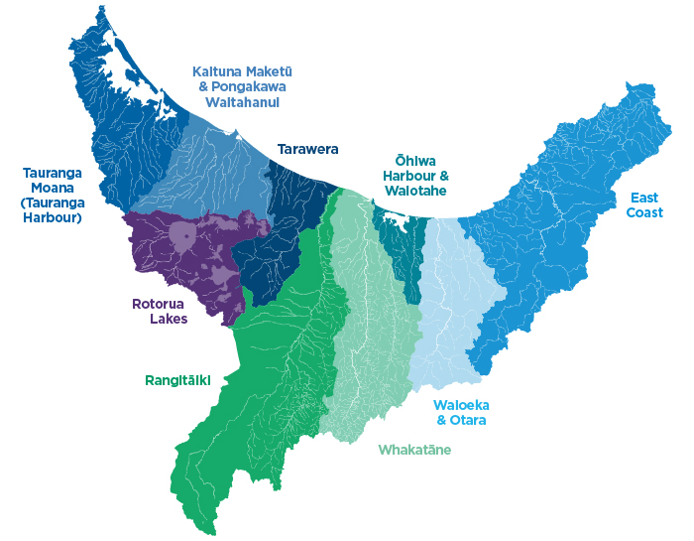
Overview of the Project
Currently progressing:
Water quality and quantity objectives, limits, rules/methods for Water Management Areas
Staged – finishing Dec 2030
Rolling review of the Regional Natural Resources Plan
Involving iwi and hapū

Slide 4
NPSFM 2020 may require …
Completion by end of 2024
Stronger recognition of Māori values and involvement – Te Mana o te Wai, compulsory māori values
New requirements – e.g., for monitoring, reporting, wetlands and streams.

Slide 5
NPSFM 2020 work programme
Reporting to Strategy and Policy Committee after NPSFM 2020 is gazetted
Stronger collaboration and partnership arrangements with iwi
Progress all WMAs and review RNRP at once
One RPS and one RNRP change by 2023

Slide 6
Te Hononga and HKM

Slide 7
Te Hononga & HKM
Purpose
To initiate a partnership approach with Māori for NPSFM implementation.
He Korowai Mātauranga (Muka 2 & 3)
Bridging the gap – developing ways in which relationships with Māori can be enhanced through collaboration.
Utilising and protecting mātauranga Māori to better inform policy provisions in plans relating to kaupapa Māori.

Slide 8
Te Whakapapa o Te Hononga

Slide 9
A partnership approach
Te Hononga proposes the following options for engagement arrangements – SUBJECT TO DISCUSSIONS WITH MĀORI:
Taiao Hubs
Kaitiaki References Groups
Sub-regional hui
Consultant/contractors
Options proposed by Māori (within the framework of the NPSFM 2020)
Komiti Māori
Co-governance entities
NB: These options may be combined or standalone

Slide 10
Kaupapa Māori Workstream
Proposed actions/tasks are:
Te Mana o te Wai framework
Identifying cultural values and interests in freshwater
Reflecting culturals values in freshwater objectives, limits and allocation
Mātauranga Māori monitoring indicators
Review of Kaitiakitanga chapter of the RNRP

Slide 11
Timeframes/milestones
Phase 1 June – August 2020
early discussions/set up of engagement options
Phase 1 – early discussions/set up of engagement options
Phase 2 September 2020 – September 2022 engagement/research/
policy development/plan review
Drafting and finalisation of plan change October 2022 – October 2023

Slide 12
Discussion

