Slide 1
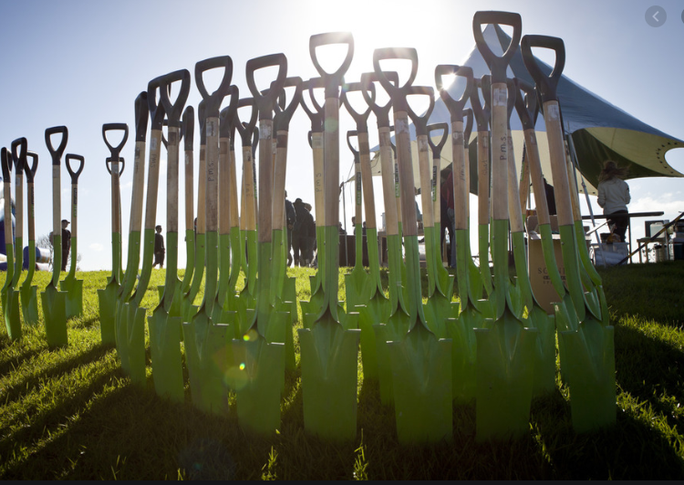
Post-COVID projects Central government co-funding and employment opportunities in the Bay of Plenty

Slide 2
Purpose of Briefing
Request by Māori Councillors
Overview of funding bids and opportunities to generate work in the region
Projects that have positive outcomes for the Taiao
Seeking advice on how to involve and engage Maori

Slide 3
Overview : Projects & opportunities to involve Maori
Provincial Growth Unit: forestry crew work
Crown Infrastructure Partners bids
Green Projects, coordinated by MfE
One Billion Trees programme
Procurement
Next steps

Slide 4
Provincial Growth Unit funding
Whakatāne District Council was asked to submit a list of unfunded jobs that could be done by forestry crews, who were affected earlier than most sectors
WDC invited BOPRC to co-submit
A list valued at $8.3M was submitted, including $2.1M in BOPRC projects
MBIE has contracted WDC for all of this work through the PGU announced by Minister Jones 27 May
BOPRC will manage track clearance and pest plant work over the next six months with contractors engaging people whose employment has been COVID-affected

Slide 5
Crown Infrastructure Partners (CIP)
A Summary of the BOPRC three CIP Bids
Project 1 | Total cost | Employment benefit | Location
Rangitāiki River Community Resilience and Flood Protection | $13.7M | 54 FTEs | Whakatāne District
Project 2 | Total cost | Employment benefit | Location
Implementing Ngongotahā Stream Independent Review | Civil works $1-2M Detainment bunds $0.7M At risk tree removal $1M | ~ 80 FTEs across all five projects | Ngongotahā Stream in Rotorua District.
Kaituna Mole Upgrade | $2.5M |  | Western Bay of Plenty District
Whakatāne River stopbank raising | $3 – 4M |  | Whakatāne District
Waioeka Estuary Restoration and Floodway enhancement | $3.5-4M |  | Ōpōtiki District
Rangitāiki Floodwalls resilience | $3M |  | Whakatāne District
Project 3 | Total cost | Employment benefit | Location
Modernising our scheme drains to best practice standards | $21M | 30-40 (est) FTEs | Kaituna plains, Rangitaki-Whakatāne plains and Opotiki

Slide 6
Green Projects (Regionwide)
Modernising scheme drains to best practice
Fish Care BOP
Upgrading Bay of Plenty Marae On-Site Wastewater Systems
Bay Conservation Cadets
Coastal Bay of Plenty Pest Plant Service Delivery
Priority Ecosystem Management (Priority Biodiversity Sites)
Japanese walnut control - region wide

Slide 7
Green Projects (Mauao)
Clean Up Tauranga Moana: dumped materials and derelict structures removal
Toitu Te Awanui
Te Maru O Kaituna River Authority Action Plan Implementation
Tauranga Moana Coastal Wetlands Restoration
Maketū estuary and lowland biodiversity initiatives
Waihī Estuary enhancement initiatives
Habitat Enhancement & Landcare Partnership [HELP] (Katikati) Inc
Kauri Dieback surveillance: Soil sampling
Kaimai Mamaku Ranges Integrated Animal Pest Control Plan

Slide 8
Green Projects (Okurei)
Tarawera Catchments Weed Control
Ka whakamōtī te Ka poti - Catfish eradication
Aukatia te Hora - Stop the Spread
Ngakia ngā taru wai - Aquatic weed Management
Ka Tāmatatia nga Kūkūwai - Wetland Restoration
Nga Kaiwhakahaere - Management Team
Wallaby Containment Fence
Te Maru O Kaituna River Authority Action Plan Implementation
Priority tree removal - Ngongotahā Stream.
Mt Tarawera wilding pines
Ngongotahā Catchment Detainment Bund Construction
Te Ariki Isthmus wattle control
Acquisition and conversion of a dairy farm in the Lake Rotorua Catchment (CONFIDENTIAL)
Tarawera Catchments Pest Control
Rejuvenation of historic retirement areas in the Rotorua Catchments
Restoration of the banks of the urban reaches of the Puarenga and Utuhina Streams
EST TOTAL PROJECT COST
$87,915,000

Slide 9
Green Projects (Kohi)
Minginui landfill plant pest clearance and native planting
Waioeka Estuary Restoration Project (CONFIDENTIAL)
Raukūmara Pae Maunga Project
Te Whānau Apanui Biodiversity Hub
EST TOTAL PROJECT COST
$40,140,000

Slide 10
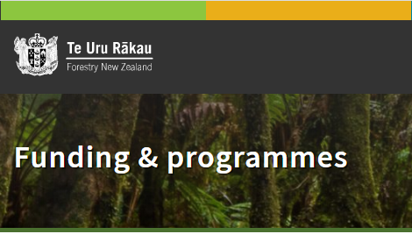
One Billion Trees
Council has recently been awarded a $700k partnership agreement through Te Uru Rakau’s 1BT programme
This will increase the number and scale of planting projects in the region until the end of 2022

Slide 11
PROCUREMENT
Current : Panel of Suppliers;
Contractors (H & S; insurance; equip; quality assurance etc);
Insurance; Equip; Quality Assurance;
Compliance with Funder conditions;
Procurement Policy and Process to be refreshed $50k in AP budget

Slide 12
Next steps
When do we find out?
How will we work?
Capacity to deliver?
Working with Maori?
Meet with Maori to consider opportunities for collaboration
Refresh procurement policy (post AP)

