Slide 1
Wallaby control trial results: Mourea/Tikitere Shane Grayling, Biosecurity Team Leader Dale Williams, Biosecurity Officer

Slide 2
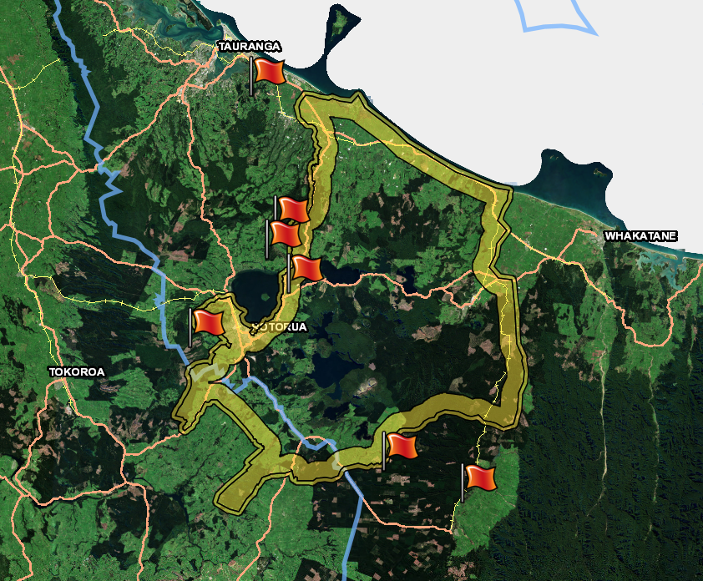
Wallaby control operations
Only control site within ‘Containment Zone’.
Strategic site, possible ‘leak point’.
Reasonably high numbers.
Trialled multiple methods in combination.

Slide 3
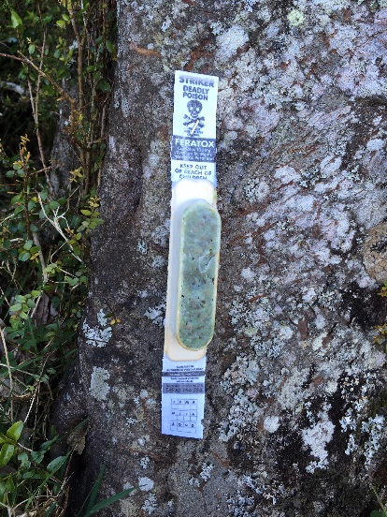
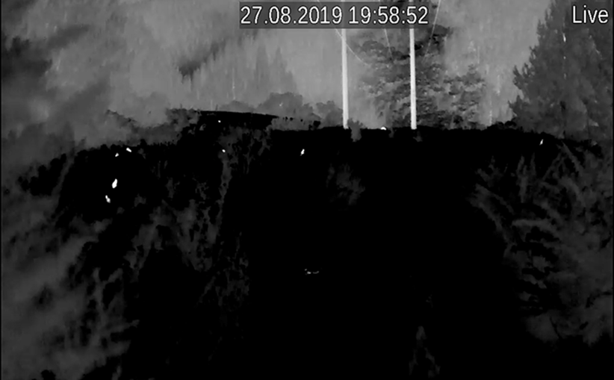
Mourea/Tikitere results
Monitoring showed 71% reduction.
Effectiveness of methods:
Cyanide (Feratox)
Nightshooting (thermal imaging)
Team hunting with dogs (daytime).
Total cost (incl. monitoring) = $40,618 or $60 per hectare.

Slide 4
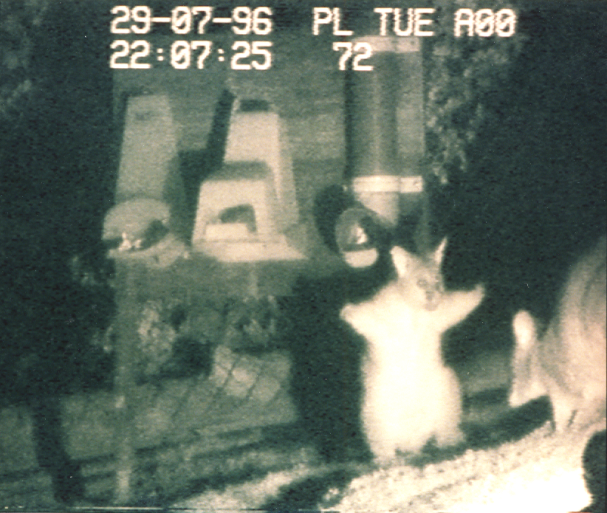
Learnings
Results consistent with other Feratox operations (70% reduction).
Nightshooting with thermal equipment site specific.
Daylight hunting not productive.
Many variables that impact effectiveness (site, season, popn. size, competition).

