Slide 1



He Mahere Taiao mō ngā Wai o Te Arawa
Te Arawa Lakes Environmental Plan 2019

Slide 2
Notes:
Te Tuapapa was lodged with Council in October 2015. We are here today to present He Mahere Taiao which accompanies Te Tuapapa. But we need to first look back to where we started and why

Slide 3

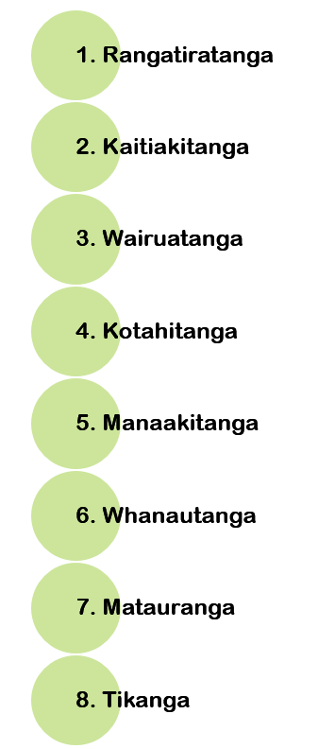
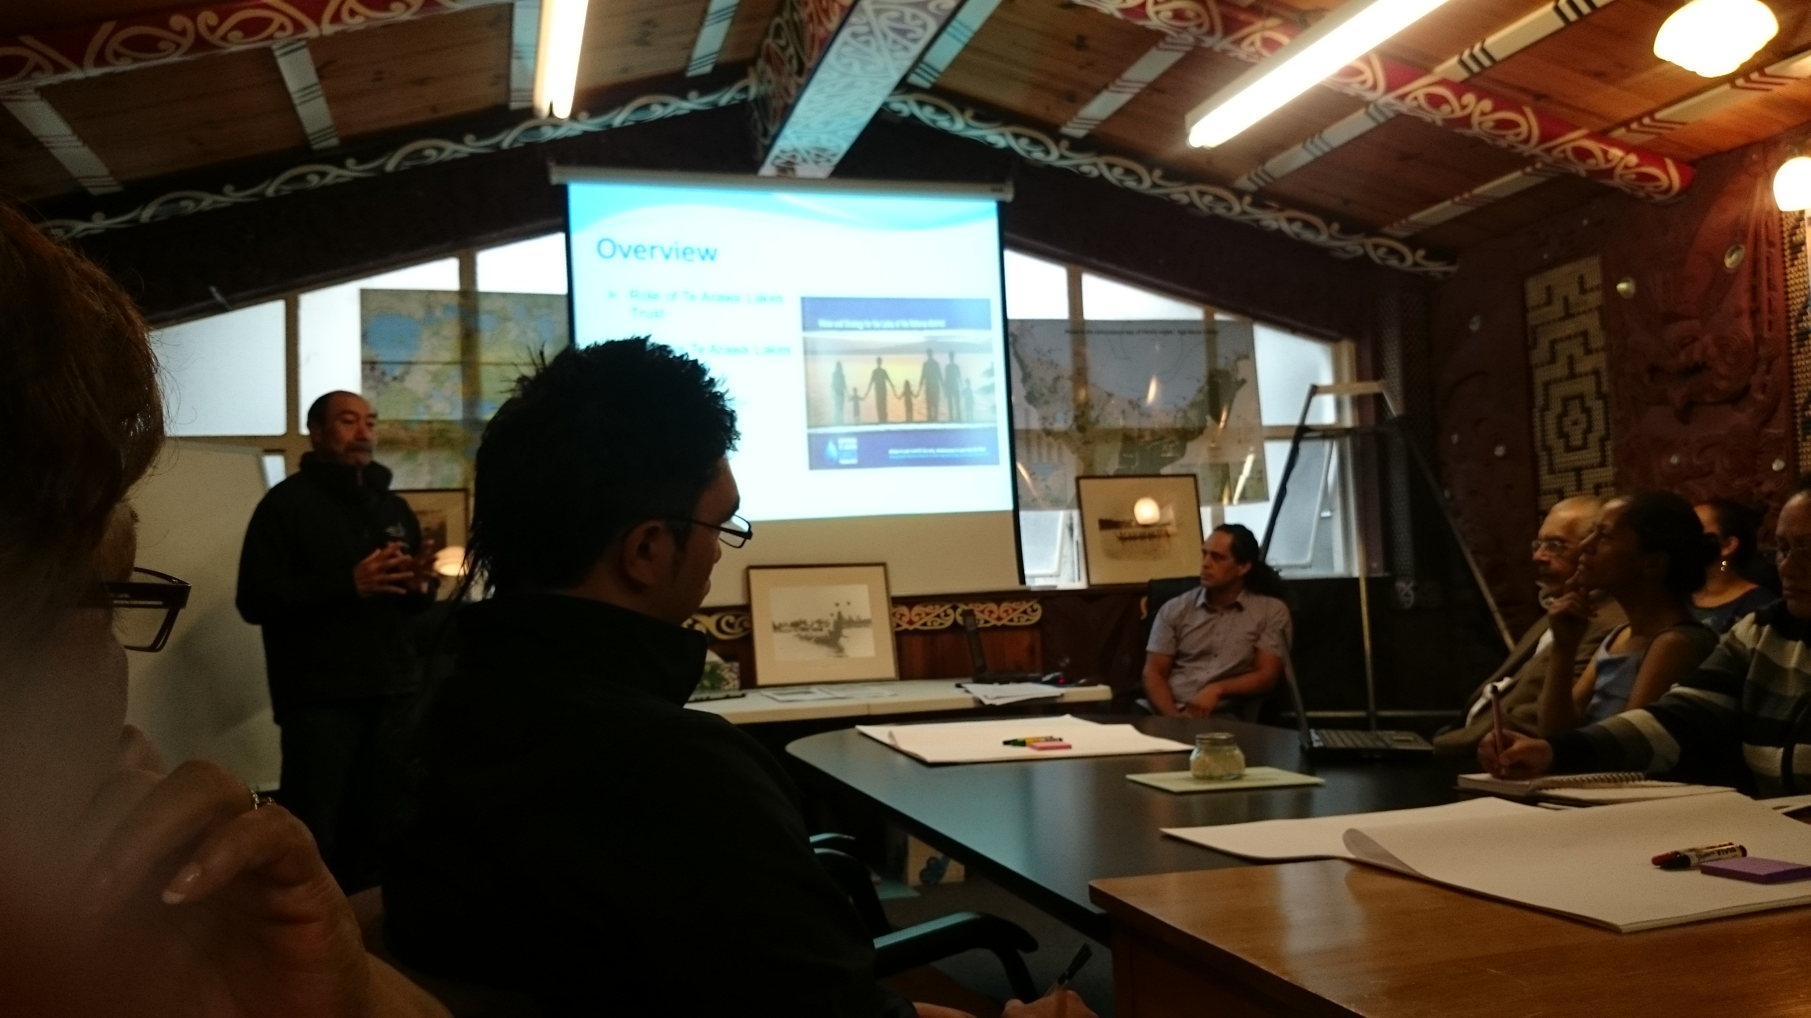
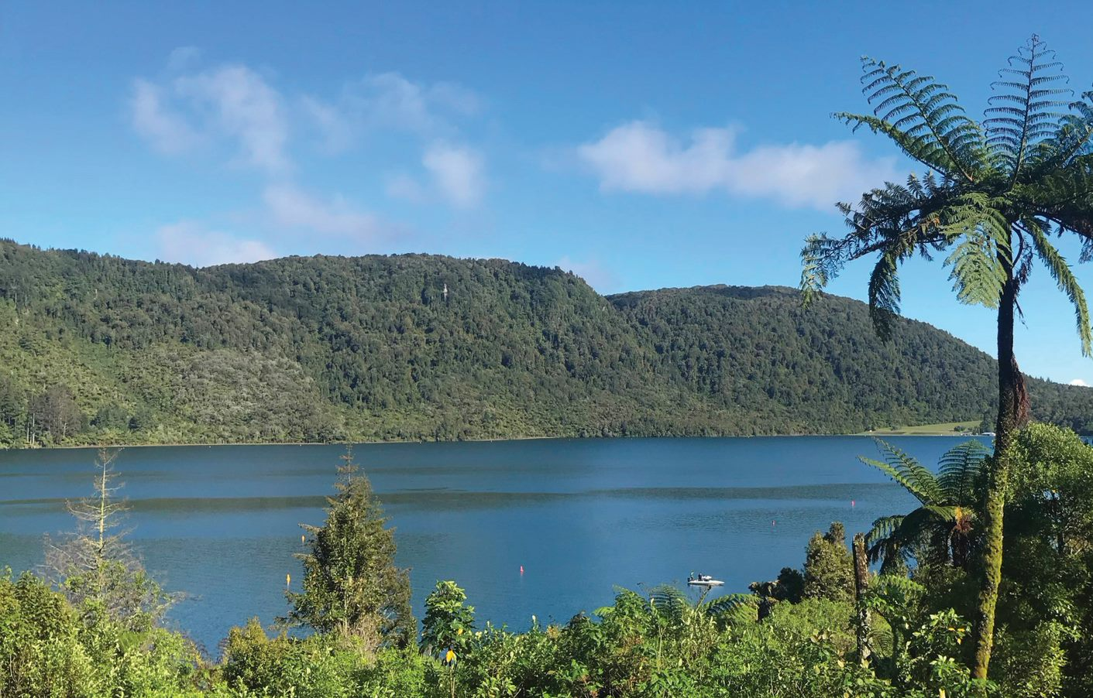
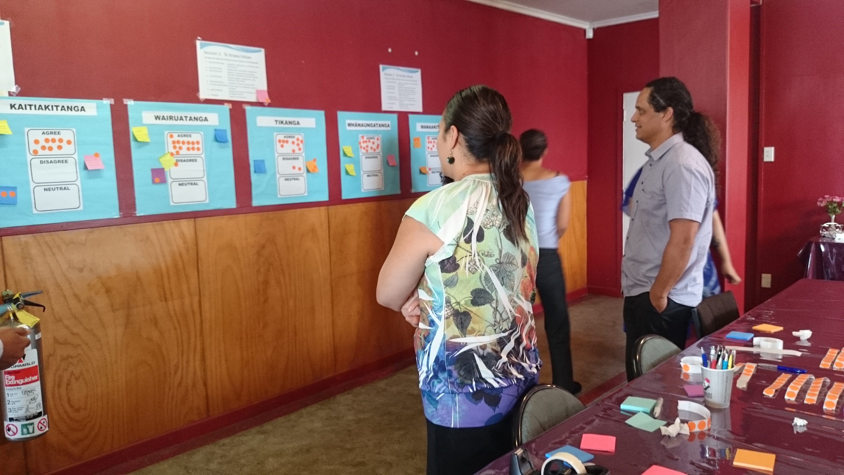
“Goal 4: The lakes catchment is managed through
Te Arawa values”
Lakes Strategy, 2013
Notes:
Initial driver was the Lakes Strategy. Our starting point to use the ‘tangas’, we had lost focus on our WAI. A new day dawned and we started again. Formation of the advisory group.

Slide 4
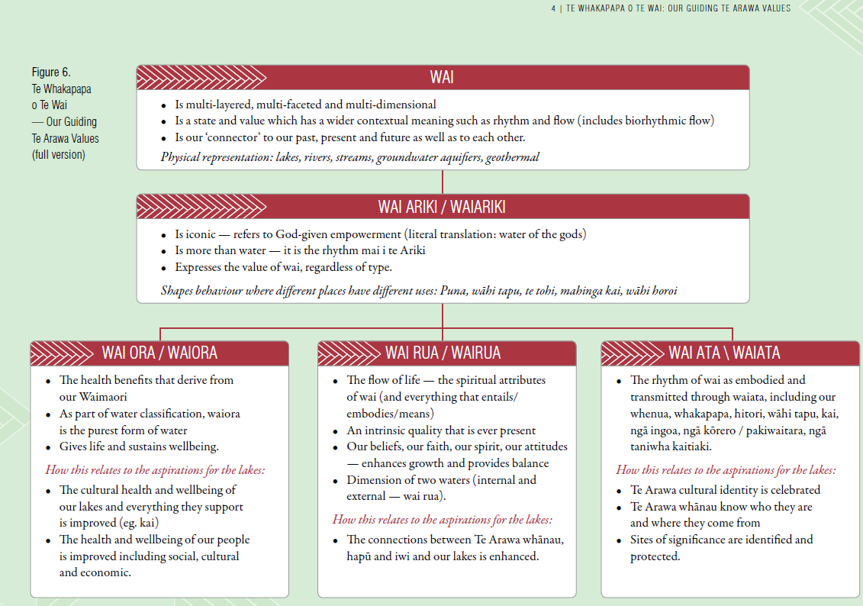
Notes:
Use of two guiding principles to connect the values to action

Slide 5
Notes:
Add korero about scope – relates to all the lakes and includes kaupapa where generalities apply; does not replace the role of iwi/hapū engagement and plans

Slide 6

NGA KAUPAPA
Land Use and Water
Ecosystems and Habitats
Biosecurity and Pest Management
Wai Rua | Wairua:
Our People, Knowledge and Practices
Cultural knowledge and practices
Building capacity and succession planning
Adapting to a changing environment
Wai Ata | Waiata:
Our Special Places
Cultural Identity
Sites, areas and landscapes of cultural significance
Lake structures and activities
Wai Ora | Waiora:
Lake Health and Wellbeing
He Korowai: Governance and Partnerships
  Recognition of Treaty Settlement Outcomes
  Working in Partnership with the Lakes Trust

Slide 7
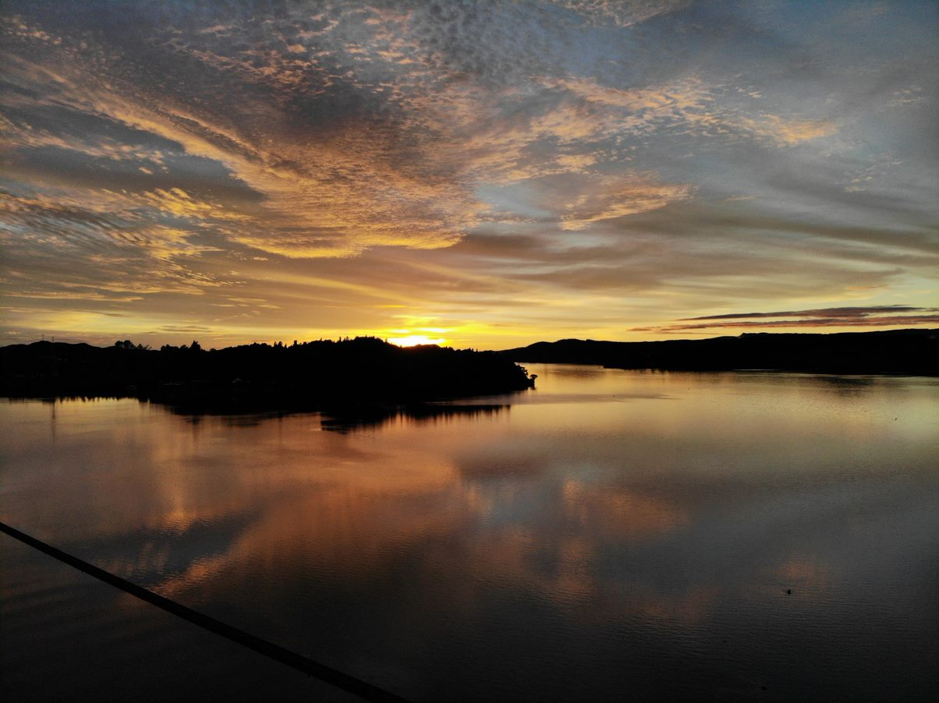
Te Arawa Lakes Trust 1194 Haupapa Street Rotorua

