Slide 1
Change 5 (Kaituna River) to the RPS Nassah Steed, Principal Advisor Strategy & Policy Committee 18 February 2020

Slide 2
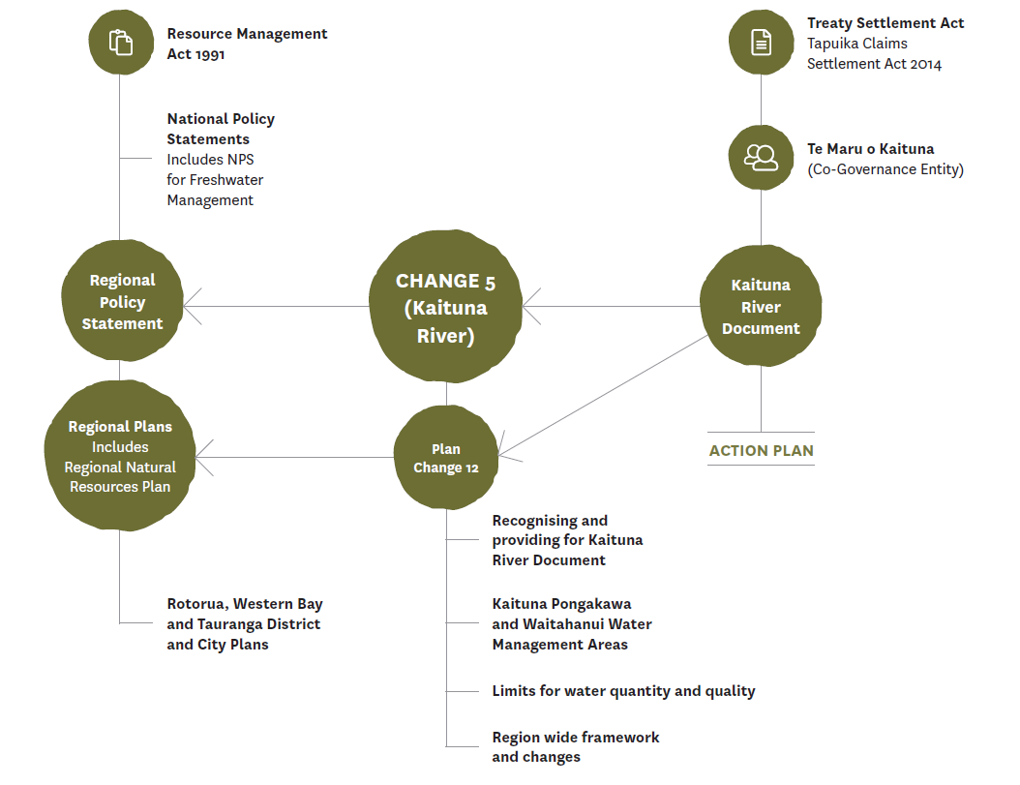
River Doc

Slide 4
Significant issues
Nine River Doc issues (pg 13) distilled to 6:
High water demand
Urban growth, climate change, land use and development pressures on River and wetlands
Declining water quality and impacts on popular swimming spots
Drainage scheme impacts
Tangata whenua disconnected with Kaituna River
Health of Maketū Estuary

