Slide 1

Bay of Plenty Regional Land Transport Plan
Regional Transport Committee- 19 December 2019

Slide 2
Introduction
Context for Regional Land Transport Plan
2018 review process
Overview of Regional Land Transport Plan 2018
Notes:
Topics to be covered

Slide 3
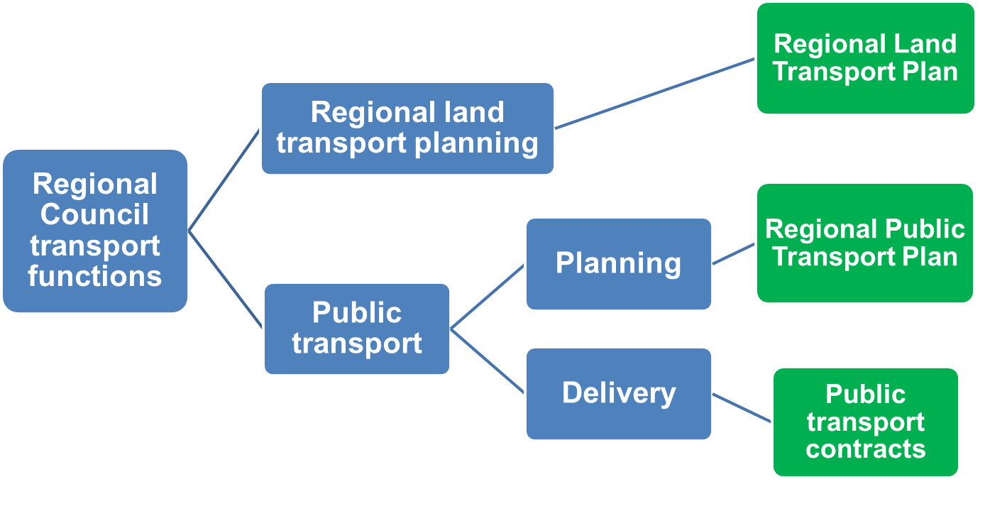
Notes:
Two Regional Council transport functions in legislation
Regional Council generally known for ‘providing bus services’
Also has a transport planning function centred on preparing a Regional Land Transport Plan

Slide 4
Regional Land Transport Planning
Land Transport Management Act:
  Regional Council must establish Regional Transport Committee
  Regional Transport Committee must prepare Regional Land Transport Plan
Notes:
Legislative mandate in LTMA

Slide 5
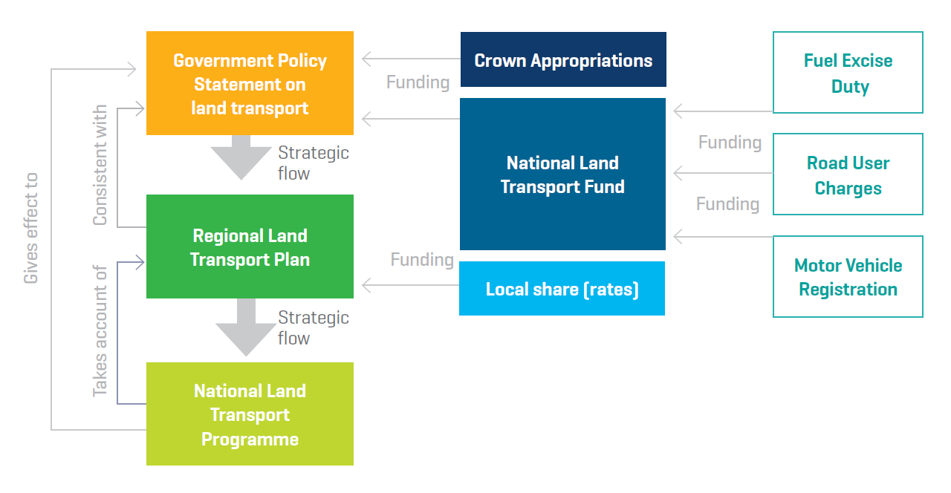
Notes:
RLTP is a key document in the New Zealand land transport planning and funding framework
The GPS sets Government direction
The National Land Transport Programme (NLTP) is developed by the NZTA and ‘gives effect’ to the GPS by allocating investment generated from road users (FEDs, RUCs, regos etc)
Regional Land Transport Plans are developed as inputs into the National Land Transport Programme (they must be ‘taken into account’).

Slide 6
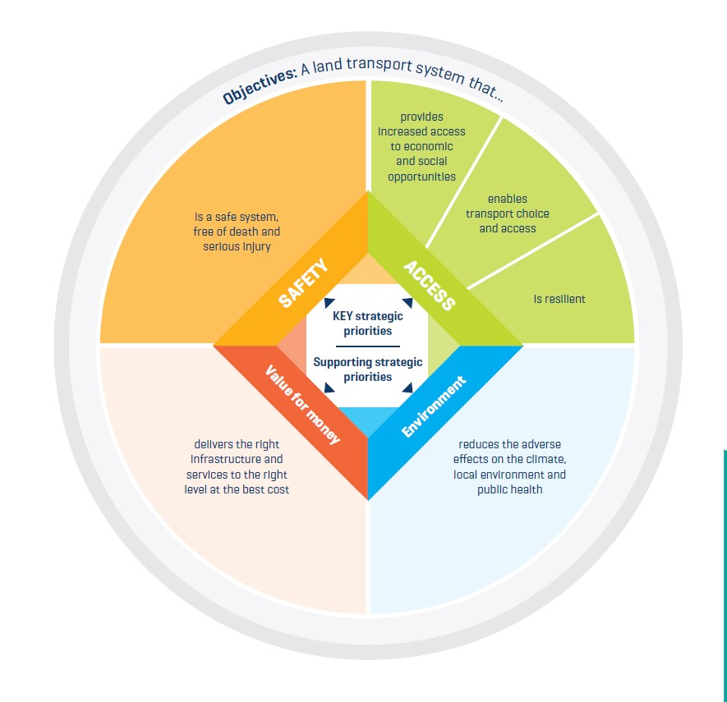
Government Policy Statement 2018

Slide 7
Regional Land Transport Plan
Integrated view of each region’s proposed land transport investment (including local share)
Input into National Land Transport Programme (NLTP)
Prepared (or reviewed) ahead of each NLTP (3 year cycle)
Notes:
In summary…

Slide 8
Regional Land Transport Plan 2018
Strategic Drivers
Society, Economy, Envt, Tech
Strategic Case
Objectives
Quality of life, Safety, Economic Performance
Optimised Tspt system + Safe System
Prioritised Activities
Notes:
Process 2018 review 1350 plus submissions, 94 presenters at hearing, GPS after public submissions before RLTP finalised
Strategic context identifies a range of drivers; key national and international connections; overview of regional transport system
Strategic case identifies key problems and benefits of resolving them; this is used as the basis for assessing and prioritising projects
Benefits translate into a set of 9 overarching objectives within the 3 areas – economic performance, safety and quality of life
The region’s strategic response to the identified problems is an ‘Optimised Transport System’ (a hierarchy of interventions) plus application of the safe system approach…
The RLTP contains a list of significant activities prioritised within their activity classes
Two-thirds of the significant activities have been proposed by Approved Organisations in the Western Bay of Plenty sub-region…

Slide 9
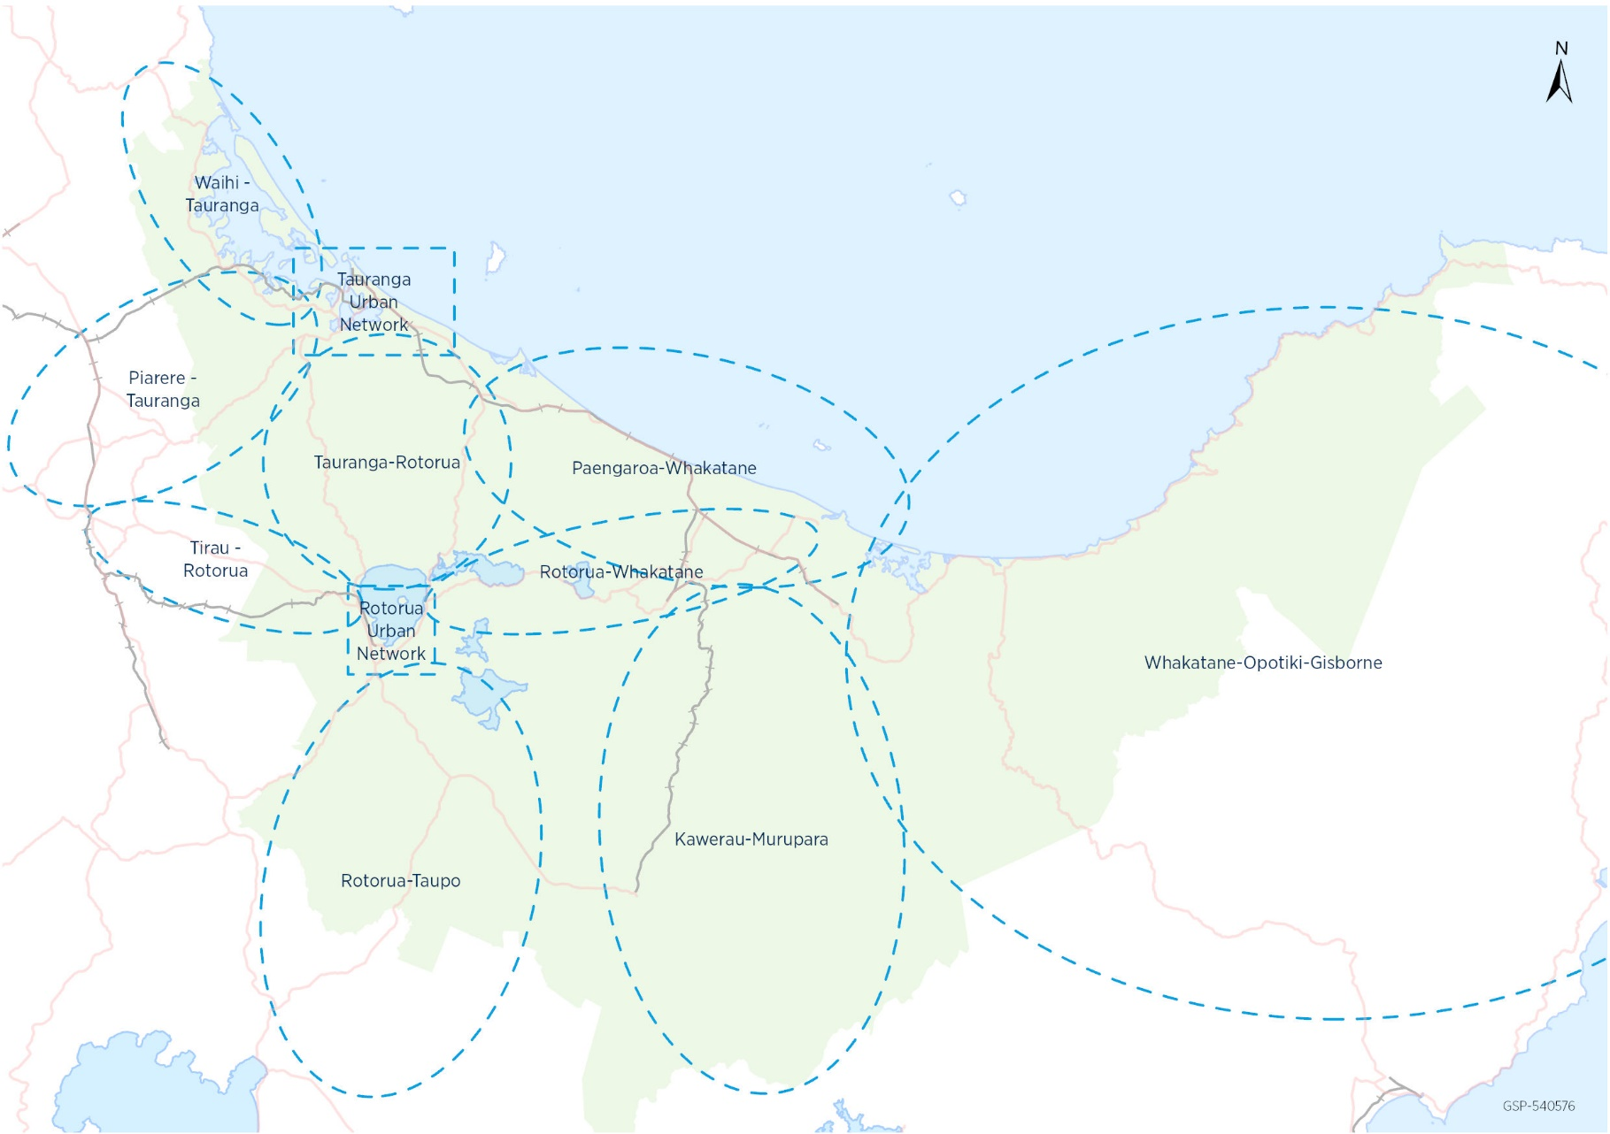
Process
Notes:
There are also a range of other more specific requirements detailed in the LTMA…

Slide 10
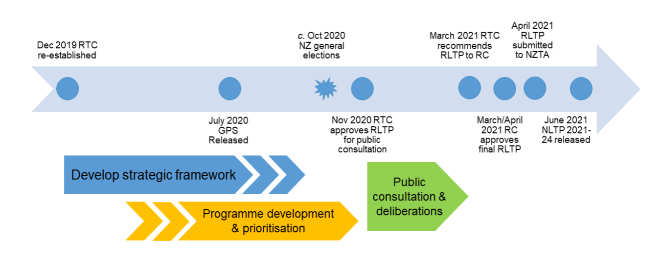
RLTP 2021 Timeframe
Notes:
National
BOP

Slide 11
Options
1. Start at the beginning
2. Build on
3. Meet requirements

