Slide 1
Consent Application RM18-0211
A consent to enable urgent repair works in streams and waterways in the Bay of Plenty

Slide 2
Key Points
Why hold the consent?
Statutory responsibilities and assisting land owners
What type of activities does the consent permit?
Repair bank erosion
Realignment and clearing debris
Clearance and maintenance of stream mouths
Other key points-
Consent 64684 – expired 2018 (operating under s124 RMA while we seek new consent)
Has been in place for 22 years
Used approx. 10-20 times per year – almost exclusively when we are contacted by land owners
Does NOT permit gravel extraction

Slide 3
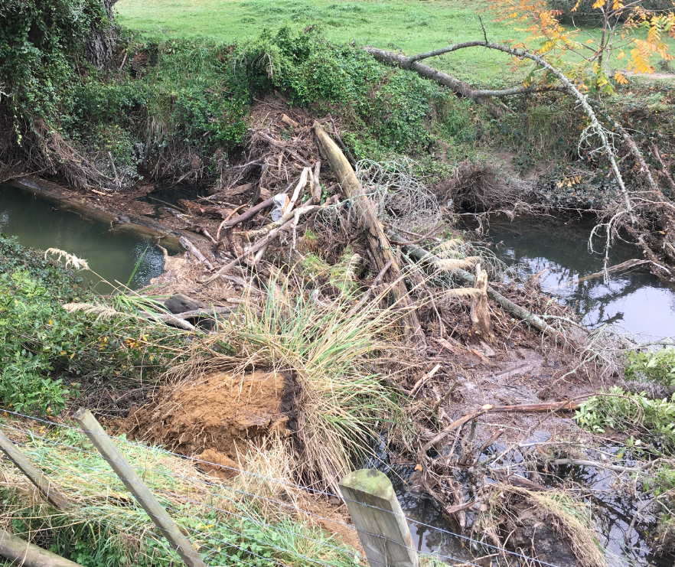
Works example – Rotorua area
Erosion occurring
Flood hazard through dam creation
Flood channel capacity issue

Slide 4
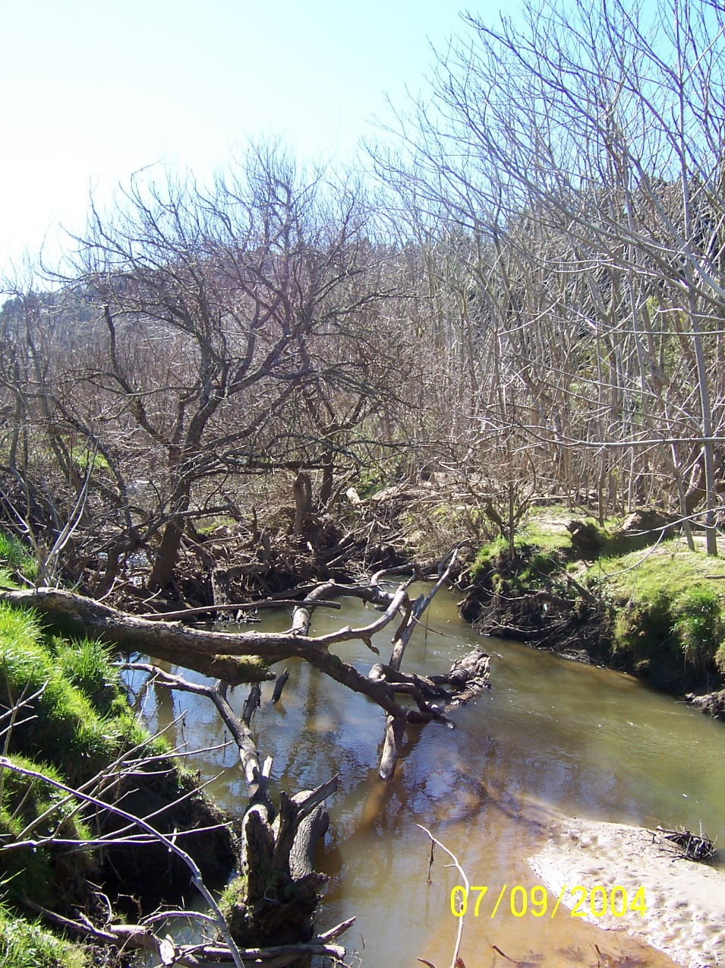
Works example – Ōhiwa/Nukuhou
Sediment build up reducing capacity of stream
Flood hazard through dam creation

Slide 5
Works example – Wairoa River
Riparian planting
Fencing setback

Slide 6
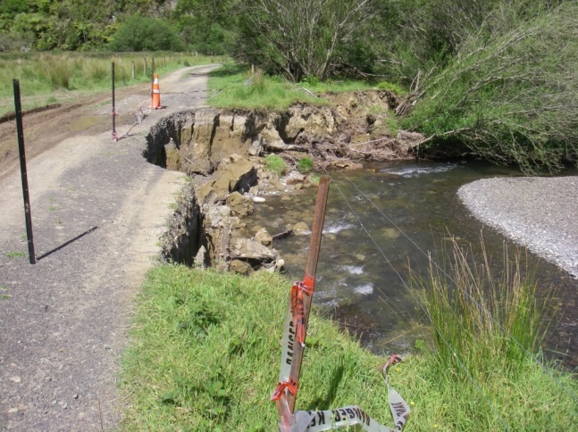
Works example – Pakihi/Opotiki
Problem – access to several properties and Motu Trail cycleway effected
Solution

Slide 7
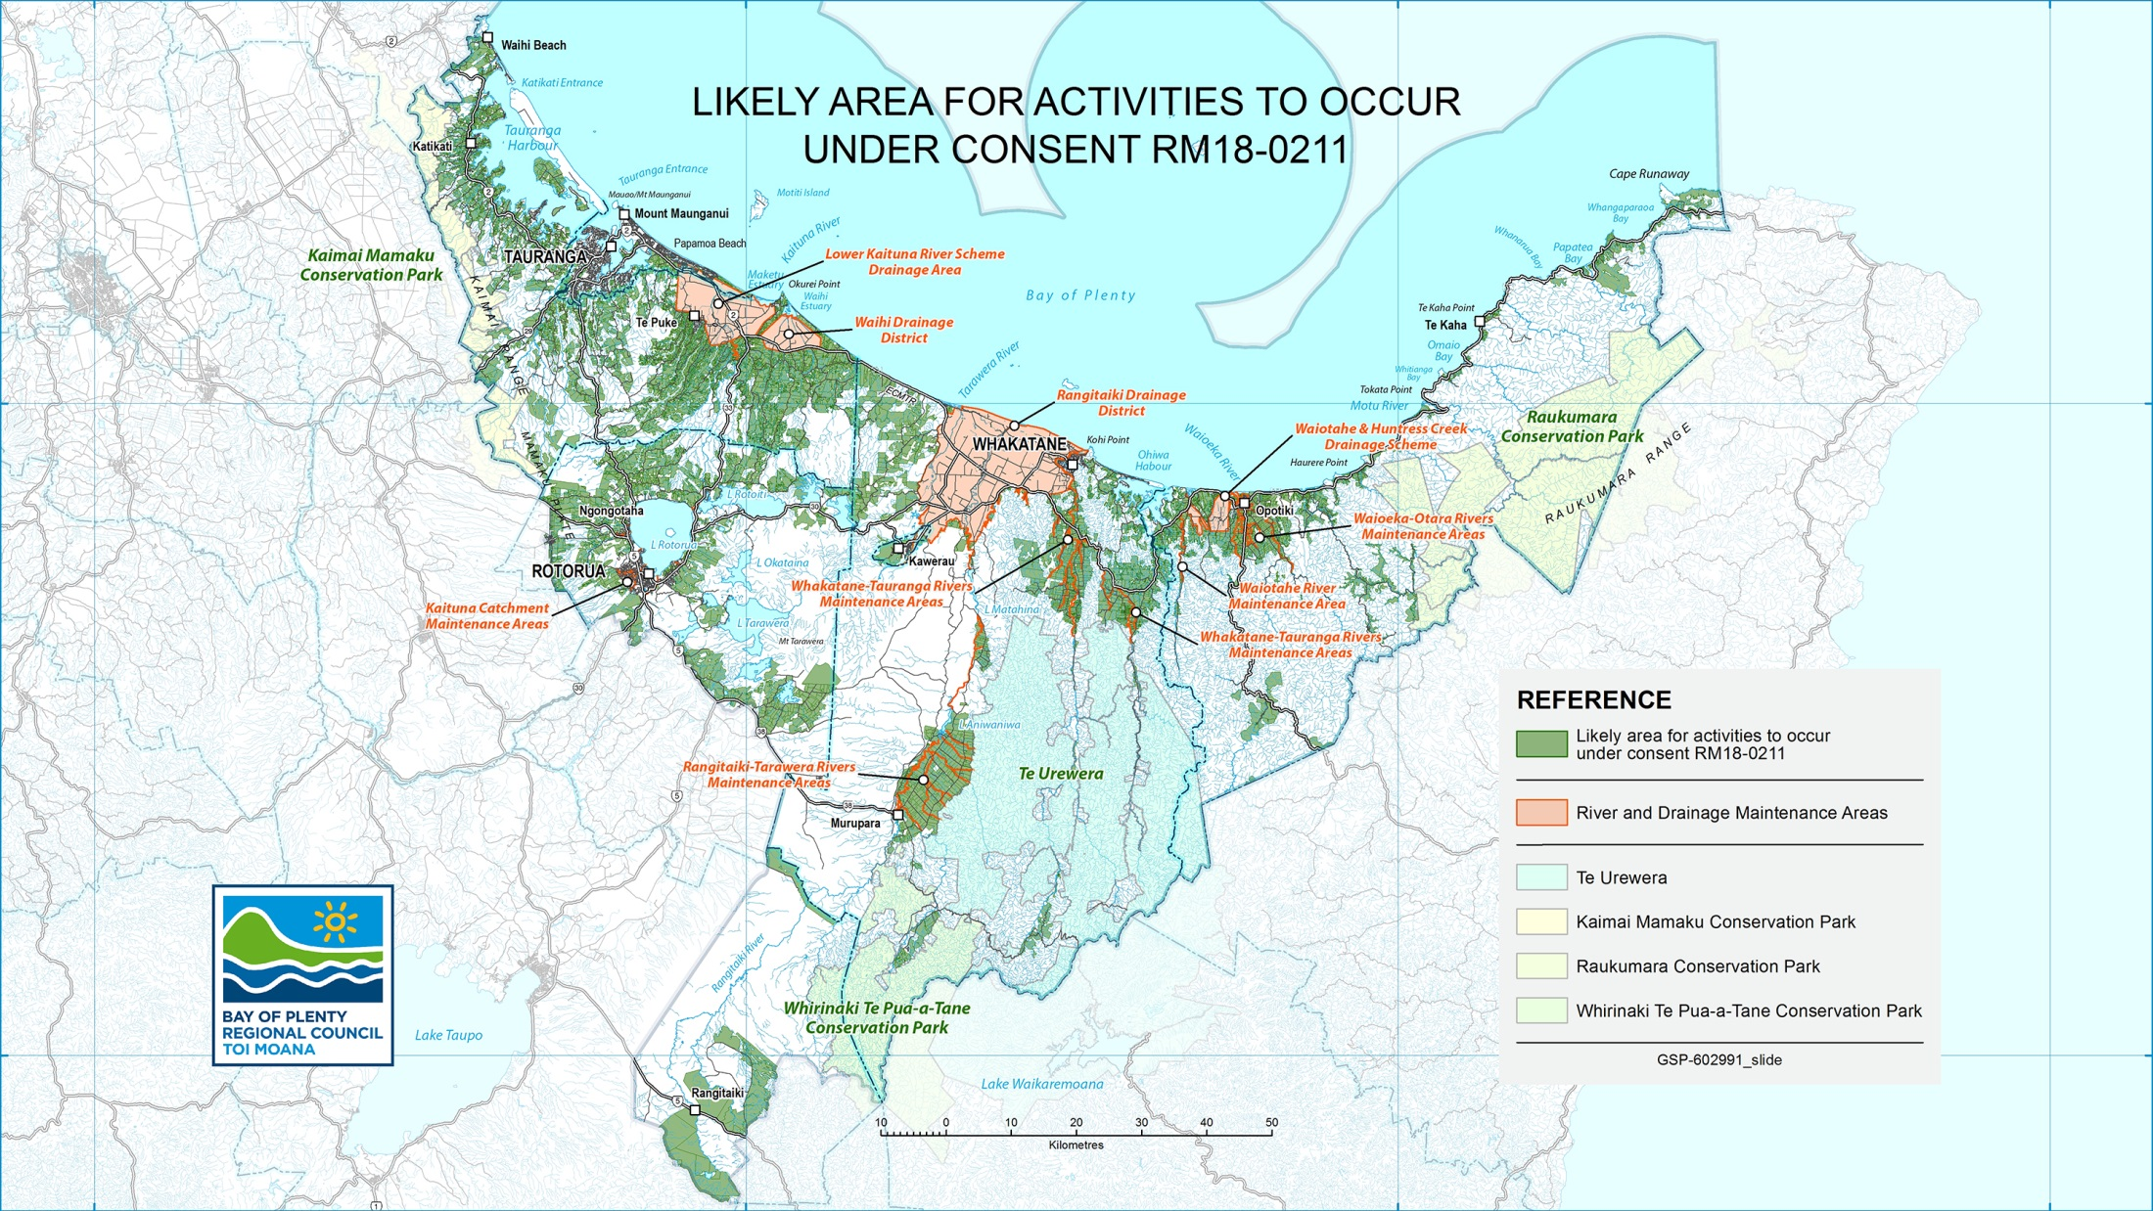

Slide 8
Consultation process
All works proposed under consent will require a Management Plan – currently considering recommending thresholds for:
Minor works (Rotorua example) – simpler process
Larger works (Pakihi example) – more detailed process
Considering recommending increased consultation requirements with Tangata Whenua
Compulsory for all works? Or,
Thresholds? E.g. scale of works – as above. Area identified in IMP?
Providing a narrative around how feedback has been incorporated and giving tangata whenua a chance to comment on management plans

Slide 9
Approximate timeline?
Pre notification consultation (March/April)
Invite to tangata whenua entities and key stakeholders (e.g. TLAs, DOC, F&G, NZTA, ward forums, advisory groups)
Facebook/website/e-newsletter
Notification/Submissions – app. May
Hearings (if required) – app. June
Decision

