Slide 1
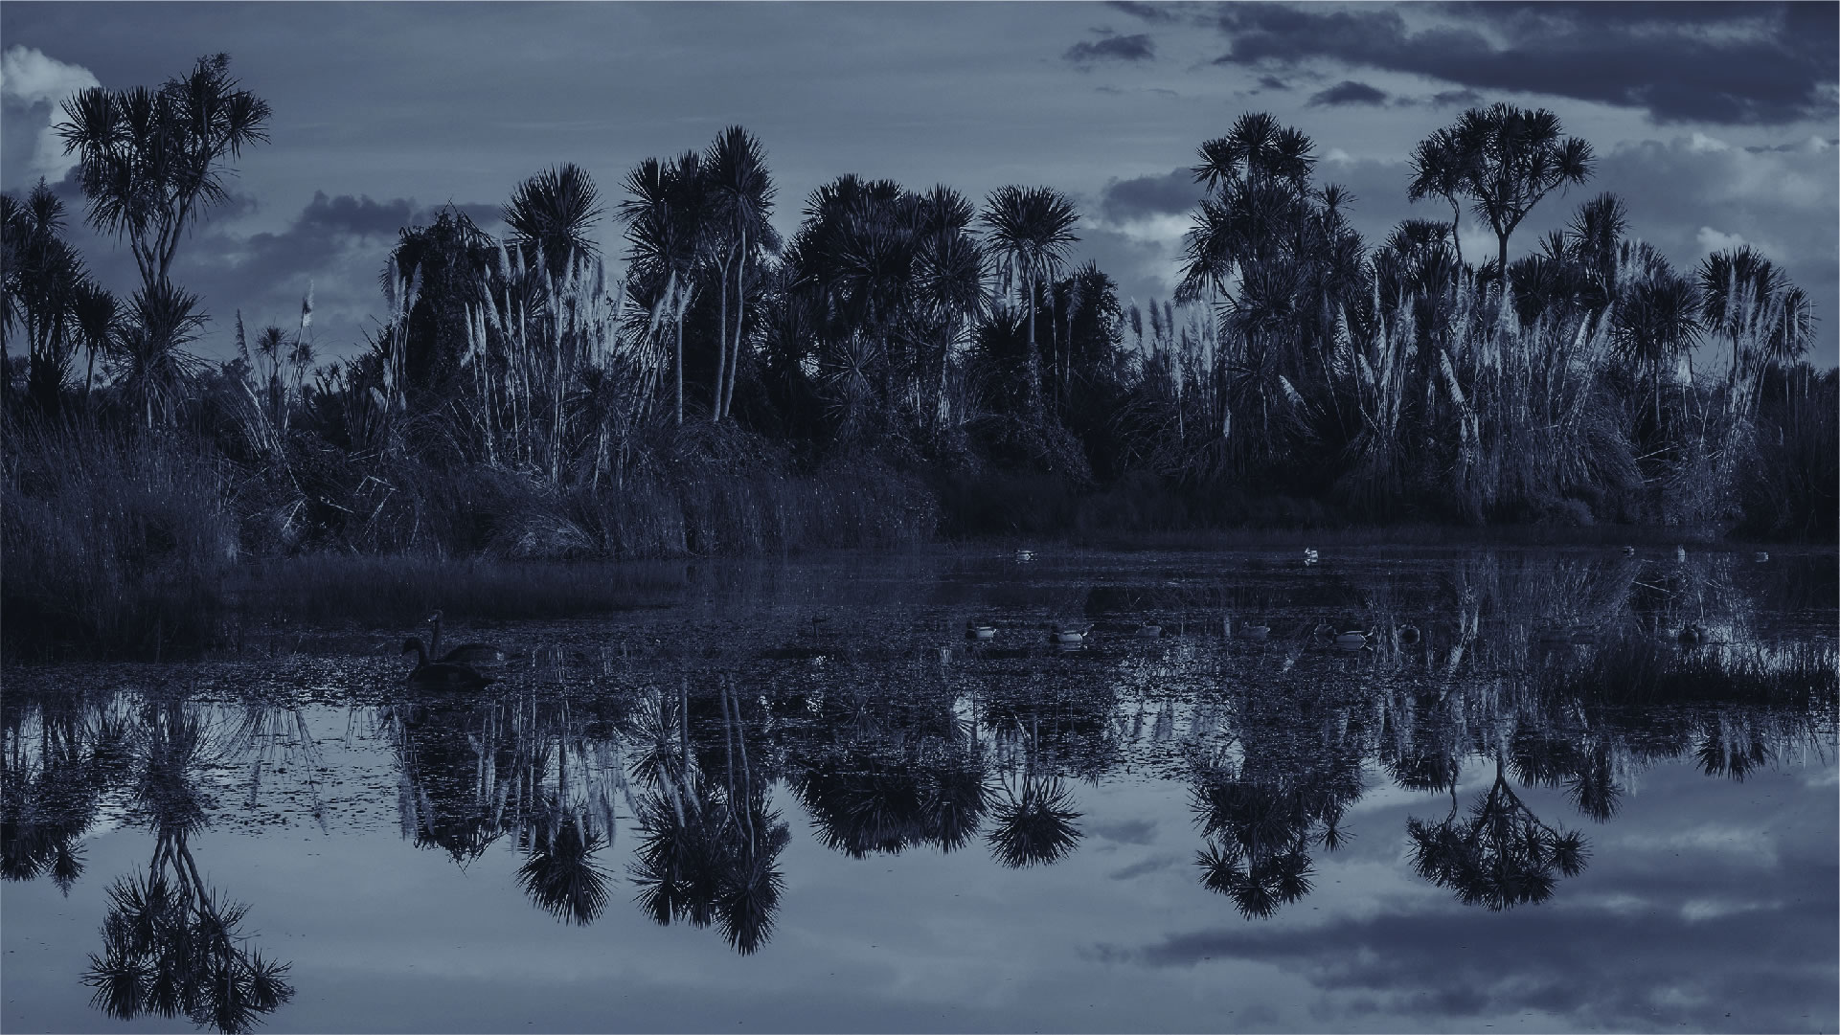
Kaituna Action Plan
Elva Conroy (consultant)
27 September 2019

Slide 2
The Brief: Write an Action Plan
To give life to the Kaituna River Document
AND IN PARTICULAR:
Reflect matters raised in submissions, IMPs etc.
Meet KRD objectives and outcomes, particularly those relating to restoration projects, cultural recognition elements (pou), education and wetlands.
Include clear and measurable actions
Lead to coordinated and collaborative on-the-ground action.

Slide 3
What we will cover today
Engagement outcomes
Plan walkthrough
Next steps
Council direction sought
That the Te Maru o Kaituna River Authority:
Receives the report, Approval of Kaituna Action Plan;
Approves the revised content for the Kaituna Action Plan (word version – content only).
Confirms a working group to guide the plan design process

Slide 4
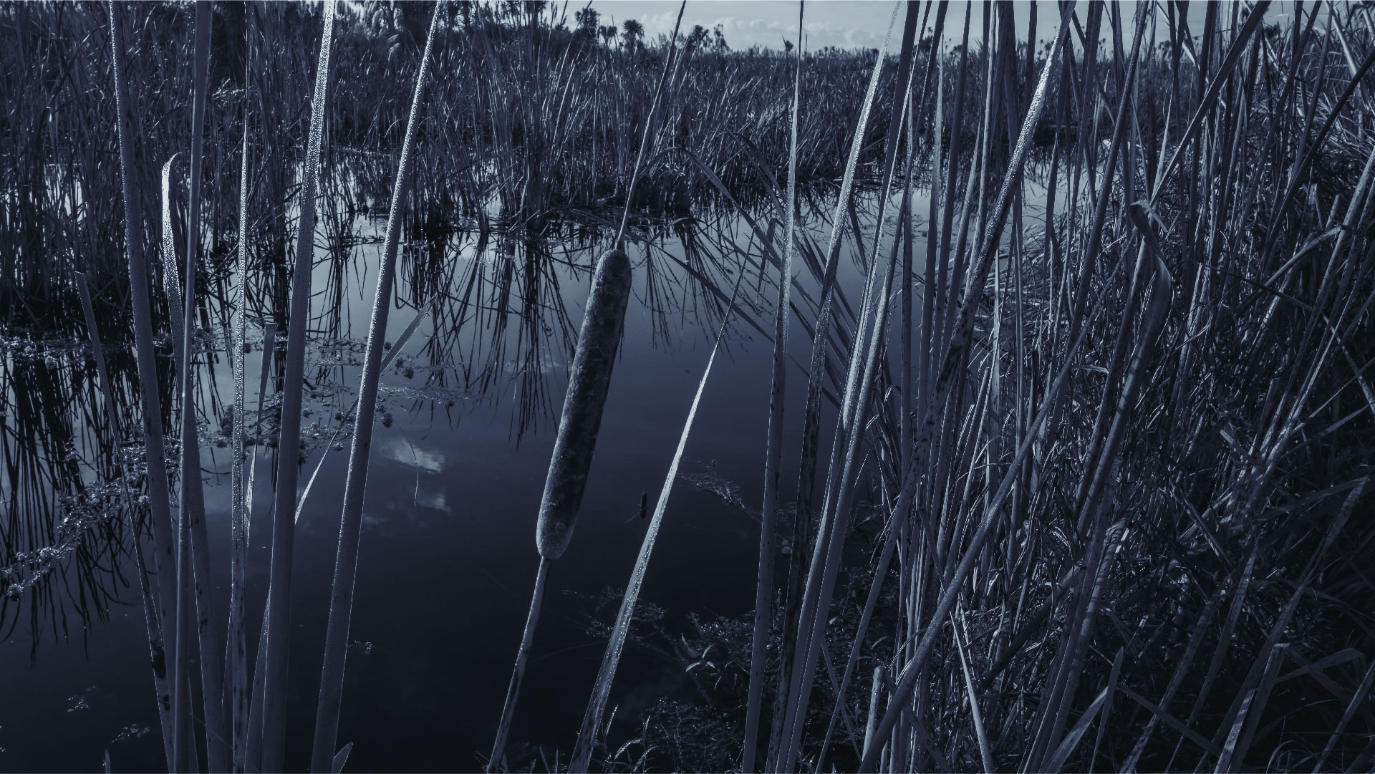
Engagement outcomes

Slide 5
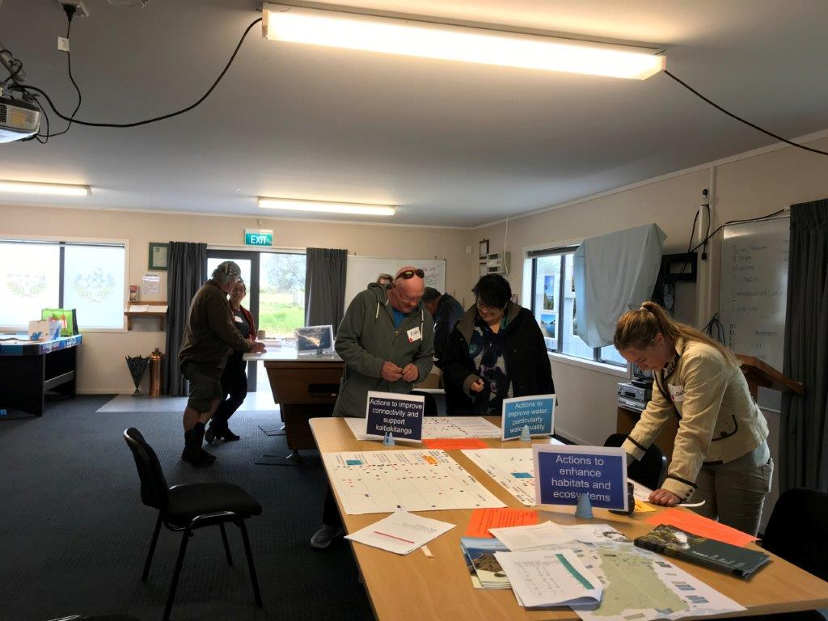
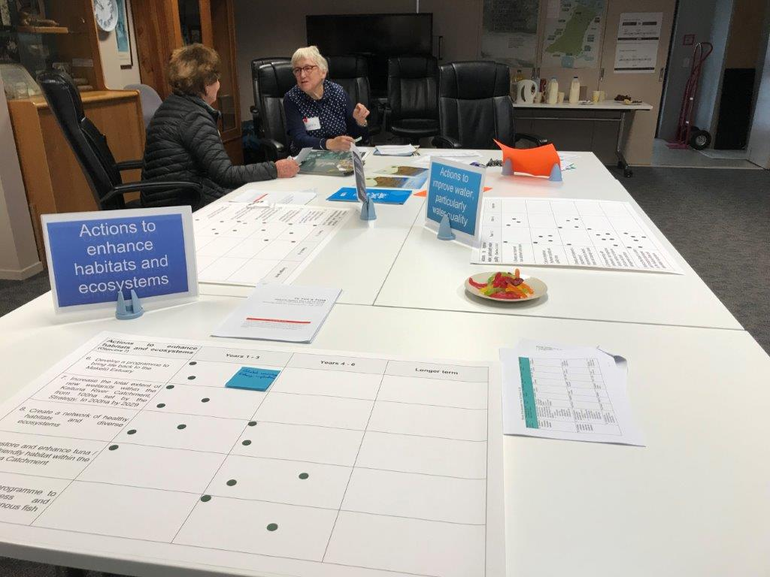
Engagement Overview
Community drop in sessions (Te Puke, Okere, Maketu).
One-on-one meetings (Tapuika whanau, Fish and Game Council, Te Tumu Landowners Group)
Online survey and emails
Also meetings with and/or feedback from, operational staff of each Council

Slide 6
Engagement Themes – drop in sessions

Slide 7
Engagement Overview
General response
What people were supportive of
Things to change or consider
Ideas
Support
Excitement
Tangible projects
Tuna theme & project
Plan simplicity
Enhanced access…in the right places…
Specific actions not just BAU
Annual work programme
Joint Partnerships
Community connector
Heritage – cultural AND historic

Slide 8
Plan walkthrough

Slide 9
Guiding Principles (no change since June)
For this Plan to be successful, Te Maru o Kaituna will do the following:
Kia whakakotahi | Integrated thinking and action - We will take an holistic and whole systems approach to improving the health of the Kaituna River.
Kia whakapiri | Collective action - We will work together to effect positive change for the Kaituna River and all it sustains.
Kia whakamārama | Collective enlightenment – We will share information / stories / data to build our collective awareness and understanding about the Kaituna Catchment.
Kia whakamana | Community empowerment – We will encourage our communities to lead and/or be part of projects within the Kaituna River catchment. This includes tangata whenua, local care groups and schools.

Slide 10
Key changes to the Plan since June meeting
PRIORITY ACTION 1 Take collective responsibility for improving the health and wellbeing of the Kaituna River and its tributaries
PRIORITY ACTION 2 Create a network of healthy and diverse Kaituna habitats and ecosystems
PRIORITY ACTION 3 Connect our communities and visitors to our River and to our projects
Simplified framework (fewer actions)
Actions split by type (priority and supporting)
More clearly defined projects & outputs
Success measures for each priority action
ENABLING ACTION 1 Collect good information about the Kaituna River and its tributaries.
ENABLING ACTION 2 Establish a Kaituna River restoration and enhancement fund.

Slide 11
Key changes to the Plan
Priority Action 1: Take collective responsibility for improving the health and wellbeing of the Kaituna River and its tributaries
Project 1. Lowland drains and drainage canal improvement project
Project 2. Freshwater quality and quantity limits project
Project 4. Focus catchments project
Priority Action 2: Create a network of healthy and diverse Kaituna habitats and ecosystems
Project 6. Post Kaituna River re-diversion enhancement project
Project 7. Wetland Re-creation project
Project 8. Kaituna habitats network project
Project 9. Pātaka Kai Project
Priority Action 3: Connect our communities and visitors to our river and to our projects
Project 10. Kaituna community connection project
Project 11. Kaituna river access project
Project 12. Kaituna Cycleway/Walkway project
Project 13. Kaituna cultural and historical heritage project
Project 15. Coastal Park Network project
Enabling Action 1. Collect good information about the health of the Kaituna River and its tributaries
Project 16. State of the Awa integrated monitoring and reporting project
Project 5. Farm environment plans project
Project 3. Consented takes and discharges project
Enabling Action 1. Establish a Kaituna River restoration and enhancement fund.
Project 18. River restoration and enhancement fund project
Project 17. Kaituna Catchment network mapping project
Project 14. Upper Catchment ‘gateway’ project
Simplified framework (fewer actions)
Actions split by type (priority and supporting)
More clearly defined projects & outputs
Success measures for each priority action

Slide 12
Key changes to the Plan
Priority Action 1: Take collective responsibility for improving the health and wellbeing of the Kaituna River and its tributaries
Project 1. Lowland drains and drainage canal improvement project
Project 2. Freshwater quality and quantity limits project
Project 4. Focus catchments project
Priority Action 2: Create a network of healthy and diverse Kaituna habitats and ecosystems
Project 6. Post Kaituna River re-diversion enhancement project
Project 7. Wetland Re-creation project
Project 8. Kaituna habitats network project
Project 9. Pātaka Kai Project
Priority Action 3: Connect our communities and visitors to our river and to our projects
Project 10. Kaituna community connection project
Project 11. Kaituna river access project
Project 12. Kaituna Cycleway/Walkway project
Project 13. Kaituna cultural and historical heritage project
Project 15. Coastal Park Network project
Enabling Action 1. Collect good information about the health of the Kaituna River and its tributaries
Project 16. State of the Awa integrated monitoring and reporting project
Project 5. Farm environment plans project
Project 3. Consented takes and discharges project
Enabling Action 1. Establish a Kaituna River restoration and enhancement fund.
Project 18. River restoration and enhancement fund project
Project 17. Kaituna Catchment network mapping project
Project 14. Upper Catchment ‘gateway’ project
Types of projects
Existing project
Brand new project
New project comprising initiatives from existing work programmes
Projects led by TMOK:

Slide 13
Our Projects
PRIORITY ACTION 1 Take collective responsibility for improving the health and wellbeing of the Kaituna River and its tributaries
PRIORITY ACTION 2 Create a network of healthy and diverse Kaituna habitats and ecosystems
PRIORITY ACTION 3 Connect our communities and visitors to our River and to our projects
ENABLING ACTION 1 Collect good information about the Kaituna River and its tributaries.
ENABLING ACTION 2 Establish a Kaituna River restoration and enhancement fund.

Slide 14
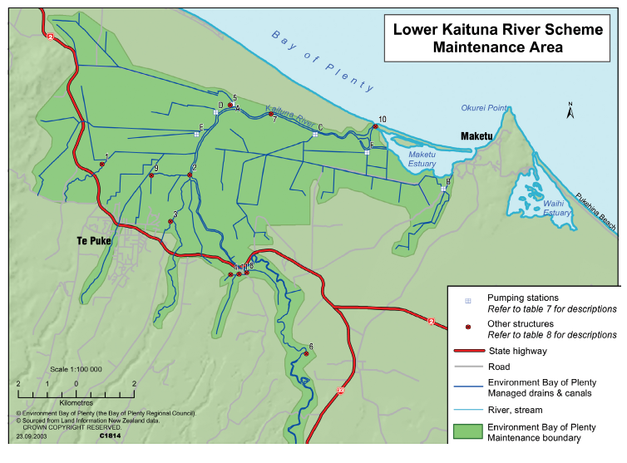
Project 1. Lowland drains and drainage canal improvement project
A continued programme of works to improve water quality, ecological health and fish passage within lowland drains and drainage canals.
Type | New project, comprising initiatives from existing work programmes
Led by | BOPRC
Outputs for 2020-2022 | Rehabilitation plan Ford Rd pump station upgrade
Linkage | Projects 4, 5, 7 and 8

Slide 15
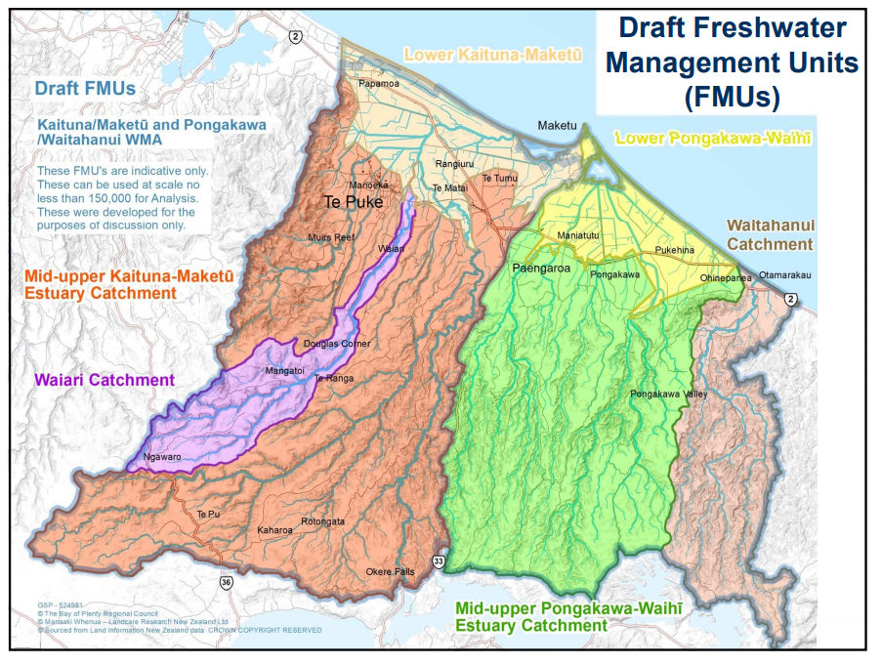
Project 2. Freshwater quality and quantity limits project
The setting and implementation of new objectives and limits for Kaituna rivers, streams and groundwater aquifers.
Type | Existing project
Led by | BOPRC
Outputs for 2020-2022 | Identified objectives and limits Draft Regional Plan Change

Slide 16
Project 3. Consented takes and discharges project
To build TMOK and community awareness and knowledge about the cumulative impacts of consented water takes and discharges on the health and wellbeing of the Kaituna Catchment.
Type | New project, comprising initiatives from existing work programmes
Led by | Te Maru o Kaituna
Outputs for 2020-2022 | Annual reporting consent compliance (BOPRC) wastewater and stormwater management (TCC/WBOPDC/RLC) Stormwater discharges from drainage schemes (BOPRC) Annual meeting with Rotorua Te Arawa Lakes Strategy Group

Slide 17
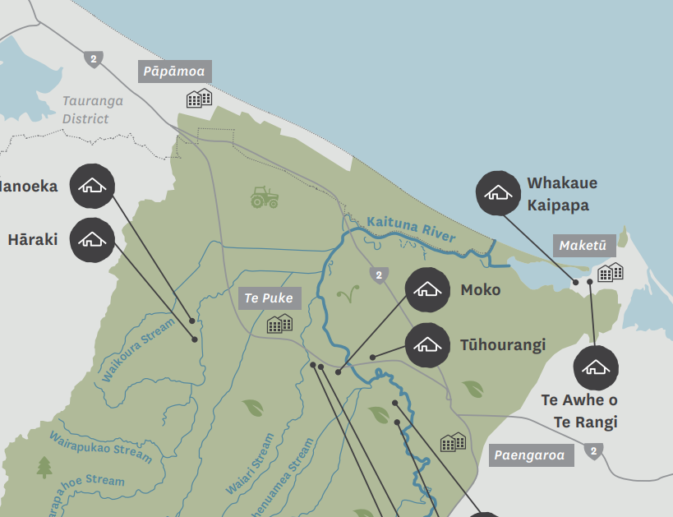
Project 4. Focus catchments project
To identify area-specific solutions to help address catchment-wide issues.
Type | Existing project
Led by | BOPRC
Outputs for 2020-2022 | Action plans for: Kopuaroa Waitepuia/Ford Road Waiari
Linkage | Projects 1, 5, 7 and 8

Slide 18
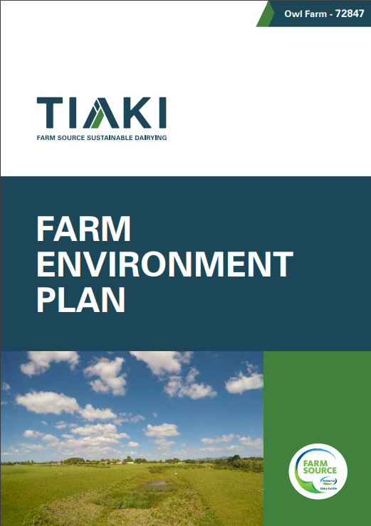
Project 5. Farm environment plans project
To identify property-specific solutions to help address catchment-wide issues. Relates to agricultural and horticultural properties.
Type | Existing project, linked with Project 4
Led by | BOPRC
Outputs for 2020-2022 | Template developed / confirmed Plans progressed for the Lower Kaituna Catchment
Linkage | Projects 1, 4, 7 and 8

Slide 19
Our Projects
PRIORITY ACTION 1 Take collective responsibility for improving the health and wellbeing of the Kaituna River and its tributaries
PRIORITY ACTION 2 Create a network of healthy and diverse Kaituna habitats and ecosystems
PRIORITY ACTION 3 Connect our communities and visitors to our River and to our projects
ENABLING ACTION 1 Collect good information about the Kaituna River and its tributaries.
ENABLING ACTION 2 Establish a Kaituna River restoration and enhancement fund.

Slide 20
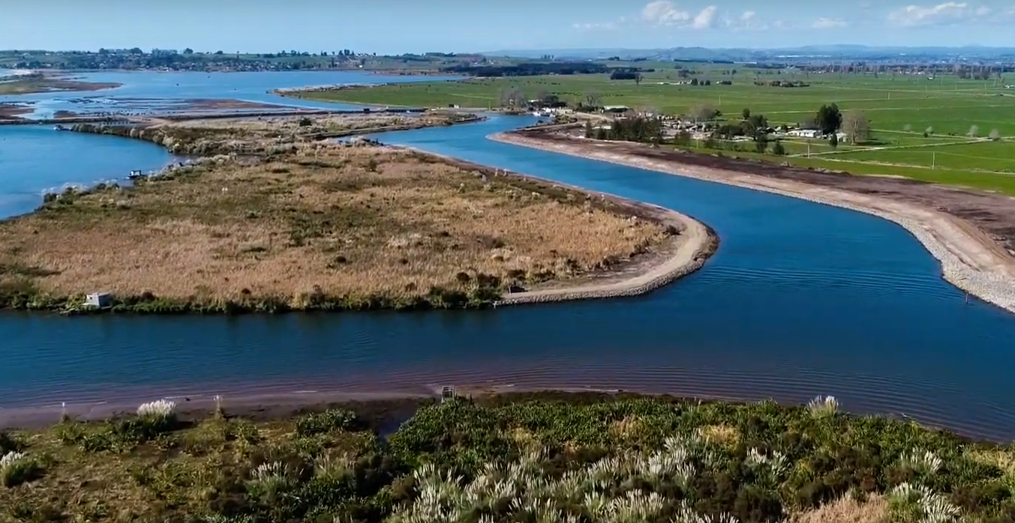
Project 6. Post Kaituna River re-diversion project
A programme of work, post-river re-diversion, to continue to bring life back to the Maketu Estuary.
Type | Existing project
Led by | BOPRC
Outputs for 2020-2022 | Complete and start implementing restoration work programme

Slide 21
Project 7. Wetland Re-creation project
To create an additional 100ha of wetlands over the next 10 years (200ha total since 2009).
Type | Existing project
Led by | BOPRC & landowners
Outputs for 2020-2022 | Te Pā Ika wetland Te Pourepo o Kaituna wetland Whakapoukorero wetland Wetland projects within existing EEF / environmental programmes
Linkage | Projects 1, 4, 7, 8 and 9

Slide 22
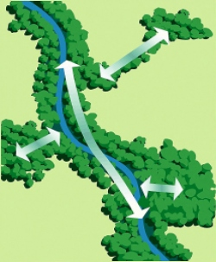
Project 8. Kaituna habitats network project
To create ecological corridors by connecting fragmented corridors of riparian / wetland / estuarine margins.
Type | New project, comprising initiatives from existing work programmes
Led by | BOPRC, WBOPDC and landowners
Outputs for 2020-2022 | Completed work programme, informed by Project 17 (mapping) At lease one habitat network connected
Linkage | Projects 1, 4, 7, 8 and 9

Slide 23
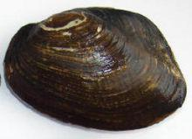
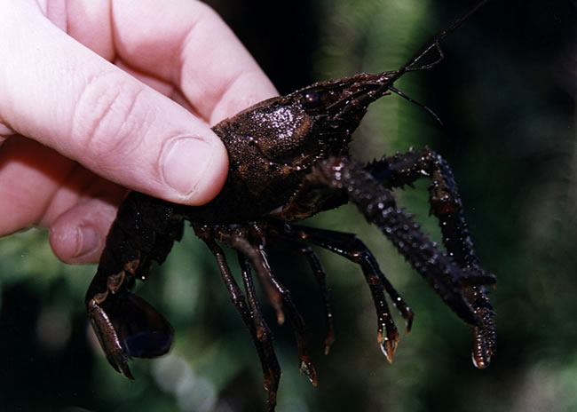
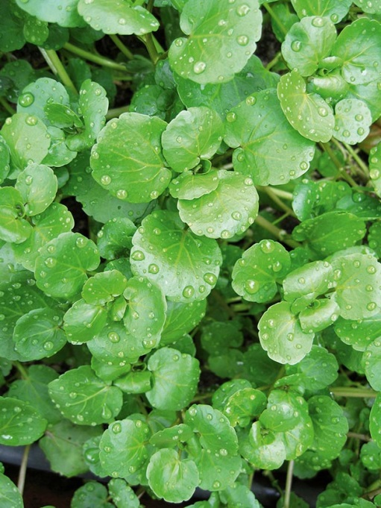
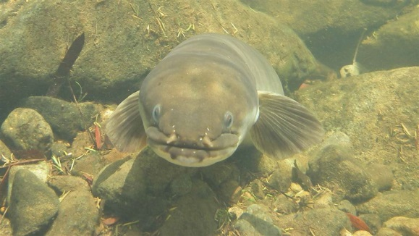
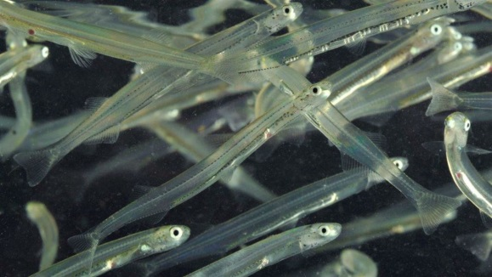
Project 8. Pātaka kai project
To increase and enhance habitats for kai awa, in particular tuna (eels), inanga (whitebait), kōura (crayfish), kākahi (freshwater mussels) and watercress.
Type | New project
Led by | Te Maru o Kaituna
Outputs for 2020-2022 | Establish Kaiawa Working Group Develop work programme Identify priority habitat restoration projects
Linkage | Projects 1, 6, 7, 8, 11 and 13

Slide 24
Our Projects
PRIORITY ACTION 1 Take collective responsibility for improving the health and wellbeing of the Kaituna River and its tributaries
PRIORITY ACTION 2 Create a network of healthy and diverse Kaituna habitats and ecosystems
PRIORITY ACTION 3 Connect our communities and visitors to our River and to our projects
ENABLING ACTION 1 Collect good information about the Kaituna River and its tributaries.
ENABLING ACTION 2 Establish a Kaituna River restoration and enhancement fund.

Slide 25
Project 10. Kaituna community connection project
To engage and connect our communities and visitors to the Kaituna River and the work that we do
Type | New project – more than just Comms
Led by | Te Maru o Kaituna (community connector)
Outputs for 2020-2022 | Completed communications strategy. TMOK website. Annual work plan released publicly. Annual river event. Three yearly river symposium.
Linkage | Projects 13-18

Slide 26
Project 11. Kaituna River Access project
Project 12. Kaituna Cycleway project
To enhance physical access to the Kaituna River.
Type | New project, comprising initiatives from existing work programmes
Led by | Western Bay of Plenty District Council
Outputs for 2020-2022 | River access mapping (linked with Reserve Management Plan review) Confirmed location and type of waka launching structure
Linkage | Projects 7, 8, 10-15
To enhance access to the River; enhance recreational opportunities and encourage economic opportunities.
Type | New project, comprising initiatives from existing work programmes
Led by | Western Bay of Plenty District Council (although community led cycleway strategy is already in development)
Outputs for 2020-2022 | Cycleway strategy completed Strategy implementation progressed
Linkage | Projects 7, 8, 10-15

Slide 27
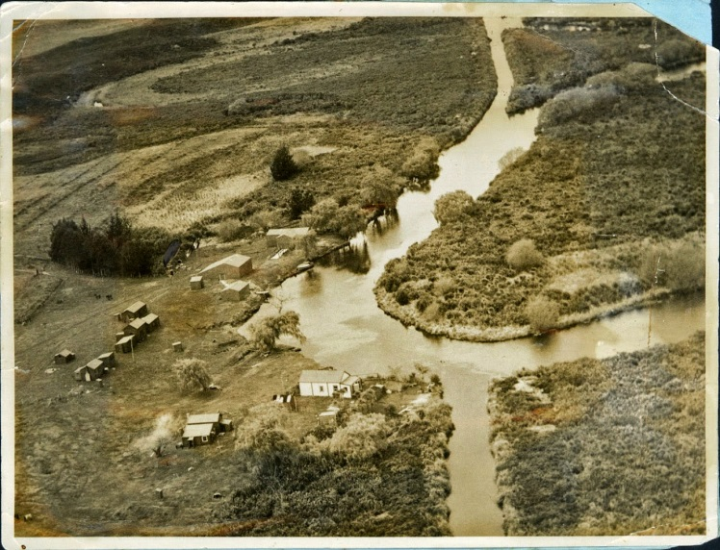
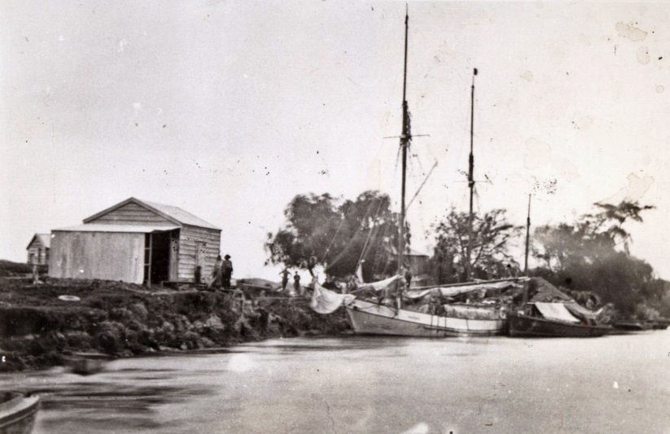
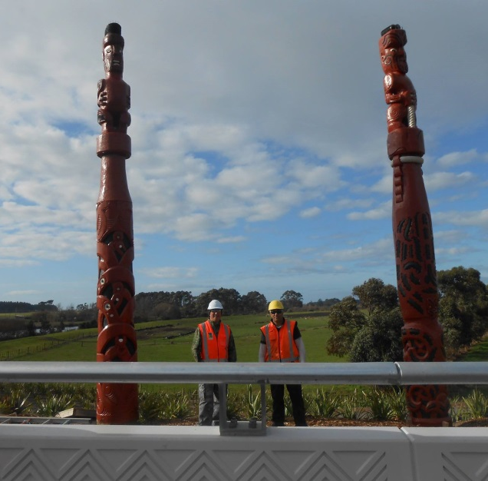
Project 13. Kaituna cultural and historical heritage project
To recognise and showcase the cultural and historical heritage associated with the Kaituna River.
Type | New project
Led by | Te Maru o Kaituna
Outputs for 2020-2022 | Complete interpretation plan Progress plan implementation
Linkage | Projects 10-15
Interpretation elements: information boards, pou, artwork
Taunga waka (refer Project 11)
Public art trails
Use of technology (e.g. i-Pou, augmented reality)
Cultural and environmental education centre at Te Pourepo o Kaituna (2026-28)

Slide 28
Project 14. Upper Catchment ‘gateway’ project
Project 15. Coastal park network project
To showcase and acknowledge the historical and cultural significance of the Kaituna River.
Type | New project
Led by | Rotorua Lakes Council with Ngāti Pikiao
Outputs for 2020-2022 | Complete concept plan Progress plan implementation
The connection of open space in the Lower Kaituna area to form a coastal park network. This is a mix of Council, conservation and private land.
Type | New project
Led by | BOPRC and landowners
Outputs for 2020-2022 | Complete concept plan Progress plan implementation

Slide 29
Our Projects
PRIORITY ACTION 1 Take collective responsibility for improving the health and wellbeing of the Kaituna River and its tributaries
PRIORITY ACTION 2 Create a network of healthy and diverse Kaituna habitats and ecosystems
PRIORITY ACTION 3 Connect our communities and visitors to our River and to our projects
ENABLING ACTION 1 Collect good information about the Kaituna River and its tributaries.
ENABLING ACTION 2 Establish a Kaituna River restoration and enhancement fund.

Slide 30
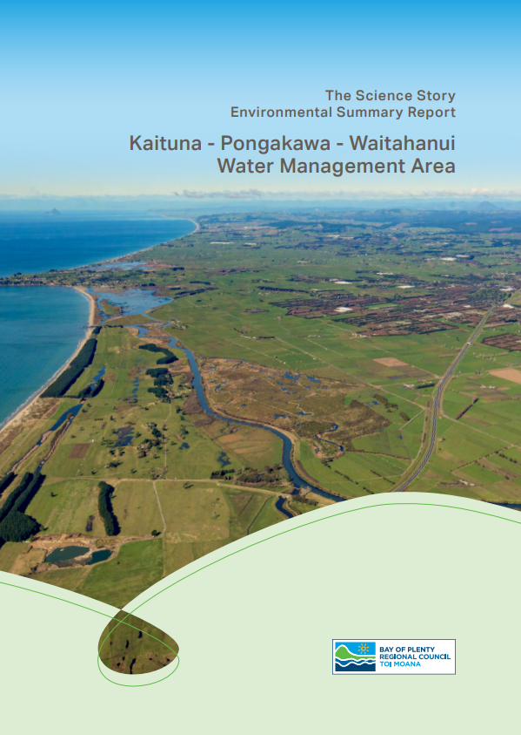
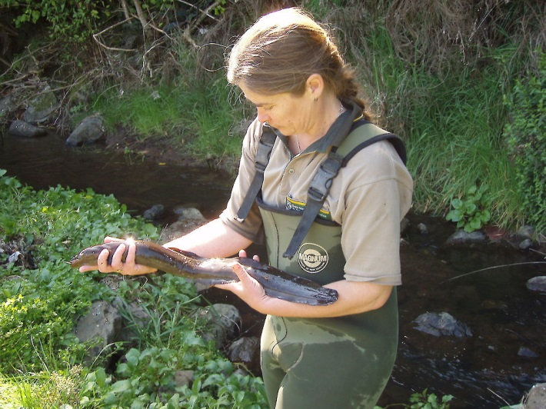
Project 16. State of the Awa integrated monitoring and reporting project
Progress to a more comprehensive way of collecting information about the health and the wellbeing of the Kaituna River (and the effectiveness of this Plan). Includes: integration of information collected by TMOK organisations identifying more monitoring sites and attributes and sources opportunities to incorporate mātauranga māori opportunities for citizen science
Type | New project
Led by | BOPRC
Outputs for 2020-2022 | Integrated Monitoring Plan completed. Plan implementation (towards a State of the Awa Report in 2023)

Slide 31
Project 17 Kaituna catchment network mapping project
Project 18 River restoration and enhancement project
Mapping to support and inform other projects within this Plan. In the long term, could be kept on the TMOK website via online mapping tool.
Type | New project
Led by | BOPRC and WBOPDC
Outputs for 2020-2022 | Stocktake and collation of existing information Mapping for Projects 7 (wetland re-creation) and 8 (habitats network)
Dedicated fund to facilitate public donations, external funding and corporate sponsorship. Fund would be used for Kaituna community projects.
Type | New project
Led by | Te Maru o Kaituna
Outputs for 2020-2022 | Establish fund Secure at least two external funding partners Annual funding round for Kaituna community projects

Slide 32
Next steps

Slide 33
Ensuring effective implementation
Next 1-2 TMOK meetings:
Annual TMOK work plan developed and released publicly
TMOK projects to be scoped
Dedicated resourcing:
Project coordinator (now)
Community connector (2020)
Funding:
importance of Annual and Long Term Plan input
external funding opportunities
Create opportunities to involve the Kaituna community

Slide 34
Resolution
Receives the report, Approval of Kaituna Action Plan;
Approves the revised content for the Kaituna Action Plan
Word version – content only
Subject to minor amendments (correct numbering)
Confirms a working group to guide the plan design process

