Slide 1
Freshwater Te Maru o Kaituna River Authority
27 September 2019

Slide 2
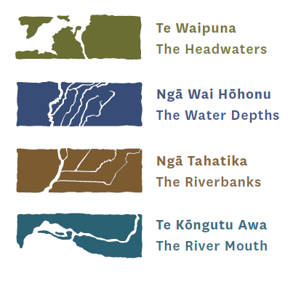
Kaupapa
Regional update
Kaituna water management area PC12 – discussion document
National update
Notes:
The kaupapa for this paper is mostly about the national update – the essential freshwater package, with a slide or two on the regional update and tangata whenua values and interests discussion document

Slide 3
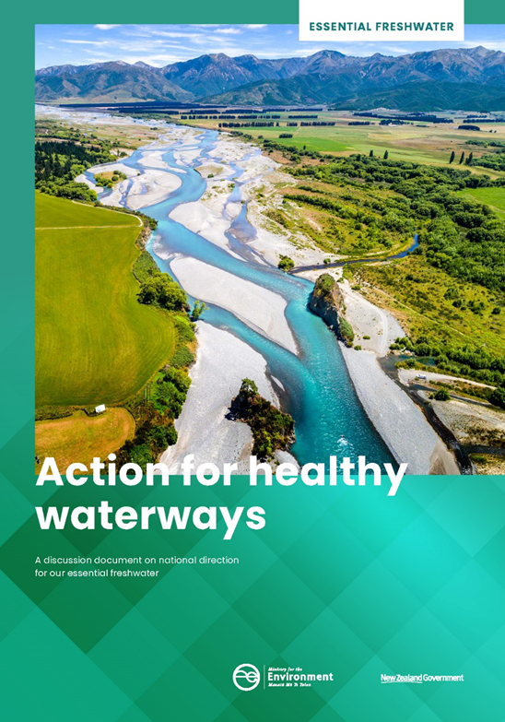
Essential Freshwater Package
What’s in the proposal?
Discussion document
Draft National Policy Statement for Freshwater Management (NPSFM) - set and clarify policy direction, raise the bar for ecosystem health
Proposed National Environmental Standards for Freshwater (NESFM)
Draft Stock Exclusion (s360 RMA regs)
RMA amendments – new streamlined freshwater planning process late 2019
Drinking water, stormwater & wastewater management proposals – high level policy further engagement mid 2020
Submission period closes 17 Oct, 31 Oct
Gazettal expected mid 2020
Rules subject to change, submissions, panel recommendation, select committee/other processes
Notes:
I’m going to try to very briefly talk you through the Essential Freshwater Package. The package comprises of a new draft NPSFM, proposed National Environment Standards, Changes to Measurement and Reporting of Water Takes Regulations, draft stock exclusion regulations and changes to the RMA. There are also a bunch of other central government policy packages out for discussion too including NPSUD and proposed NPS Highly Productive Land.
There is a lot going on; its all interconnected and submissions close (for Freshwater) on 31 October.
Essential Freshwater Programme - 31 Oct 2019
Reform of the resource management system – late 2019?
Planning for successful cities - Urban Development – 10 Oct 2019
Protecting our valuable land - Highly Productive Land – 10 Oct 2019
Reducing harm from waste - Product Stewardship – 4 Oct 2019
Hazardous substances assessments: improved decision making 30 Sept 2019
Allocation after that – 2019 / 2020

Slide 4
Five key components to proposal
Setting and clarify policy direction
NPSFM & RMA changes – includes strengthening Te Mana o te Wai, streamlined freshwater planning process, plans in place by 2025
Raising the bar for ecosystem health
NPSFM and NESFM changes
Improved farming practices through NESFM and s.360
Supporting delivery of safe drinking water
high level proposals detail to follow later this year
Better management of storm water and wastewater
high level proposals detail to follow later this year

Slide 5
Te Mana o te Wai NPSFM
Hierarchy of obligations
health of wai
essential human health needs - drinking
use / social, cultural and economic wellbeing
Long- term regional vision
Flexibility to apply TMotW locally
Integrated whole of catchment basis - ki uta ki tai
Notes:
The first of the changes concern Te Mana o te Wai.
TMotW has been in the NPSFM from the inception. In 2014 it was mentioned in the preamble, in 2017 elevated to statement of national significance and now it is a fundamental concept. It means putting the water first. Exercising manaakitanga, kaitiakitanga. Doing what’s right.
Te Mana o te Wai hierarchy of obligations, that –
the first priority is the health of the water,
the second priority is providing for essential human health needs, such as drinking water, and
third is other consumption and use?

Slide 6
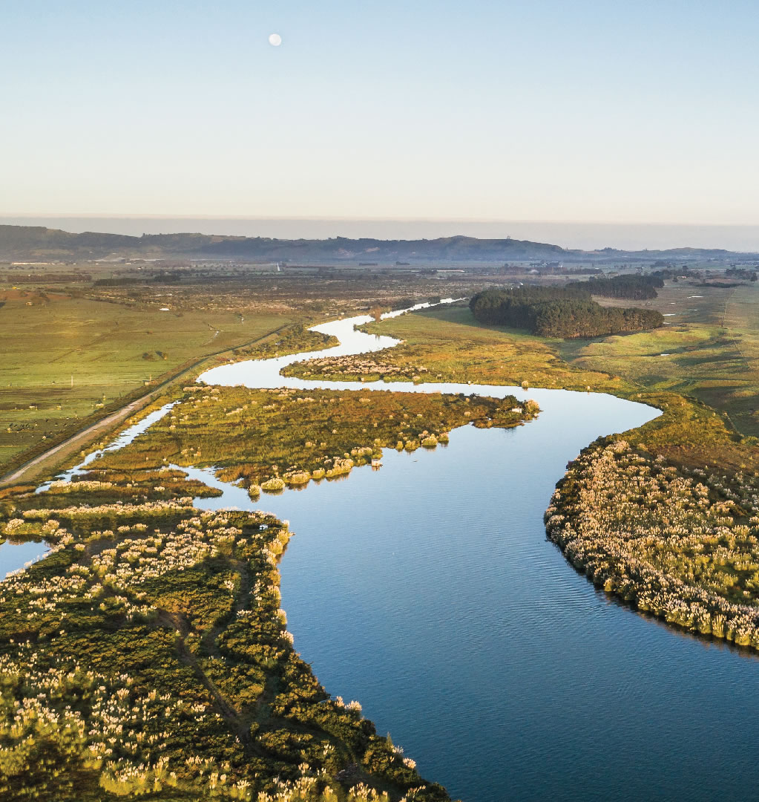
Māori values
New Māori values:
Option 1: Make mahinga kai a compulsory value;
Option 2: Create a tangata whenua freshwater values category in the NOF
Mātauranga Māori must be included in monitoring
Notes:
The proposal includes the possibility of a new compulsory Mahinga Kai “value”. In the NPSFM “Values” are things we set objectives for and then manage within limits – sometimes bands. For mahinga kai we might be interested in inanga, tuna, or koura abundance for example – which we might be managing to achieve an objective of local communities having for easily gathering a feed.
NOF
Systematic monitoring
Involve iwi and hapū

Slide 7
More integrated management NPSFM
TAs to have policies on effects of urban development on water
Notes:
The NPSFM says: District Plans must include objectives, policies, and methods to avoid, remedy, or mitigate the cumulative adverse effects of land use on freshwater bodies, freshwater ecosystems, and sensitive receiving environments resulting from urban development. i.e. We all play our part.
More integration also includes TMotW and whole of catchment integration - ki uta ki tai

Slide 8
Raising the bar on ecosystem health
NPSFM and NESFM changes
Holistic ecosystem health
New attributes and management approach
Aquatic life / fish passage
Improve protection for threatened species
Provide for fish passage
Habitats
No further loss of streams or wetlands
Water quality
New bottom line
for nutrients
Reduce sediment
Higher standard for swimming
Water quantity
Clarify flow requirements
Real time reporting – mandate telemetry
Introduces ‘ variability of flow’ and ‘environmental flows and levels
Notes:
While scientific attributes like eColi, Nitrogen, Phosphorus remain very important, the draft NPSFM has substantially raised the bar on ecosystem health. We must now prioritise ecosystem health above all else – meaning our science and how we state objectives and policies will probably need to be more direct about its impact on ecosystem health.
Science requirements have increased. In terms of water quality we must now manage sediment, and for N and P must manage beyond the very minimal toxicity bands we previously had. New higher standards for swimming but narrowed to locations we want to swim and when we want to swim (over summer) have been introduced too. There is a new attribute for lakes – for invasive weeds.
Although concerned with water quality the NPSFM touches on quantity too and emphasises needing a link between allocation limits and ecosystem health. Proposed changes to the “Measurement and Reporting of Water Takes Regulations” will require the supply of take data every 15 Minute – i.e. it mandates telemetry.
Clarify minimum flow requirements including objectives to state ecosystem health outcome, flows and limits must relate to objectives
Mandate telemetry (direct electronic transmission) - measuring water use every 15 minutes, transmitting daily electronic records, starts with consents of 20 l/s, 6 years later smaller consents

Slide 9
New Freshwater Planning Process RMA
New regional plans in place by 2025
Give full effect to NPSFM 2020
Expert panels will hear/consider plans
Restricted options for appeal
4.1.(2) The final decisions on changes to policy statements and plans that are necessary to give effect to this National Policy Statement must be publicly notified no later than 31 December 2025
Notes:
To kick things along, changes to the RMA were introduced to the house this week. The new Bill requires councils to notify changes to their regional policy statements and regional plans to implement the National Policy Statement for Freshwater Management (NPS-FM) no later than 31 December 2023, and make final decisions by 31 December 2025. It sets up new freshwater hearings commissioners and a new process, chaired by a retired or current Environment Judge.
New planning process for freshwater
Restricted avenues for appeal & plans operative by 2025
Appointment of Freshwater Commissioners (RMA amendment bill – tangata whenua nominated representatives)
We are anticipating the need for changes to engagement with tangata whenua and wider community to met these timeframes for the whole region! May need to rely more heavily on advise from co-governance groups, facilitate tangata whenua engagement more at a hubs of interest scale rather than iwi by iwi? More about that shortly – Reuben will be talking to you about the discussion doc and next steps.

Slide 10
Improving farm practises NES & Reg
Restrict intensification
Farm Plans
Reduce N in N-impacted catchments (upper Rangitāiki)
Control intensive winter grazing, feedlots, stock holding areas
Stock Exclusion regs
Notes:
These are standardised rules the government is proposing. Our plans will refer to them … we can be more restrictive if needed, but they come into effect when a consent is renewed or sought.
Draft Stock exclusion Regulations: Are different, because they are regulations they are effective when gazetted. Landowners must do/abide immediately - (differing timeframes)
Stock setback from wetlands & lakes and rivers > 1m
Stream crossing only by bridge
Stock – cattle, deer & pigs (not sheep), different requirement for different slopes

Slide 11
Supporting delivery of safe drinking water
Better management of storm water & wastewater
High level proposals detail to follow later this year
Strengthen requirements to assess and control risks to drinking water sources.
Set minimum standards for wastewater discharges and overflows
Require all operators to follow good practice risk management
Water Sensitive Design guidance for urban development
No draft policy or NES yet

Slide 12
What’s missing?
Māori rights and interests
Cultural allocation / policies about allocation methods
Notes:
But there are big gaps too. In particular proprietary rights to FW are not addressed. <<ref Wai 2358>>
Government have signalled in the discussion document – ongoing work
The Government has indicated in the Essential Freshwater discussion document that it will continue to work with Māori to
address their rights and interests in freshwater, particularly in the context of addressing allocation issues. The timeline within the discussion document states ongoing work on allows of allocation of allowances to discharge – 2019 – 2020
Government response to Wai 2358?

Slide 13
Where to find out more
MfE website
MfE roadshows – public & hui sessions well attended
Kahui Wai Māori sessions & material on MfE website
Freshwater flash & Komiti Māori panui - subscribe to keep in touch
BOPRC information sharing sessions
Rotorua - Monday 30 September 1-3pm at Rotorua Lakes Council Chambers
Awakeri - Tuesday 1 October 1-3pm at Awakeri Events Centre
Te Puke - Wednesday 2 October 1 – 3pm at The Orchard

Slide 14
Regional update
Plan change 9 – Region Wide Water Quantity
First step in two stage process to improve water allocation limits
Plan Change 10 – Lake Rotorua Nutrient Management
Environment Court interim decision in favour of the PC10 nitrogen allocation method.
Identified additional provisions needed in relation to Treaty Settlement land. No date for stage 2 hearings yet.
Progress towards resolving appeals continues

Slide 15
Reflecting tangata whenua values and interest: draft discussion document
TMoK feedback / endorsement to release for further engagement
Does it capture the essence of kōrero to date?
Ngā ara whakamua / going forward?
thoughts about ideas in part 3
Opportunities to reflect tangata whenua values and interests in plan change

Slide 16
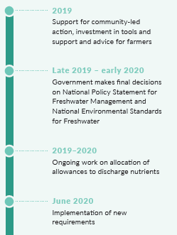
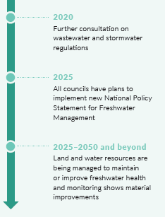
Timeline

Slide 17
1. Set and clarifying policy direction
NPSFM & RMA changes
Te Mana o te Wai strengthened
New Māori compulsory value – two options
New streamlined freshwater planning process
Direct more integrated management - ki uta ki tai
Exceptions for major hydro schemes

