Slide 1
State of the Ōhiwa Harbour and Catchment

Slide 2
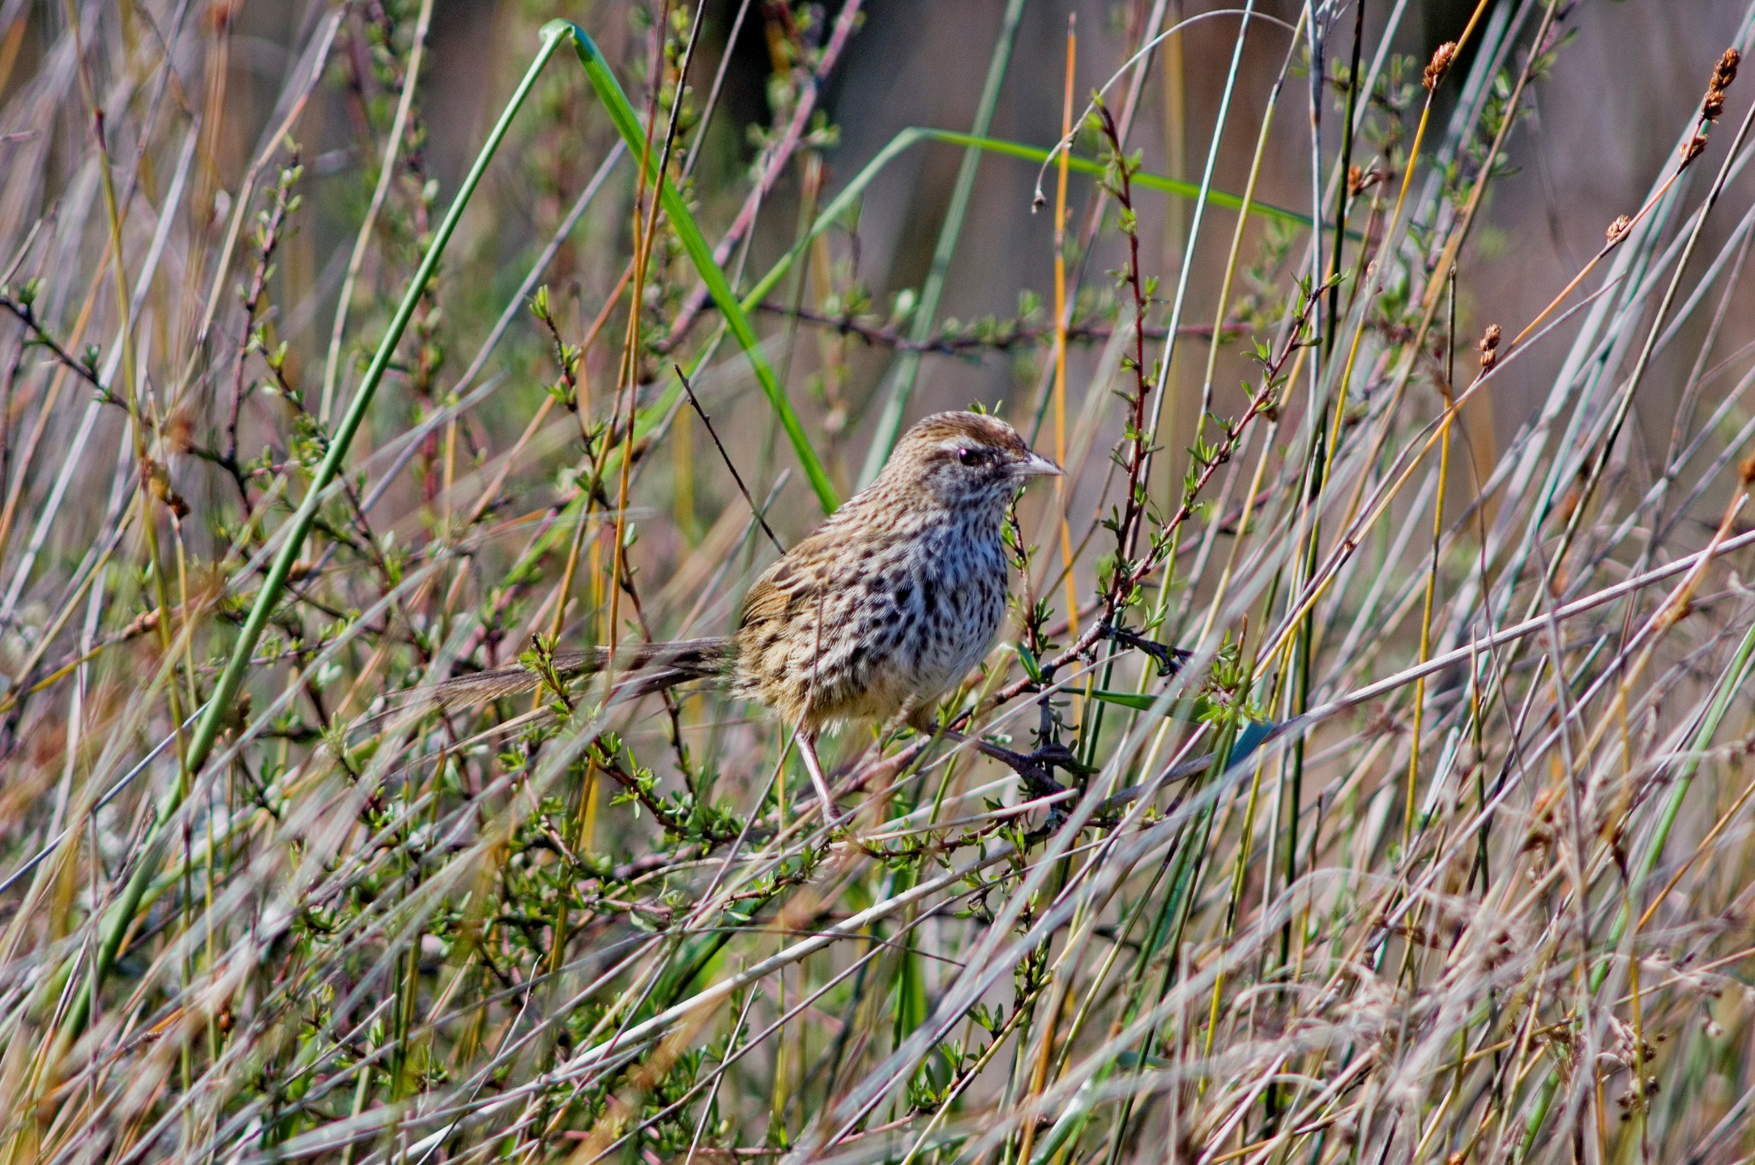
Fernbird on Uretara Island
12 birds in 2012
54 birds in 2019

Slide 3
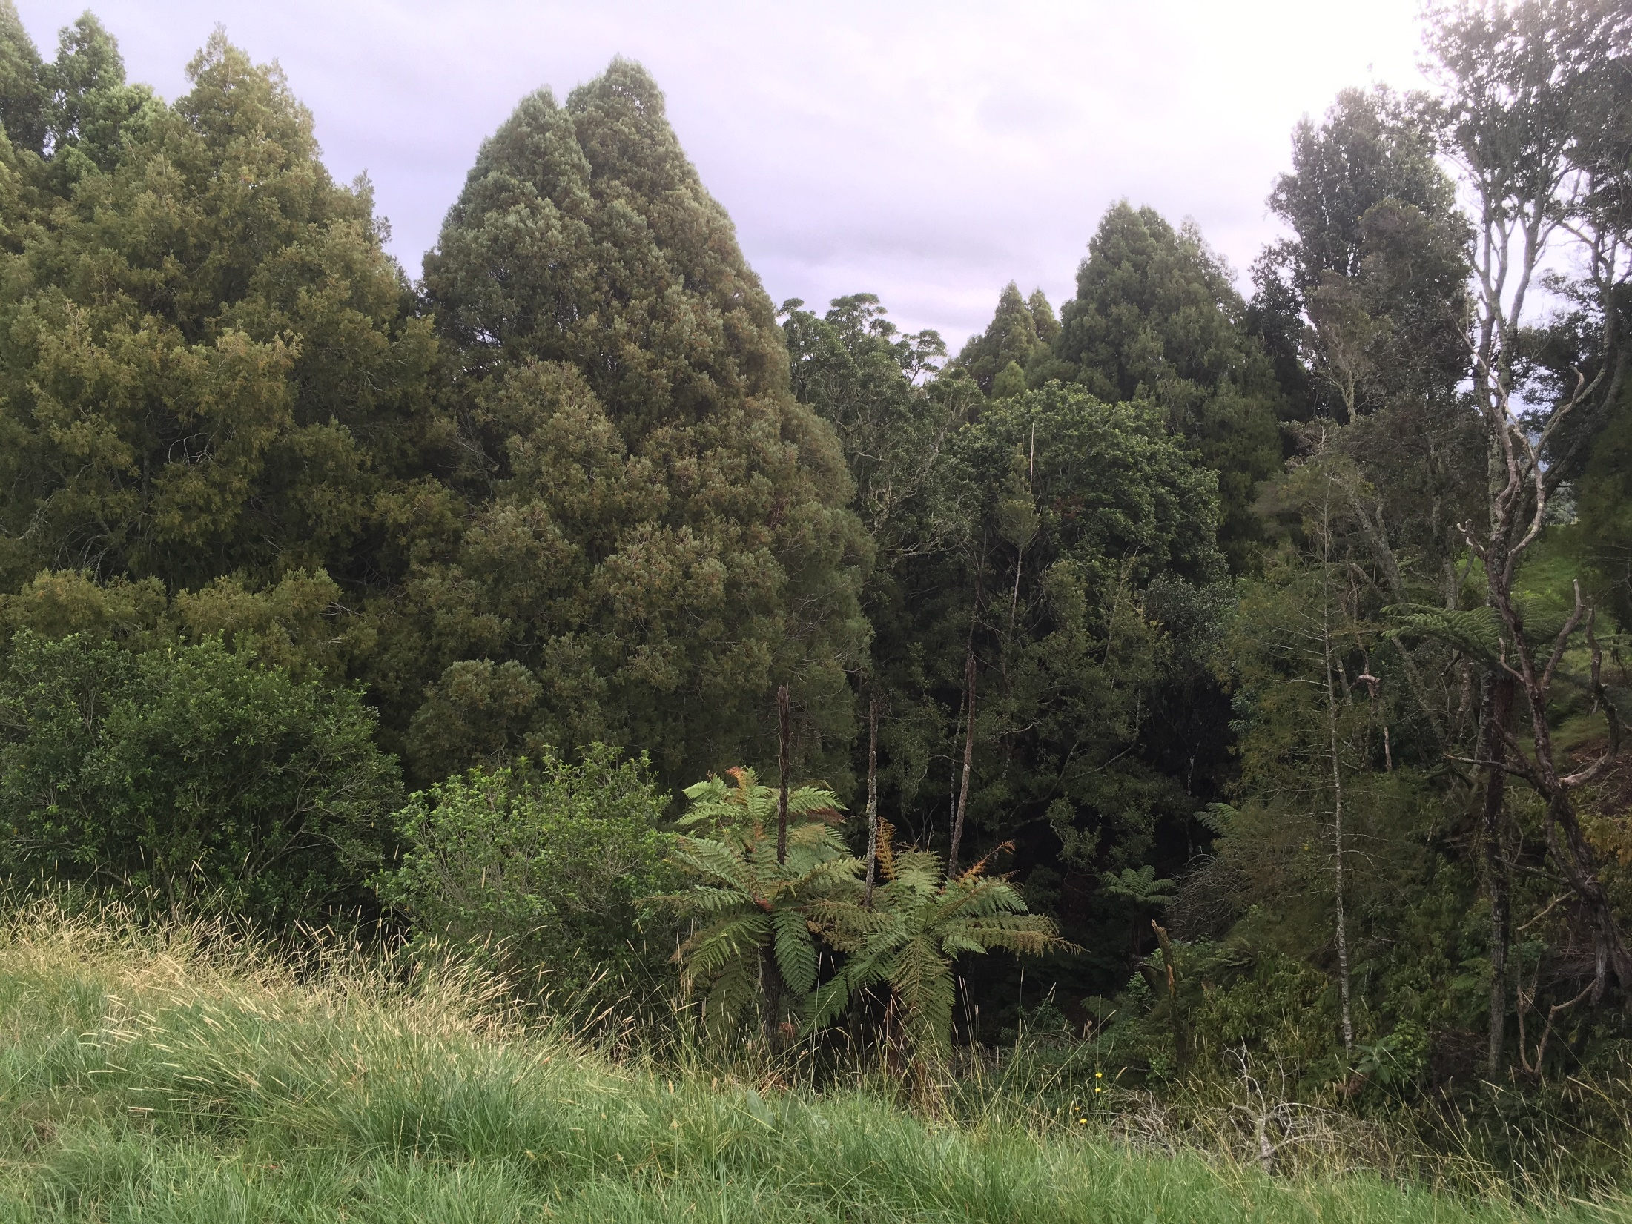
10ha of kahikatea forest fenced

Slide 4
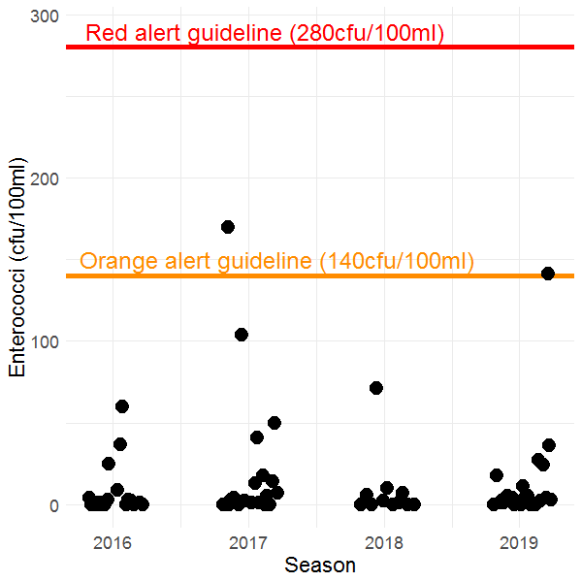
Ōhiwa Harbour bathing water quality

Slide 5
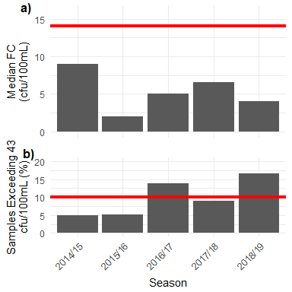
Ōhiwa Harbour shellfish consumption safety

Slide 6
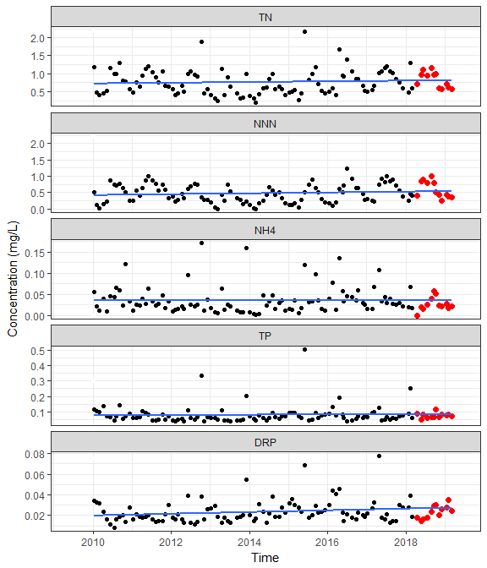
Nukuhou River
nutrient trends

Slide 7
Nukuhou River E.coli trend

