Slide 1
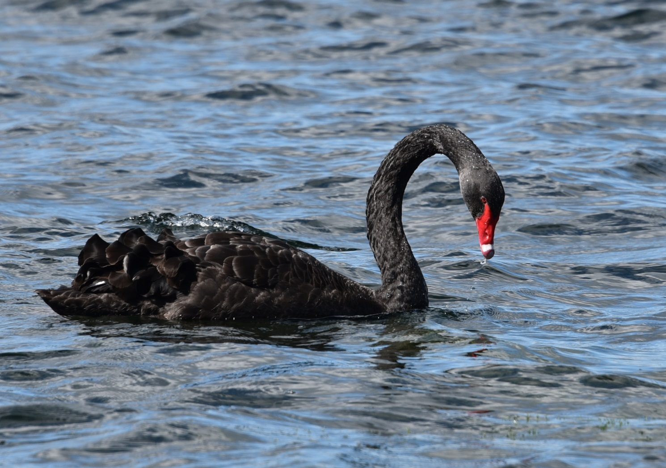
Black Swan Ohiwa &Tauranga Harbours

Slide 2
Three main complaints
They are eating all the seagrass (Zostera sp.);
They poop everywhere and are contaminating the harbour;
They are responsible for the eutrophication of the lakes and rivers
Sometimes people complain that there are just too many swan
Interestingly we probably receive more complaints from the public when we try and reduce swan numbers.

Slide 3
Today
Discuss the relative impact of swan on the Zostera cf. anthropogenic contaminants and sediment inputs.
Show that relative to other nutrient and fecal coliform inputs swan don’t even hit the radar
But first off, I wish to give you a quick introduction to the black swan, and specifically discuss the Tauranga and to a lesser degree, Ohiwa Harbour populations.

Slide 4
Status
NZ had at least two swan an endemic swan, Cygnus sumnerensis (Pouwa) and a native, C. atratus (the black swan).
Found in pre-European middens
By time Europeans arrived both were extinct in NZ
About 100 reintroduced by the Acclimatisation Societies in 1860s
This population increased faster than can be explained by breeding of the introduced birds. Consensus is that they reintroduced themselves about the same time

Slide 5
Population dynamics
Long lived (>25years), but most of Waikato birds don’t live longer than 8 years
Some colony nest some solitary.
2/3 of eggs of colony nesting swan hatch and up to ¼ of nests fail to produce anything.
Up to 40% of cygnets die in their first year.
Only eat plant material, prefer aquatic plants cf. terrestrial.
Susceptible to large weather events (Wahine storm killed thousands of swan). Took over 10 years for the population to recover. (loss of Ruppia Beds).

Slide 6
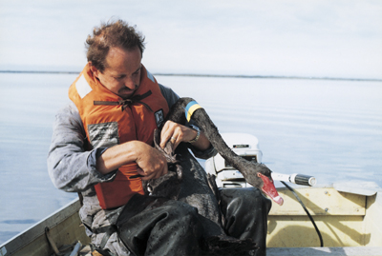
Neck collars and leg banding

Slide 7
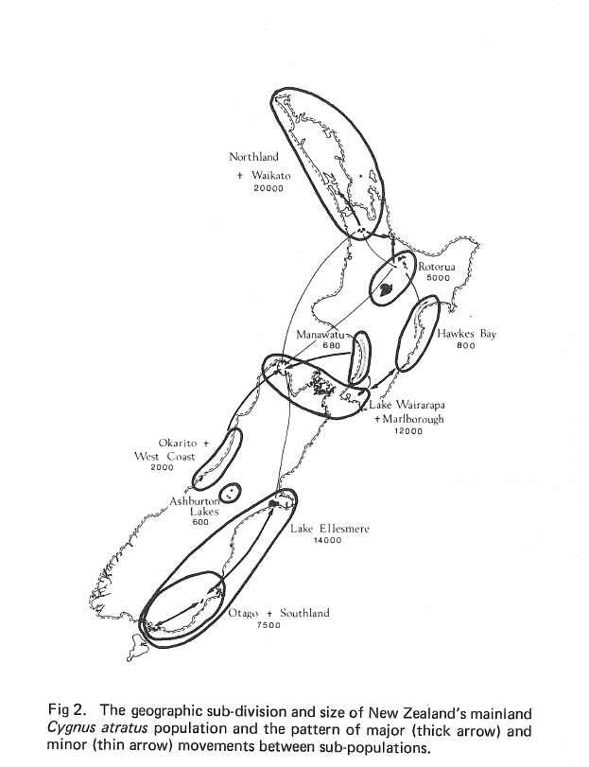

Slide 8
Legal Status
Listed as a game bird under the Wildlife Act (Schedule 1 Wildlife Act 1953).
May be hunted with Minister of Conservation’s Authorisation

Slide 9
Fish and Game
Set up under the Conservation Act
Report to Parliament
Manage sports fish and game birds
Make game bird harvest recommendations to the Minister of Conservation
Funded solely from licence sales

Slide 10
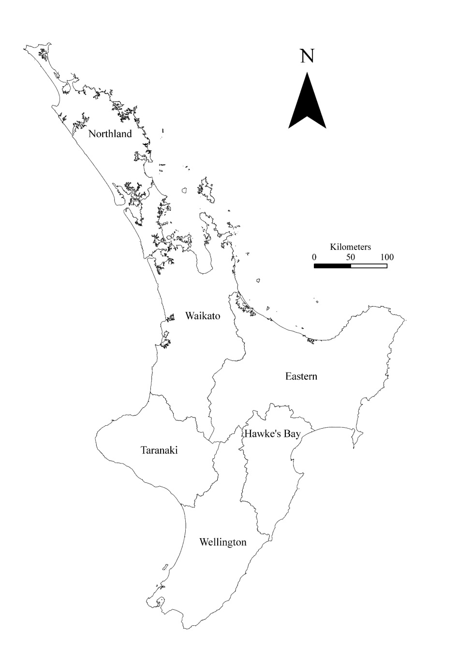

Slide 12
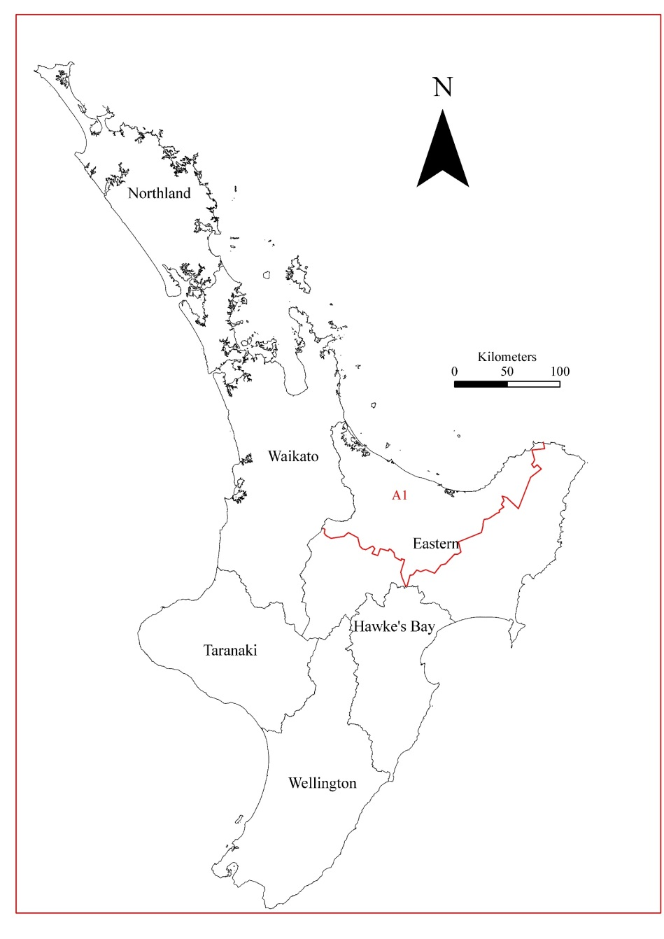

Slide 14
Waikato Swan

Slide 16
Ohiwa swan population
Stopped counting in 2000 as population so low.
39 were counted in 2018 (about 1 per every 40ha of harbour)
From a F&G management perspective the population is too low to warrant annual monitoring
If swan on Ohiwa were the same density as Tauranga harbour we would expect the Ohiwa population to be about 950

Slide 17
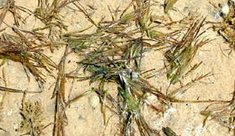
Impact of swan on Zostera
World wide seagrass is vanishing 10 times faster than tropical rainforest
Zostera is an important habitat for juvenile marine species including snapper
Zostera is consumed by swan
Dos Santos estimated a swan on Tauranga Harbour will eat 394 g DW day⁻¹
She considered that if the swan consumed 19-30% of the harbours Zostera it becomes unsustainable.
This she estimated is equivalent to 4630-7400 swan

Slide 18
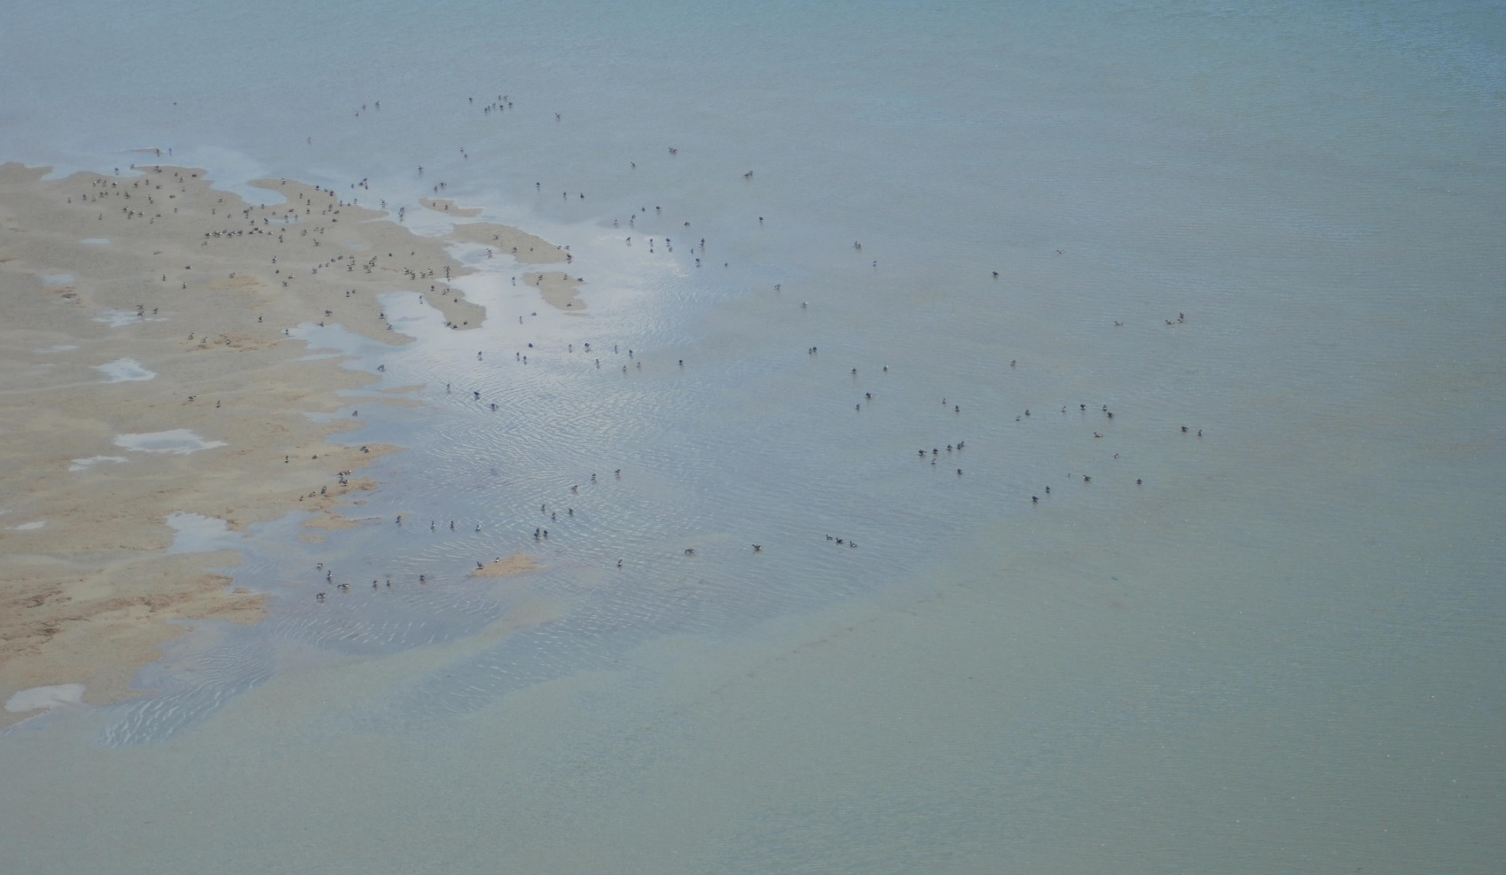
Tauranga Harbour is not suitable habitat for breeding
The problem with these estimates is that Zostera growth fluctuates with the seasons and;
So do swan numbers

Slide 20
Swan were most numerous in Autumn which coincides with maximum Zostera growth

Slide 21
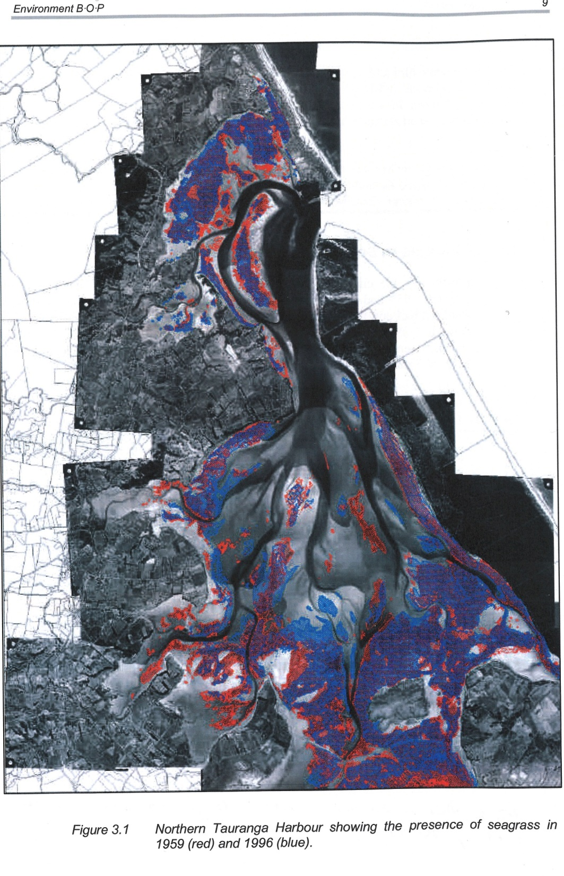

Slide 22
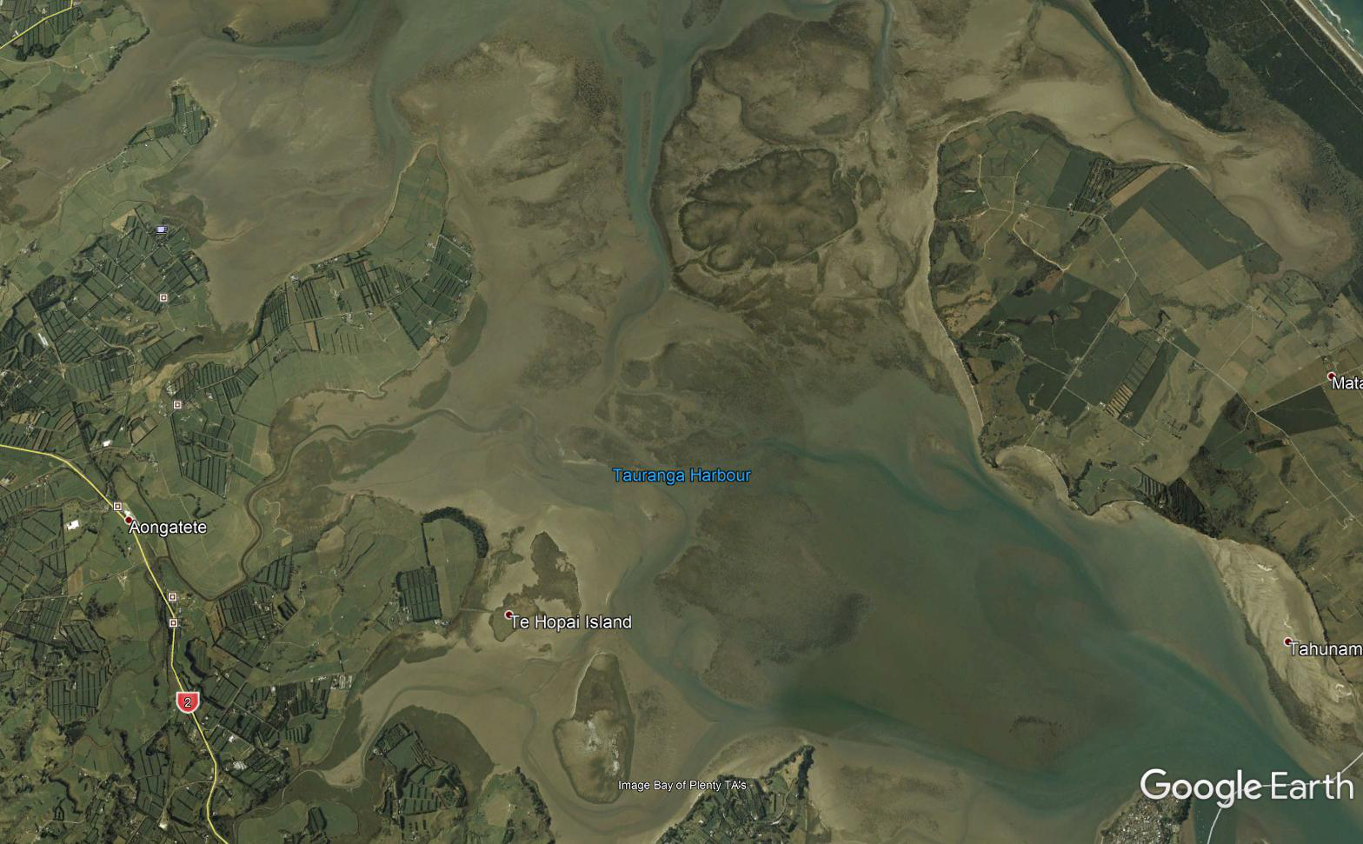

Slide 23
Seagrass (Zostera sp.) (SG Park EBOP Report 99/30)
Rates of seagrass loss in the Tauranga correlate well with the suspended sediment loading.
Evidence strongly points to sediment and nutrient runoff as the main factor involved in seagrass loss from the harbour.
The southern harbour has relatively 3 times the catchment of the northern harbour and has experienced a far higher rate of seagrass loss confirming this impact at a larger scale

Slide 24
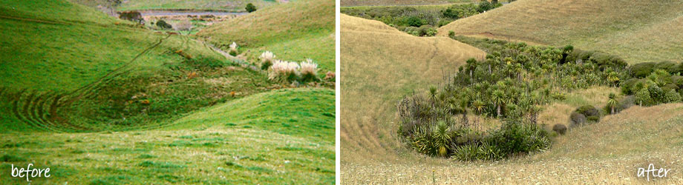
Whaingaroa (Raglan) Harbour Care (Fred Lichtwark)

Slide 25
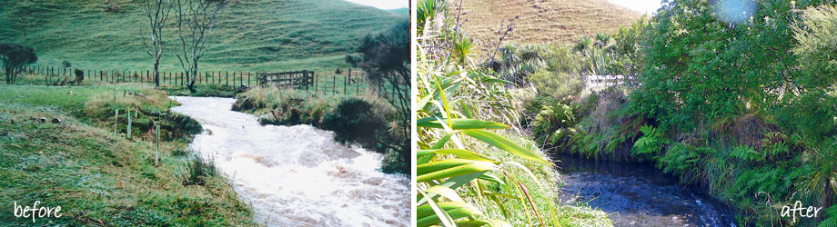

Slide 26
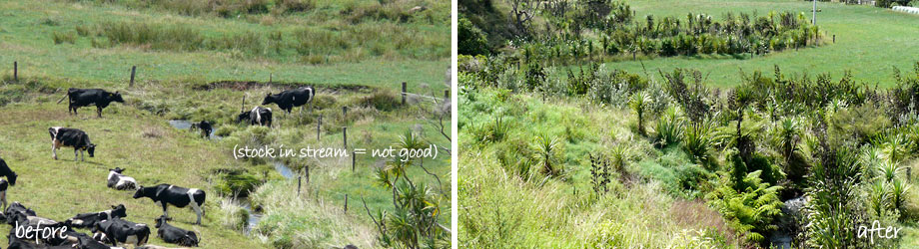

Slide 27
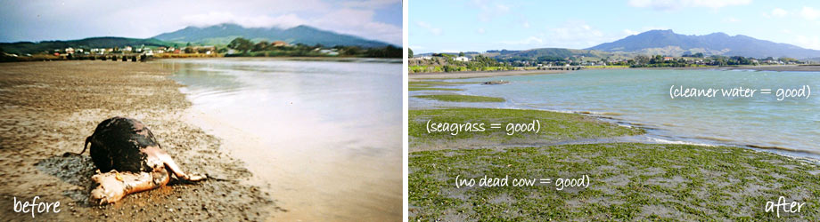

Slide 28
Eutrophication and Swan
If we get a complaint from the public, it is usually to do with the amount of poop on the mud flats.
In the political arena, concerns relate to swan eutrophication and fecal coliforms.
NIWA (Paul Sagar et. Al 1995) looked at contribution of swan to nutrient loadings. They commented that the inputs from swan need to be compared with the other [nutrient] inputs and consideration should be given to whether the birds are importing nutrients to the water body or merely recycling them.

Slide 29
The evidence for large lakes (Taupo, Ellesmere) is that the contribution by swans is very small.
For example based on the number of swan on Lake Rotorua in 2003 a total of 21 kg of N (NH4-N; ammonium) or P (Dissolved Reactive Phospherus) per annum was produced.
The Waiohewa, a geothermal stream, that flows into Lake Rotorua, discharges 40 – 50 kg NH4-N per day.
Fish (1975) estimates almost 41 kg of PO4-P enters Lake Rotorua each day from Hamurana Spring alone.

Slide 30
Fecal coliforms
The amount of poop clearly upsets some Tauranga residents however it is what happens in nature. Bears do it in the woods swan do it in the estuaries.
Again using Lake Rotorua as an example:
At a flow of 2m³/sec the Ngongotaha stream (measured at the SH 5 bridge) contributes almost 70,000% more fecal coliforms than the swan.

Slide 31
So what is the answer
Humans have already driven NZ swan to extinction once before, we have to be careful that we don’t do it again.
Need to be cautious how they are managed don’t want a similar Canada goose debacle which has seen the population explode since it has been taken off the game bird schedule (Schedule 1 Wildlife Act 1953) in 2012.

Slide 32
Council’s responsibilities
The amount of sediment entering the harbour is in the Council’s hands (through catchment management).
If the Council is serious about wanting to clean up the harbour check out what Fred Lichtwark and friends have done over in Raglan (Fred Lichtwark - Plenty More Fish in the Sea: The Whaingaroa Harbour Journey).

Slide 33
F&G Position
Given the amount of sediment input and continuing loss of the Zostera beds, in some months of the year swan numbers are possibly in the zone defined by Dos Santos as unsustainable.
It is not clear if these high seasonal populations of swan are having a long-term impact on Zostera bearing in mind that population fluctuates over the year as does Zostera growth (i.e. we need more info.)

Slide 34
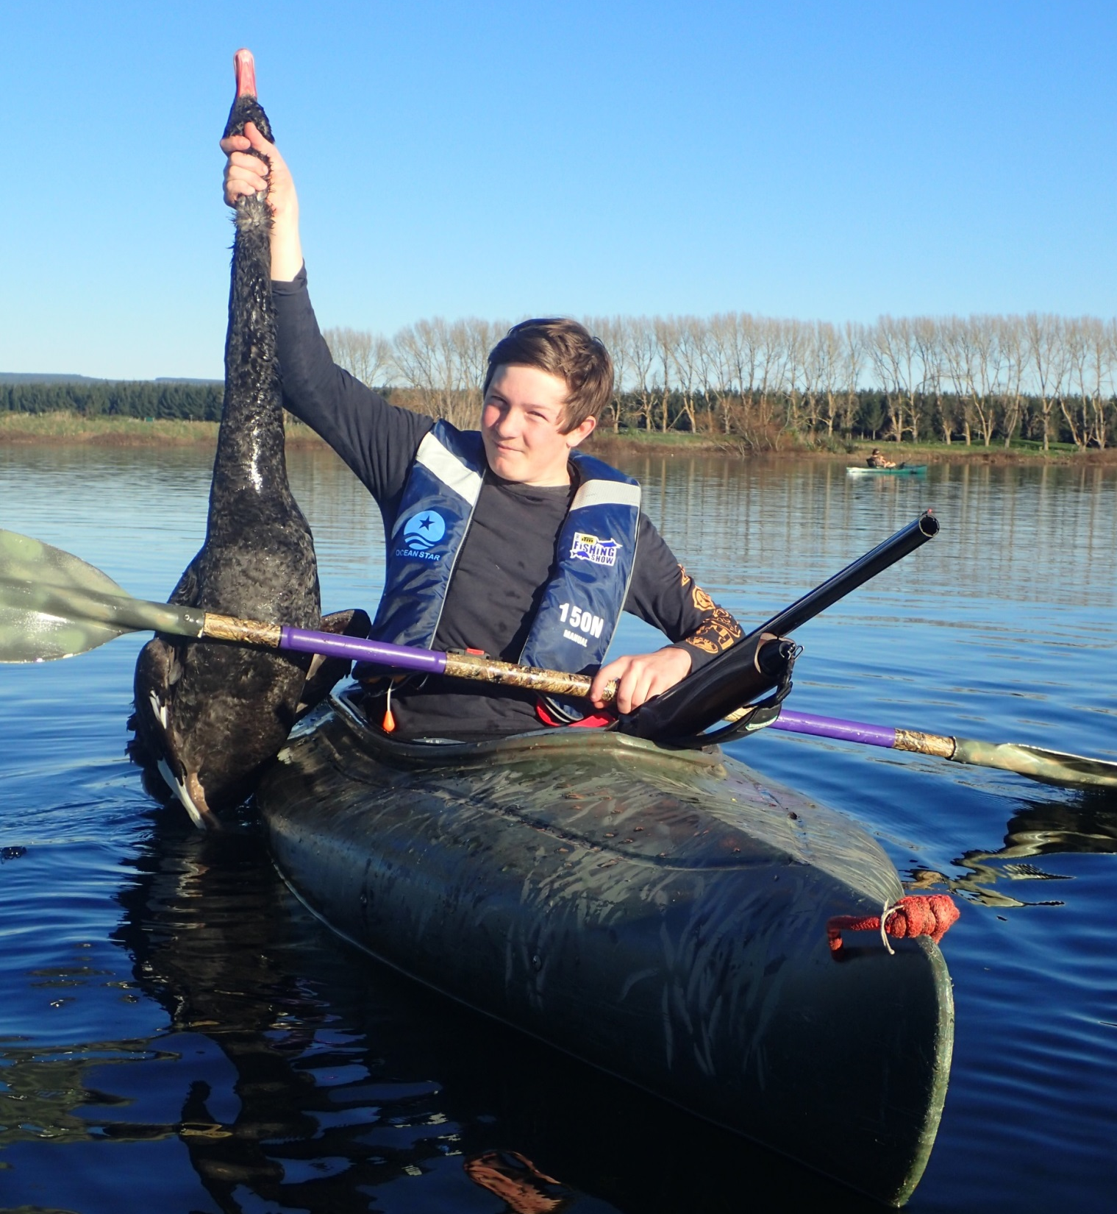
F&G’s response
F&G are trying to reduce the swan population through very relaxed hunting regulations (no limit and 4-month season) and;
A special swan season in February
During this special season we have assisted the Western Bay of Plenty F&G club to have an organized shoot.

Slide 35
Collaborative answer
Need to make informed decisions based on sound science.
F&G have had discussions with Waikato University (Professors Chris Battershill and Ian Hawes) and EBOP staff Environmental Scientist Josie Crawshaw and Biosecurity Manager Greg Corbett
Prepared to work collaboratively to ID solutions where genuine issues are identified.

