Slide 1
Presentation for BoP RTC
6 Sep 2019

Slide 2


Slide 3
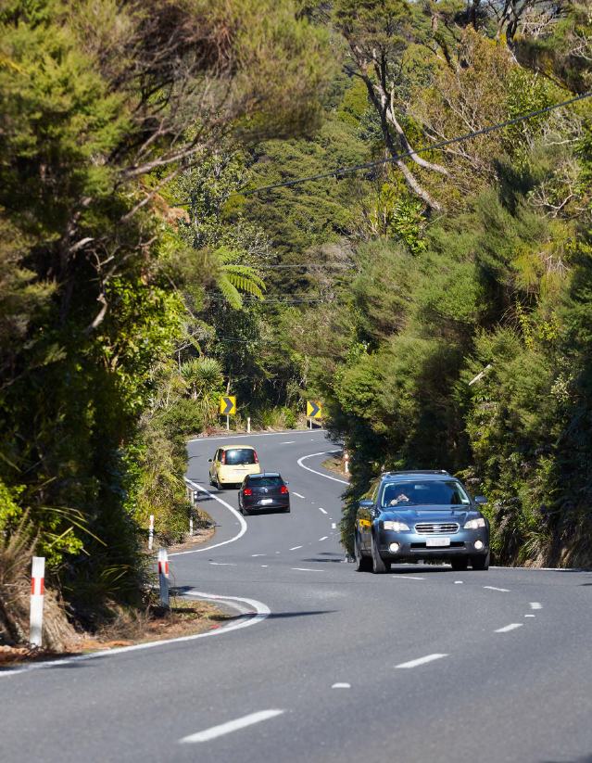
Today
Road safety in context
Strategy development
Tackling unsafe speeds
3

Slide 4
How NZ compares internationally
On average, 1 person is killed every day on New Zealand roads.
Another 7 are seriously injured.

Slide 5
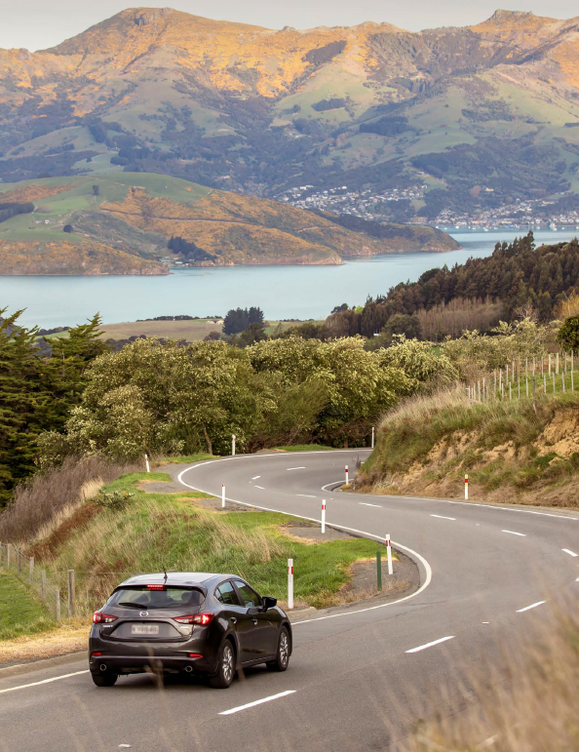
An effective Road Safety Strategy
Builds a joint understanding of the problem
Provides clarity of purpose and sets out what we want to achieve
Provides decision-making principles
Sets out where we will focus our efforts
Enables effective prioritisation of actions
Galvanises action from stakeholders
Holds decision makers to account
5

Slide 6
Our different roles in transport and road safety
Ministry of Transport
overall stewardship of the transport system
Provides advice to the government to help it meet its transport objectives, including:
NZTA
funds, builds, manages and regulates the land transport system
Allocates funding for land transport infrastructure and services
NZ Police
enforce compliance with road rules
Provides road policing services including:
Local Government
manage local roads, regulatory transport functions
funding levels and priorities
advice on legislative, regulatory and policy settings
Crown agency governance, performance and accountability.
Manages driver and vehicle licensing, vehicle inspections and rules development.
Manages the State highway network
Provides land transport safety and sustainability information and education.
speed management
drink / drugged driving enforcement
seatbelt enforcement
a visible road safety presence.
Own and maintain the local road network and perform important regulatory transport functions.
Funds infrastructure and public transport services alongside central government
Responsible for transport planning and land use planning.
commercial vehicle investigation

Slide 7
Progress to date
April 2018
May – December 2018
January – June 2019
Cabinet agreed to a new road safety strategy to be developed
Begin to frame strategic approach and consideration of priority actions
Modelling of interventions and impact
Further engagement with regional stakeholders & special interest groups
Consultation document prepared
Development of new strategy announced at the Local Government Road Safety Summit
Reference group workshops held and outcomes reports prepared
Early engagement with regional and sector stakeholders
Cabinet process
July / August 2019
Public consultation
August – end 2019
Read and analyse submissions
Develop final strategy and first action plan for release by end of year
Policy development, drafting and modelling
for strategy, focus areas and action items
PAGE 2

Slide 8
Engagement with Local Government
Local Government Summit, April 18
LG representatives on reference groups
Presentations at LGNZ forums, including rural and provincial sector and Metro Mayors
Discussions with RTCs and RTC chairs
Conversations with road safety working groups across NZ
Strategy specific workshops in 14 regional locations across NZ March/ April 2019
Conversations with LGNZ Policy Advisory Group and TSIG during consultation
Broad support for Vision Zero
  Needs meaningful change to be credible
Safe System needs to be strengthened and embedded
  Driver behaviour still seen as a key focus by many stakeholders
  Acknowledgement of the importance of speed, support for more streamlined processes for setting speed limits.
A call for strong leadership and effective coordination
Strategy needs to reflect rural needs as well as metro
Need for on-going partnership with Maori in this area
Need to bring community with us
Local Government conversations
What we heard

Slide 9




Road to Zero framework
Vision:
A New Zealand where no one is killed or seriously injured in road crashes
2030 Target:
A 40 percent reduction in deaths and serious injuries (from 2018 levels)
Principles:
We plan for people’s mistakes | We design for human vulnerability | We strengthen all parts of the road transport system | We have a shared responsibility for improving road safety | Our actions are grounded in evidence and evaluated | Our road safety actions support health, wellbeing and liveable places | We make safety a critical decision making priority
Focus areas:
Infrastructure and speed | Vehicle safety | Work-related road safety | Road user choices | System management

Slide 10
Tackling Unsafe Speeds Programme

Slide 11
Tackling unsafe speeds:
3 initiatives being considered
Improving the way councils plan and implement speed limit changes – establishing a new regulatory framework for speed management.
Transitioning to lower speed limits in areas with high numbers of active mode users – this includes around schools and in urban centres.
Adopting a new approach to safety cameras – moving towards the Swedish model.

Slide 12
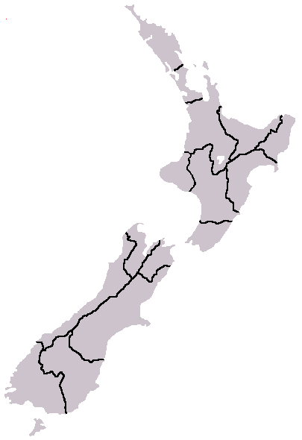
Improving the way councils plan and implement speed limit changes – establishing a new regulatory framework for speed management
The NZTA would be required to develop a National (State Highway) Speed Management Plan, and to then work collaboratively with RCAs and Regional Transport Committees to support the development of Regional Speed Management Plans.
Speed management plans would:
  be aligned with the land transport planning process
  take a ‘one network’ approach to considering speed limit changes
  address Government priorities outlined in the Road Safety Strategy
  align, where appropriate, with recommended safe and appropriate travel speeds when proposing speed management changes
  be consulted on by RCAs to ensure robust analysis and local knowledge is accounted for
  outline how and when speed limit changes will be implemented.
This approach would remove the current bylaw-making requirements and is intended to clarify and streamline the speed limit setting process. A ‘one network’ approach ensures that speed management planning for state highways and local roads is aligned.

Slide 13


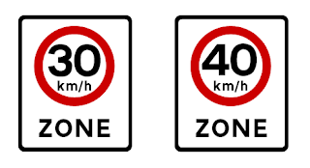


Transitioning to lower speed limits in areas with high numbers of active mode users – around schools and in urban centres
The following options are being considered:
ROADS OUTSIDE URBAN SCHOOLS
RCAs would be required to implement a maximum speed limit around urban schools. This could be a permanent or variable speed limit.
This could be 40 km/h for all schools, with RCAs having the option of implementing a 30 km/h speed limit.
ROADS OUTSIDE RURAL SCHOOLS
RCAs would be required to implement a maximum speed limit of 60 km/h (variable or permanent) around rural schools.
ROADS IN URBAN CENTRES
RCAs would be required to review speed limits on key roads in urban centres where there are high numbers of active mode users.
This would involve the consideration of implementing 30 km/h or 40 km/h speed limits.
?
Photo: NZ Herald

Slide 14
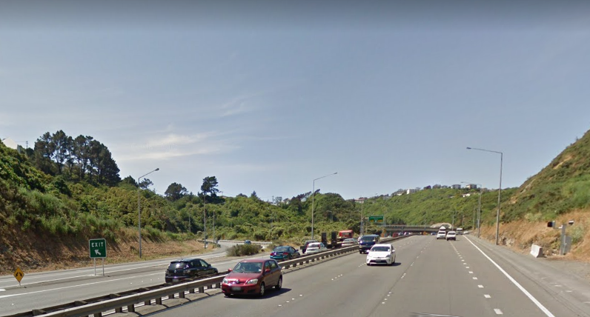
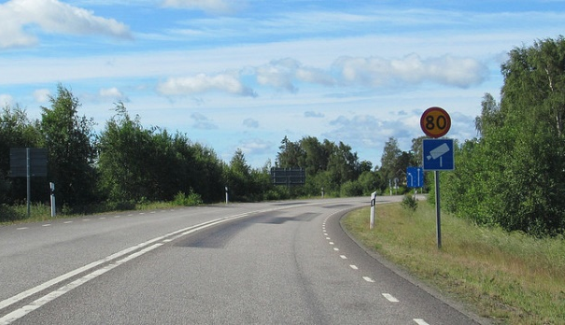
A new approach to safety cameras – moving towards the Swedish model
A new approach would include the following components:
Additional safety cameras would be rolled out and installed on the highest risk parts of the network.
Cameras would be made clearly visible and well-sign posted so that road users have advanced warning they are approaching a camera.
Public messaging would be focused on explaining the purpose of safety cameras, the risks of speeding and why they are located in certain locations.
In addition:
The current back-office processing system is reaching the end of its life and will be upgraded, allowing for the introduction of more cameras and different types of cameras including average speed cameras.
Police currently owns the camera network and processes infringement notices. The option of transferring ownership and operational responsibilities of the camera network to NZTA is being considered.
No signage to alert motorists of camera
Upcoming camera is clearly signed

Slide 15
What next?

Slide 16
Delivery and next steps
Before end 2019: Strategy and first action plan published
Other key steps between now and end 2019 to progress specific actions will include:
Consultation on Accessible Streets
Policy decisions on the Tackling Unsafe Speeds package
Rule changes to mandate ABS in motorcycles
Big programme of road improvements thorugh NZTA’s Safe Networks Programme
Q1 2019 (Jan – Mar) | Q2 2019 (Apr – Jun) | Q3 2019 (Jul – Sep) | Q4 2019 (Oct – Dec)
Engagement and research to develop proposed
strategy and immediate actions
Before end 2019:
Strategy & first action plan published
On-going engagement
and finalisation
of consultation
documents
4 week
public
consultation
Analyse
submissions,
Finalise
strategy
PAGE 19

Slide 17
How the system works
Crown appropriations
Government outlines objectives and funding for land transport
GPS
National Land Transport Fund
NZTA sets out projects to be funded from NLTF
NLTP
Regional councils outline their transport priorities
RLTPs
Local share

Slide 18
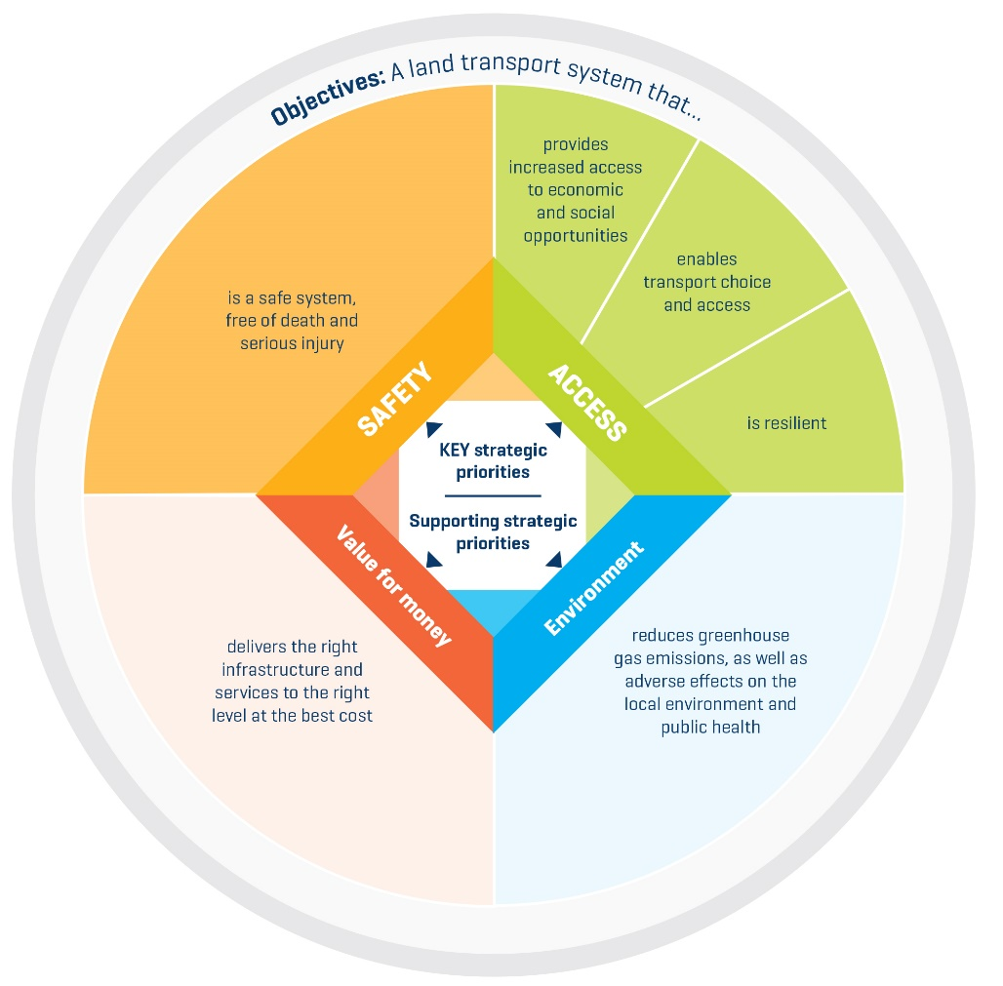
GPS 2018 was ambitious

Slide 19
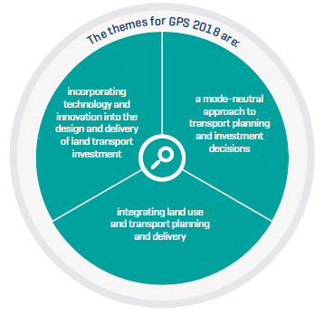
3x Themes
The themes delineate how the results should be delivered to ensure the best transport solutions for New Zealand are achieved.

Slide 20
Greater ambition means greater calls on the NLTF
Current GPS commitment
Revenue Pressures
Previous
GPS commitment
NLTF
Environment Policy
Rail
Other cost pressures

Slide 21
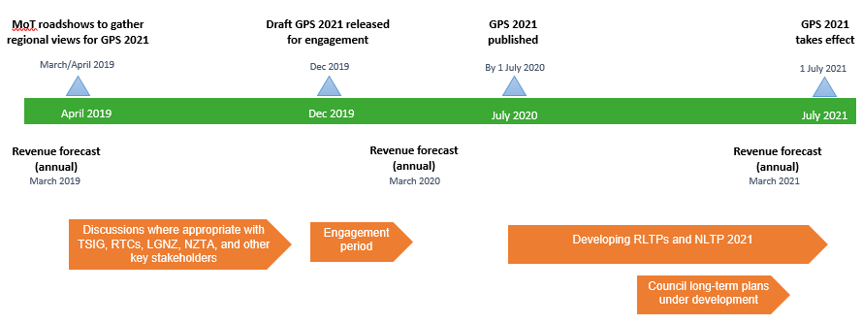
GPS 2021 development timeline
April 2019
Dec 2019/ Jan 2020*
July 2020
July 2021

Slide 22
We heard views from the region at our roadshow
Positive feedback on GPS 2018 direction
Sudden change in direction at short notice caused difficulties for the region
Suitability of mode shift varies between sub-regions
GPS timing is very important, consider local elections

Slide 23
Bay of Plenty regional transport update – Aug 2019
Safety is a major issue in the region
  Particularly along SH routes (e.g. SH2/SH29), and key urban areas
Roads are vital part of the region’s transport network
  Safety and access improvements.
  NZTA are investing more than ever before in public transport and walking/cycling in urban areas.
Urban Form and Transport Initiative (UFTI) launched in December 2018
  Strategy development and planning is underway
  Draft Foundation Report expected in August and a final report by December 2019.

