Slide 1
Essential Freshwater

Slide 2
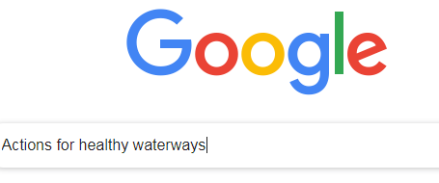

Slide 3
Essential Freshwater Scope
Set and clarify policy direction
Support delivery of safe drinking water
Raise the bar for ecosystem health
Better manage storm water and wastewater
Improve farming practices

Slide 4
Timeline
Proposals released discussion document National Policy Statement National Env. Standards | Stock exclusion Regulatory Impact Statement (RIS) | 5 Sept
Public meetings in Rotorua (5.30 – 7.30pm Rydges) |  | 18 Sept
Submission period closes |  | 17 Oct
Subject to change - submissions, panel recommendation, government processes |  | Nov - March
Resource Management Act changes introducing streamlined planning process late this year |  | Late 2019
NPSFM and NESFM effective from mid-2020 |  | Mid 2020
Three Waters proposal consultation mid-2020 |  | Mid 2020

