Slide 1
Tauranga Moana Water Management Area NPS-FM implementation update (Plan Change 16)
16 August 2019

Slide 2
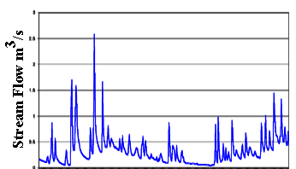
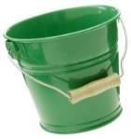
Plan Development
TE MANA O TE WAI
Allocation limit
Reliability/variable flow restrictions
Minimum flow
QUANTITY
recharge
Allocation limit
Nutrients
Minimum level
Sediment
Bacteria
QUALITY
Values
Attributes
Objectives
Limits
Methods

Slide 3
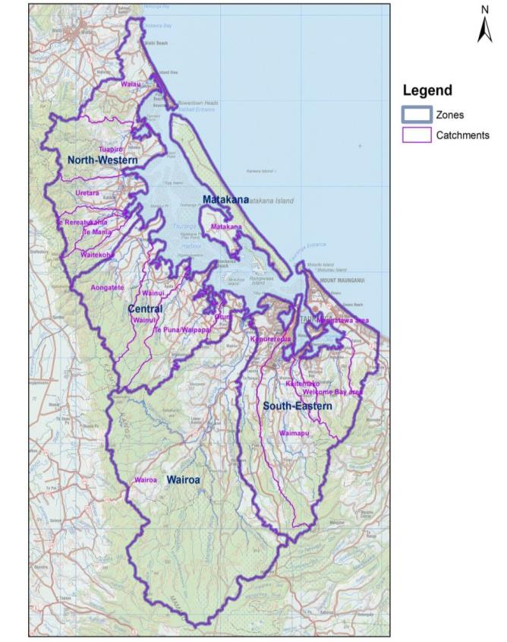
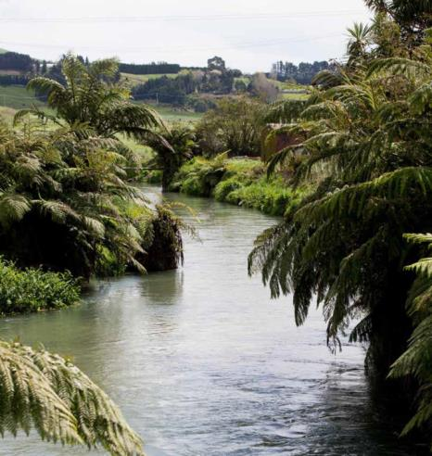
Tauranga Moana WMA:
Surface water catchments and “zones”

Slide 4
Fishing effort (sports fish) (Source: Unwin 2016, NIWA)

Slide 5
Recreational use (n=710) (Source: Matthews 2018, YSM Research)

Slide 6
Agricultural Statistics (Source: Agricultural Production Census, StatsNZ)

Slide 7
Horticulture Statistics (Source: Agricultural Production Census, StatsNZ)

Slide 8
Economic value and employment

Slide 9
Surface water quantity (Te Mania)
0.051

Slide 10
Surface water allocation and consents (as of August 2018)

Slide 11
Groundwater allocation and consents (as of August 2018)

Slide 12
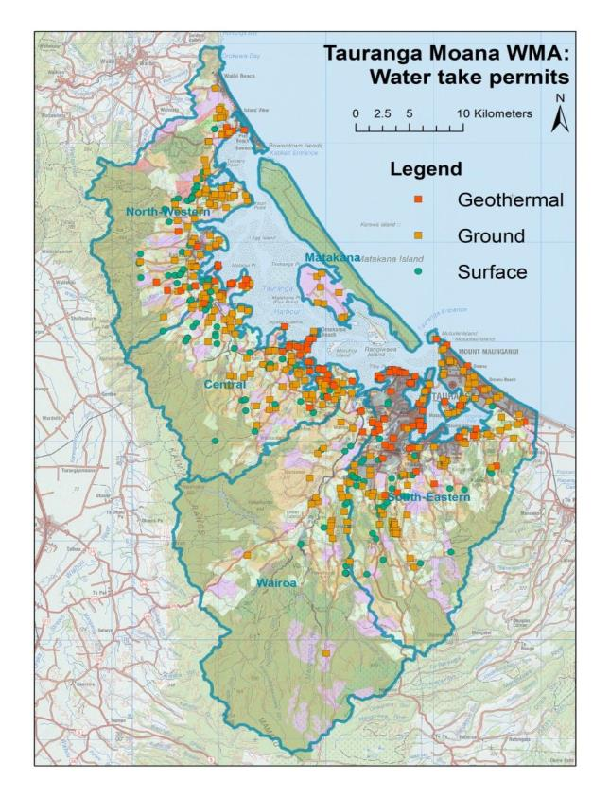
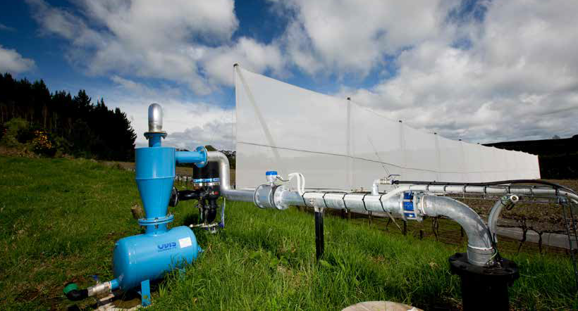
Water take consents

Slide 13
Some challenges: poor data

Slide 14
Estimated permitted/unconsented surface water takes (Source: Rutter et al 2015, Aqualinc)

Slide 15
Estimated permitted/unconsented groundwater takes (Source: Rutter et al 2015, Aqualinc)

Slide 16
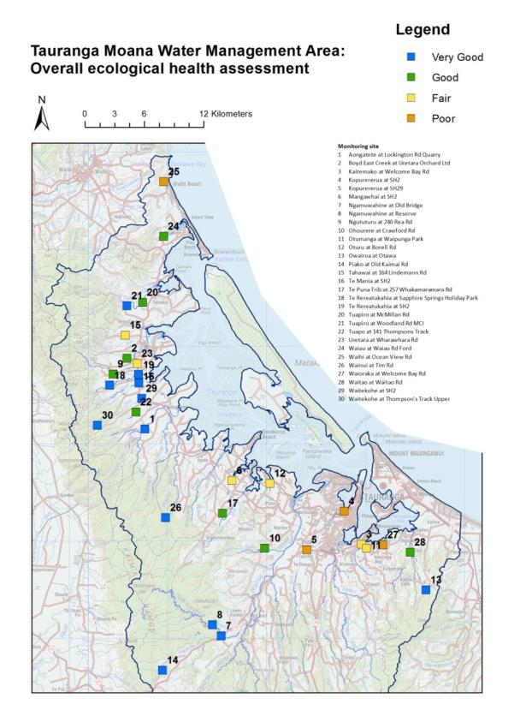
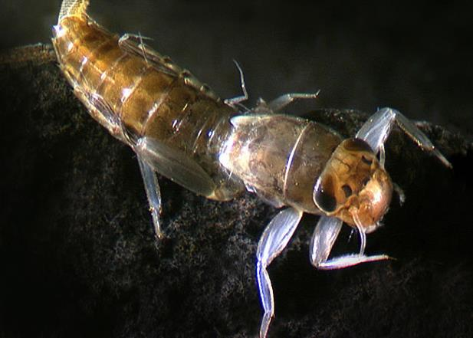
Overall ecological health assessment (Source: Lawton et al 2019, Tauranga Moana SoE report)

Slide 17
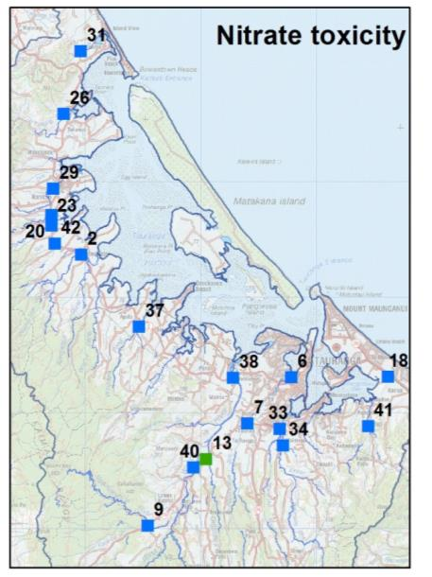
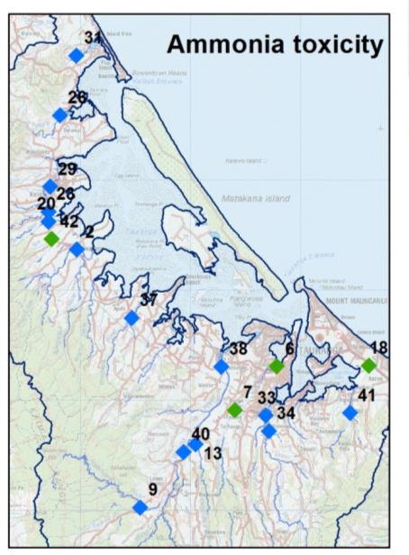
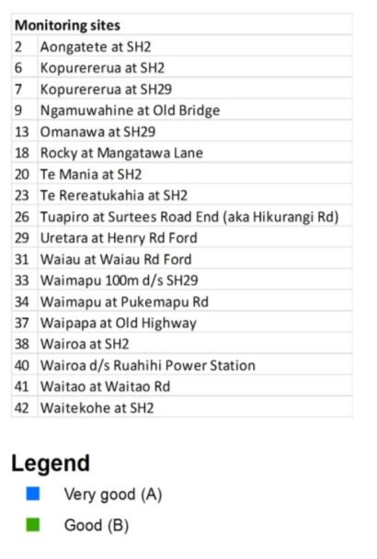
Nitrate & ammonia toxicity (Source: Carter et al 2018, Freshwater in the Bay of Plenty & Lawton et al 2019, Tauranga Moana SoE report)

Slide 18
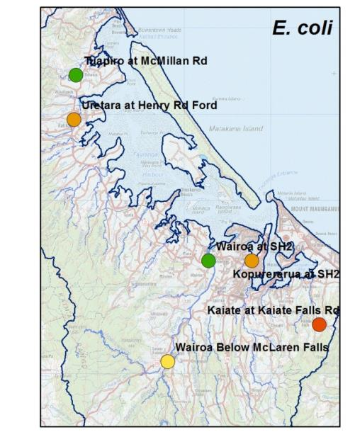
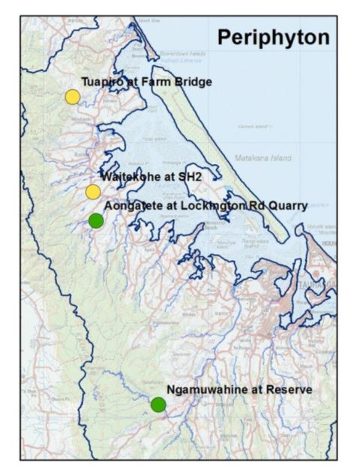
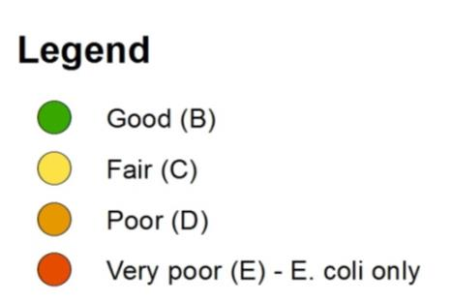
E. coli & periphyton (Source: Carter et al 2018, Freshwater in the Bay of Plenty & Lawton et al 2019, Tauranga Moana SoE report)

Slide 19
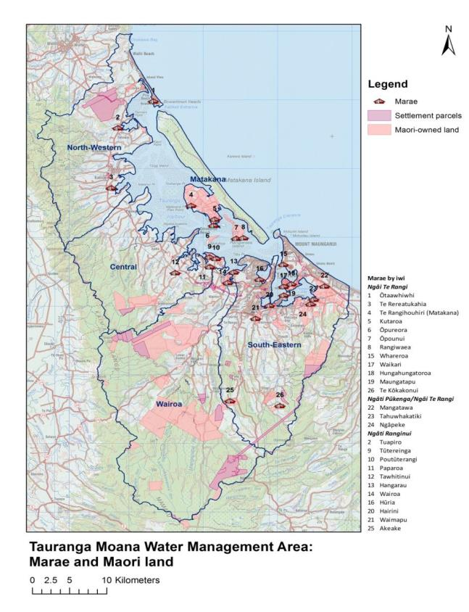
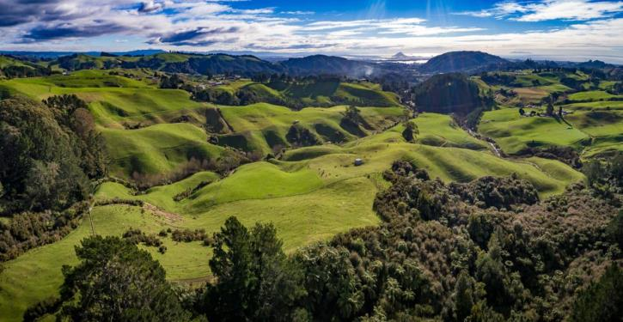
Māori-owned land

Slide 20
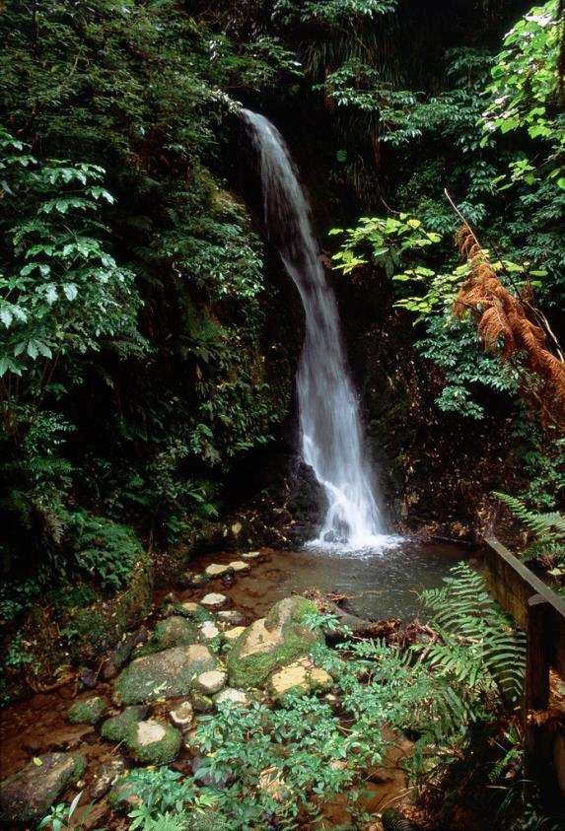
Work currently underway
Review of stormwater discharge consent monitoring data
Advice on integrated catchment models
Groundwater model

Slide 21
Next steps:
Central government Essential Freshwater proposals and response
Wai Māori Kaupapa: cultural flow assessments, mana whenua values, Matauranga Māori
Harbour requirements
Freshwater Management Units
Stakeholder and community values
Decisions on catchment modelling

