Slide 1
Achievements of the 2016/19 Triennium
Public Transport Committee, 9 August 2019

Slide 2
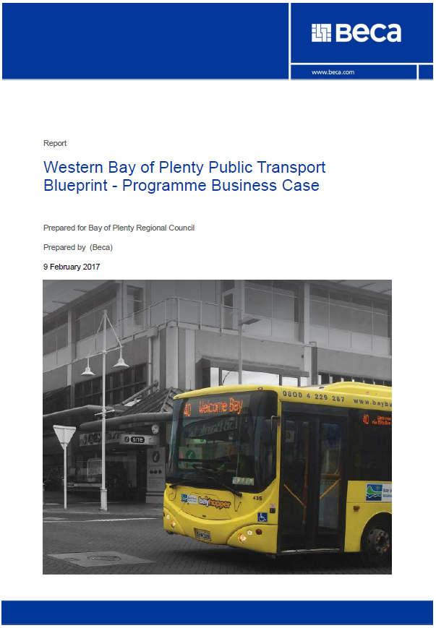
Blueprint, Blueprint, Blueprint …
Strategic Business Case (Feb ‘16)
Programme Business Case (Feb ‘17)
Detailed Business Case (Sep ‘17)
Procurement (Q2/3, ‘17/18)
Commencement (Dec ’18)
Phases 1, 2, 3 (2019)

Slide 3
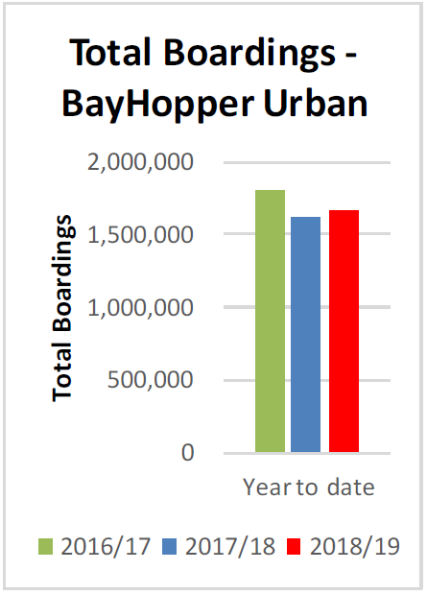
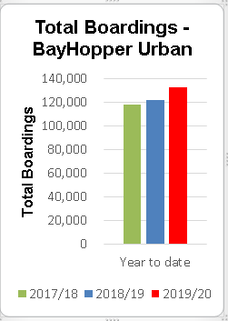
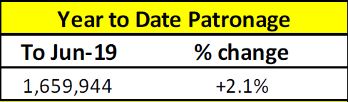


Slide 4

Collaboration/Partnership
Blueprint
RITS
UFTI
With:
  TA partners
  Govt partners (NZTA)
  Regional council partners

Slide 5

Technology
Wi-Fi:
  Western Bay
  Rotorua
  Eastern Bay
Real time

Slide 6
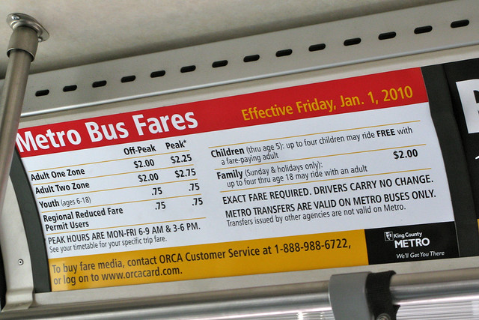
Rotorua Concession Bus Fares (2018)

Slide 7


2017 NZTA Procedural Audit

Slide 8
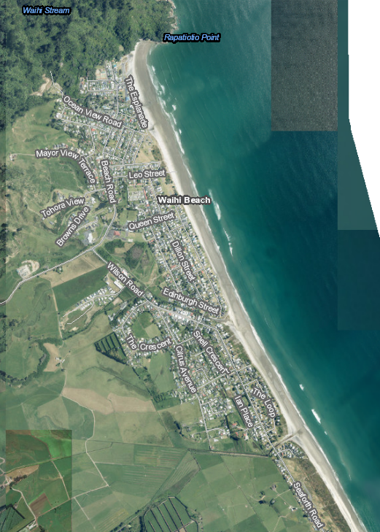
New Services
Additional Tauranga school bus services
Tauranga routes 36 (Pāpāmoa), 41 (Maungatapu) & 71 (Matua)
Waihī Beach
Ruatāhuna
Additional tertiary / commuter

Slide 9

School Student Bus Fare-Free
Welcome Bay 2019
Tauranga City-wide 2020
On:
  Urban
  School

Slide 10
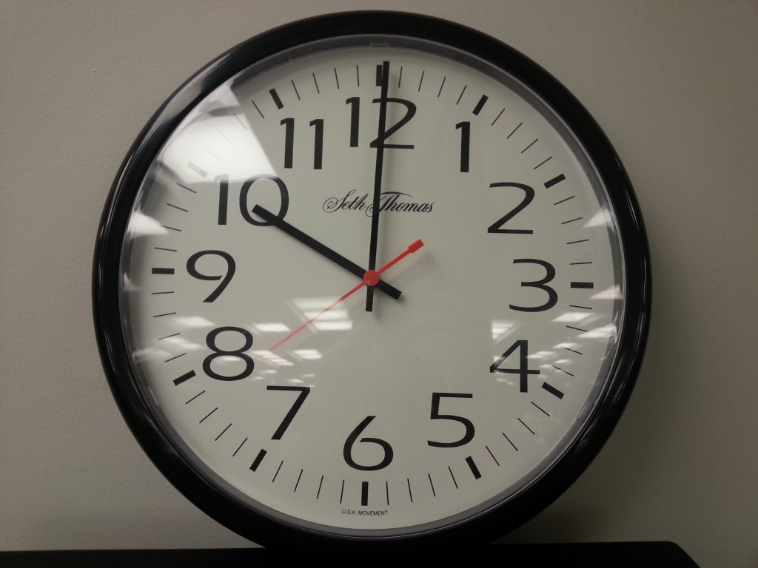
SuperGold Card Concession Hours
Trial extended hours in 2019/20

Slide 11
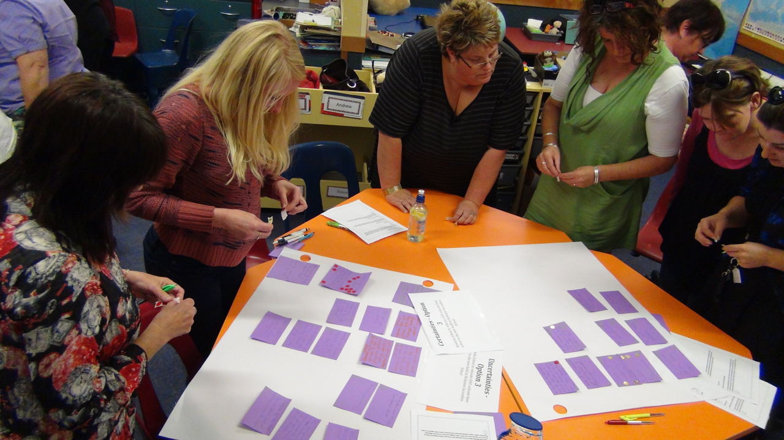
Engagement with Public / Stakeholders

