Slide 1

Western Bay of Plenty Public Transport Implementation Plan
2019/20-2021/22

Slide 2
Overview
Coordinates existing projects from
  Regional Public Transport Plan
  PT Blueprint
  Council decisions
  Existing staff initiatives
Provides a structure for working collaboratively to achieve Blueprint outcomes
Scope is not limited to the Blueprint
Has alignment with UFTI

Slide 3
The implementation plan
Includes an action plan;
Reiterates why we are improving public transport;
Outline how we will track the delivery of the action plan;
How to make amendments to it; and
Ensure its delivered on time.

Slide 4
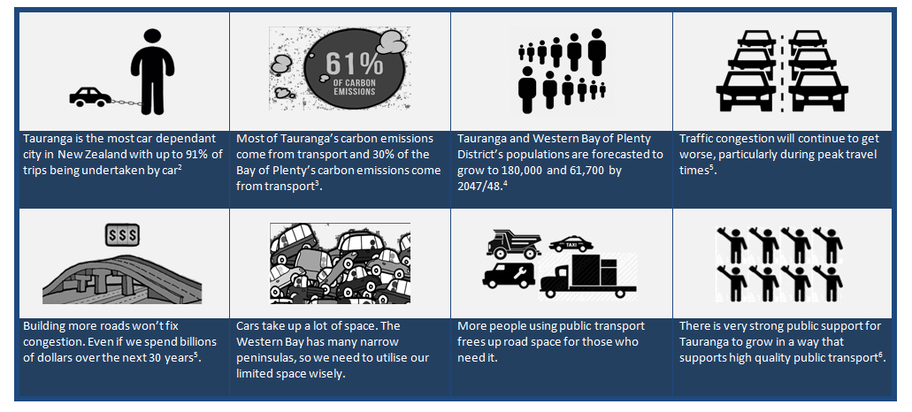
Why do we need to improve?

Slide 5
Action Plan
List 1: Confirmed and committed projects(in scope)
List 2: Un-committed projects (out of scope)
List 3: Urban form and transport initiative projects

Slide 6
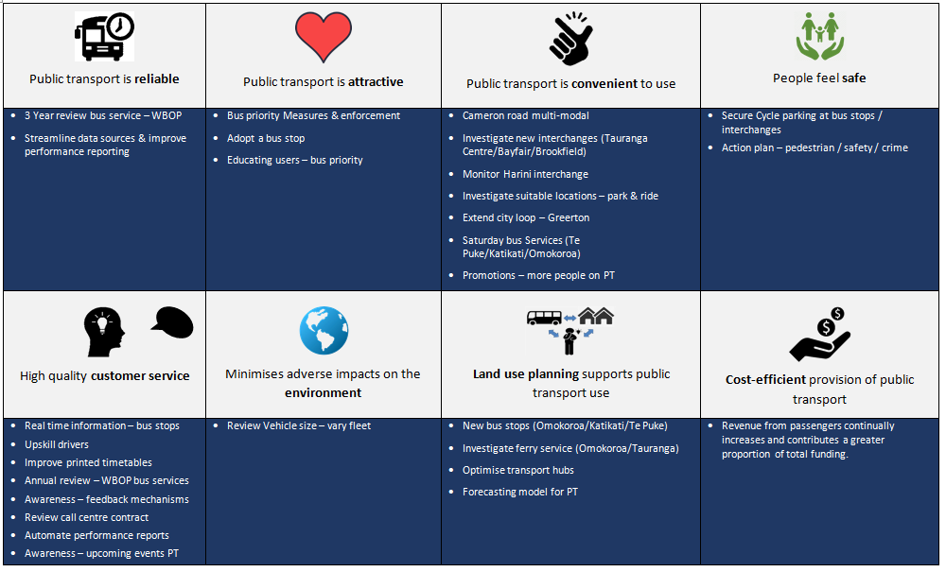
Linking action to outcomes

Slide 7
Next steps
Finalise the Implementation Plan based on feedback
Engage a project coordinator to motivate and monitor progress
Track progress of projects within the action plan
Report back on progress

