Slide 1

Focus Catchments
Tauranga Moana Advisory Group
16 August 2019

Slide 2
Focus Catchments
A new approach to engagement and incentives, targeting 11 small at-risk catchments where water quality and in-stream ecology can be monitored and managed ahead of NPS-FM Plan Changes

Slide 3
Why Change?
MfE Essential Freshwater alignment
LTP 2018-28 Swimmability KPI
Focus on outcomes
Links policy, science and land mgmt
Links to industry, eg Fonterra 50CP

Slide 4
What’s not changing?
Biodiversity programme
Care group support
Coast Care / Estuary Care
Land management advisory services

Slide 5
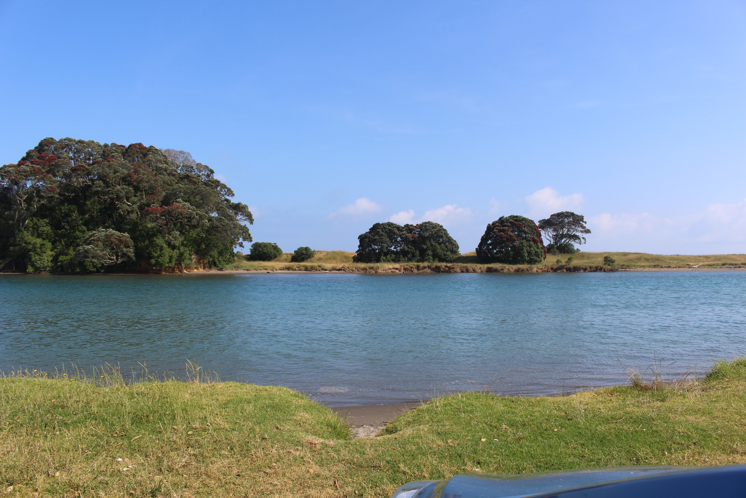
Selection Process
Divider slide

Slide 6
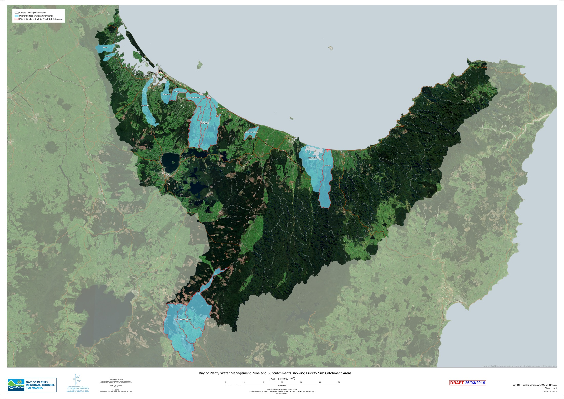
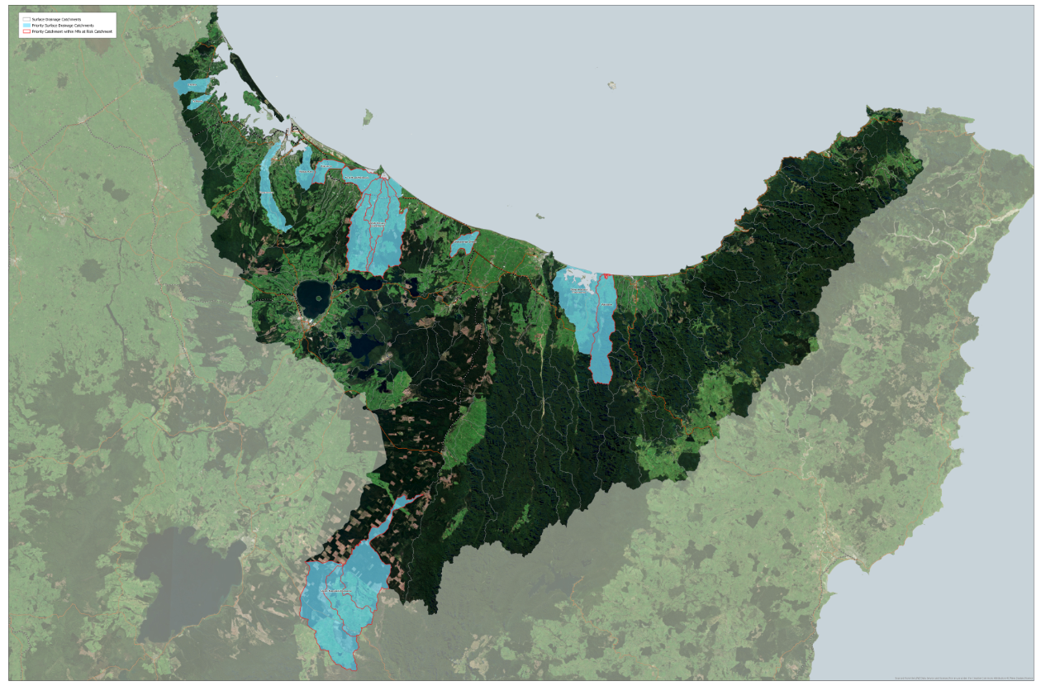
Insert Map

Slide 7
Farm Environment Plans
Fonterra Tiaki Template (Dairy)
NZ Gap Environment Management System (Fruit and vegetables)
Beef and Lamb Land Environment Plan
Overseer, MitAgator, LUCI…

