Slide 1
Freshwater update Te Maru o Kaituna River Authority
28 June 2019

Slide 2
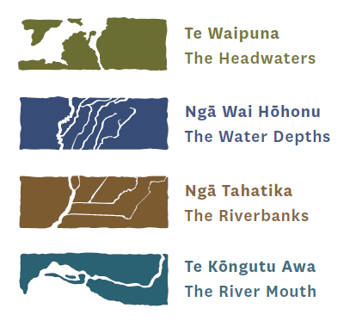
Kaupapa
Regional update
Kaituna water management area PC12
National update

Slide 3
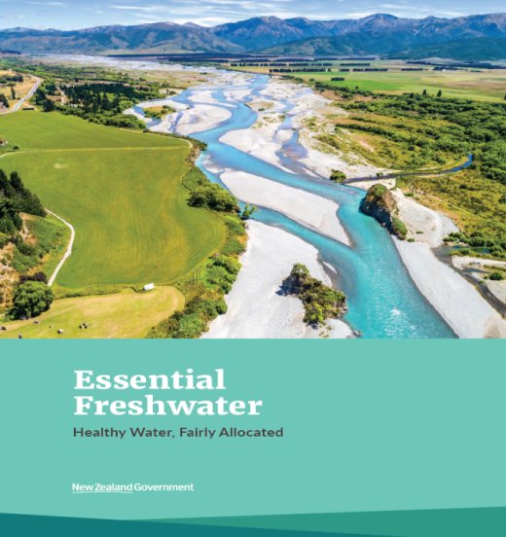
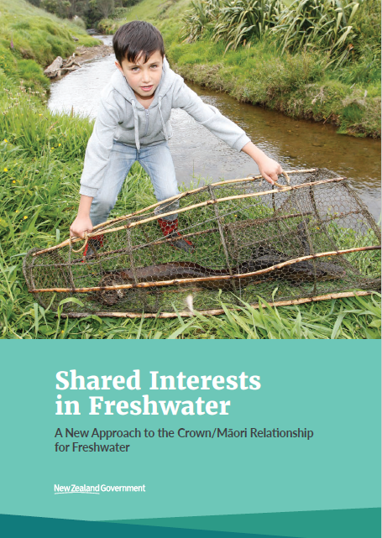
National Update – Essential Freshwater
Amendments to RMA, NPS-FM & new NES
Public consultation Aug/Oct 2019?
Large policy package to:
Stop degradation and loss
Address past damage
Address allocation issues

Slide 4
Regional update
Plan change 9 – Region Wide Water Quantity
First step in two stage process to improve water allocation limits
Plan Change 10 – Lake Rotorua Nutrient Management
Awaiting Environment Court interim decision – stage 1 matters
Pre mediation meeting with appellants
Suggested solutions to be discussed with Toi Moana subcommittee

Slide 5
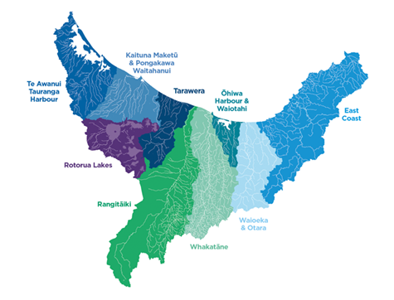
Kaituna / Pongakawa /
Waitahanui & Rangitāiki
Recognising & providing for Kaituna River Document
Plan change 12

Slide 6
Kaituna-Pongakawa-Waitahanui timing (PC12)
! Dependent on …
National Policy
Plan Change 9 progress
Water quantity modelling...
Solution building
Now-late 2019
Drafting
Mid – late 2019
Publish
Draft Plan Change
Late 2019
Notify Proposed Plan Change
Mid 2020
Hearings
Discussion document / public communications

Slide 7
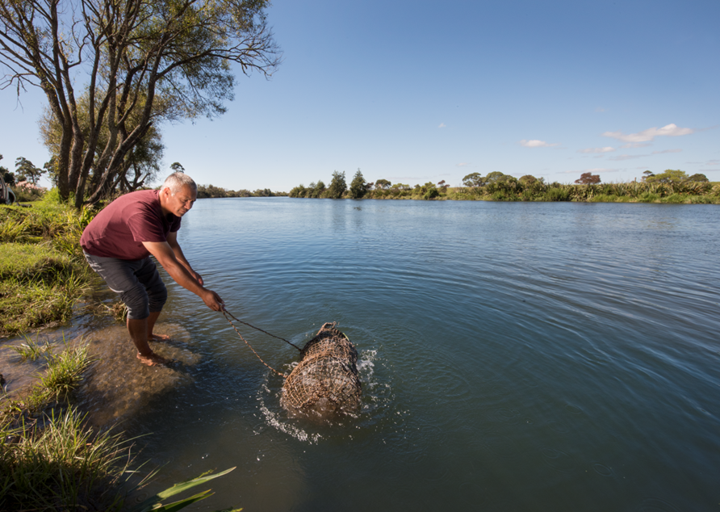
Water quality and ecology issues
Poor ecological health in estuary
Mahinga kai, cultural and recreation values affected
Sediment, phosphorus and nitrogen loads from the catchment are key contributors
Contact recreation / swimming in rivers
Safe at monitored freshwater sites
Some lower catchment water bodies may not be safe
Compromised in estuary some of the time

Slide 8
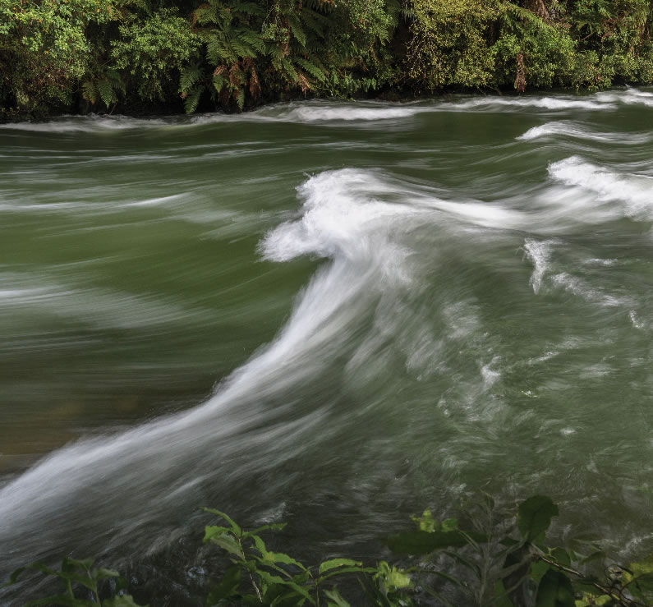
Water quality and ecology cont. issues
Algal growth in rivers & streams generally not an issue
Ecological health and connectivity compromised in lowland water bodies
Ammonia and nitrite toxicity risks indicated in lowland drainage canals only (not an issue elsewhere)
Worsening nitrogen trends (still within A band)
Localised high E.coli affects swimming and mahinga kai
Increasing nitrate in freshwater
Increasing demand on resources
Declining estuarine health
Estuary not always swimmable, affects social and cultural values

Slide 9
Draft measurable objectives
 | objective is met |  | objective not met |  | insufficient data
Future Management Unit (FMU) | Lower Kaituna | Mid-Upper Kaituna | Waiari Water Supply | Lower Pong-akawa | Mid-Upper Ponga-kawa | Waita-hanui
Attribute | Objective
Macro Invertebrate Community Index (MCI) | B | B | A | B | B | A
EPT - Ephemeroptera (mayfly), Plecoptera (stonefly) and Trichoptera (caddisfly) | B | B | A | B | B | A
Bay of Plenty Index of Biotic Integrity (BOP­­_IBI) | B | B | A | B | B | A
Periphyton | B | A | A | B | A | A
Macrophytes | < 50% | < 50% | < 50% | < 50% | < 50% | < 50%
Nitrate-nitrogen (toxicity) | A | A | A | A | A | A
Ammonia-nitrogen (toxicity) | A | A | A | A | A | A

Slide 10
Draft measurable objectives cont.
 | objective is met |  | objective not met |  | insufficient data
Future Management Unit (FMU) | Lower Kaituna | Mid-Upper Kaituna | Waiari - Water Supply | Lower Pongakawa | Mid-Upper Pongakawa | Waita-hanui
Attribute | Objective
Dissolved Oxygen (below point sources) | B | B | A | B | B | A
Acidity (pH) | B | B | A | B | A | A
Temperature (Cox-Rutherford Index) | B | B | A | B | A | A
Flow habitat protection level for indicator species
E. Coli | B | B | A | B | A | A
Benthic Cyanobacteria | A | A | A | A | A | A
Cyanobacteria- planktonic | A | A
Toxicants/irritants | >90% | >90% | >99% | >90% | >90% | >90%

Slide 11
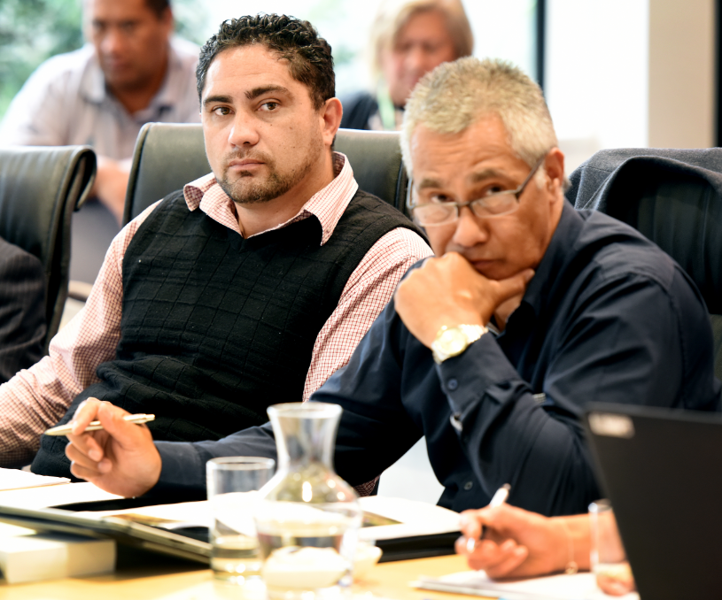
TMoK governance
Ensuring Kaituna, he taonga tuku iho recognised & provided for in planning docs
Advice & recommendations to Toi Moana at key steps throughout plan change process
Facilitate iwi participation in PC12 process

Slide 12
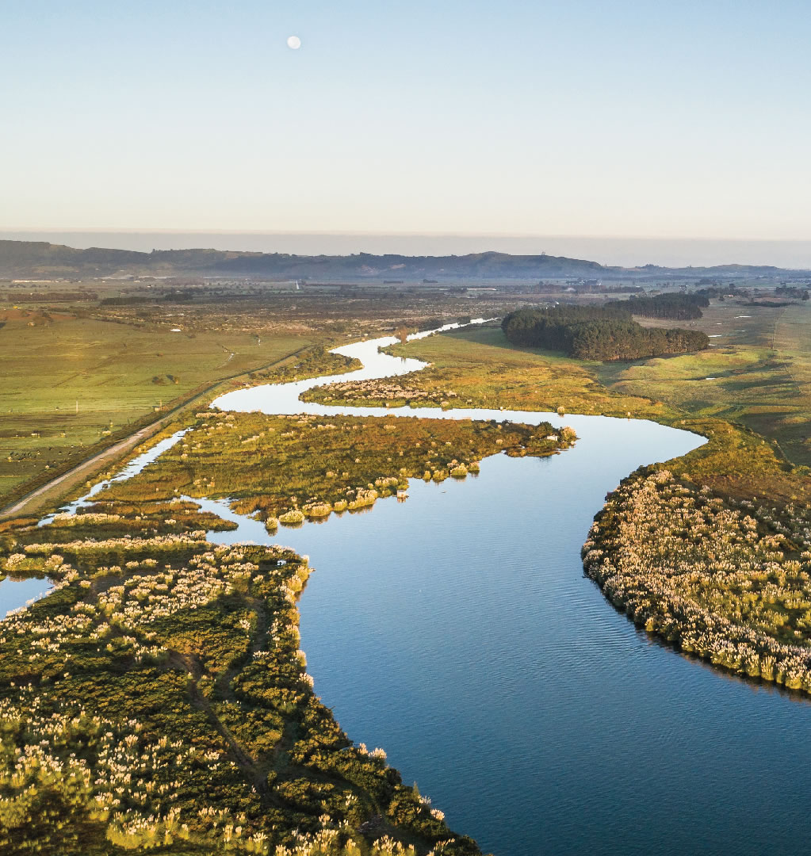
TMoK advice and river doc contribution
‘Agreed standards’ for water quality mauri of the water
Identify and recommend specific swimming locations, depth & location required for taunga waka, places for cultural ceremonies & water quality requirements
Te Mana o te Wai – is there a TMoK collective view
How mātauranga Māori can be woven into monitoring framework
Align action plan priorities

Slide 13
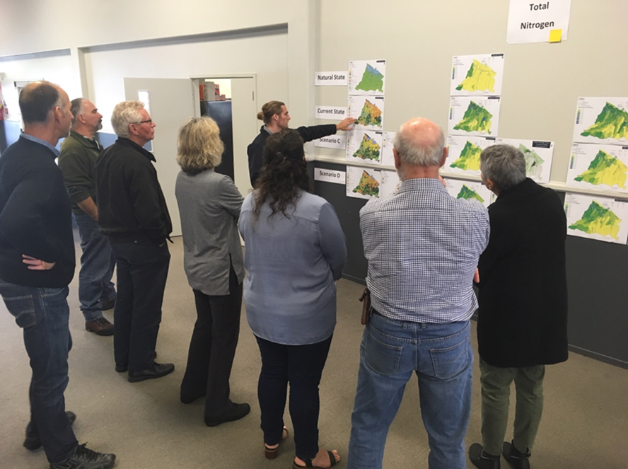
Kaituna Freshwater Community Group
Workshop 10
Surface water quality modelled good practice results

Slide 14
Implications
 | Estimated reduction needed | Approx. reduction achieved
Contaminant | Maketū (after re-diversion) | Good management practice & + current land use
Nitrogen | 63% | 10%
Phosphorus | 38% | 8%
E.coli^ | 60% | 10%
Sediment | ?* | 1%

Slide 15
Conclusions
Good practice requirements across all land uses:
will start to reduce contaminant loads to estuaries
alone will not achieve anywhere near the reduction needed to achieve moderate estuary health
Further reduction options should be considered including
actions requiring more substantial investment
changes in farm systems/land use
regulation and/or public investment in land/works

Slide 16
Next steps
Staff complete draft assessment:
options for “holding the line” and “reducing the load”
options re targets and timeframes
initial assessment of costs, benefits, affordability, social/cultural/economic/environmental impacts
implications of national policy proposals
uncertainties/information gaps and implications for decision making
iwi/hapū, Te Maru o Kaituna, community group, and community feedback to date

