Slide 1
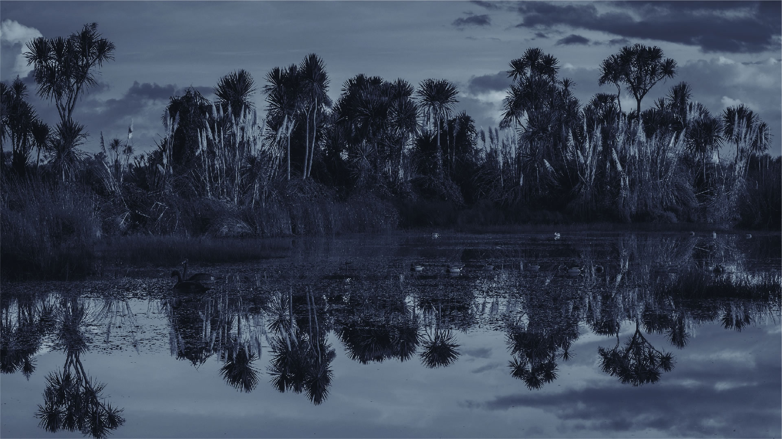
Draft Kaituna Action Plan
Elva Conroy (consultant)
28 June 2019

Slide 2
What we will cover today
1. Plan Overview
Structure and format
Content
2. Next steps
Engagement
Timeframes
Plan design

Slide 3
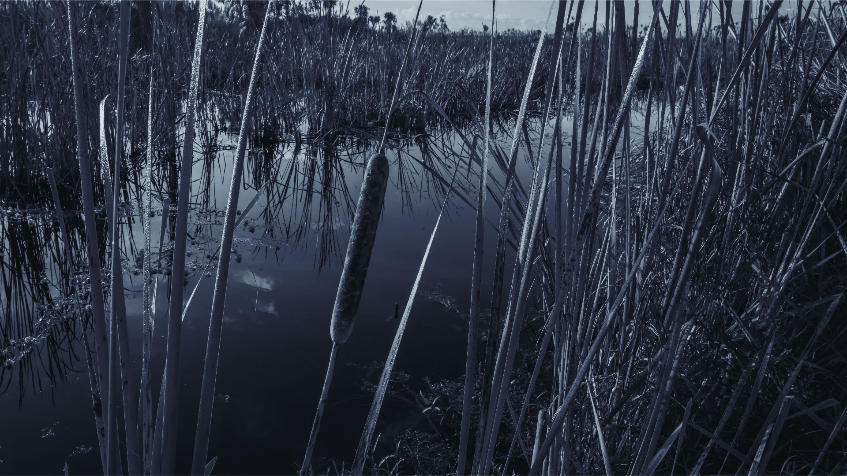
Plan overview

Slide 4
The Brief: Write an Action Plan
To give life to the Kaituna River Document
AND IN PARTICULAR:
Reflect matters raised in submissions, IMPs etc.
Meet KRD objectives and outcomes, particularly those relating to restoration projects, cultural recognition elements (pou), education and wetlands.
Include clear and measurable actions
Lead to coordinated and collaborative on-the-ground action.

Slide 5
Plan Overview: Guiding principles
For this Plan to be successful, we will do the following:
Kia whakakotahi | Integrated thinking and action - We will take an holistic and whole systems approach to improving the health of the Kaituna River.
Kia whakapiri | Collective action - We will work together to effect positive change for the Kaituna River and all it sustains.
Kia whakamārama | Collective enlightenment – We will share information / stories / data to build our collective awareness and understanding about the Kaituna Catchment.
Kia whakamana | Community empowerment – We will encourage our communities to lead and/or be part of projects within the Kaituna River catchment. This includes tangata whenua, local care groups and schools.

Slide 6
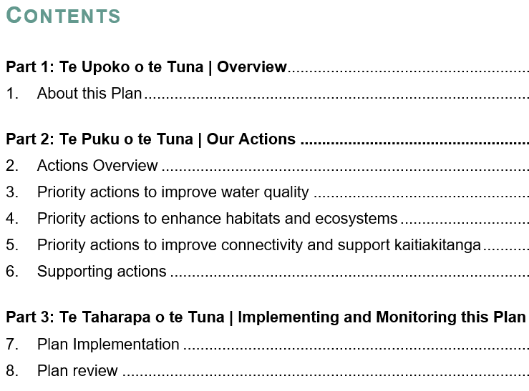
Plan Overview: Structure and Format
Plan Theme: Tuna / Eel
Plan name
Plan structure
Plan actions

Slide 7
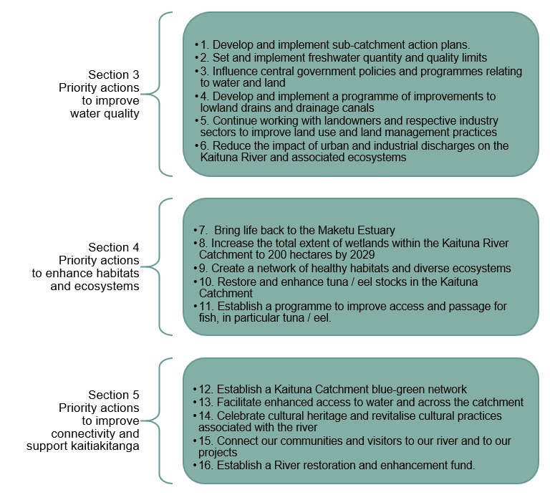
Plan Overview: Our draft Actions
Action
Sub-action / project
Overview / Introduction
Sub-action / project
Work programme
Actions (10 years) + Projects (1-3 years)
Concurrent implementation
Plan coordination

Slide 8
Next steps

Slide 9
Engagement
Provide feedback loop + confirm suite of actions / projects
Draft plan made publicly available with online survey
Email to individual submitters with link and feedback loop
2-3 workshops / drop in sessions
Okere including recreational users
Maketu and/or Te Puke
To be completed 1st week of August

Slide 10
Timeframes and plan design
Te Maru o Kaituna Workshop
22 Feb & Mar 2019
Plan engagement July – early August
Working draft of the Action Plan 28 June 2019
Plan to Te Maru o Kaituna (for approval 30 Aug 2019
Incorporate feedback 9 August
Plan launch December 2019
Document format:
Word version
Word version
Publish-ready version

