Slide 1
Overview
“We are the mana”: Mana of Hapu of Te Whanau a Apanui and What this means in Practice
  Refer to Te Oniao Presentation (separate attachment & Komiti Maori Presentation on 18 December 2014 at Maungatapu marae)
  We, hapu, own the water in our freshwater catchments including surface and aquifer.
What the Crown and Local Government can do to recognise the mana of Hapu within Te Whanau a Apanui.
  Current Crown process and AIP (separate attachment)
  Delegation of Powers, Consenting Authority, Power sharing.
  What do we get for $55,000 rates in Te Whanau a Maru that we can’t do ourselves for ourselves?
Te Whanau a Maruhaeremuri Hapu Trust:
  60 hectares of high value horticulture approved over last 2 weekends (Raekahu 17B and Tawaroa Toopu Trust) from maize and sheep & beef.
  Seeking with BOP RC:
  NPS, Monitoring & Sharing Data
  Investment from Quayside Investments Limited directly in to our region
  Support for 11 house Papakaenga development
  Support for workforce development.

Slide 2
Key Points
“The Masters Tools will Never Dismantle the Masters House”
Ownership is the language that Pakeha understand. Let’s go there.
“Let’s start with ‘we own the freshwater’ and fight from there” Hon Koro Wetere.
The Crown and Councils are our enemy. The people change but the system remains the same.
We need new tools, jointly developed, jointly resourced and implemented by hapu.

Slide 3
Tamati Kruger – Te Oniao Conference
“Te Urewera is the land, the forest, the water, the life within and the air space”
“The councils have no power in Te Urewera… nor does DOC”

Slide 4
Turanga Iwi Waimaori
“The real enemy for our whanau and hapu aspirations with respect to freshwater is the council. Unless there is real change by the council, these hui are a waste of time”
Tutekawa Wyllie
Next Steps for Rights and Interests in Freshwater in Turanga
January 2015

Slide 5
“In Te Whanau a Apanui, we believe that you cannot put a rahui over something you don’t own”
Rikirangi Gage, ICF Wananga/Hopuhopu February 2012

Slide 6
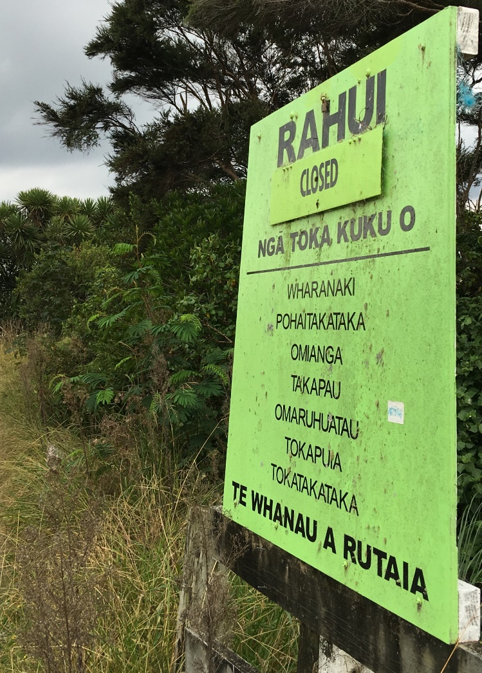

Slide 7
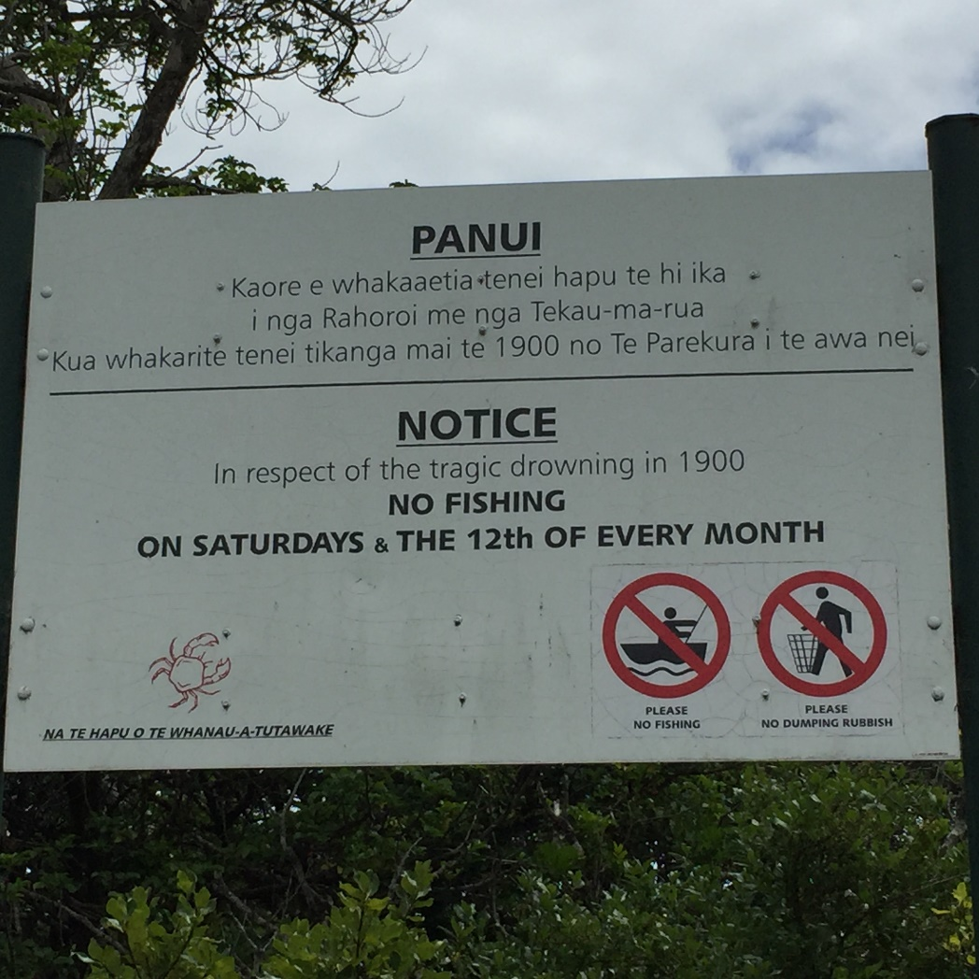

Slide 8
“Ko te tikanga te ture ki teenei takiwa. Kaare i koo atu, kaare i koo mai.”
(Tikanga is our law. Full stop.)
Kylie Poihipi, August 2013

Slide 10
Komiti Maori
Maungatapu Marae
18 December 2014
”One estimate found the settlement of iwi rights to fishery quota increased the value of quota (for all commercial users) by 45% through removing residual uncertainty…. A similar gain in the value of water assets to the primary sector would translate into a gain of $3.5b…”
Sapere (December 2014)
Notes:
Thank you for taking to time of our your busy schedules to this hui on Iwi Rights and Interests in Freshwater.
Over the coming two months the Freshwater Iwi Leaders Group are conducting a series of regional hui on Iwi Rights and Interests in Freshwater across the country.
The Freshwater Iwi Leaders Group has been tasked by the Iwi Chairs Forum to engage with the Crown in the context of the Crown’s ongoing policy work in relation to developing a new framework for the management of freshwater in Aotearoa.
These hui will serve as an important opportunity for the Iwi Leaders Group to provide an update on the work that has been achieved to date and to get feedback from you (and our respective marae, whānau, hapū and Iwi) on your aspirations in relation to the management, use and allocation of freshwater.

Slide 11
Waitangi Tribunal (2012)

Slide 12
Crown Position –
Supreme Court Decision (2013)

Slide 13
Prime Minister – 14 September 2012
“The government has a very clear position, it believes no one owns water, it does believe that on a case by case basis certain Maori may have rights and interests…but we don’t believe water is a nationalised issue; I don’t see the need for a national hui, national conversation.” Mr Key said.

Slide 15
Maori are Developers

Slide 16
Sapere Report (Dec 2014)
“We found that rights based regime offers strong advantages over a consents based regime”
[All quotes in this section are from the Sapere Report commissioned by the Freshwater ILG which was released on Monday, 15 December 2014. A copy is available]

Slide 17
Improved incentives for investment and capital formation
Consents are subject to various uncertainties and risks which impede investment, and are difficult to use as collateral for credit.
“The economic impairment resulting from uncertainty of existing consents will be substantial as the economic value of water to New Zealand is estimated by the Ministry of the Environment at $34.85b per annum”

Slide 18
Powersharing with iwi

Slide 19
Power Sharing
‘As with Mauao, this is about the restoration of mana. The Crown sought to confiscate our Maunga despite the protests of our tūpuna. DoC, on behalf of the Crown, became the owner and the Tauranga District Council the Manager. Tauranga Iwi fought hard for the return of Mauao over many decades. This was eventually achieved in 2008, outside of the Treaty settlement process. Tauranga Iwi are now the title holders and sole governors of Mauao. They set the vision for the future management and use of Mauao and co-manage with the Tauranga District Council. The public interest is protected under this arrangement. All costs are met by the TDC. A similar arrangement could work with Waimāori. Restore the mana and the rest will fall into place. As with the return of Mauao, the public need not feel threatened’.
(Hon. Mita Ririnui, Freshwater Hui, November 2014)

Slide 20
Options for Power Sharing
Separate Councils
Consenting Authority with Iwi
Independent Water Allocation Board
Co Governance
Co Management
Joint Committees
Accords/Protocols/Statutory Acknowledgements

Slide 21
Te Whanau a Apanui
Apanui could be their own council tomorrow.
The operational costs will be through ODC and BOPRC rates being paid to Apanui.
At the very least the following should be easy in the Apanui rohe:
  Consenting Authority
  Independent Water Allocation Board.

Slide 22
Te Whanau a Maru will determine what is best for Te Whanau a Maru: No one else.

Slide 23
Te Whanau a Maruhaeremuri Hapu Trust & NPS, Monitoring & Sharing Data
Seek Regional council to support monitoring of waterways in East Coast -support economic development & protect waterways. Currently there is limited continuous monitoring & little/ no information on groundwater
Hapu want a closer working relationship & discussions on how best to deliver NPS (Local limits)
As a result of economic development (consents required & monitoring of land) – Hapu see a better way as to how information is shared with Regional council & available for land owners to access
About to go through significant consenting in the Eastern BOP – Need to make sure these processes are efficient / enabling, whilst protecting the natural resources.

