Slide 1
Māori Drowning Prevention in the Bay of Plenty Presentation to BoPRC Komiti Māori
Neil McInnes
11 June 2019

Slide 2
Context
To provide BoPRC Komiti Māori with an overview of:
The Māori drowning statistics for BoP
The Bay of Plenty Water Safety Strategy
WSNZ’s Māori strategy refresh project
Note that
WSNZ has made submission to BoPRC 2019/20 Annual Plan seeking financial and other support for the Bay of Plenty Water Safety Strategy
WSNZ is currently assessing funding applications for 2019/20 from BoP and Māori providers

Slide 3
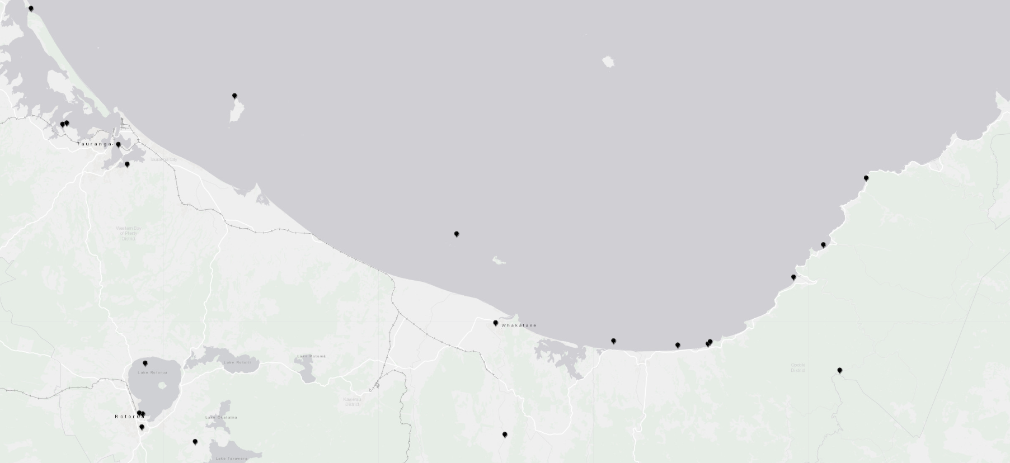
Bay of Plenty – Māori drowning deaths 2009-2018

Slide 4
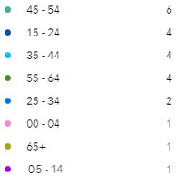
Bay of Plenty – Maori drowning deaths by age 2009-2018

Slide 5
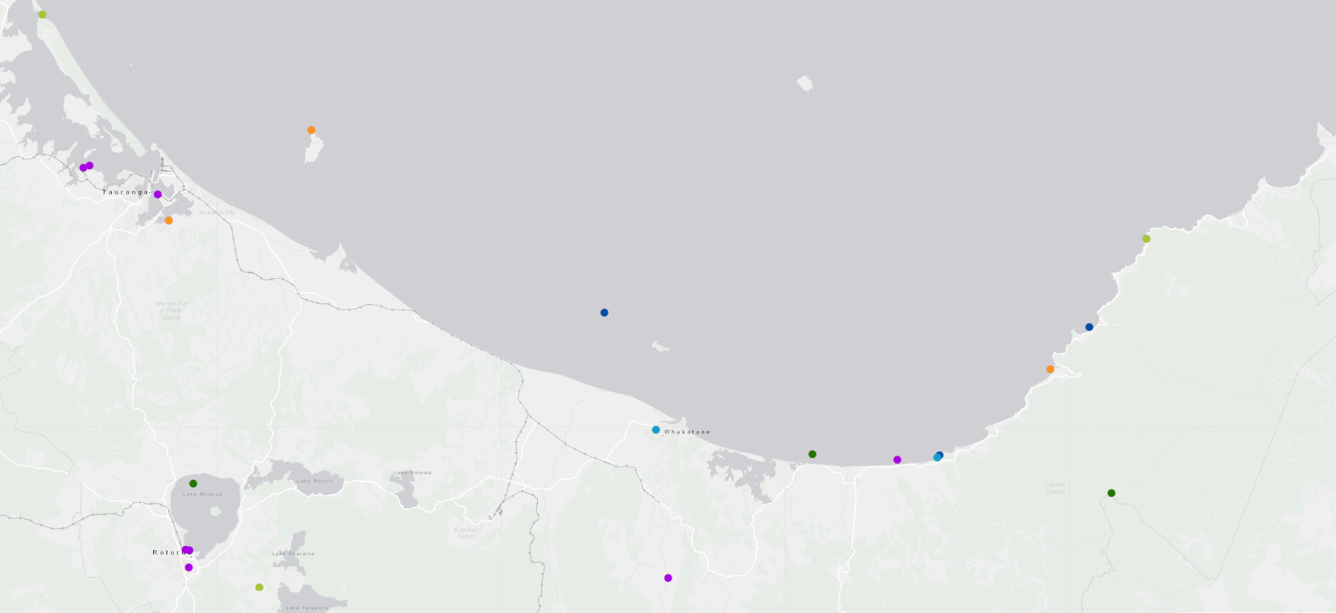
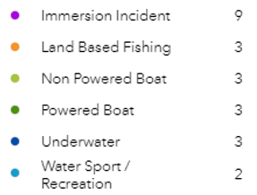
Bay of Plenty – Maori drowning deaths by activity 2009-2018

Slide 6
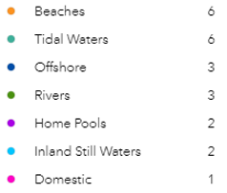
Bay of Plenty – Maori drowning deaths by environment 2009-2018

Slide 7
BoP Water Safety Strategy
WSNZ is facilitating the development of a series of water safety strategies in regions with high drowning rates
A strategy for BoP has been developed and an approach to implementation agreed
Recruit a Strategy Manager and house them with Sport BoP
The strategy identifies priority work streams and investment priorities for drowning prevention in BoP
The objectives of the strategy are:
Greater regional ownership of drowning prevention
Improved co-ordination of effort and capability across BoP
Increased funding and activity

Slide 8
BoP Water Safety Strategy
WSNZ made 3 of the drowning prevention priorities in the BoP strategy priorities in its 2019/20 funding prospectus
Recruiting a new manager to manage relationships with funded partners
WSNZ is asking BoPRC to:
Contribute to funding for the Strategy Manager
Work in partnership with WSNZ on signage, engagement with Māori and fresh water safety
Engage with the community of interested parties in BoP
Promote the strategy

Slide 9
WSNZ Māori Strategy refresh
WSNZ is refreshing its Māori strategy and seeking to improve its capability to work with Māori:
Being supported by Tangaroa Ara Rau – a Māori advisory group
Have a project plan with different work streams including:
Kia Maanu, Kia Ora
Relationships with Māori
Māori data, research and evaluation issues
WSNZ is looking to build relationships with iwi/Māori in areas where it has existing funding relationships and/or regional water safety strategies
opportunities for working with Bay of Plenty tangata whenua

Slide 10
He patai?

