Slide 1
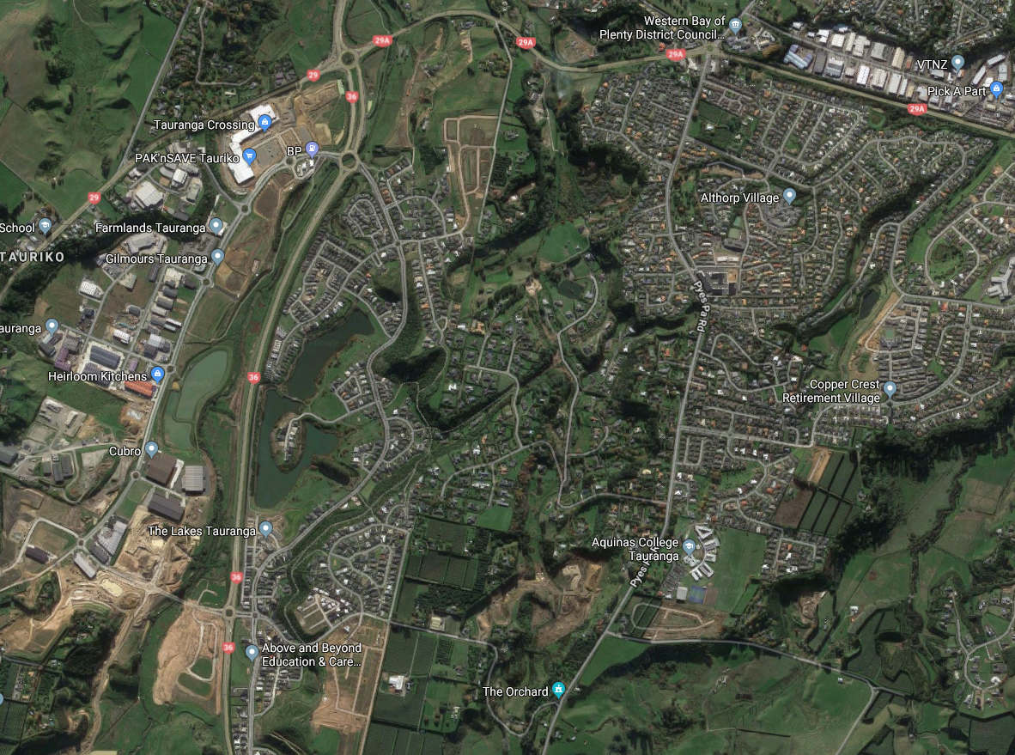
Havenbrook Village
Orange Grove Village
Althorp Village
Tauranga Crossing
Kennedy Road

