Slide 1

Phase 3 Review
Public Transport Committee
10 May 2019

Slide 2
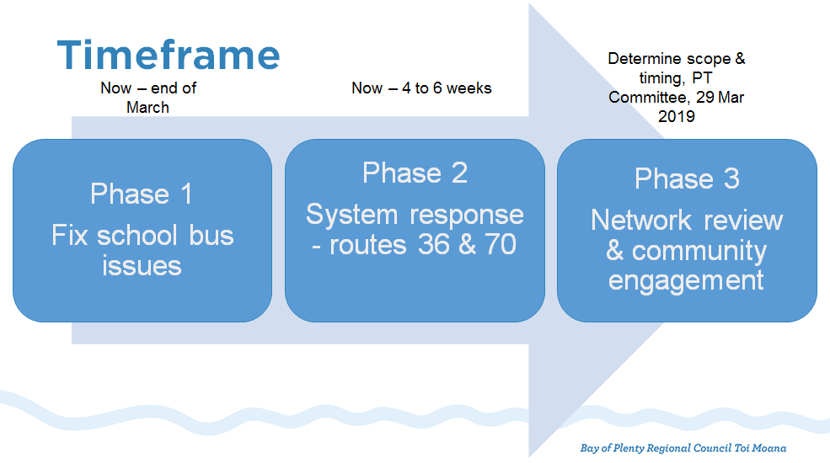
Phases

Slide 3
March 2019 Decisions
“2 Approves Phase 3 - Option 2 network review as described in Sections 3.2.2 and 3.2.3 of the agenda report …
4 The Network Review will include:
  identifying the differences in assumptions going forward from the assumptions on which the Blueprint was based on (including separate versus integrated school services, environment and customer behaviour);
  assessing whether these differences may have a significant impact on the philosophy and approach underlying the Blueprint; and
  if significant impact, then strategically review that element.”

Slide 4
Review Timings

Slide 5
Low Cost, Low Risk
The resolutions currently being investigated include:
extension of routes;
additional trips to meet capacity or better meet community needs; and
minor diversions or re-routing of trips to improve access or coverage.
Requiring trade-offs between:
journey time;
coverage;
legibility; and
cost.

Slide 6
Significant Changes
Pāpāmoa and Mount Maunganui
will focus largely on the issue of transfers at Bayfair; and
changes to transfers will likely require significant changes to the Hospital Link, City Link, 30 and 33 services.
Western Suburbs
will largely focus on accessibility;
likely to include the addition of new services and/or modifications to existing routes; and
will examine the opportunity for on-demand services.

Slide 7
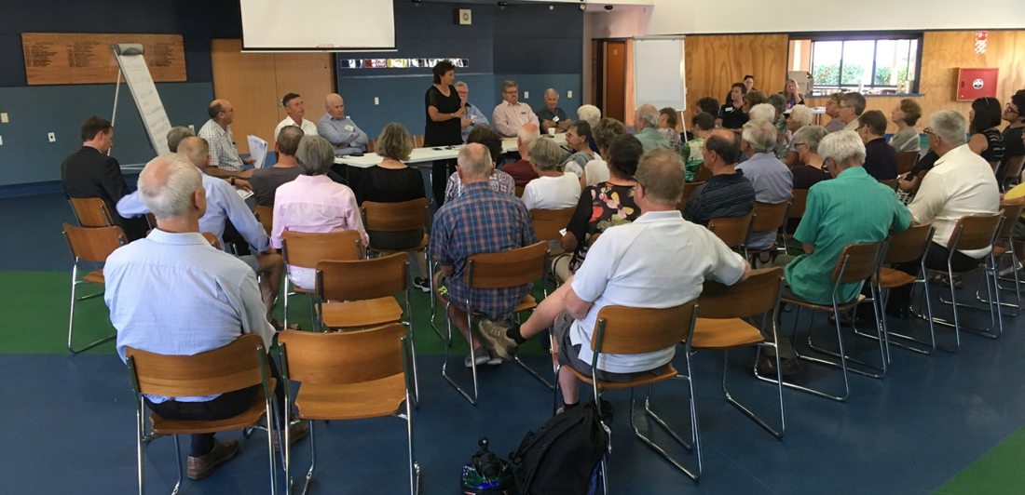
Next Steps
complete planning and where necessary, undertake engagement on low cost, low risk improvements;
begin Pāpāmoa/Mount and Western Suburbs reviews and plan public engagement process.

Slide 8
Questions?

Slide 9
Change Requests
City Link/Hospital Link – routed along Totara St (congested) and City Link uses
Grace Avenue
Extended operating hours of the Gold Line
Route 1 (Pyes Pa) – loss of direct service to Mount, loss of direct service to
Hospital (re-routed along Fraser St instead of Cameron Rd),
closer drop off/pick up to Grace Hospital
Routes 30 (The Boulevard) and 33 (Pāpāmoa Beach) – loss of direct connection to CBD and Mount Maunganui including opposition to having transfer
perceived (or real) longer trips
Route 30x (Golden Sands Express) – run all day
Route 40 (Welcome Bay) – use/don’t use Ballintoy Dr and extend to Ranginui Rd
Crosstown & 52X (Lakes Express) – include Kennedy Road and other Lakes growth areas
Extend CrossTown service to Bethlehem
Lack of an Ohauiti school bus service
Western suburbs (routes 60, 62, 70, 72) direction and connection of routes
Re-route 60 (Cambridge Heights) to include Vale Street
Reinstate route 62 (Bethlehem) as it was and extend
Change route 72 (Otumoetai) so buses go both ways
Route 221 (Te Puke) – include Pāpāmoa Plaza
Operational issues – driver training, idling buses, etc
Pricing of Te Puke bus fares
Extended SuperGold Card concession hours
Desire for smaller buses
Infrastructure concerns, particularly at Bayfair
Replacement of coverage services with patronage services

