Slide 1

Performance of BayHopper Passenger Trips
Dec ‘18 – April ‘19

Slide 2
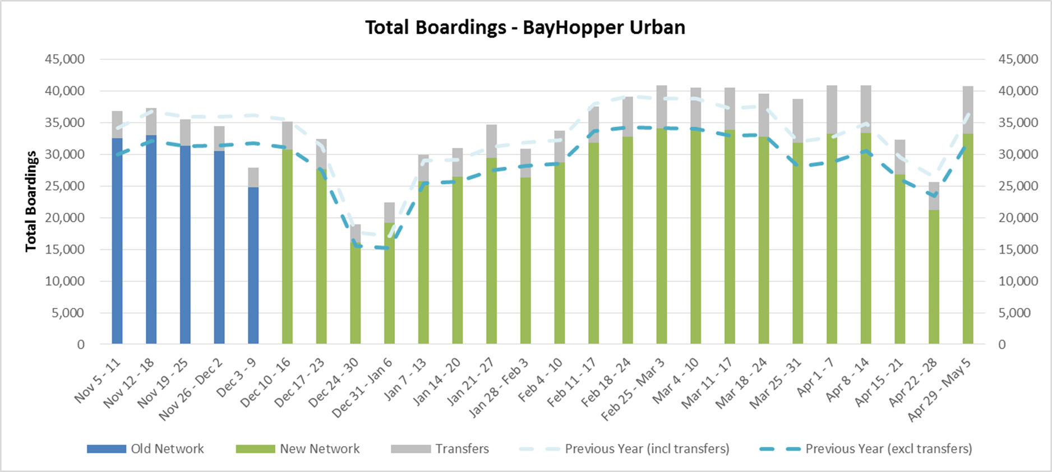

Slide 3
