Slide 2
Planning for Te Tumu
Presentation to TMOK – 3 May 2019

Slide 3
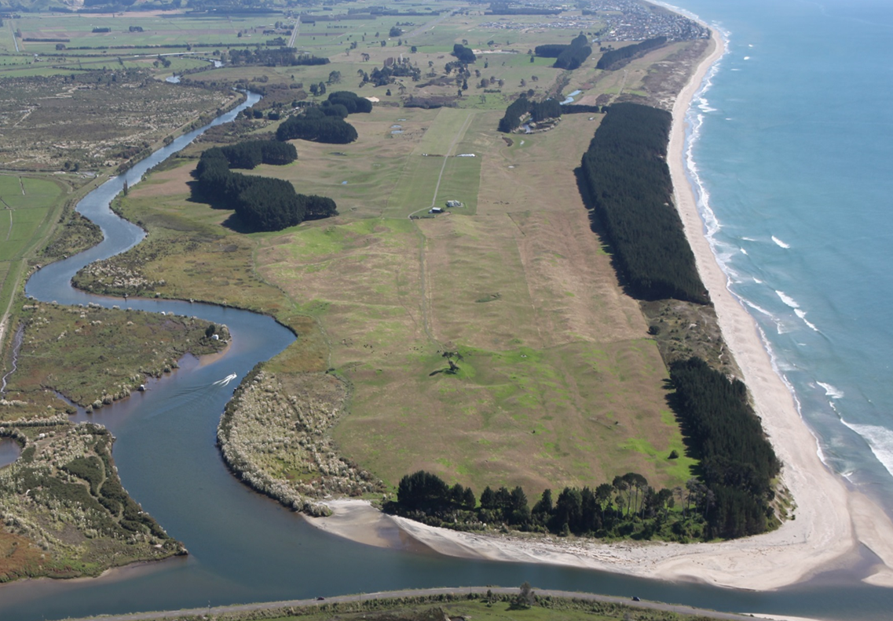

Slide 4
Our presentation
Last time we updated you on:
The vision
Technical reports
Tangata Whenua Working party
Draft Structure Plan and timing
This time we are updating you on:
Engagement with tangata whenua
Cultural Heritage Literature Review
Cultural Management Plan

Slide 5
What is being planned for?
Connection of Te Tumu and Wairakei
Large employment base to deliver internal trip containment
Focus around Golden Sands Town Centre (zoned and located within Wairakei)
Network of local commercial centres and schooling
Provision for changing density and housing typology
Based around integrated plans of:
Density
Public Ream and Open Space
Vehicle Movement and Public Transport
Pedestrian and Cycle Movement Plan
Cultural Heritage and Archaeological Recognition

Slide 6
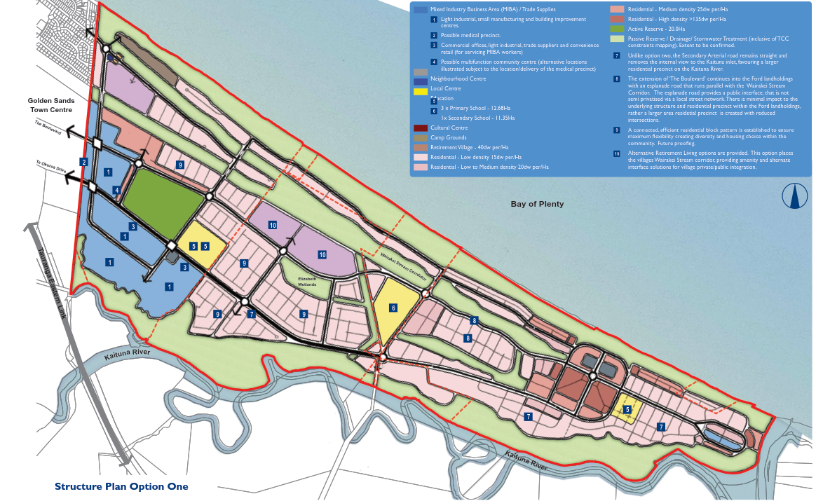

Slide 7
How are we engaging with Tangata Whenua
Te Tumu Tangata Whenua Working Party:
Nga Potiki
Ngati He
Ngai Te Rangi
Ngati Whakaue ki Maketu
Tapuika
Waitaha
Ngati Pukenga
Ngati Rangiwewehi
Ngati Rangiteaorere Koromatua Council
Ngati Uenukukopako Iwi Trust
Engaging on a 4 weekly basis with the Working Party on planning matters.

Slide 8
Cultural Heritage Literature Review
A review and assessment of relevant iwi and hapu management plans, Deeds of Settlement, Treaty Settlement legislation including statutory acknowledgments and deeds of recognition, relevant cultural impact assessments, consent and plan change documents as they relate to the Te Tumu lands.
Inform and support the Te Tumu structure plan and plan change documentation in order to fulfil statutory requirements in the preparation of a plan change and support the preparation and presentation of evidence at subsequent hearings

Slide 9
Key Areas of Literature
Treaty Settlement Deeds and Legislation
Iwi Management Plans
Cultural Impact Assessments (17+)
Statutory and non-statutory documents

Slide 10
Key Themes
Statutory processes for consents
Participation of Māori in decison-making processes and development of Te Tumu
Range of development opportunities on Māori land
Recognition of significance of Kaituna River and Wairākei Stream
Management of sites and areas of significance incl. access
Management of water quality (stormwater)

Slide 11
Key Issues, Concerns and Opportunities
Sites and areas of significance including koiwi – protection, management, interface, urupā
Protection and enhancement of the Kaituna and Wairakei Stream
Cultural recognition, participation and consultation
Enhancement of ecological values of wetlands, dunes, waterways
Water quality
The development of Māori owned land
Employment
Improved land practises and design
Natural hazards
Recreation, sport and leisure
Opposition to the construction of a bridge between Te Tumu and Maketu and a Marina
Light spill – night sky
Clean up contaminated sites

Slide 12
Kaituna – he taonga tuku iho
Access to the Kaituna River including Tauranga waka
Sites of significance have been identified and appropriate protection mechanisms are in place including access. Clarify with tangata whenua if there are other sites not identified in IMP that may require recognition.
Pou or other appropriate markers at sites of significance
Development of cultural management plan to include areas adjacent to Kaituna River
Significant ecological areas precluded from development.
Māori Land Trusts have identified some education, economic and tourism opportunities, mostly focussed on land based on conservation and permeculture
Swales, ponds, flow paths and wetlands during extreme wetaher conditions. The stormwater approach will enhance ecological values at Te Tumu

Slide 13
Pathway Forward
Working through specific responses to literature in structure plan, plan change, landscape plan, cultural plan and stormwater plans
Continue working with working party and direct engagement with iwi/hapū this year based on themes
Explore options for engagement with tangata whenua post structure plan and notification.

Slide 14
Development of Cultural Management Plan
To enhance the special relationship between tangata whenua and the land and waters of Te Tumu.
Develop and provide for a cultural recognition, commemoration and enhancement programme in the sandunes, Wairākei Stream and lands adjacent to the Kaituna River.

Slide 15
Links to other plans and activities
Cultural Management Plan
Landscape
Plan
City Plan
Structure Plan
Kaituna Document
CMP Stage 1

Slide 16
Proposed method for preparing the plan
Brief
Workshops
Draft plan
Implementation plan
Final plan
Proposed date 2020

Slide 17
Proposed method for preparing the Plan
Developing a brief together
Literature Review and information collation
Workshops to identify identify issues and opportunities
Issues and Opportunity Mapping
Investigation and assessment of each issue and opportunity
Drafting plan
Implementation Plan

