Slide 1
Bay of Plenty Regional Council
Public Transport Committee
29th March 2019

Slide 2
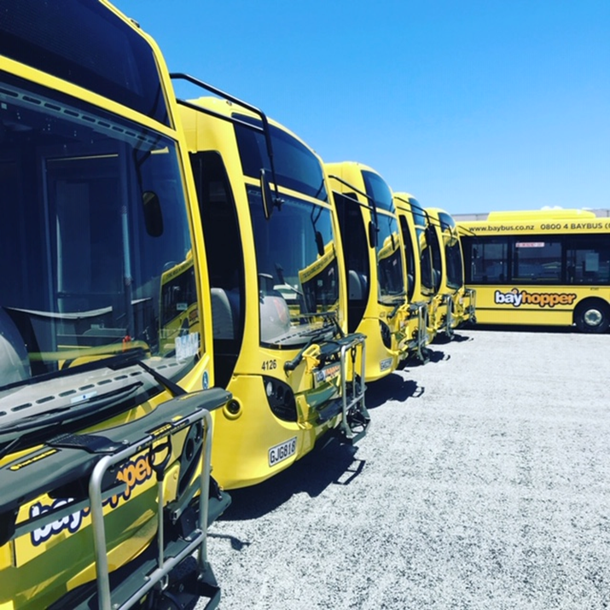
Senior Management
Zane Fulljames, CEO
Scott Thorne, Chief Commercial Officer
Claire Neville, GM Operations

Slide 3
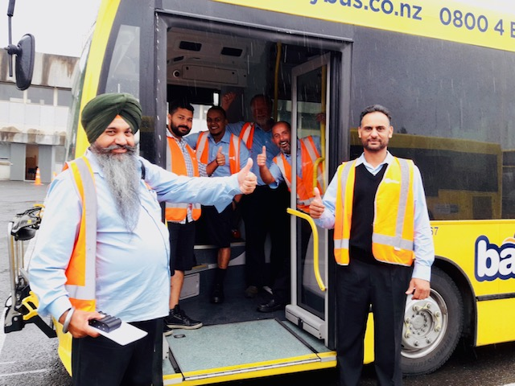
NZ Bus in Tauranga
Two depots - Greerton and Papamoa
Full operations and fleet maintenance functions
Fleet of 96 buses fully branded and equipped with onboard systems
Industry leading driver training

Slide 4
Operational Performance
Successful go-live on 10 December 2018
Good level of performance in December and January
Major Issues in first 2 weeks of February (at start of school term) due to staff shortages
Swift response to issues resulted in return to good performance in March
Notes:
Average:
Dec: 97%
Jan: 96.5%
Feb: 93.7% - 2 days where Trips operated were 83.3% and 87% (6 Feb and 23 Feb respectively)
Mar so far: 98.8% - 8 days so far this month where there has been 100% trips operated.

Slide 5
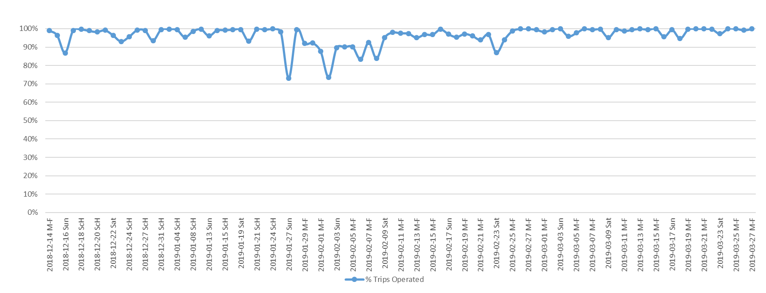
Operational Performance
100%
27 January – 10 February
50%
December
January
February
March
% Trips Operated

Slide 6
Response to Staff Shortages
In response to staff shortages and resulting cancelled trips, NZ Bus:
Seconded drivers from Auckland to bolster local resources
Maximised operational responses including overtime etc.
Ramped up recruitment efforts
Worked with BOP staff to reallocate over half of school trips to other operators
Improved communication and information provision to provide better clarity and certainty to customers
Spent an additional $400k to support operations to achieve stable staffing and performance ($1.2m actual spend compared with original $870k plan for recruitment and training costs)

Slide 7
Example of
Bus Back advertising as part of NZ Bus Recruitment campaign

Slide 8
Current Situation
As a result of actions taken:
Enough drivers recruited and trained to meet current schedule requirements
Significantly improved reliability performance
98.8% trips operated in March 2019
Reduced customer complaints
Improved communication with regular performance meetings between NZ Bus and BOPRC staff
Notes:
50% reduction in complaints comparing March with Feb

Slide 9
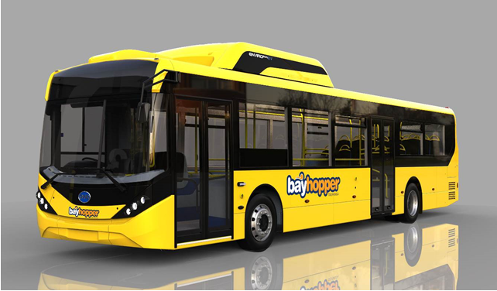
Other Outcomes
All NZ Bus drivers in Bay of Plenty now earning the current Living Wage of $20.55
Plan to introduce Electric Vehicles - August 2019

Slide 10
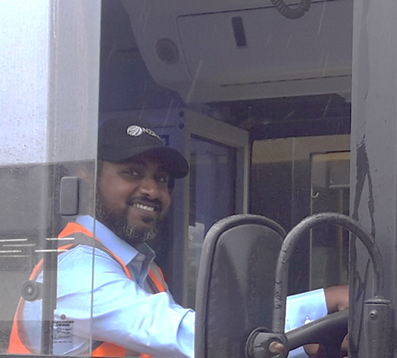
Plans for the future
Working with BOPRC staff to:
Undertake a collaborative review of run times and loadings to maximize network performance for the customer
Maintaining focus on our bus driver recruitment pipeline
Deliver improved operational responses through an action plan that is regularly monitored

Slide 11
In Summary
NZ Bus has enough bus drivers to operate the current schedule and is building further capability to support growth as required;
Services are running reliably; and
Drivers are better paid;
Work is underway with BOPRC to review timetables;
Plan for electric buses to arrive in August;
There is a commitment to partnership, operational stability, reliability for the customer and continuous improvement.

