Slide 1
Mussel Restoration Trial Update Ōhiwa Harbour
Report to the OHIF 28th March 2019
Dr Kura Paul-Burke

Slide 2
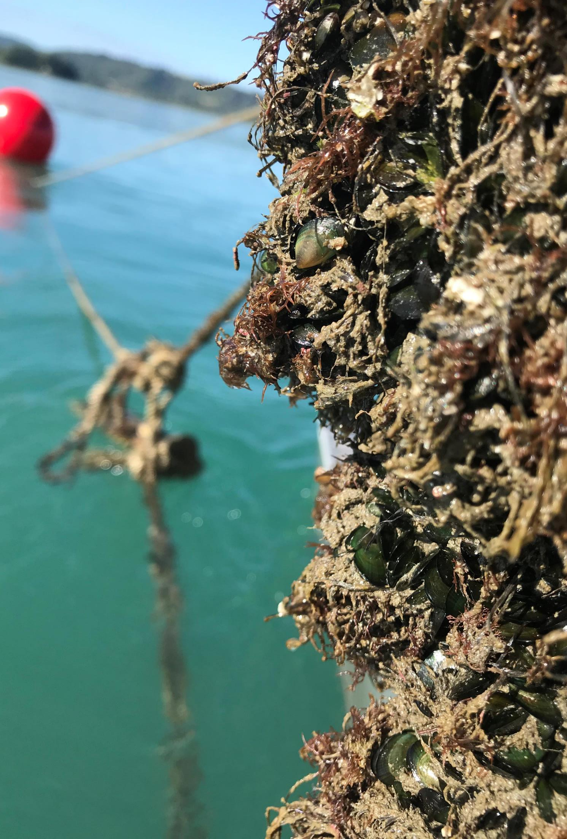
Mussel Restoration Trial Aims
Identify:
Can mussel spat from Ōhiwa be collected on lines in the harbour
Can relocated mussels survive and recruit on the bottom
Can cages provide respite from seastar predation
Options for assisting mussel restoration and replication on a large scale

Slide 3
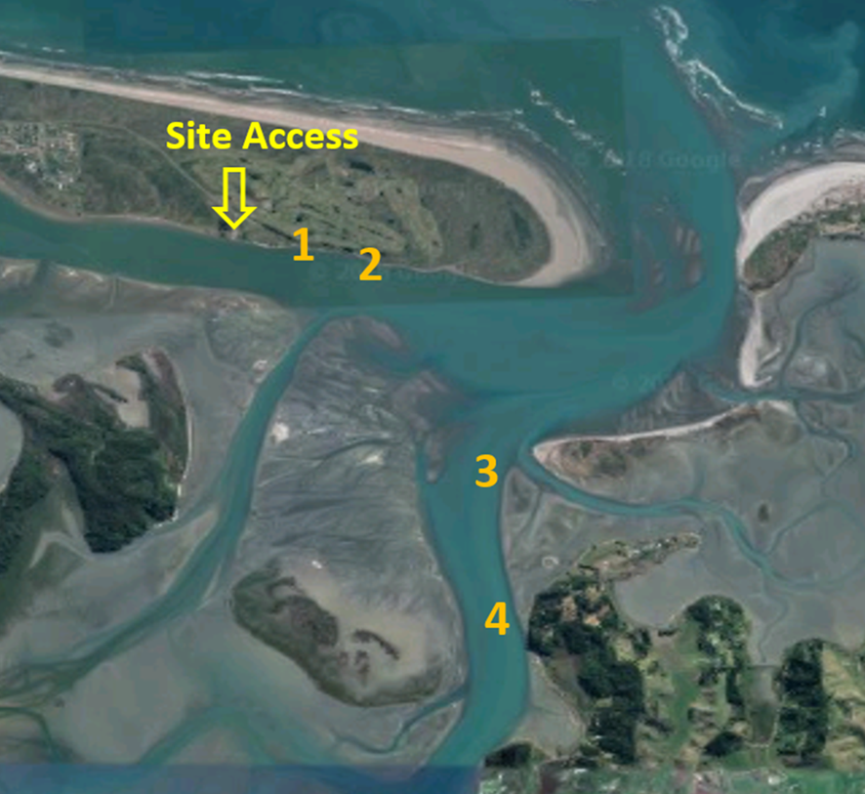
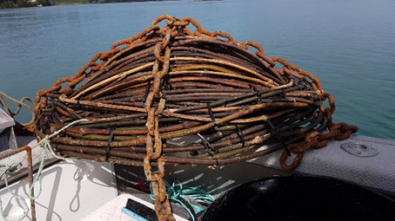
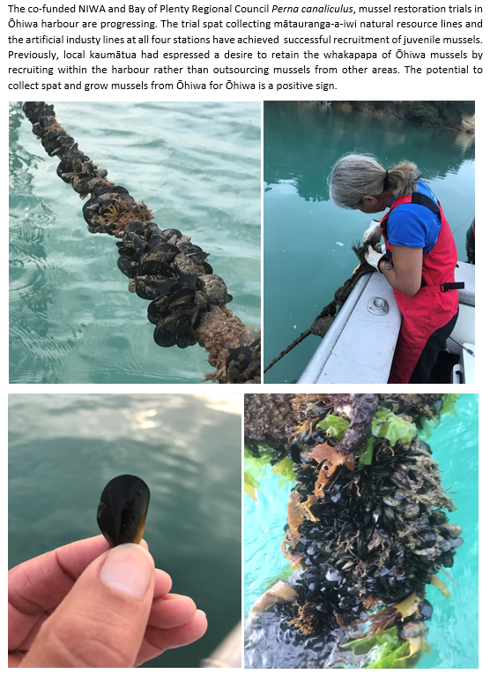
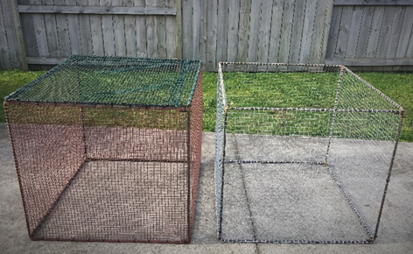
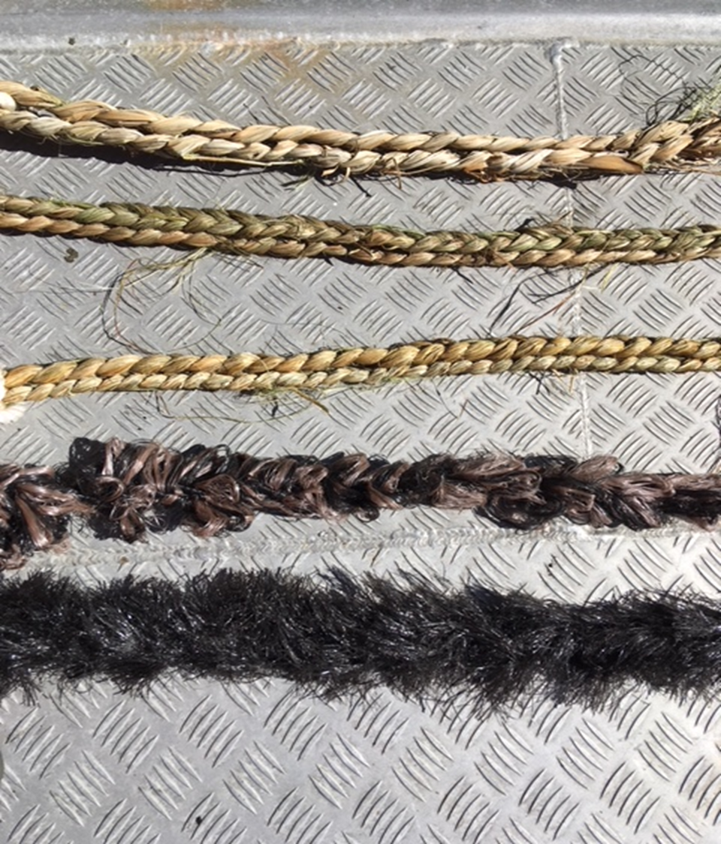
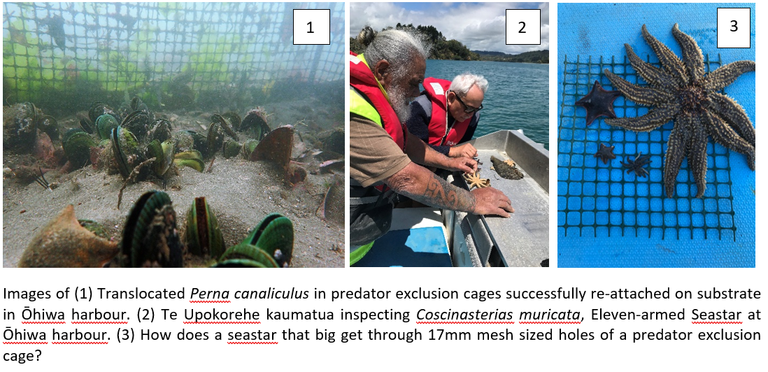

Slide 4
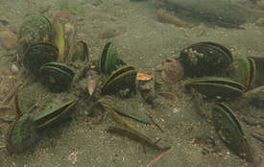
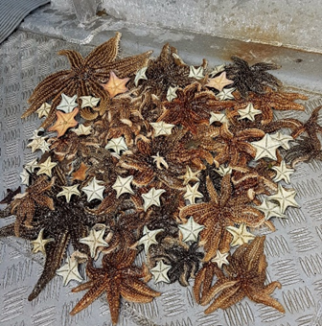
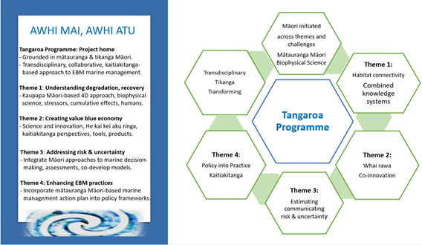
Supporting Activities
Patangaroa/Seastar Management Tool Trial – NIWA funded $40k, Northland Marine Research Centre, Bream Bay
Master of Marine Science Student – Habitat Suitability Index (HSI) for shellfish restoration
National Science Challenges, Sustainable Seas – Awhi Mai Awhi Atu co-developed funding proposal
2x Peer Reviewed Publications
Notes:
Seastars November 2018 – 4 weeks after cages installed in station 2

Slide 5
Next Steps
Monitoring
Seastar mgmt. tool trial
National Science Challenge Funding, co-develop full proposal
Distribution mapping/compare current to original 2007 beds between months March - June
Establish HSI fieldwork & iwi hui

Slide 6
Kia ora

