Slide 1
Monitoring Ohiwa Harbour
Update at 28 March 2019

Slide 2
Sampling Locations

Slide 3
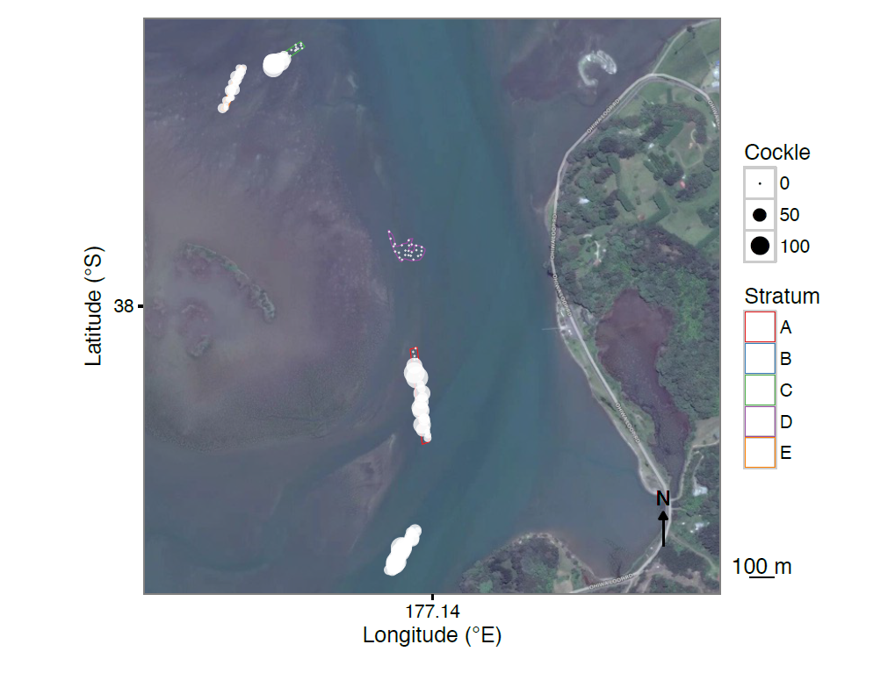
Cockles

Slide 4
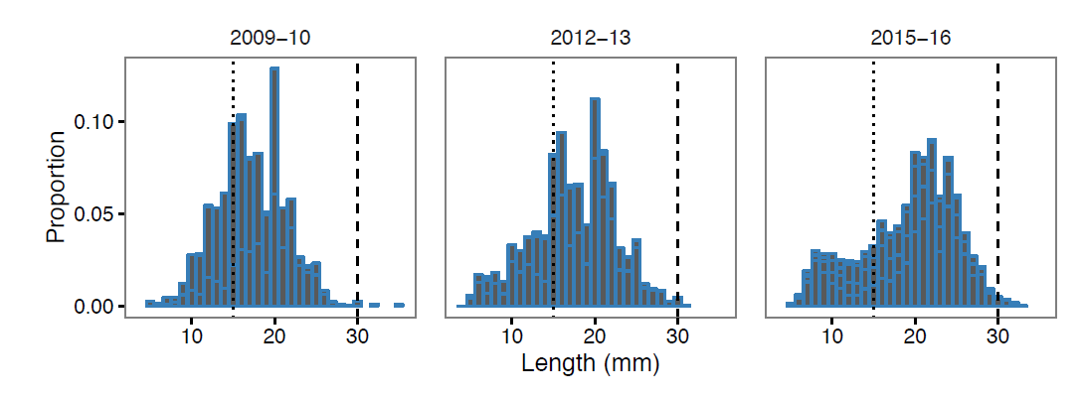
Cockle Size

Slide 5
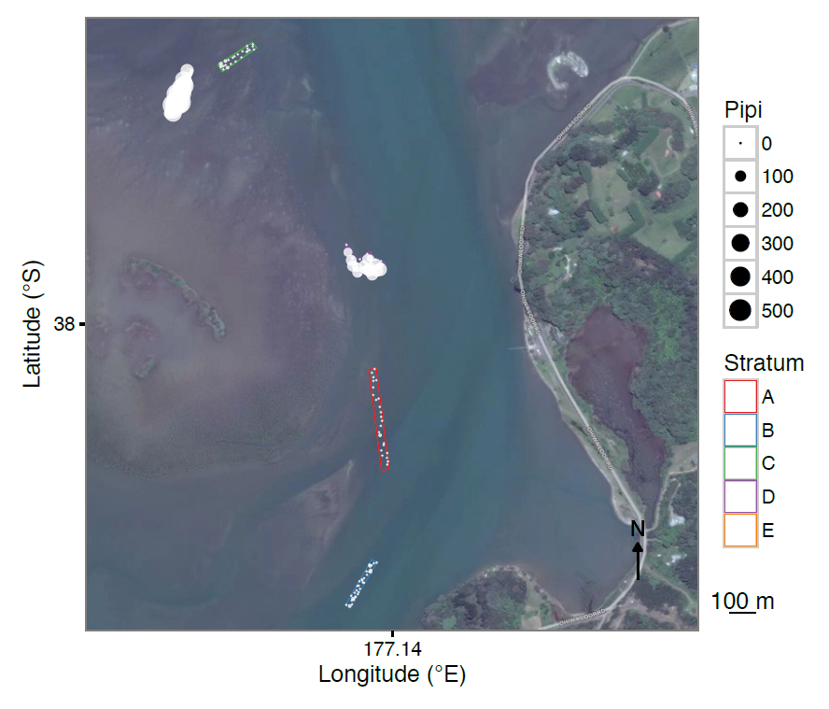
Pipi

Slide 6
Pipi Size

Slide 7
Offences January 2018- Current
Offence | outcome | Number of people
Possess more than 3 times the daily limit of shellfish (451 +) | Prosecute | 3
Possess 2 to 3 times the daily limit of pipi (301 – 450) | $500 infringement notice | 3
Possess 1 to 2 times the daily limit of pipi (151 – 300) | Warning | 1
Provide False Details to Fishery Officer | Prosecute | 1
Use a staked net and use a net without correct float markings | Warning | 1
Possess undersize fish | Warning | 1

