Slide 1
Port Ōhope Redevelopment Project
WHAKATANE DISTRICT COUNCIL

Slide 2
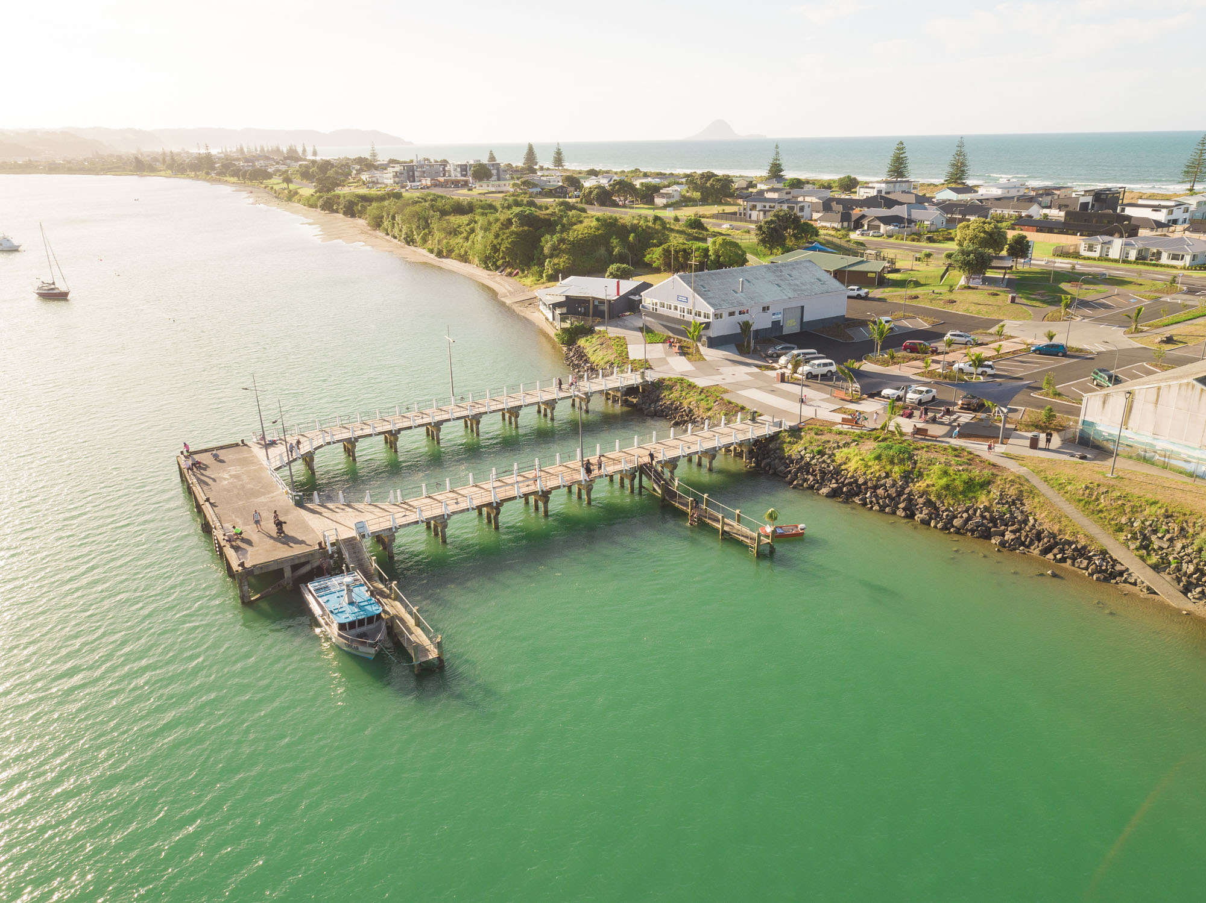

Slide 3
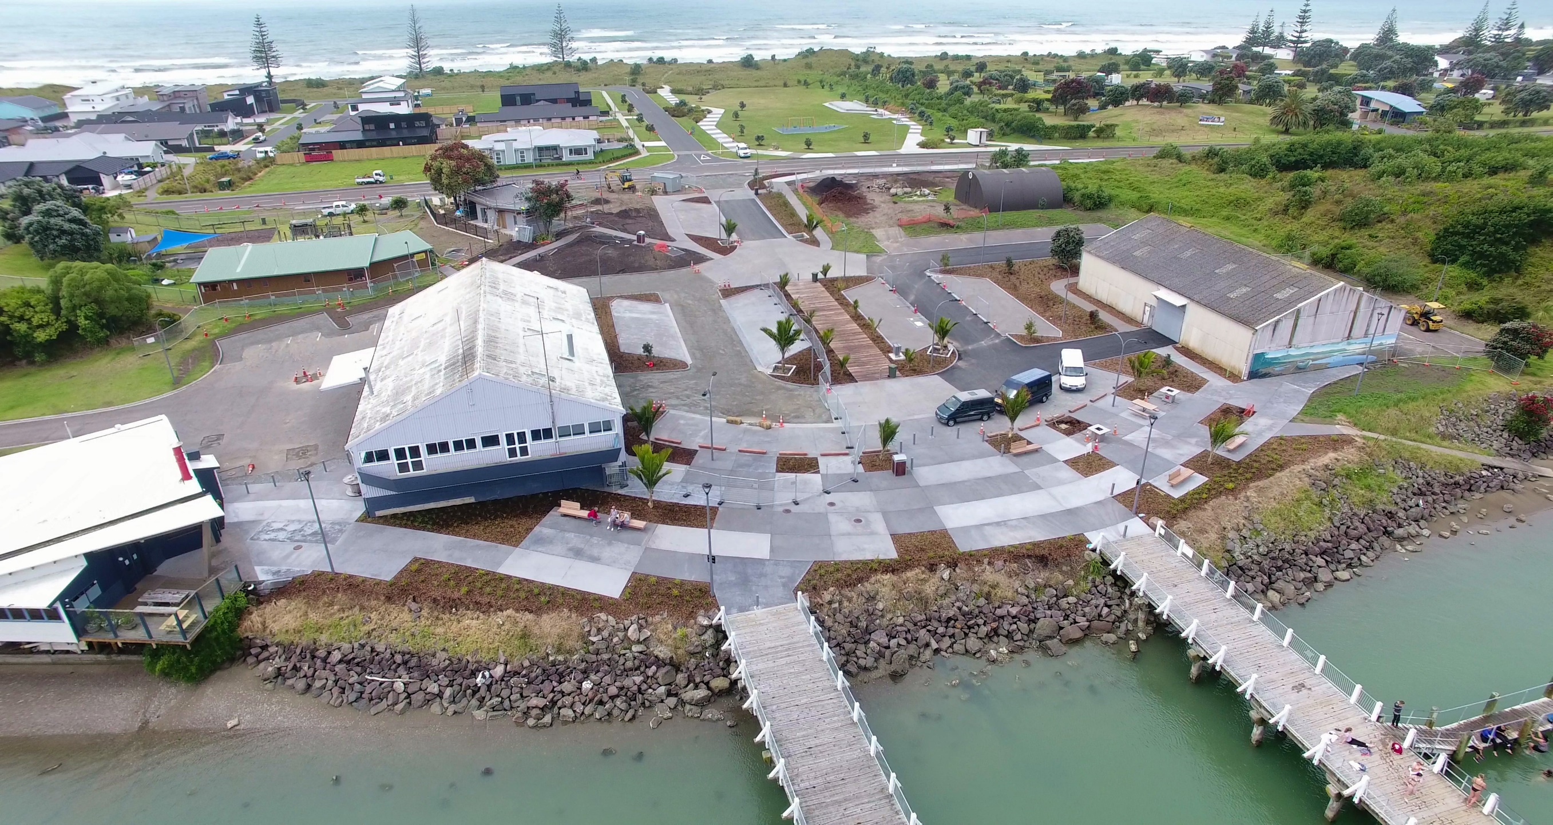

Slide 4
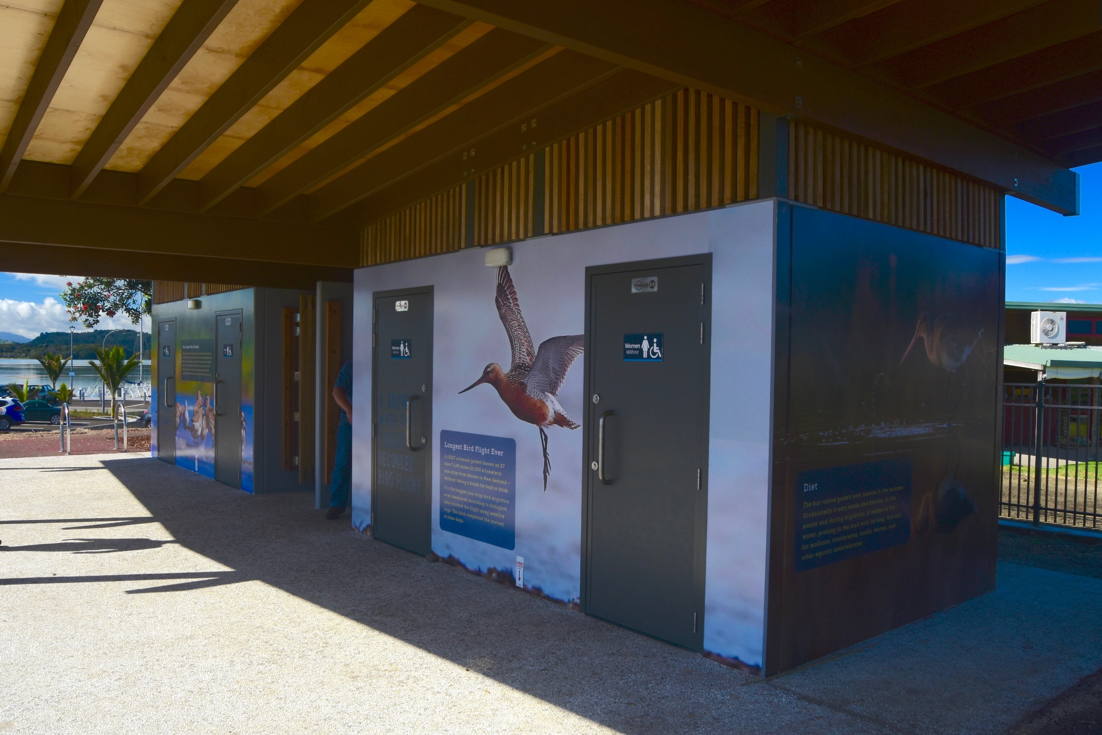

Slide 5
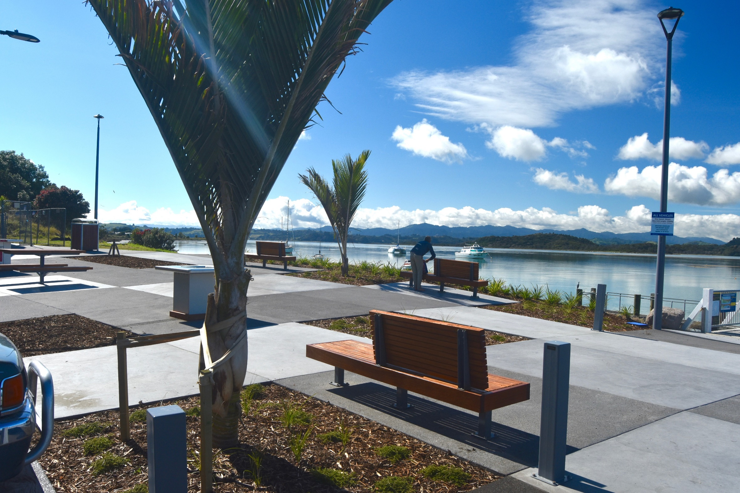

Slide 6
