Slide 1
Tauranga Review Phase 3 Scope Public Transport Committee, 29 March 2019
Notes:
Main purpose is to seek Council approval on routes 36 and 70 so we can address bulk feedback we’ve received quickly.
We are delighted to be here today collated and analysed feedback, huge effort 10th March/11th 4 days to collate and analyse it all huge effort.

Slide 2
Outline
Existing Issues
Phase Three Scope
Network or Strategic Review Options

Slide 3
Context
After 10 years of little change, Council rolled out a new network on 10 December 2018 designed to:
implement shorter, more direct routes;
increase the reliability of services;
operate longer hours;
run at 15 and 20 minute frequencies compared to 30 minutes;
increase peak urban vehicles to 61 from 40;
increase passengers to 3.1 million from 2.2 million; and
at an increased cost ($16.4 million budgeted contract cost versus $13.0 million).
Notes:
Yesterday at SLG Tauranga most car dependant city in NZ, suburban growth led to congestion and longer travel times.
Reliable, frequent and direct bus service, high performance.
Development of the blueprint took over 2 years May 2015 – approval 26 Sep 2017 involved a lot of community engagement, extended period, received over 1470 pieces of feedback.
Council made a number of key decisions regarding the network. Audit and Risk paper legal review of the procurement process.
Buses all kneeling, accessible buses, with bike racks.

Slide 4
Top 10 Cross Sector Vehicle Trip Demands During the AM Peak Period
Notes:
The central CBD area attracts the largest number of vehicle trips during the AM peak period, following this the southern end of Cameron Road and Mt Maunganui also attract a high proportion of trips.
The origins of trips are more dispersed. The area with the highest departures is the Otumoetai, Matua, Brookfield, Behtlehem area. Following this the Papamoa, Cameron Road south, CBD and Mt Maunganui areas generate a relatively high number of trips.
There is a high number of trips between the Papamoa and Mt Maunganui sectors, both ways.
The central corridor of Cameron Road south, CBD and Mt Maunganui generates and attracts a high number of trips, both ways.
The highest ten trip demands between key Tauranga City sectors during the 2016 AM peak period are shown in Figure 7 and the corresponding table below.

Slide 5
What happened?

Slide 6
Phases

Slide 7
Phase 1 – Fix School Buses
Immediate focus – remedy school buses
10 Dec – additional 11 school buses
18 February + 4 school buses
25 February – Council decision to award emergency replacement school buss services. 6 school buses to Bethlehem Coachlines
4 March 6 school buses to Go Bus, Living Wage, dedicated school route Maungatapu – Tga Boys & Girls
11 March 10 school buses to Go Bus
18 March 6 school buses to Go Bus

Slide 8
Phase 2 Route 36 & 70
Community feedback received:
From Oct 2018
3 public meetings: Maungatatpu, Otumoetai and Pāpāmoa
Additional meeting in Maungatapu
Additional 50 pieces feedback received
Changes made
Notes:
Majority feedback 25% Pāpāmoa, Maungatapu and Matua

Slide 9
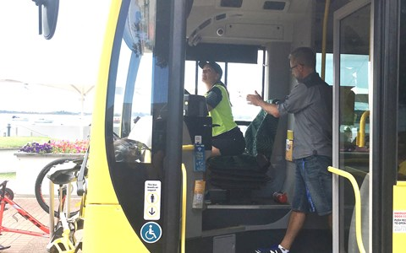
Phase 3 Network Review & Community Engagement

Slide 10
Phase 3 – Network review
Network Review
Review all feedback
Minor changes
Substantive network changes
Pāpāmoa
Western Suburbs
Review Infrastructure requirements
Western Bay fare review, including structure
Other workstreams
Living Wage Business Case
Bus right-sizing
Tauranga School Fares Business Case
Options to regain trust and perception
SuperGold Card operating hours review

Slide 11
Other change requests
City Link/Hospital Link – routed along Totara St (congested) and City Link uses
Grace Avenue
Extended operating hours of the Gold Line
Route 1 (Pyes Pa) – loss of direct service to Mount, loss of direct service to
Hospital (re-routed along Fraser St instead of Cameron Rd),
closer drop off/pick up to Grace Hospital
Routes 30 (The Boulevard) and 33 (Pāpāmoa Beach) – loss of direct connection to CBD and Mount Maunganui including opposition to having transfer
perceived (or real) longer trips
Route 30x (Golden Sands Express) – run all day
Route 40 (Welcome Bay) – use/don’t use Ballintoy Dr and extend to Ranginui Rd
Crosstown & 52X (Lakes Express) – include Kennedy Road and other Lakes growth areas
Extend CrossTown service to Bethlehem
Lack of an Ohauiti school bus service
Western suburbs (routes 60, 62, 70, 72) direction and connection of routes
Re-route 60 (Cambridge Heights) to include Vale Street
Reinstate route 62 (Bethlehem) as it was and extend
Change route 72 (Otumoetai) so buses go both ways
Route 221 (Te Puke) – include Pāpāmoa Plaza
Operational issues – driver training, idling buses, etc
Pricing of Te Puke bus fares
Extended SuperGold Card concession hours
Desire for smaller buses
Infrastructure concerns, particularly at Bayfair
Replacement of coverage services with patronage services

Slide 12
Phase 3 – Network review principles
Evidence-driven decisions using the best available information at hand.
Staged approach so that low cost low risk changes can be implemented without delay
Continue to work alongside Tauranga City Council to identify areas for infrastructure improvements, including shelters, bus priority and interchange facilities
Continue to work with our communities in developing solutions that meet a diverse range of needs
Work within existing budgets unless there is a significant reason for increasing funding envelopes

Slide 13
Strategic Review vs Network Review
Option 1 - Strategic Review
Would run alongside network review; review limited to minor changes until Strategic Review complete
Would review strategic case & programme case to:
Determine if current network will meet objectives identified through business cases
Re-test alignment with Council objectives for passenger transport
Propose system-wide changes to network design & infrastructure provision if required.
Review completed in mid-2020
Implementation of significant changes likely early 2021.
Option 2 - Network Review
Examine current network for minor improvements can be made mid 2019 and late 2019
Examine network for areas where significant changes may be required and implement late 2019, subject to funding approval.
Option to review progress and strategic direction in 12 months following bedding in

Slide 14
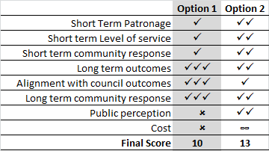
Preferred Network Review - Option 2
Option 2 – provides best short term outcomes
Can review strategic direction in 12 months once network bedding-in complete.

Slide 15
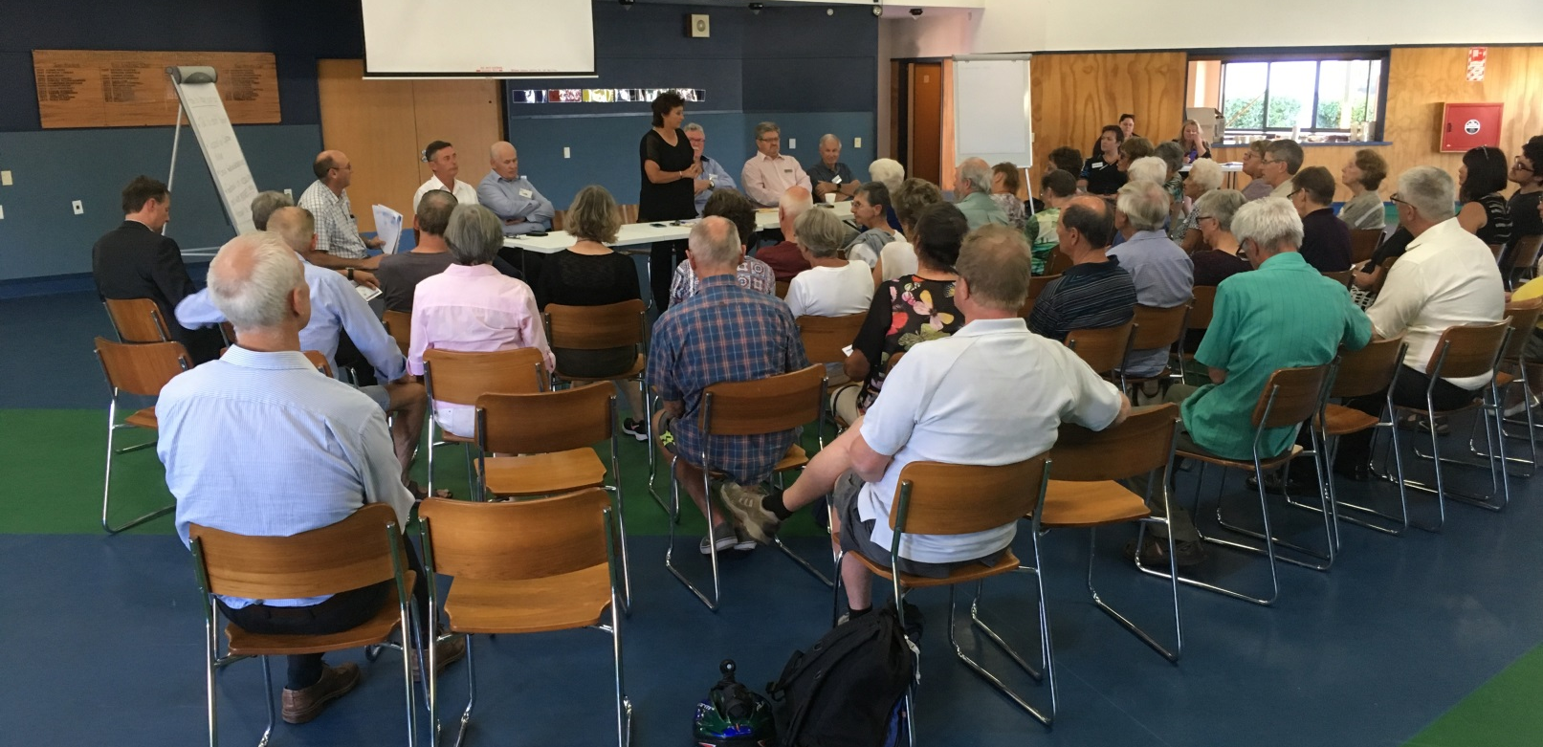
Consultation
Current process working well for significant issues – local public meetings, phone feedback, on-line forms etc
For minor improvements/changes with limited negative impacts a more limited approach may be taken.

Slide 16
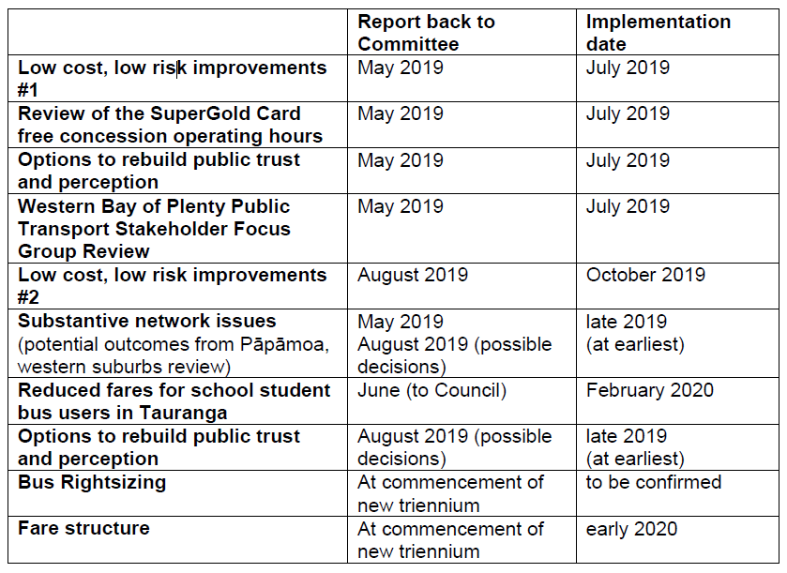
Next Steps
Notes:
Check reduced fares how links to annual plan question
Fare structure – noted previous pt committed this financial year june ish

Slide 17
Questions?

Slide 18
Strategic Review vs Network Review
What does the Committee wish to achieve with the review:
A network better aligned with Council and Community aspirations
A better functioning network as soon as possible
VS

Slide 19
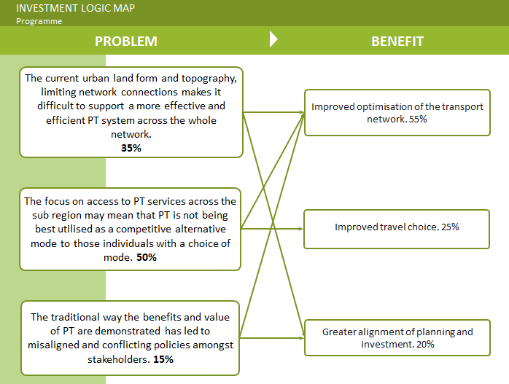
Strategic Outcomes

Slide 20
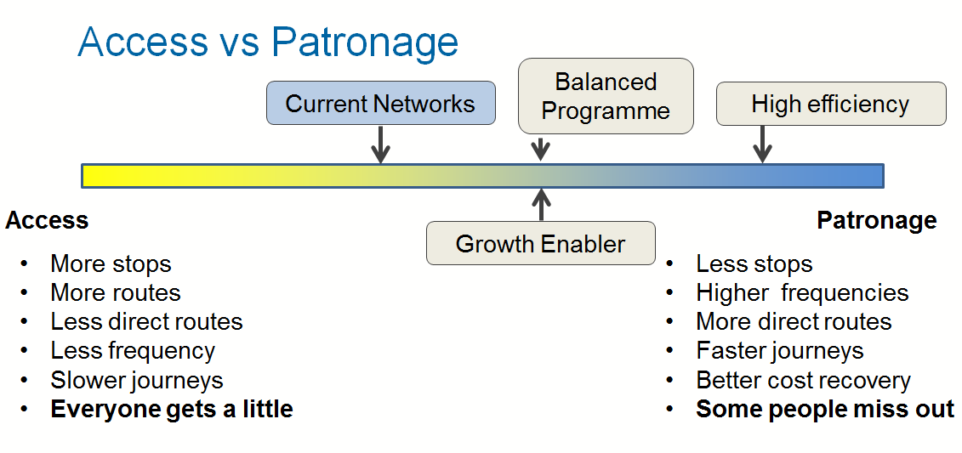
Strategic Outcomes

Slide 21
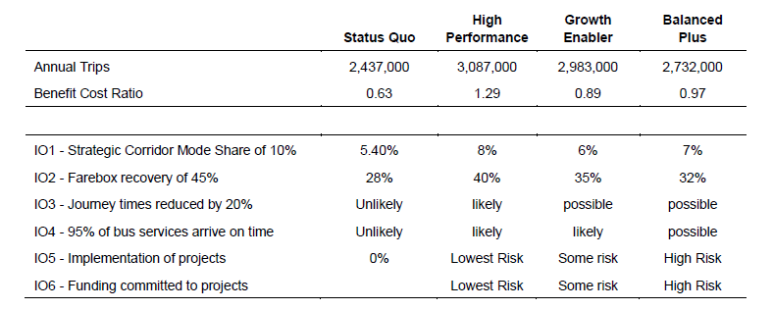
Strategic Outcomes

