Slide 1
Black Swans in Ōhiwa Harbour

Slide 2
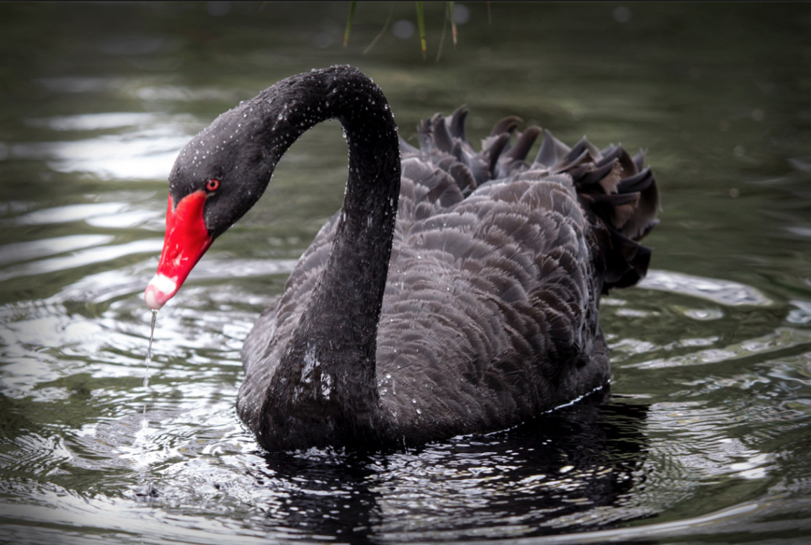

Slide 3
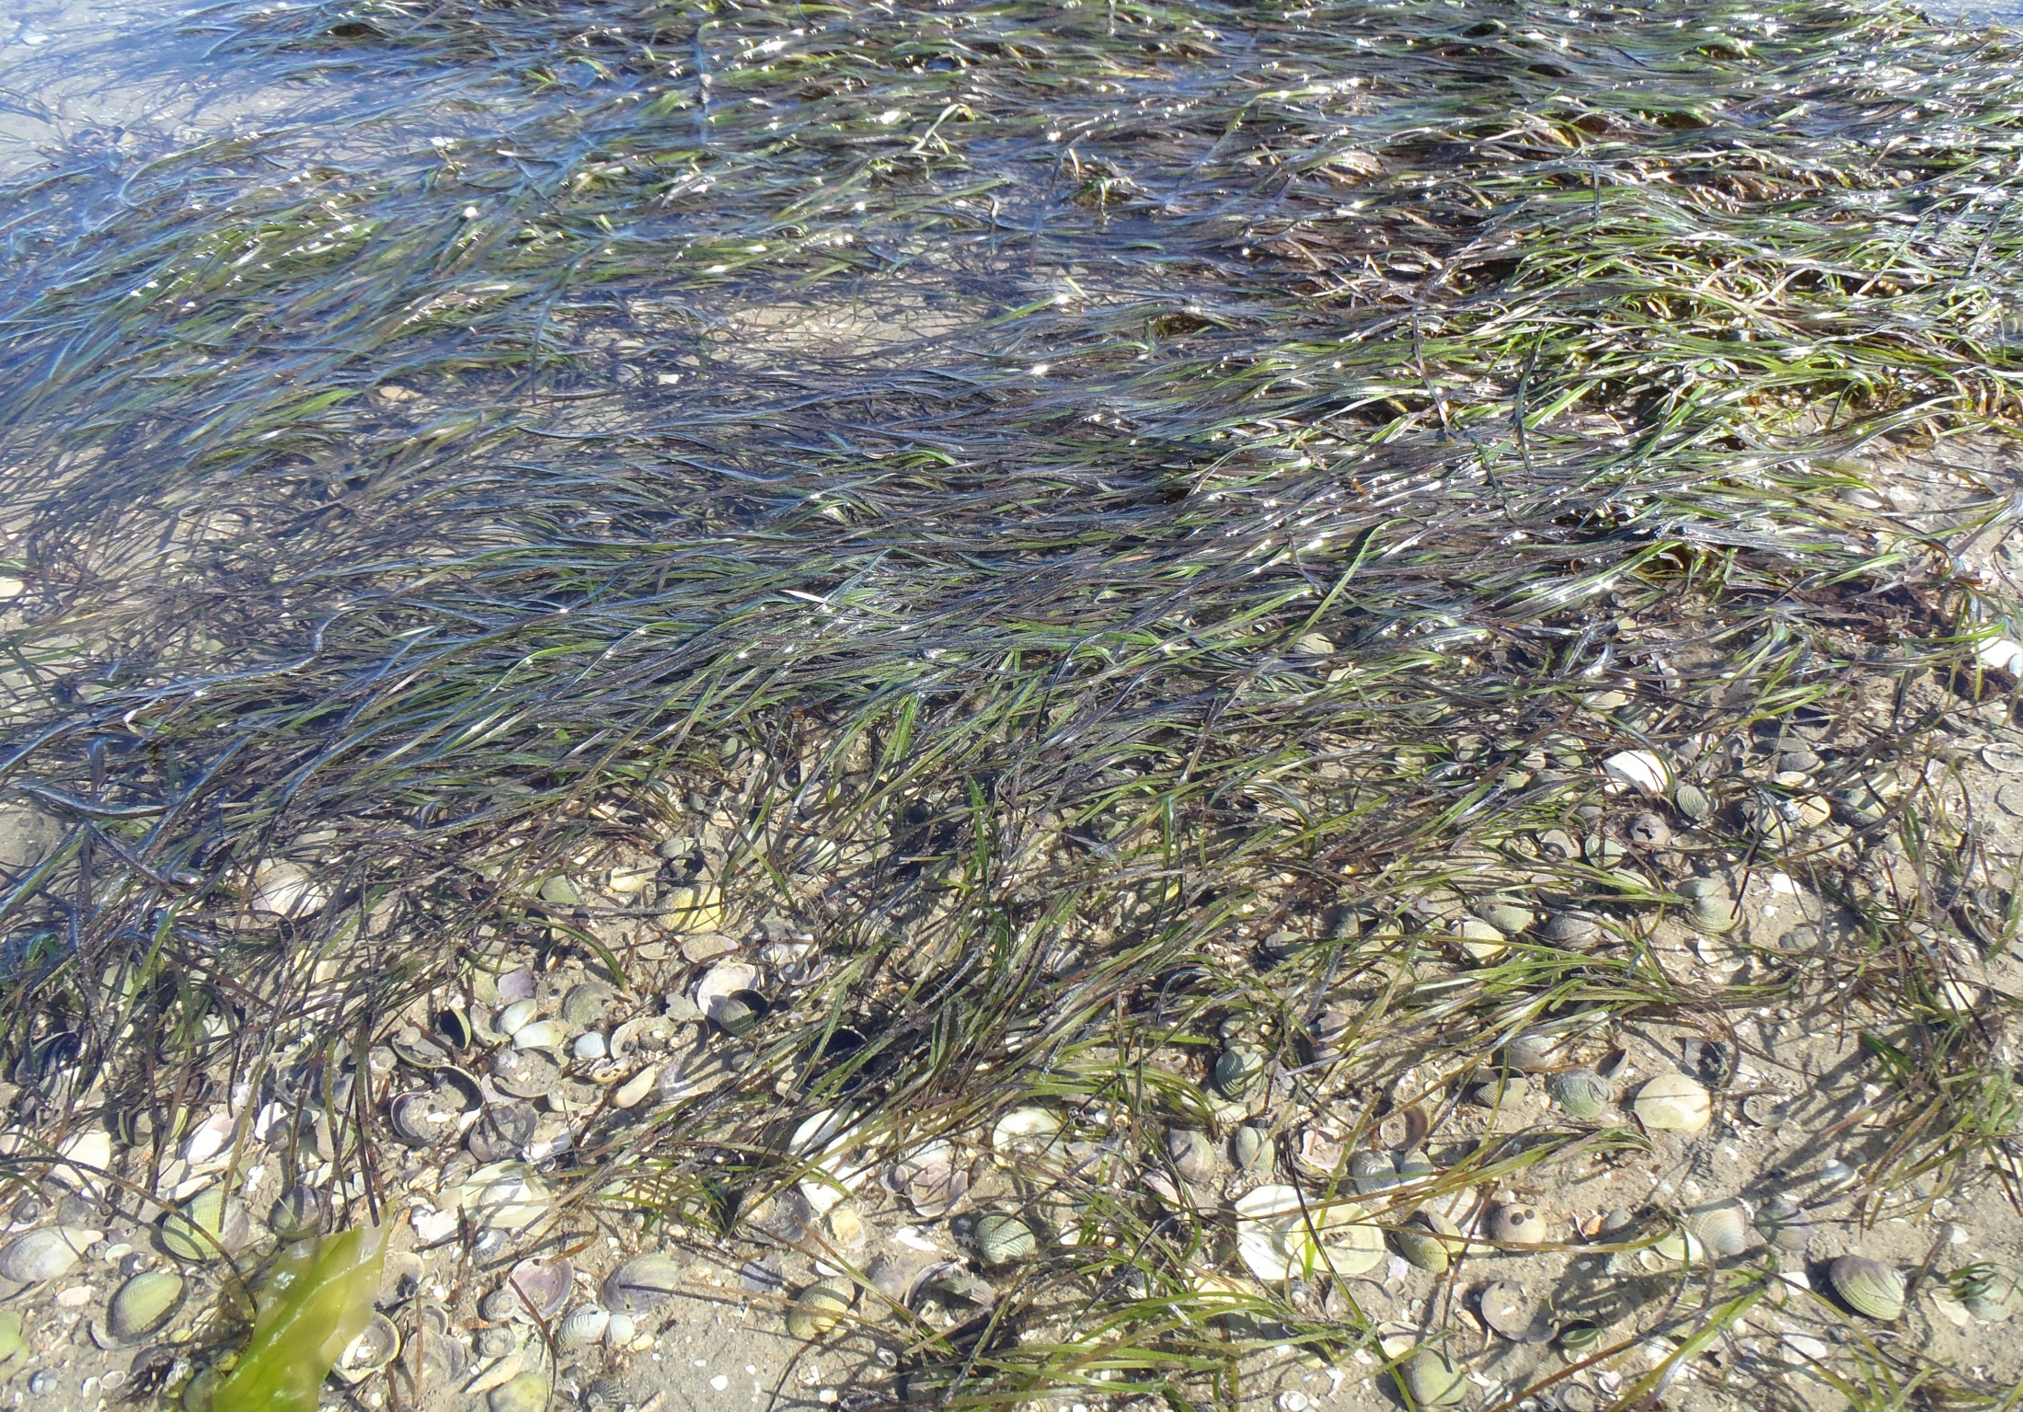
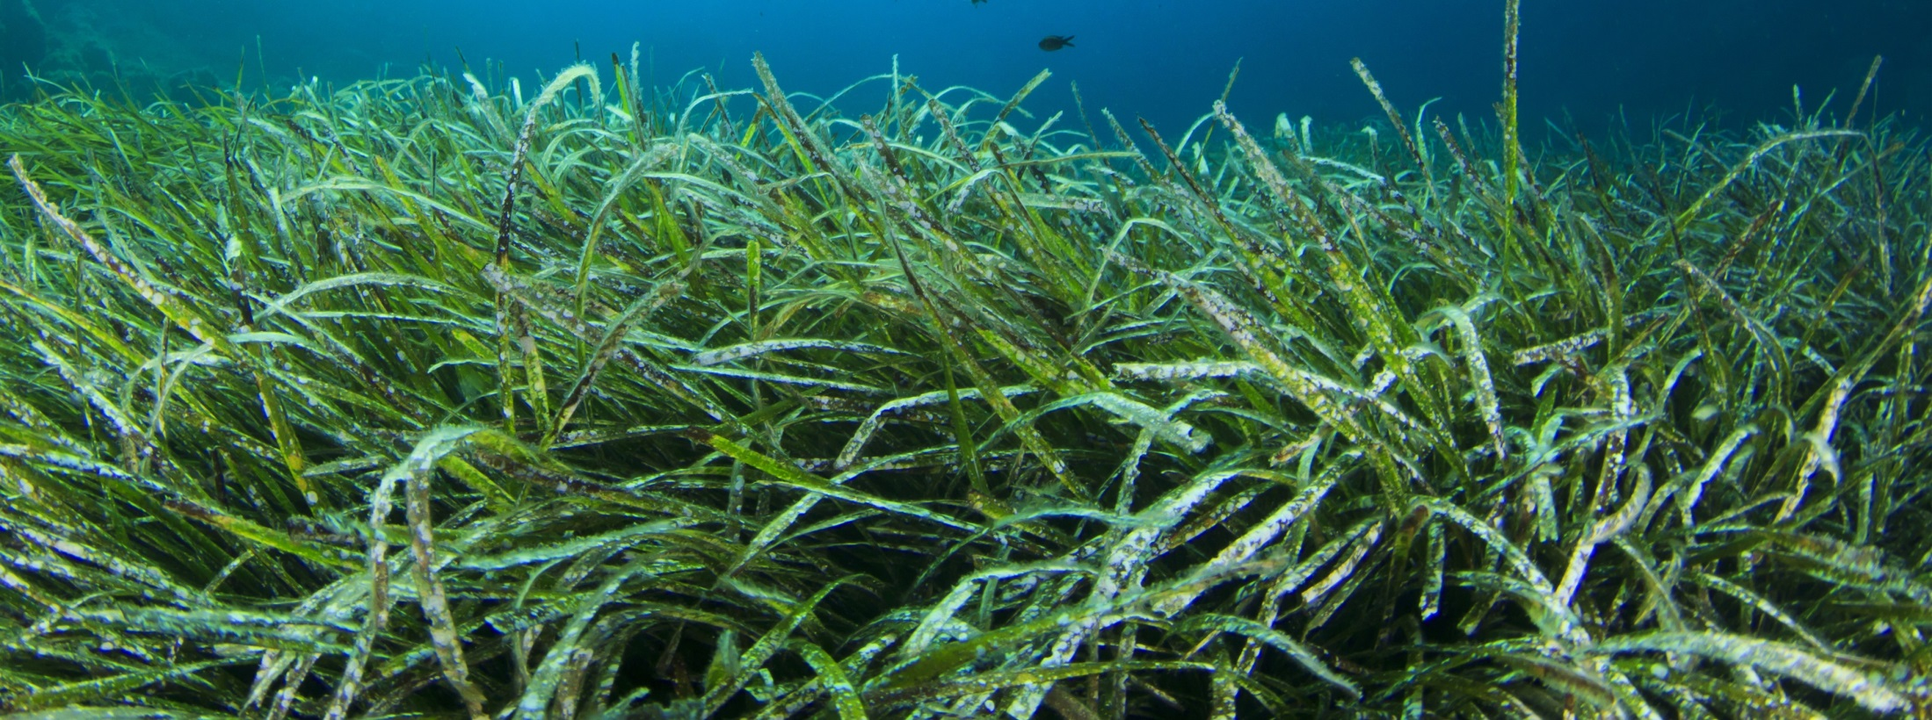

Slide 4
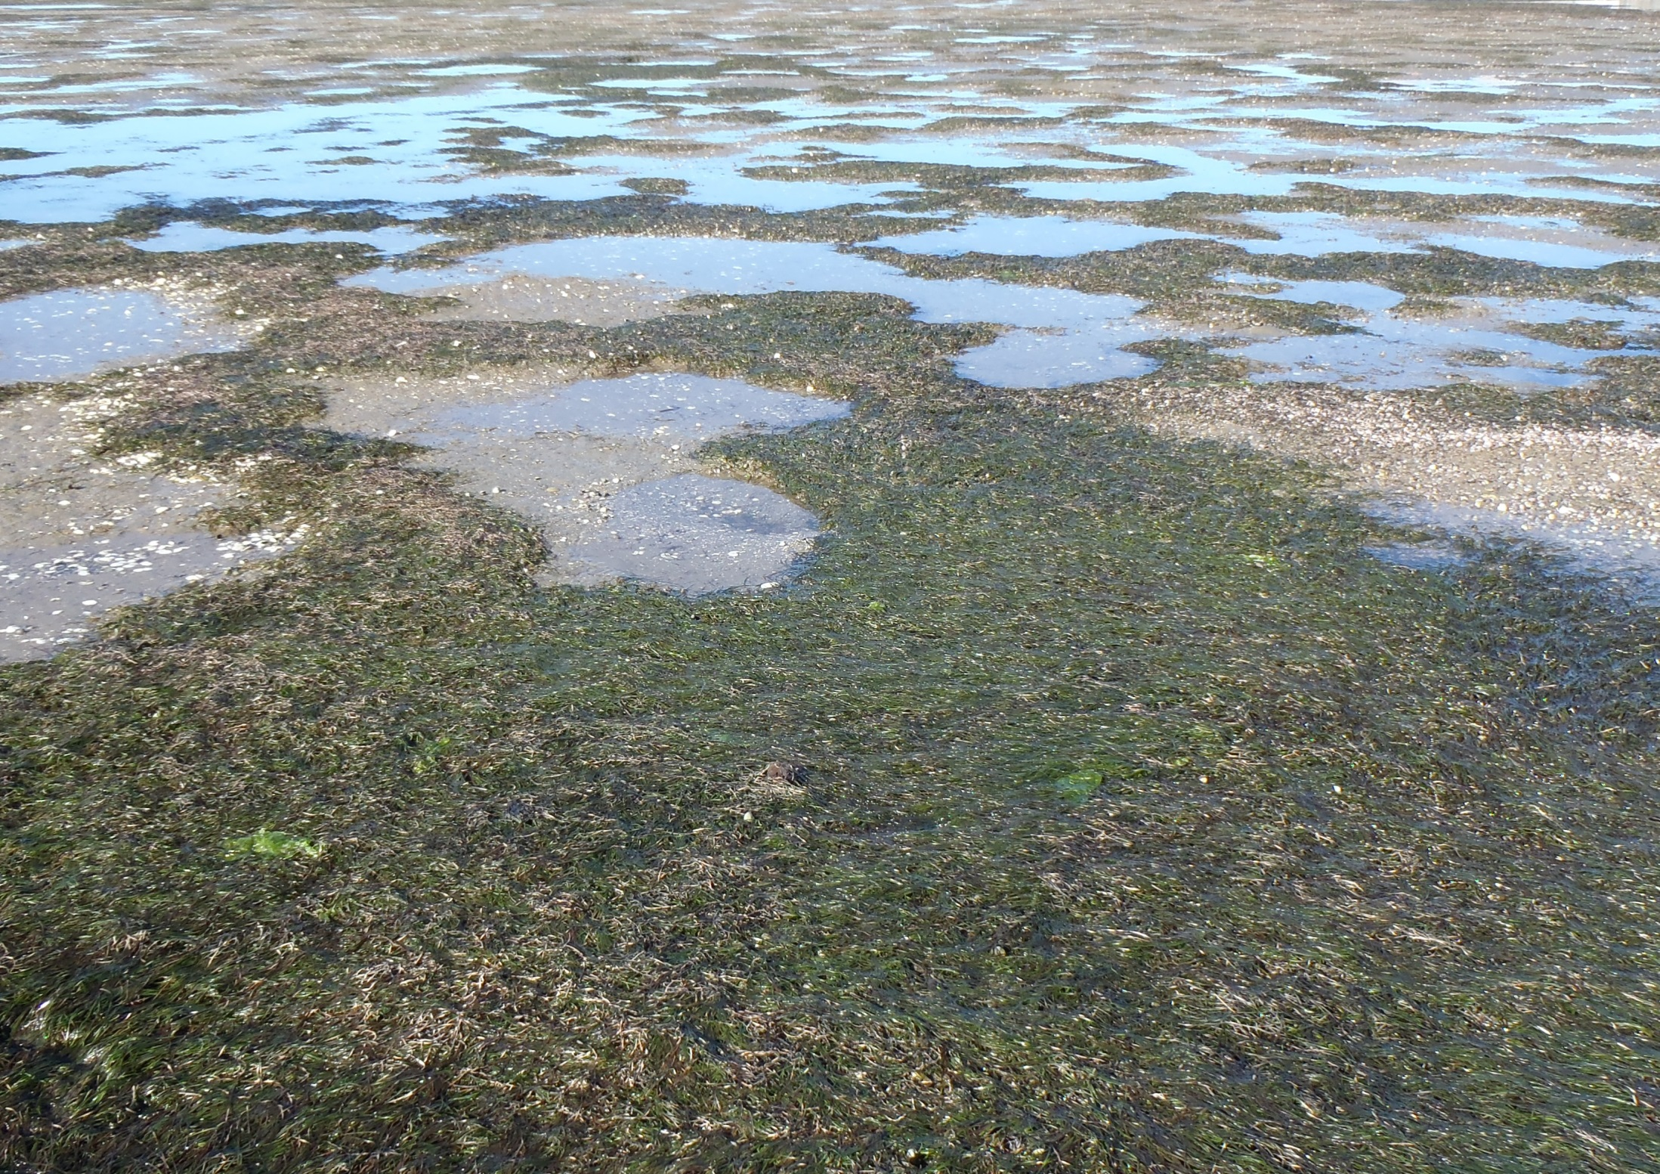

Slide 5
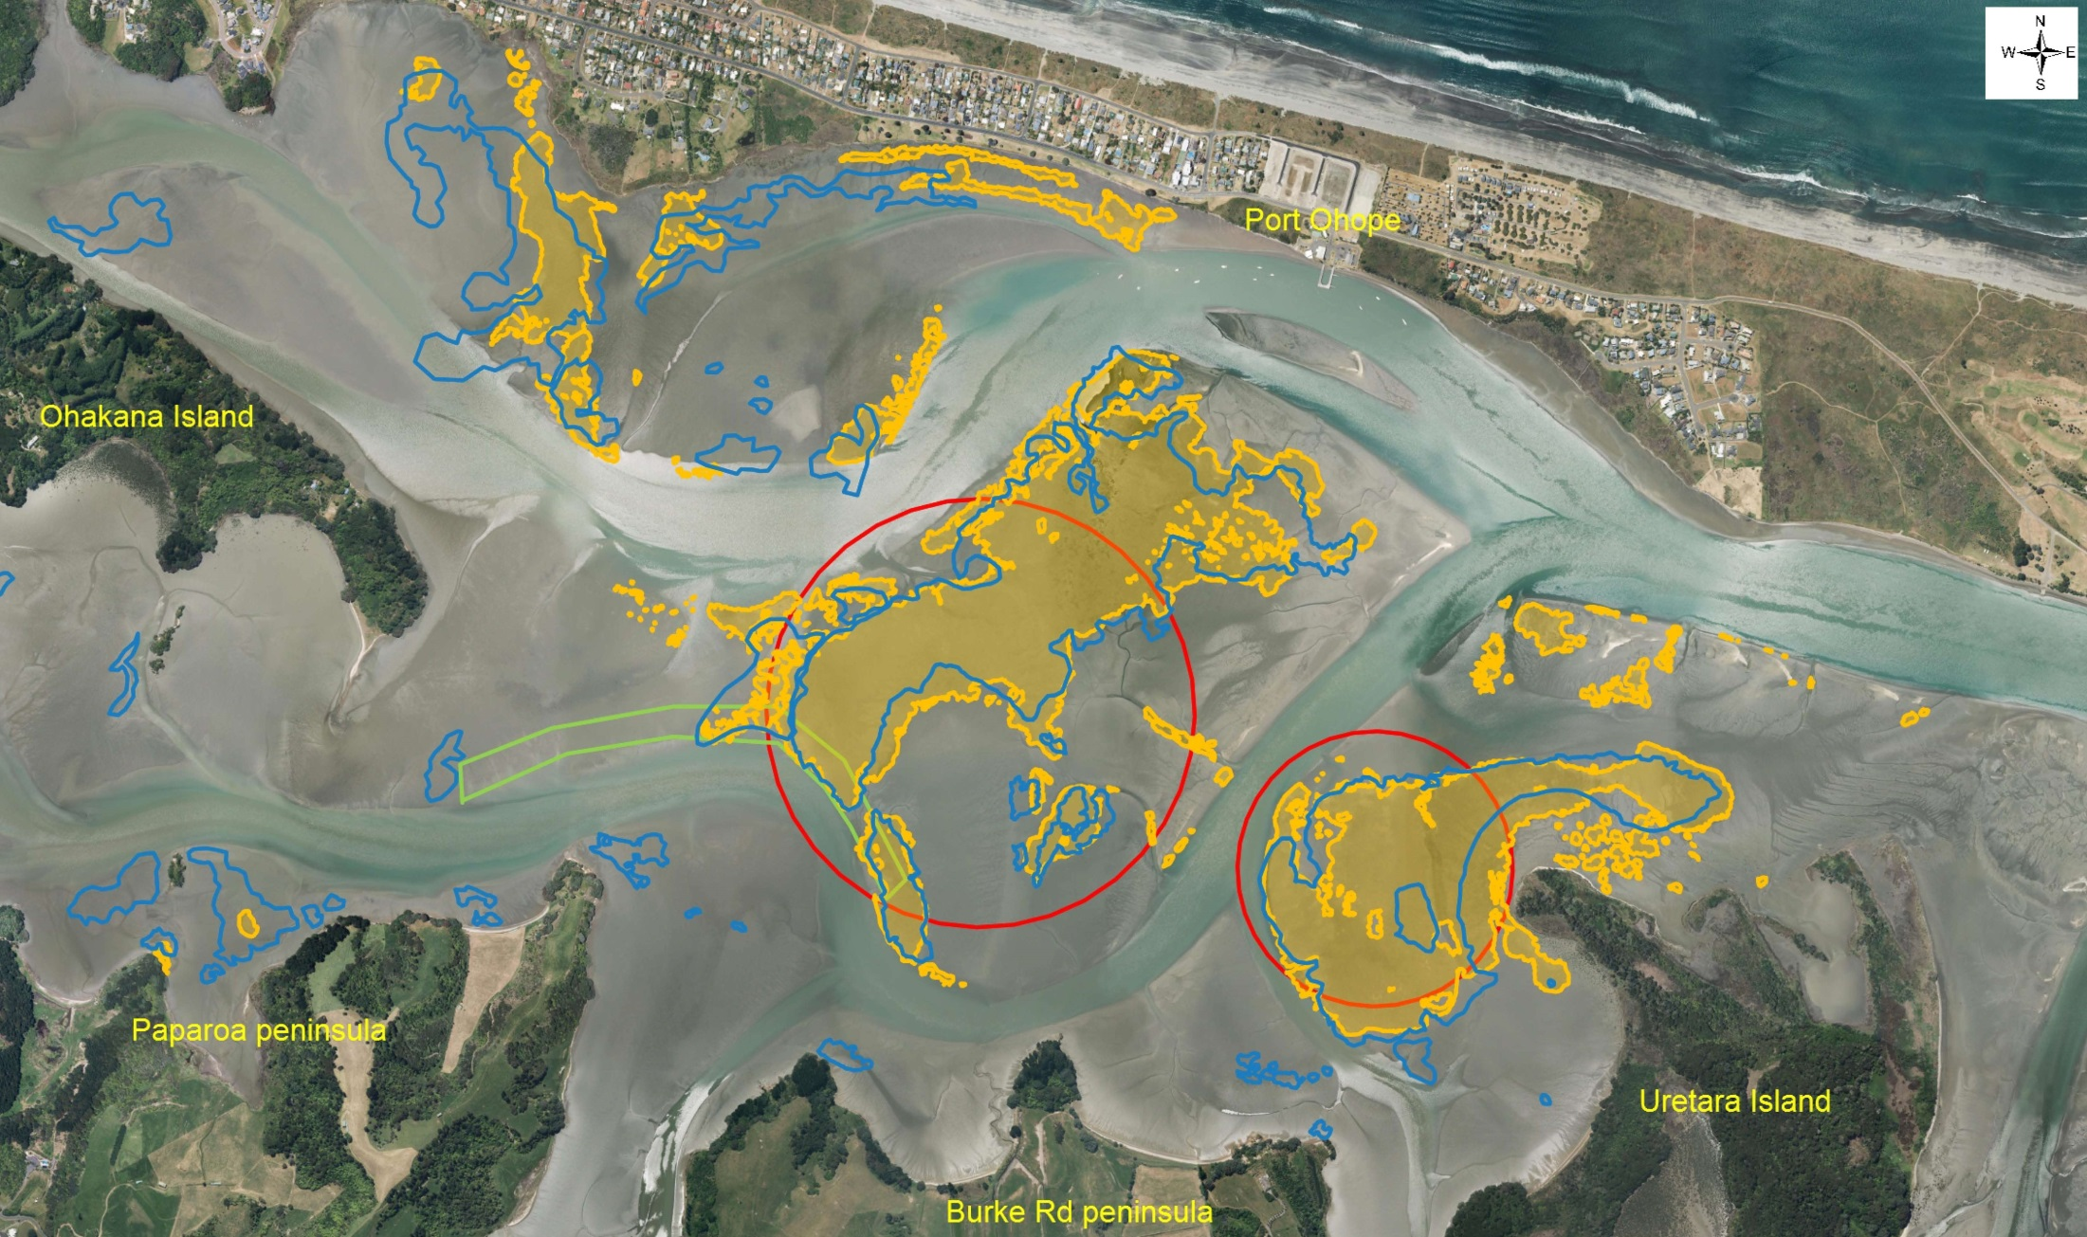

Slide 6
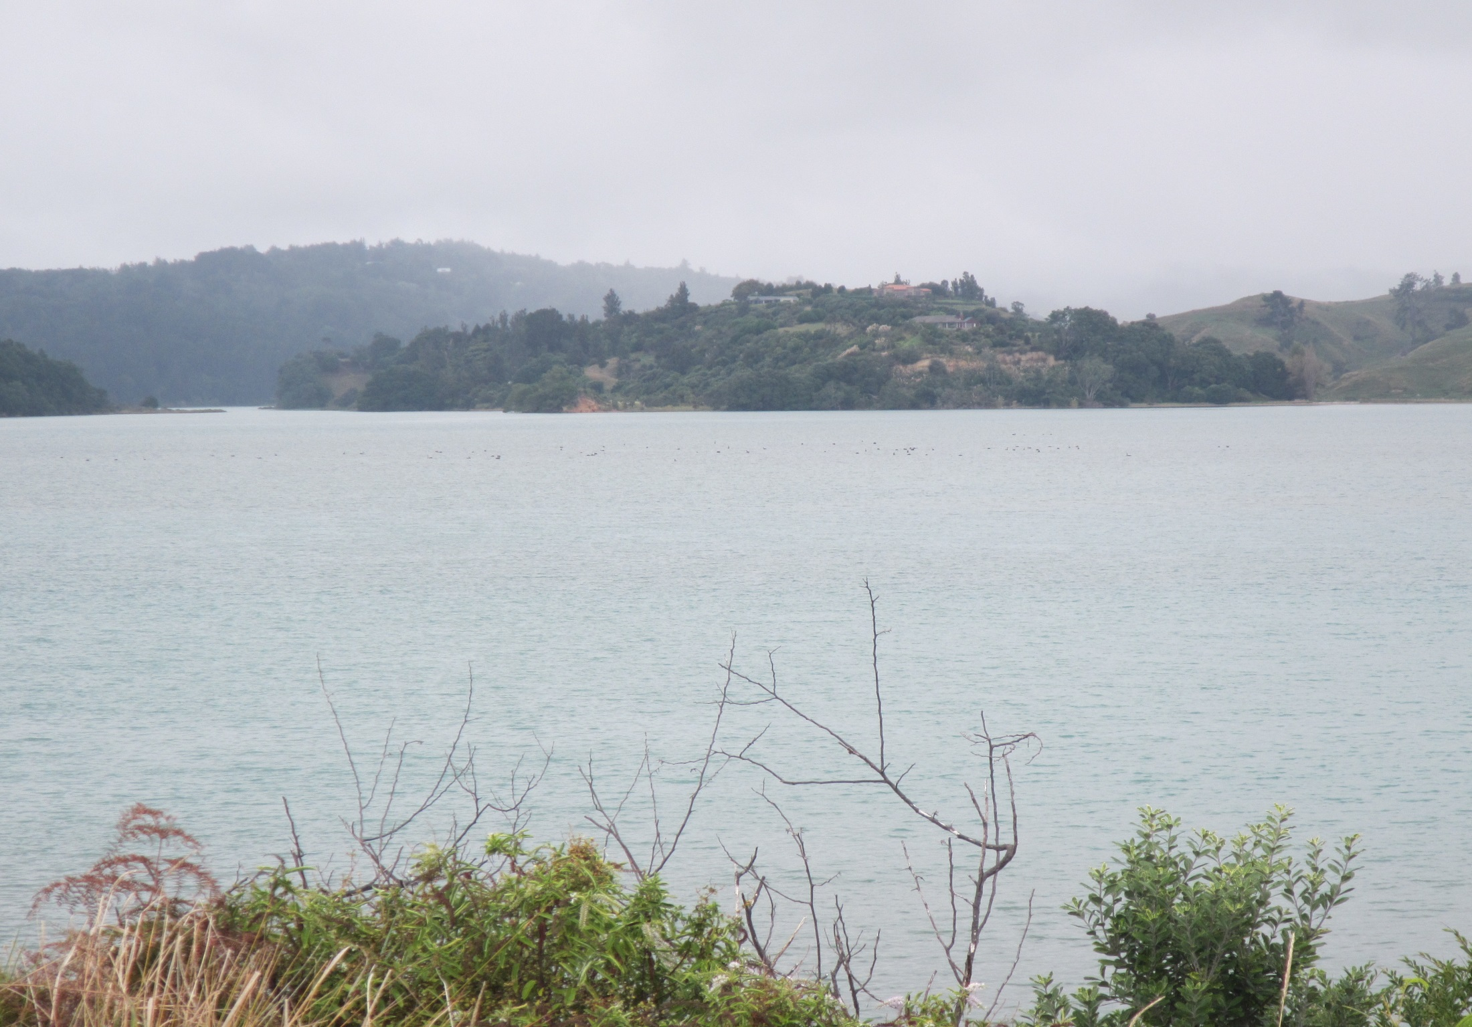

Slide 7
Black swan monitoring
Date | Count | Tide | Notes
26/02/19 | 59 | High | One group feeding in middle of harbour
05/03 | 57 | High | 2 groups feeding, slightly towards
11/03 | 74 | High | 2 groups 66 + 8. Feeding
18/03 | 67 | Low | Roosting alongside channel in front of Paparoa with a few in water
25/03 | 74 | High | One group feeding in usual area

